Slide 1
Preliminary 2020-21 Budget Assumptions
April 14, 2020
Item 11.1

Slide 2
Key Areas of Discussion for Tonight
Enrollment
Revenues
MYP Assumptions
1

Slide 3
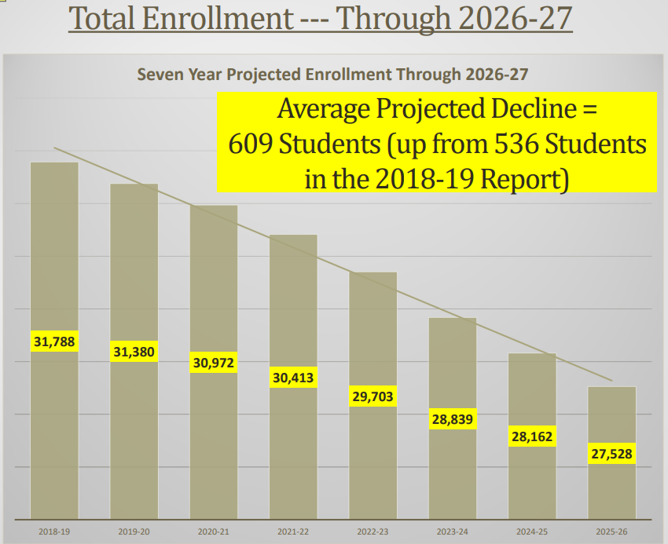
Enrollment
January 21, 2020
Board Agenda
Well before all of the potential “Corona Virus” effects on enrollment
2

Slide 4
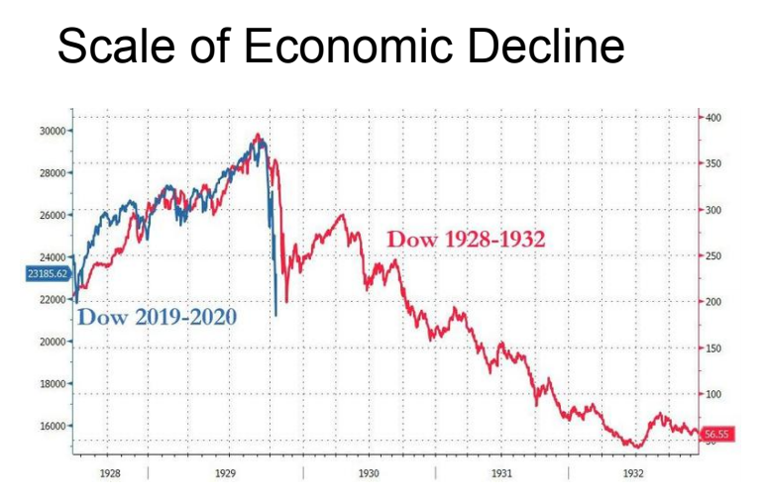
Revenues >>>
Potential Corona Virus Economic Effects on State Revenues
Certainly “Potential” Scale and not absolute
But the market data that is already real --- and has absolutely occured --- is the blue line in this graphic
3

Slide 5
Revenues >>>
Potential Coronavirus Economic Effects on State Revenues
UCLA Anderson School Forecast
“Tremendous Shock [to the economy]”
“[Potential for California to lose] 2.2 million jobs [and have an unemployment rate of] more than 16%”
“[Potential for] $50 billion in lost tax revenues over two years”
CA Department of Finance
Available data on State Revenues is “very, very negative”
“The [Proposition 98] Guarantee will not be spared”
“Everything’s on the table”
Third Party Experts Like School Services and Capital Advisors
Tricks in the State’s Playbook from the Great Recession
Deficit Factors (sending 75 cents on the dollar, for example)
Unfunded or Partially Funded Statutory COLAs
Cash Deferrals (within and between fiscal years)
4

Slide 6
MYP Assumptions --- Continuously Updated With Current Data
“Big Four” Turn the Page Costs
Step/Column
STRS/PERS
Health and Welfare
Special Education
Enrollment
COLAs
One-Time Dollars
5

Slide 7
Next Steps
Continued 2020-21 Budget Updates to the Board throughout the Spring
Virtual “Budget Roadshows” through YouTube
Governor’s May Revise
SRVUSD’s 2020-21 Adopted Budget scheduled for action June 23rd
California’s 2020-21 Adopted Budget by June 30th
45-Day Budget Revision in August 2020
6

Slide 8
Thank you
Please continue to stay safe and diligence during these unprecedented times
7

