Slide 1

May 26, 2020
Governor’s May Revise Projection for the State’s
2020-21 Adopted Budget

Slide 2
Agenda
2
Governor’s May Revise
  Economic Data
SRVUSD Impacts
  Per Student Local Control Funding Formula (LCFF) dollars
  Structural Deficits

Slide 3
Economic Data
3

Slide 4
California Revenue Impact
4

Slide 5
Continued Risks to California’s 2020-21 Budget
5

Slide 6
California Likely to Revise its 2020-21 Budget As More Information Becomes Available
6

Slide 7
Governor’s January Budget vs. May Revise
7

Slide 8
Proposition 98 Funding Levels
2007-08 (Great Recession) to 2020-21 (Today)
8

Slide 9
Cash Deferrals
9

Slide 10
Cash Deferrals
10

Slide 11
Average Per Student Local Control Funding Formula (LCFF) Impact
11

Slide 12
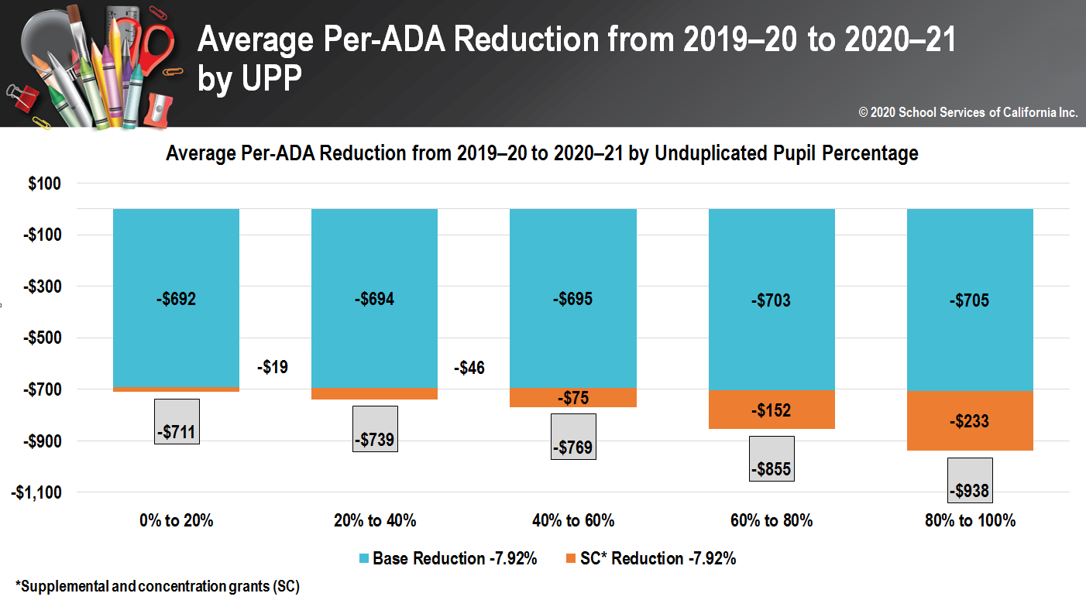
Average Per Student Local Control Funding Formula (LCFF) Impact
12

Slide 13
Average Per Student Local Control Funding Formula (LCFF) Impact
13

Slide 14
Projected Impact on SRVUSD’s LCFF Revenues
14
30,000+ ADA @ $700 per ADA = at least $21+ million straight cuts (likely $25+ million all-in)
+
Lost Projected LCFF Increases as-of 2nd Interim ($10+ million)
=
At Least $35+ Million* in Reduced LCFF Revenues
*For the 2020-21 Fiscal Year Compared to 2019-20 2nd Interim LCFF Projections

Slide 15
“Turn the Page Costs” Continue
15

Slide 16
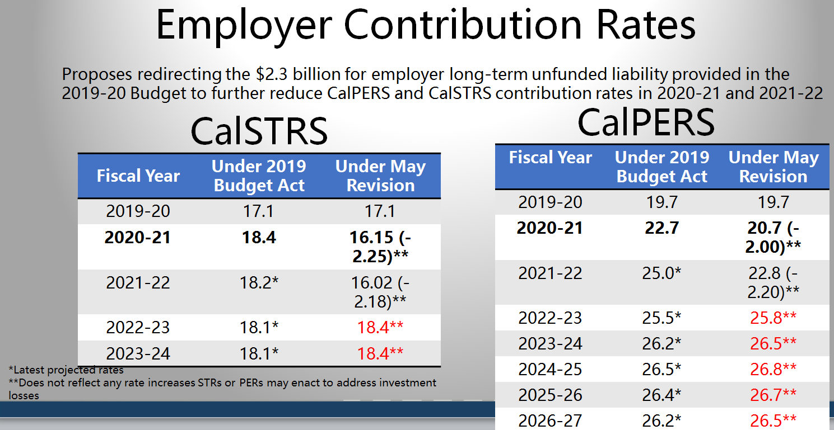
“Turn the Page Costs” Continue
16

Slide 17
Example Impact On An Average District’s Reserves --- Negative Balances Immediately
17

Slide 18
Sacramento’s Considerations Moving Forward
18

Slide 19
Next Steps for the 2020-21 Adopted Budget
19
2020-21 Adopted Budget Public Hearing (June 9th)
2020-21 Adopted Budget (June 23rd)
45-Day Budget Revision (August 2020)
2019-20 Unaudited Actuals (September 2020)
2020-21 First Interim (December 2020)
Thank you

