Slide 1
Local Control and Accountability Plan
(LCAP)
June 2022

Slide 2
SRVUSD Strategic Directions
Built on a foundation of academic excellence, we are broadening our definition of success.

Slide 3
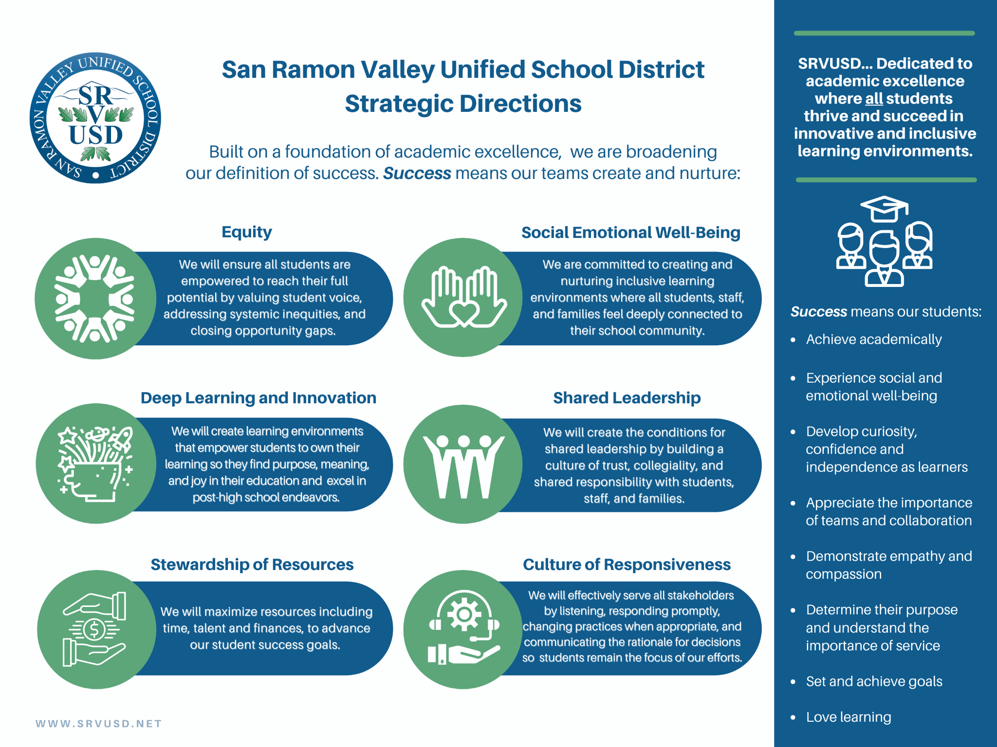

Slide 5
SRVUSD Strategic Direction: EQUITY
Goal ONE: Create learning environments that are safe, equitable, and provide a sense of belonging for all students and staff.
Goal THREE: Develop teaching and learning experiences that are responsive to and supportive of diverse cultures and identities.
Goal TWO: Create culturally responsive and equity-informed policies, procedures, and practices that lead to equitable outcomes for students.
Goal FOUR: Recruit, hire, and retain a more diverse staff.

Slide 6
EQUITY
LCAP ACTIONS (12):
(EXAMPLES)
ACTION(2.1): Employ an SRVUSD Director of Equity
ACTION(2.4): Implement an Ethnic Studies course at each comprehensive High School
ACTION(2.6): Community Equity Stakeholder and Engagement Committees
ACTION(2.12): Train all staff on the Responding to Discrimination and Hate Handbook, the Gender Support Plan, and Gender 101.

Slide 8
SRVUSD Strategic Direction: DEEP LEARNING AND INNOVATION
Goal ONE: Create a coherent system that is aligned to support instruction.
Goal TWO: Develop and implement instructional models to engage students in learning at deep levels.
Goal THREE: Use authentic forms of assessment where students are expected to meaningfully apply essential knowledge and skills to new situations.

Slide 9
DEEP LEARNING AND INNOVATION LCAP ACTIONS (22): (EXAMPLES)
Action(1.10): Employ District Wide Coordinators: STEM, ELA/English Learner, SEL + College and Career Readiness, Technology and Assessment
Action(1.1): District Wide (K-12) MTSS Professional Development and District MTSS Liaisons assigned at each school site
Action(1.22): Expansion of Universal TK
Action(1.12): Grading reform committee to develop authentic assessments where students are able to transfer and apply the knowledge they have learned.

Slide 10
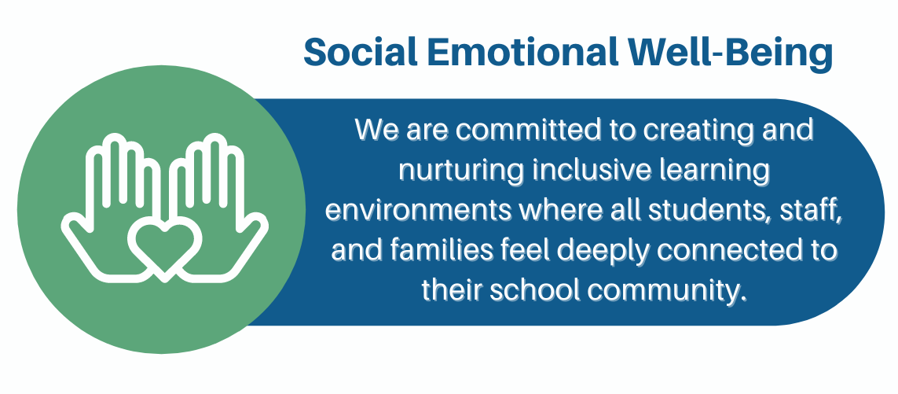

Slide 11
SRVUSD Strategic Direction: SOCIAL EMOTIONAL WELL-BEING
Goal ONE: Develop a shared commitment to a culture of wellness, where every student’s emotional health is respected and supported across the system.
Goal TWO: Create and nurture instructional environments that prioritize students’ social emotional well-being.

Slide 12
SOCIAL EMOTIONAL WELL-BEING LCAP ACTIONS (21): (EXAMPLES)
Action(3.3): Employ SRVUSD Social Workers
Action(3.6): Employing eleven counselors at Elementary Schools
Action(3.4) : Provide School Counseling and Intervention Program (SCIP) services at all sites
Action(3.7): Support Wellness Centers at comprehensive high schools

Slide 13
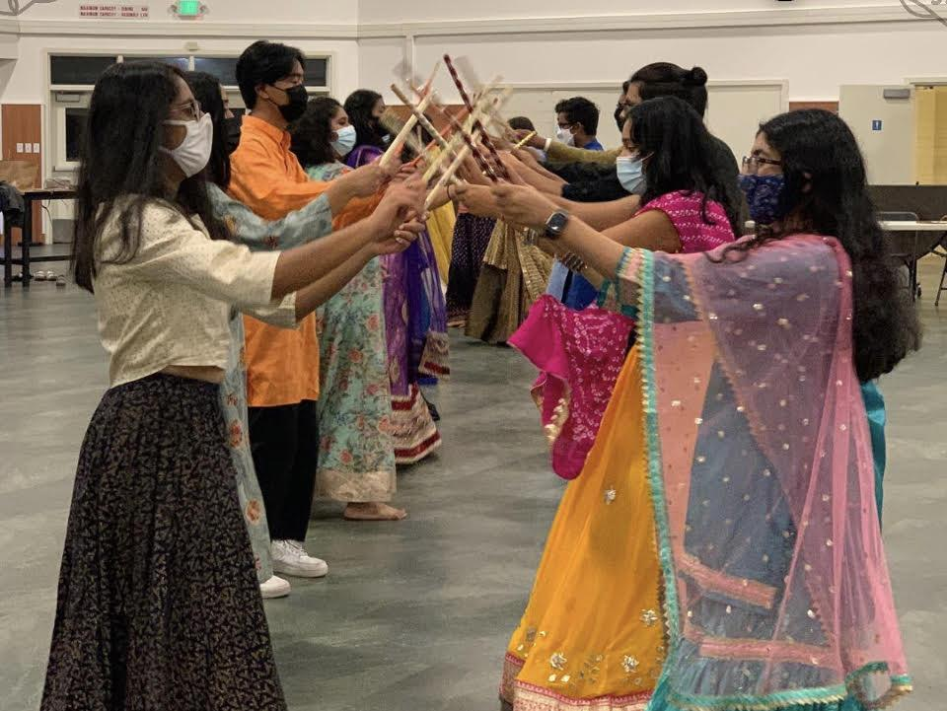
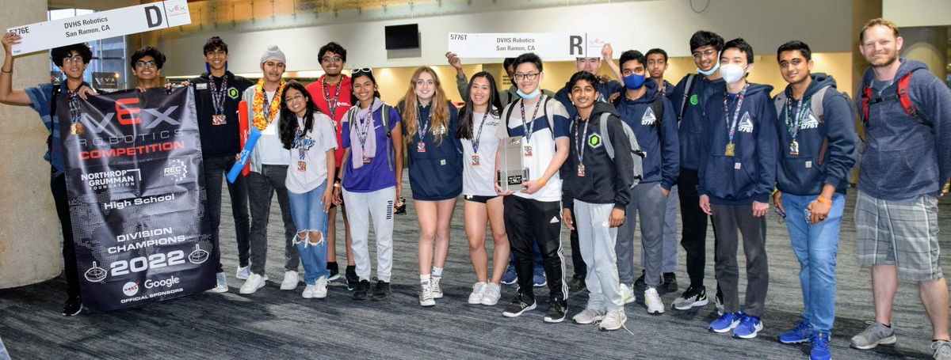
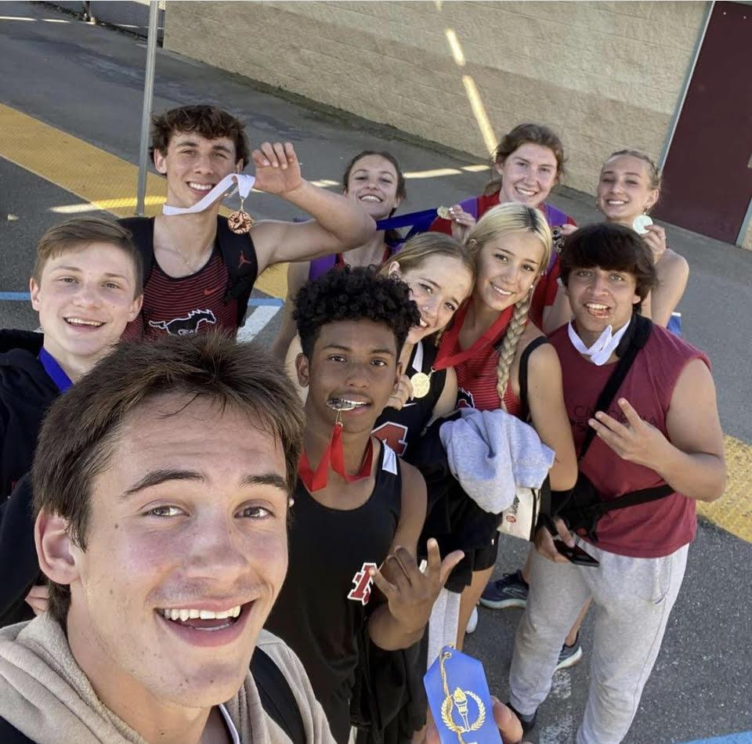
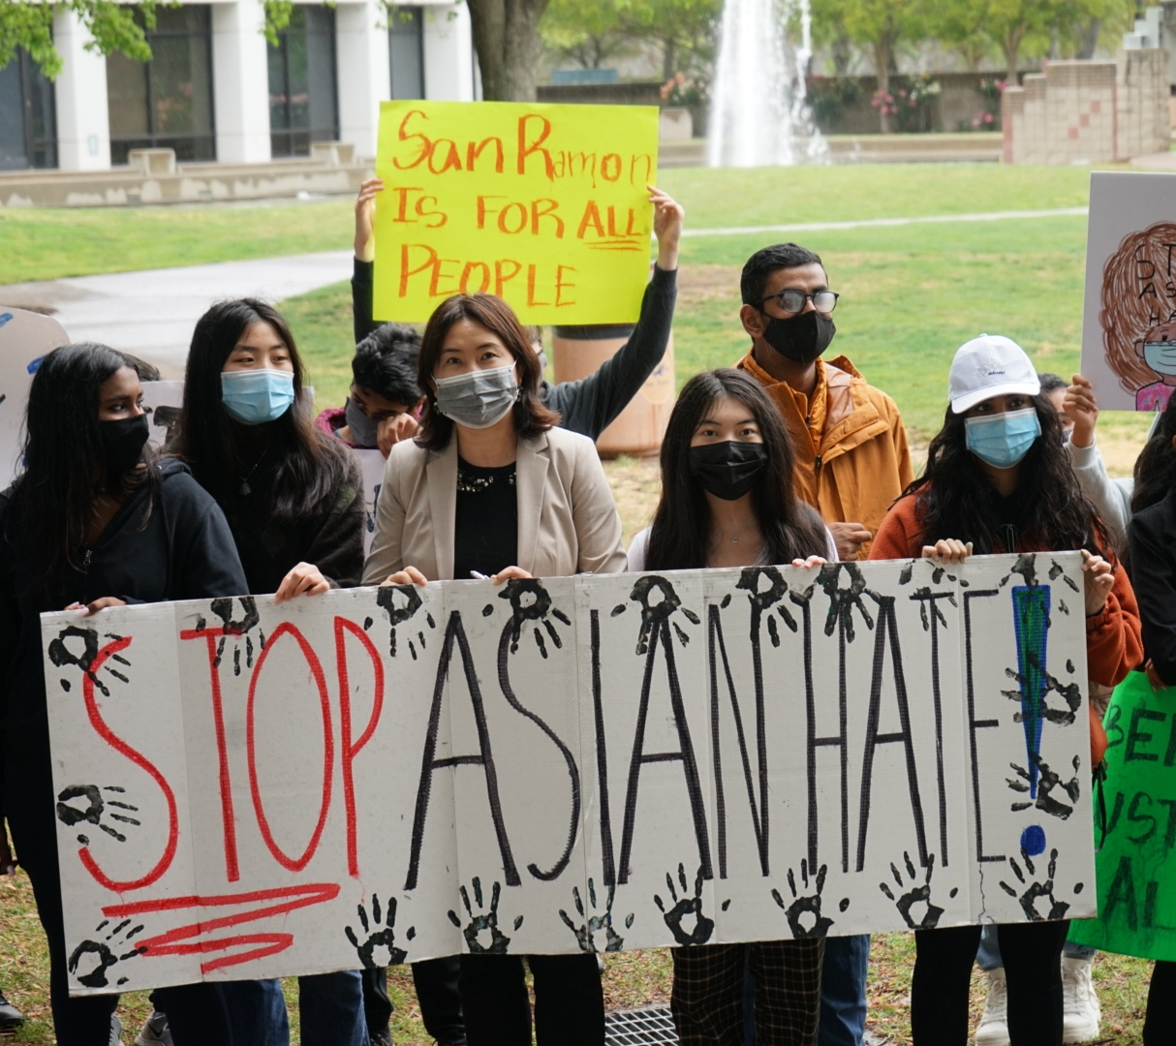
Our Students

Slide 14
Thank You!
Questions/Comments?

