Slide 1
A-G
Success Grant
May 17, 2022

Slide 2
A-G Success Grant
Purpose:
To increase the number of California high school students who graduate A-G eligible.

Slide 3
A-G College Entrance Requirements
◄Sequence of classes in various subject areas that students must complete with a C- or higher.
◄Needed for students to be minimally eligible for University of California (UC) or California State University (CSU) systems.

Slide 4
$534,793
$534,793
One-time grant
through 2025-26

Slide 5
Strategic Directions
Deep Learning & Innovation
Equity
Goal #2
Goal #3
Develop teaching and learning experiences that
are responsive to and supportive of diverse
cultures and identities.
Develop and implement
instructional models
to engage students in
learning at deep levels.

Slide 6
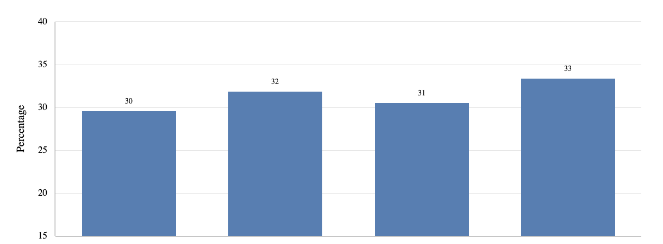
Percentage of Students
Not A-G Eligible
San Ramon Valley Unified School District: 2017 through 2021
33%
32%
30%
31%
17-18
18-19
19-20
20-21

Slide 7
A-G Success Grant:
Planned Expenditures
PACK: MATHS SYMBOLS
Expanding access to A to G coursework
Professional development on inclusive instructional practices.
Expanding after school credit recovery classes.
Enhancing our current
AVID program Advancement Via Individual Determination
District lead
Sections
Engaging parents
Understanding importance of A-G completion early-on.
Increase counseling support
Professional development on systemwide practices that illustrate benefits of A-G and college & career readiness
Assigning one counselor per site to monitor A-G completion
College and Career Coordinator

