Slide 1
AFRican american history month
February 2022
Theme: Black Health and Wellness

Slide 2
BLACK HISTORY MONTH TIMELINE
1909
1926
1970
1976
NAACP Founded
Negro History Week Established
The Month First Observed
BHM Gets Presidential Endorsement
The National Association for the Advancement of Colored People is founded.
February 12, 1909
Gerald Ford urges Americans to honor the U.S. Bicentennial by also celebrating Black History Month.
February 10, 1976
The precursor to Black History Month is started by historian Carter G. Woodson, the “Father of Black History.”
Proposed by Black educators and students at Kent State University in 1969, the first Black History Month observance takes place one year later.
Notes:
https://nationaltoday.com/black-history-month/

Slide 3
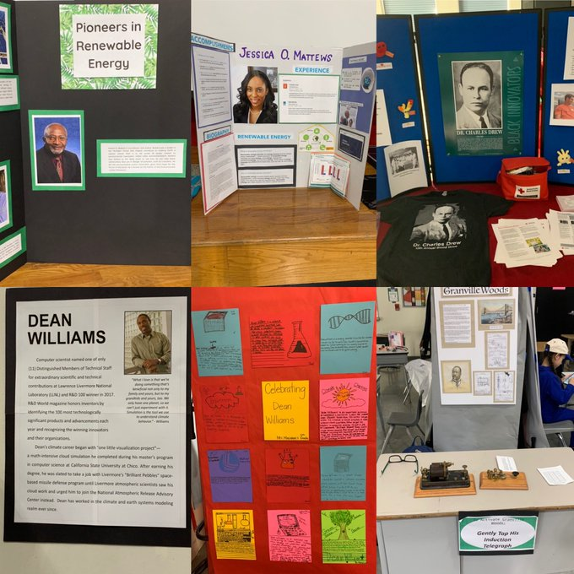
African American History Museum at Iron Horse Middle School
Periodic Table of Black History at
California High School

Slide 4
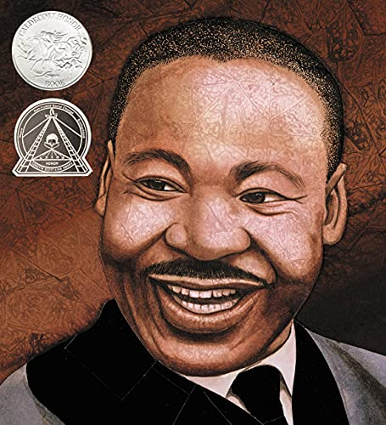
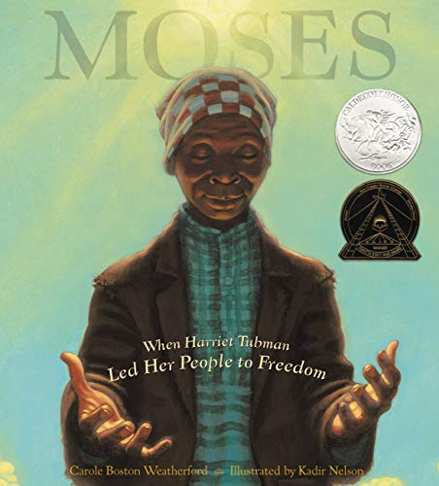
Read Aloud Books

Slide 5
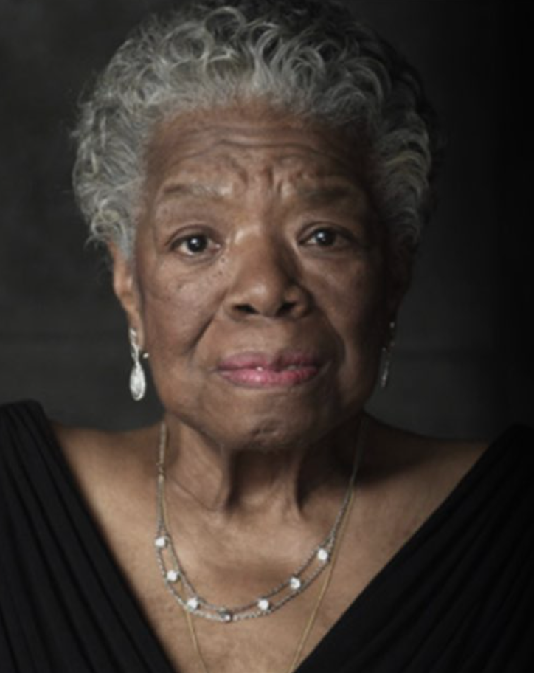
Maya angelou
“People will forget what you said, people will forget what you did, but people will never forget how you made them feel.

