Slide 1
Arts Education Month
visual arts
performing arts

Slide 2
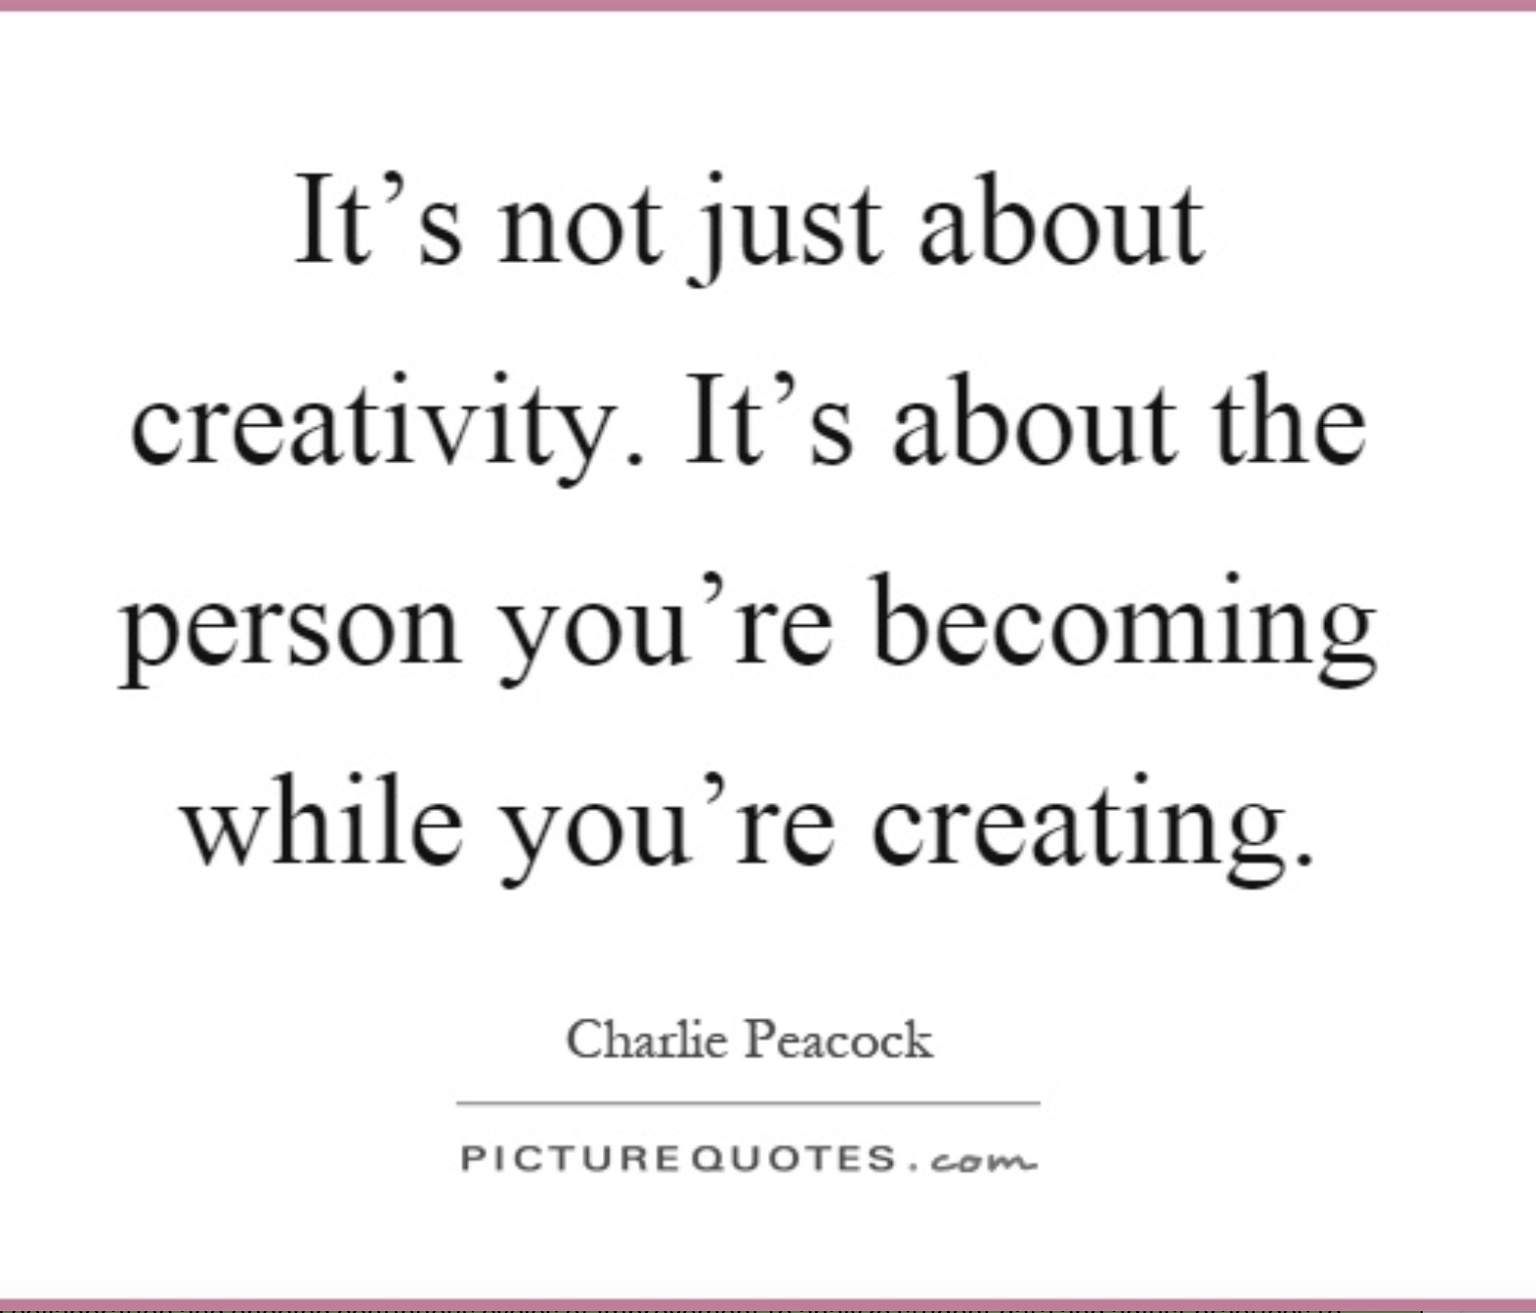
Our Framework
We foster artistic literacy and fluency in the arts where students create, perform, produce, present, respond, and connect through symbolic and metaphoric forms.
An artistically literate person is able to transfer arts knowledge, skills, and capacities to other subjects, settings, and contexts.
Notes:
The arts are required subjects in California. The visual and performing arts standards and framework are grounded in the understanding that an artistically literate person is able to transfer arts knowledge, skills, and capacities to other subjects and contexts.

Slide 3
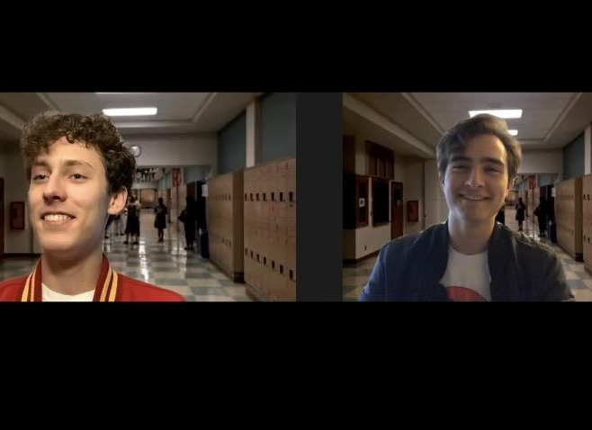
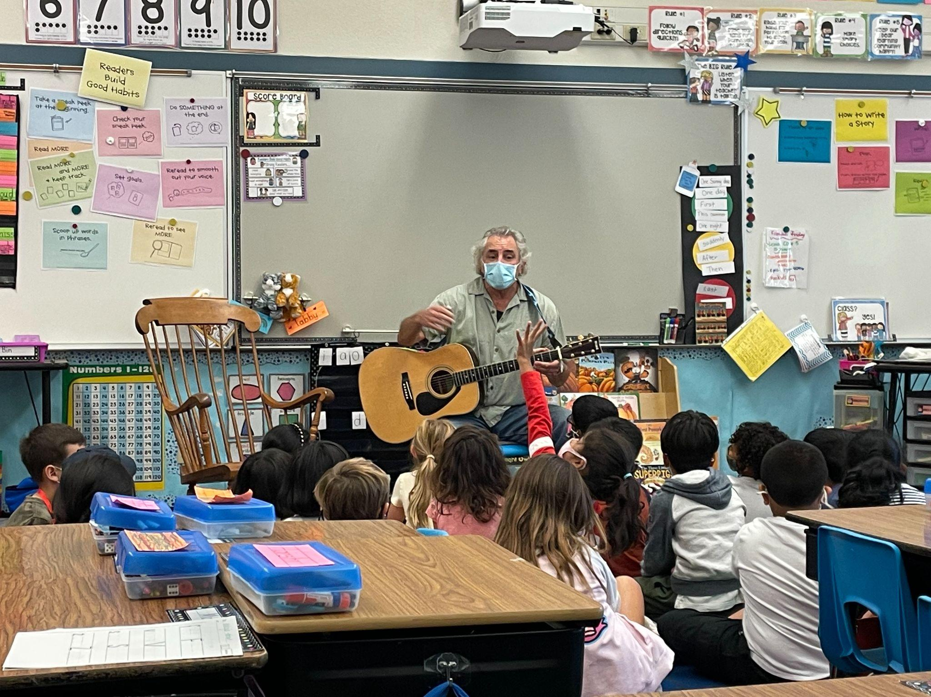
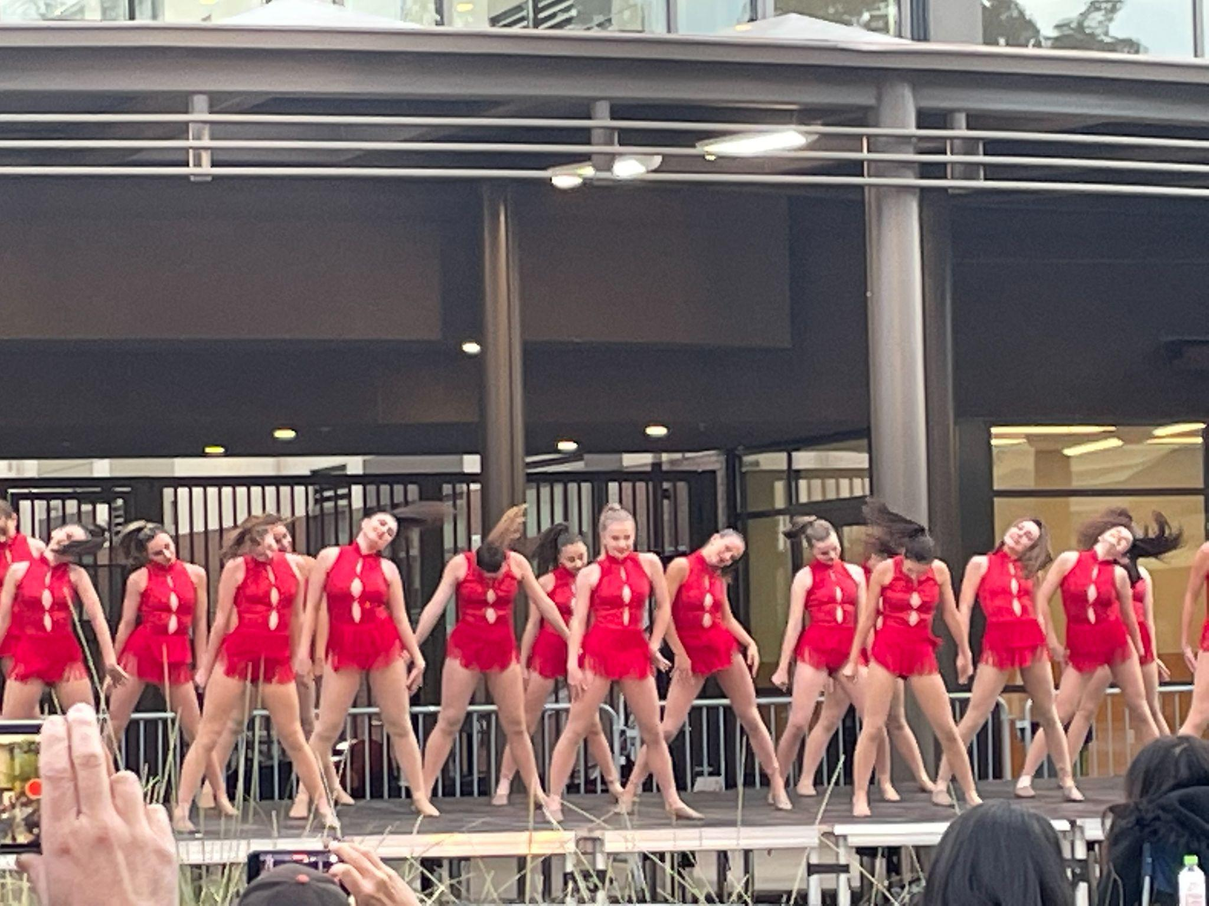
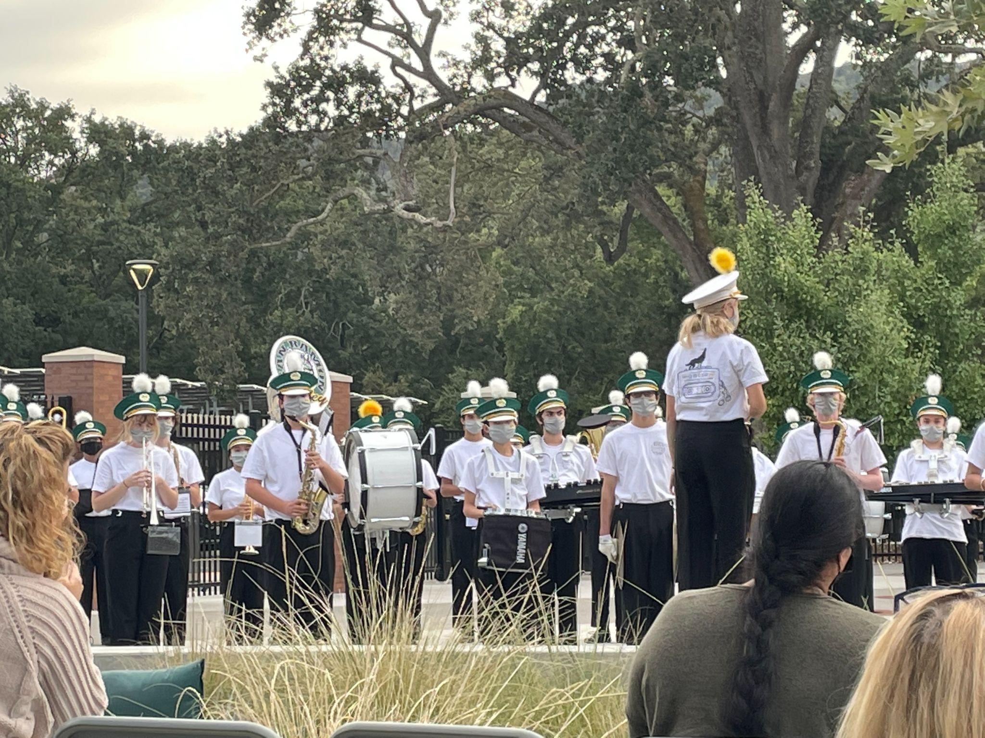
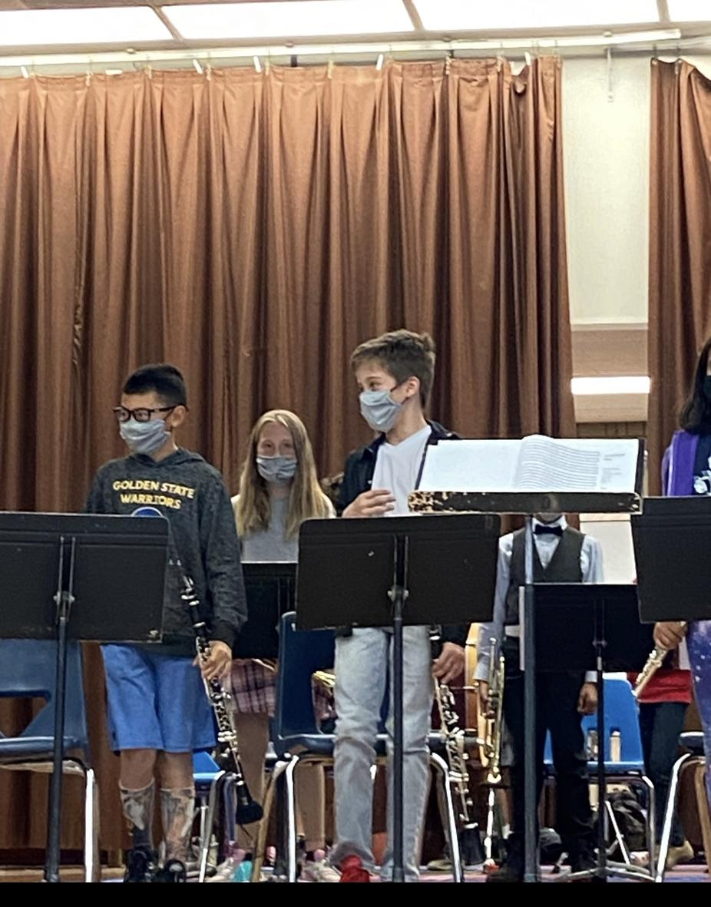
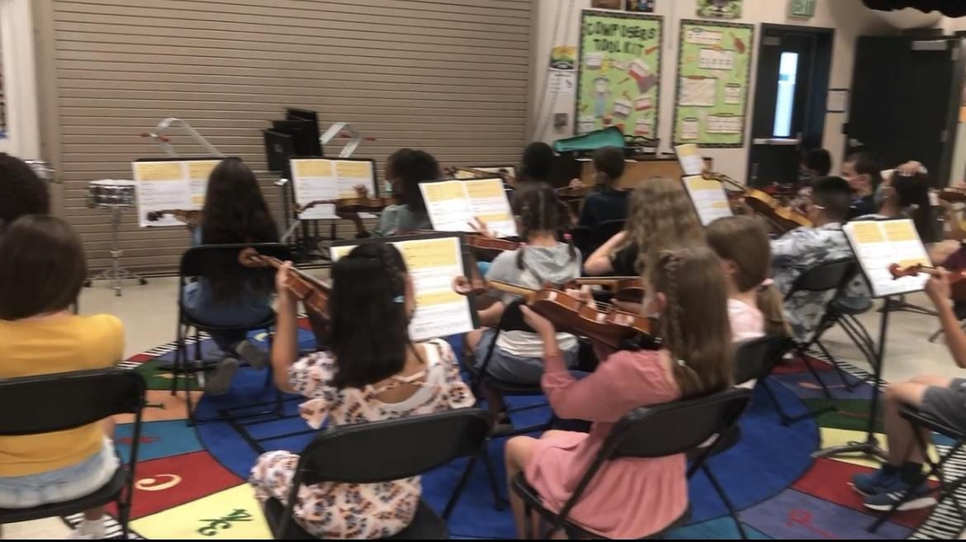
Arts Education During COVID
Musician PPE
Rehearsals & performances outdoors
Dance
Drama
Classroom Music
Marching Band
Elementary Band
Elementary Orchestra
Notes:
Meeting our artists’ needs during COVID proved to be a challenge but out teachers and students worked hard to mete the state and county guidelines to run the programs smoothly. We were given special musicians PPE and moved many of our rehearsals and performances outdoors during the first semester.
All slides are new

Slide 4
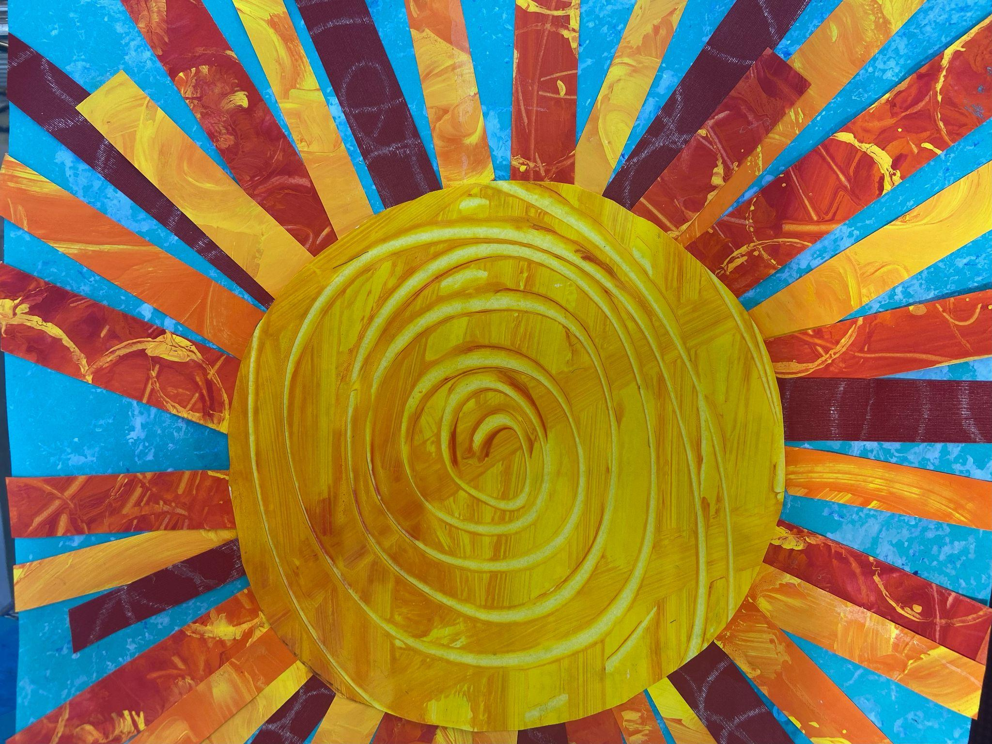
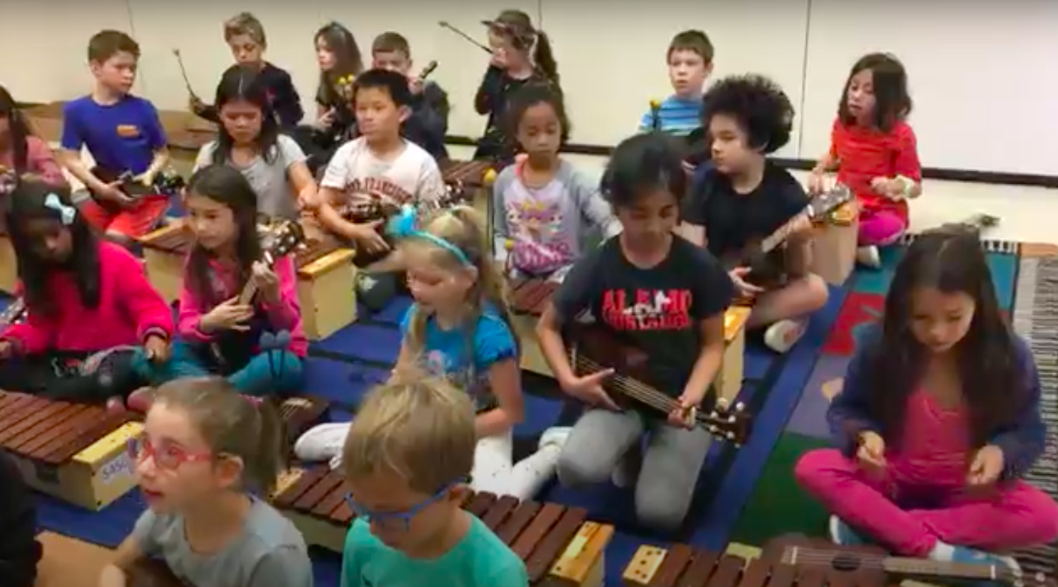
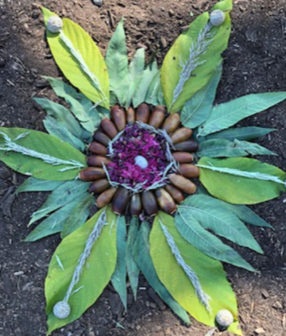
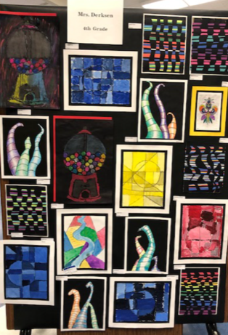
TK-5 Arts Education
“Teacher led and student centered”
Mrs. Raaum, Alamo Elementary
Students receive Orff training and ukulele instruction
Ms. Nielsen, Art Teacher
Montevideo Elementary
Ms. Bowles, Montair Elementary
Visual Art
Notes:
Repeated photos…do you want us to get new photos or remove the slide?

Slide 5
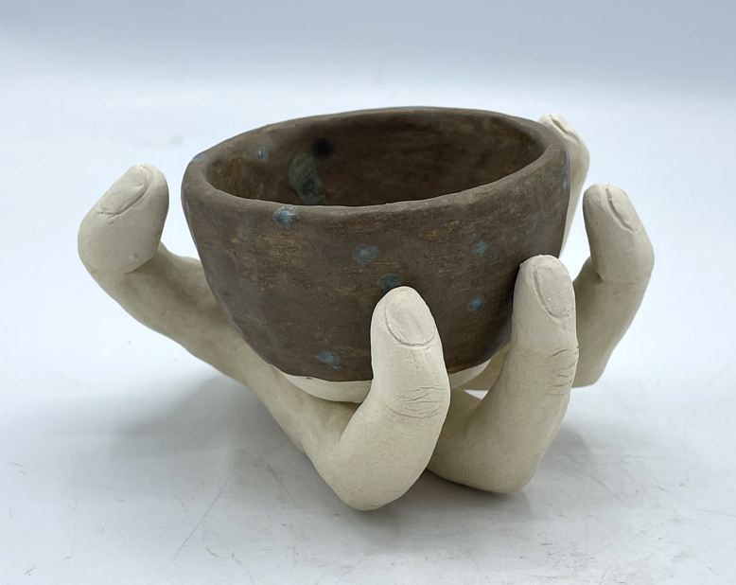
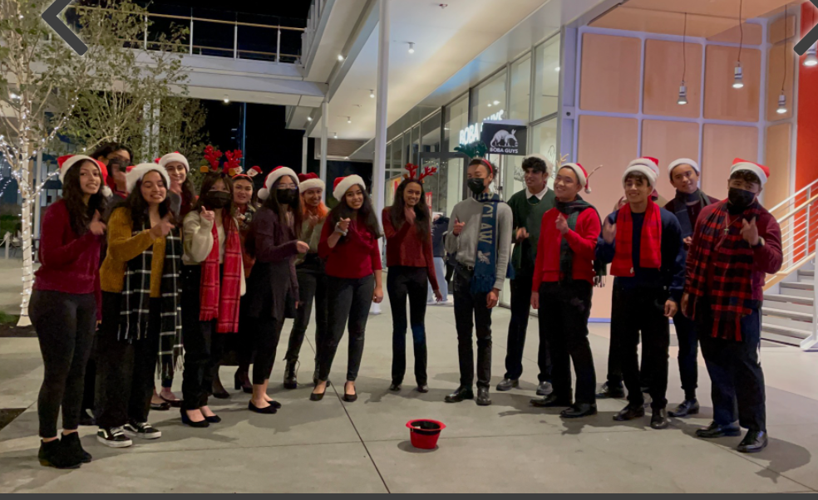
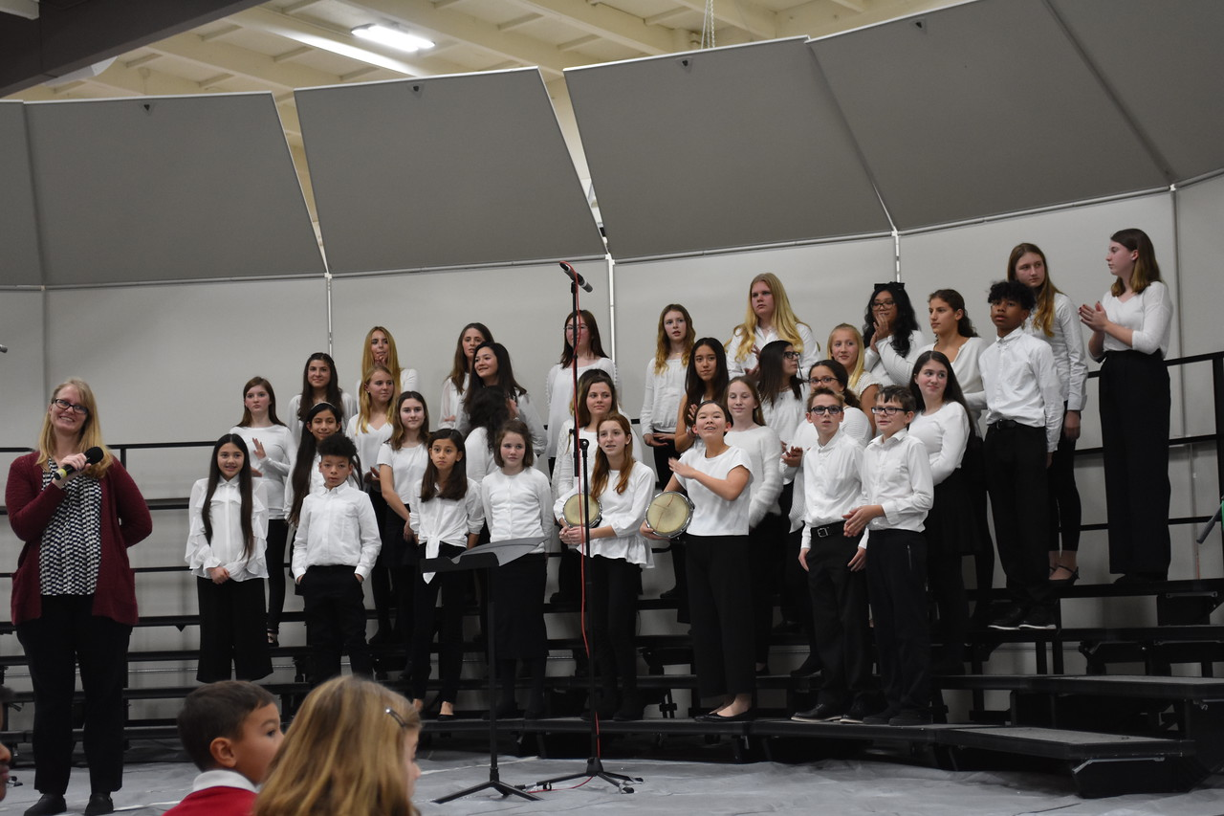
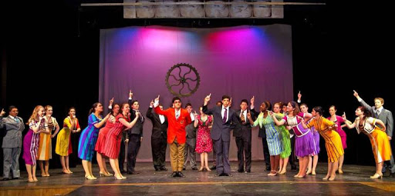
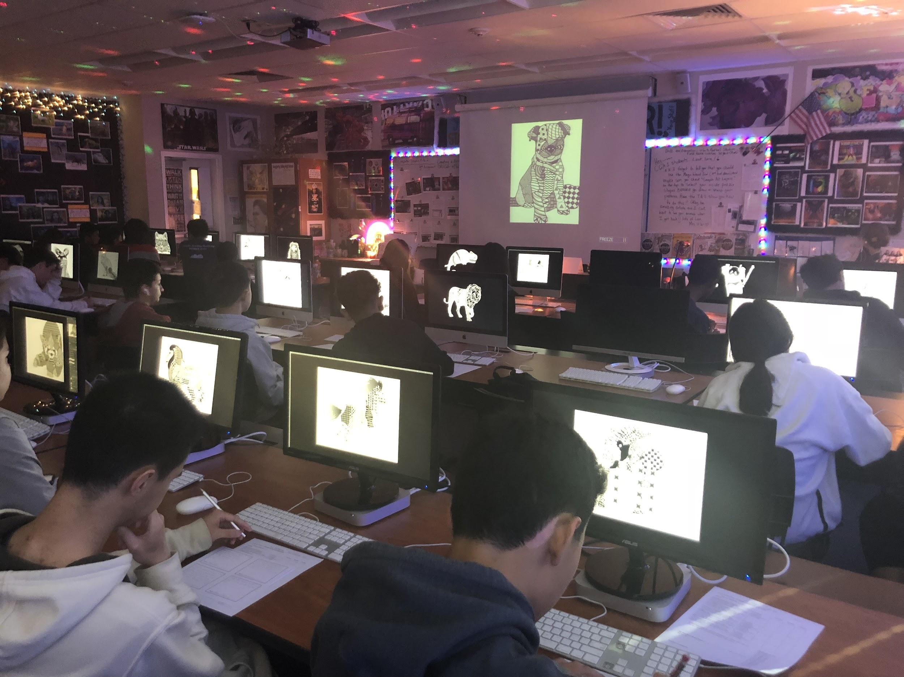
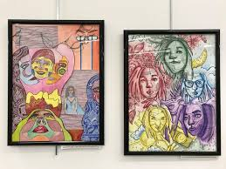
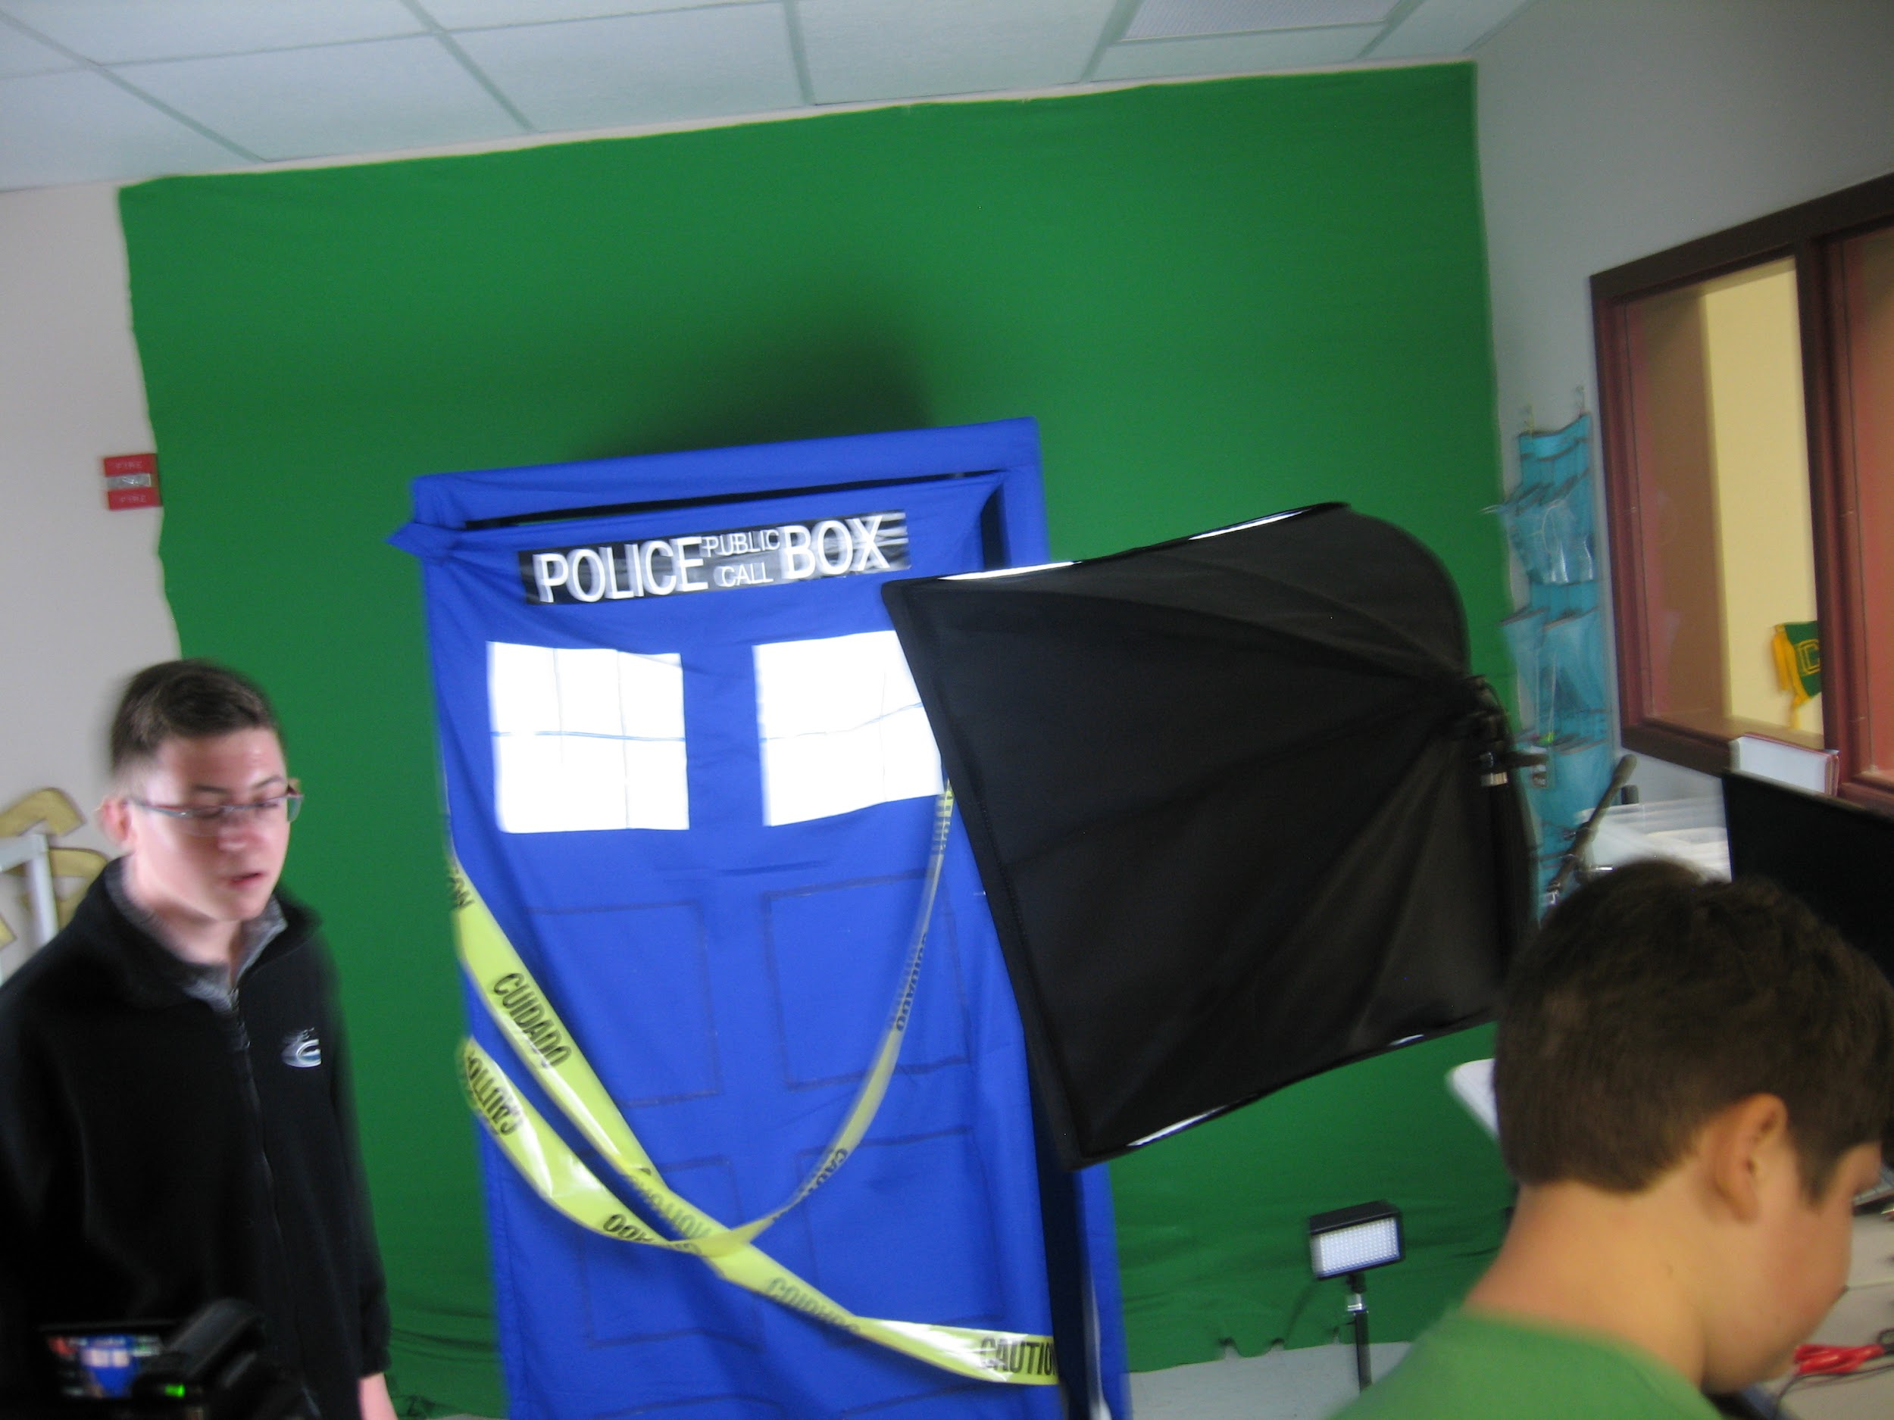
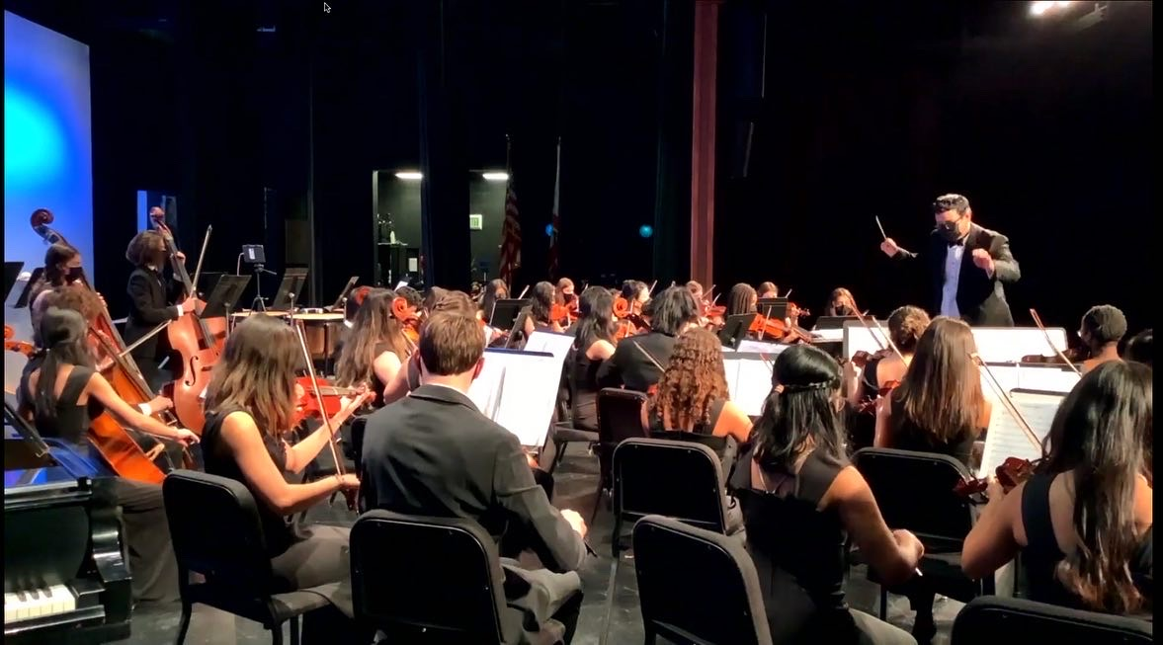
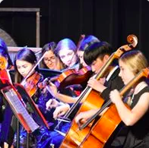
Secondary Arts Education
Ceramics
Choir
Digital Photo
Theatre
Computer Graphics
Drawing/Painting
Video Production
Orchestra
Notes:
Arts education in our middle schools and high schools provide students with experiences in many types of artistic expression: from ceramics to orchestra..students building essential skills such as creativity, problem solving, perseverance, and collaboration.
New pics for ceramics, orchestra and choir

Slide 6
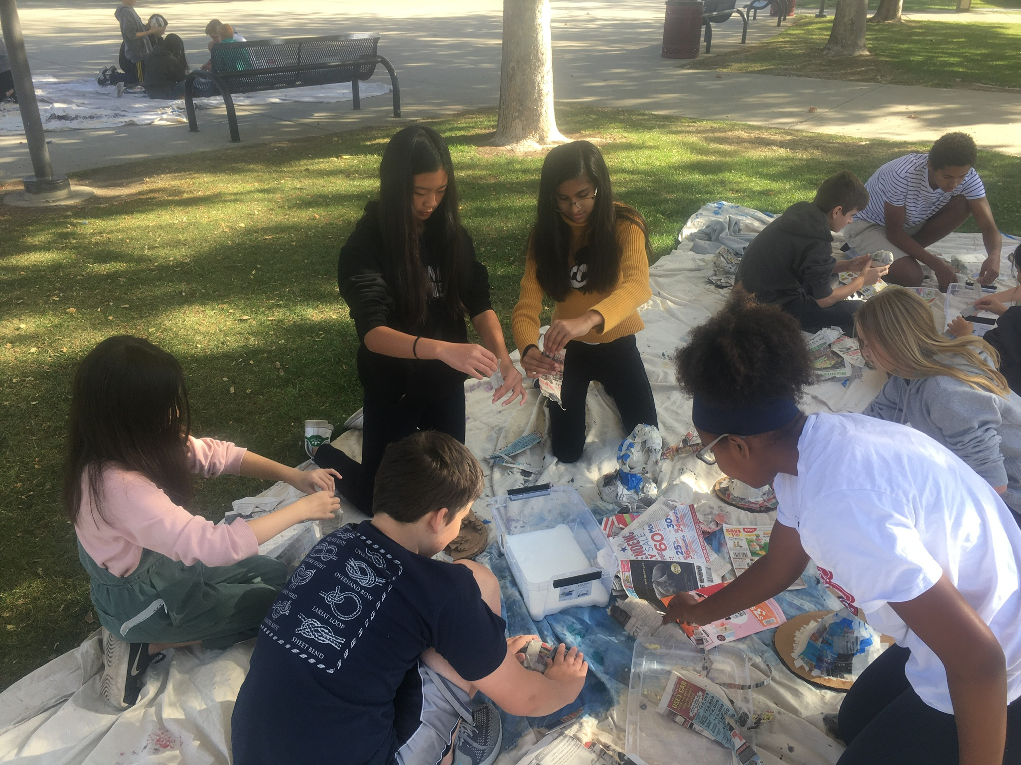
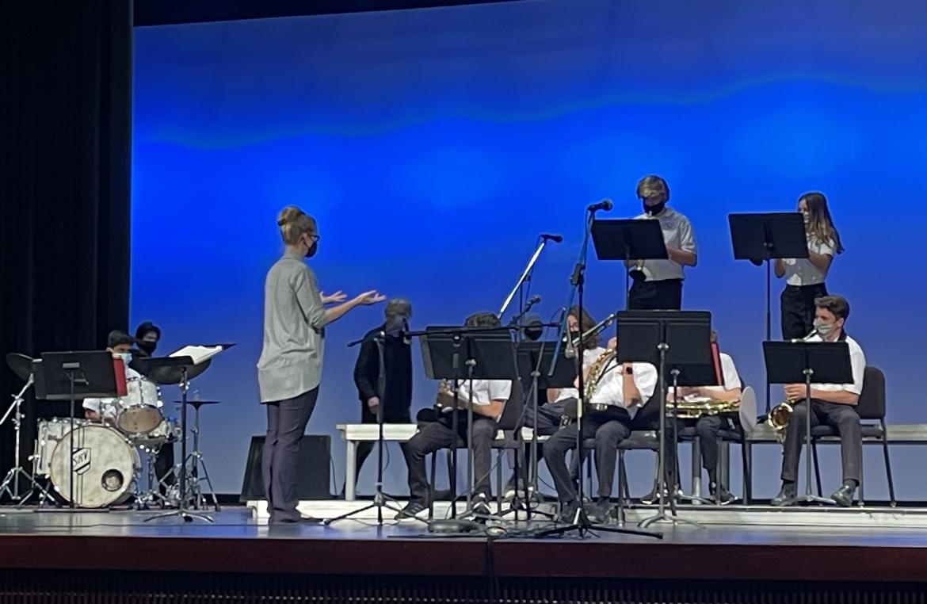
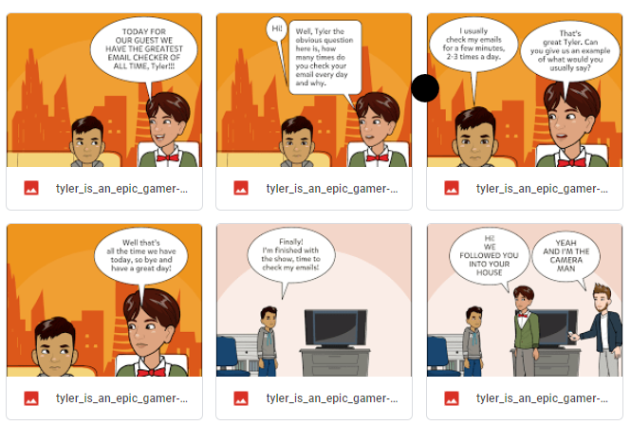
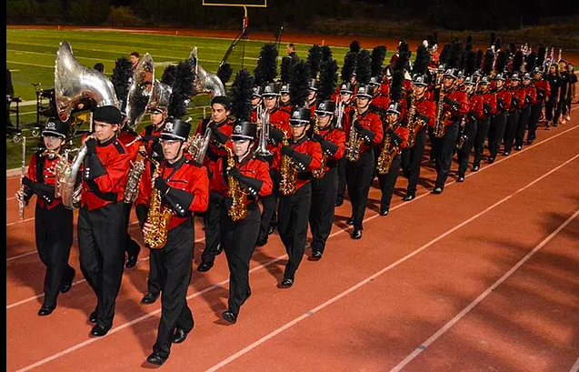
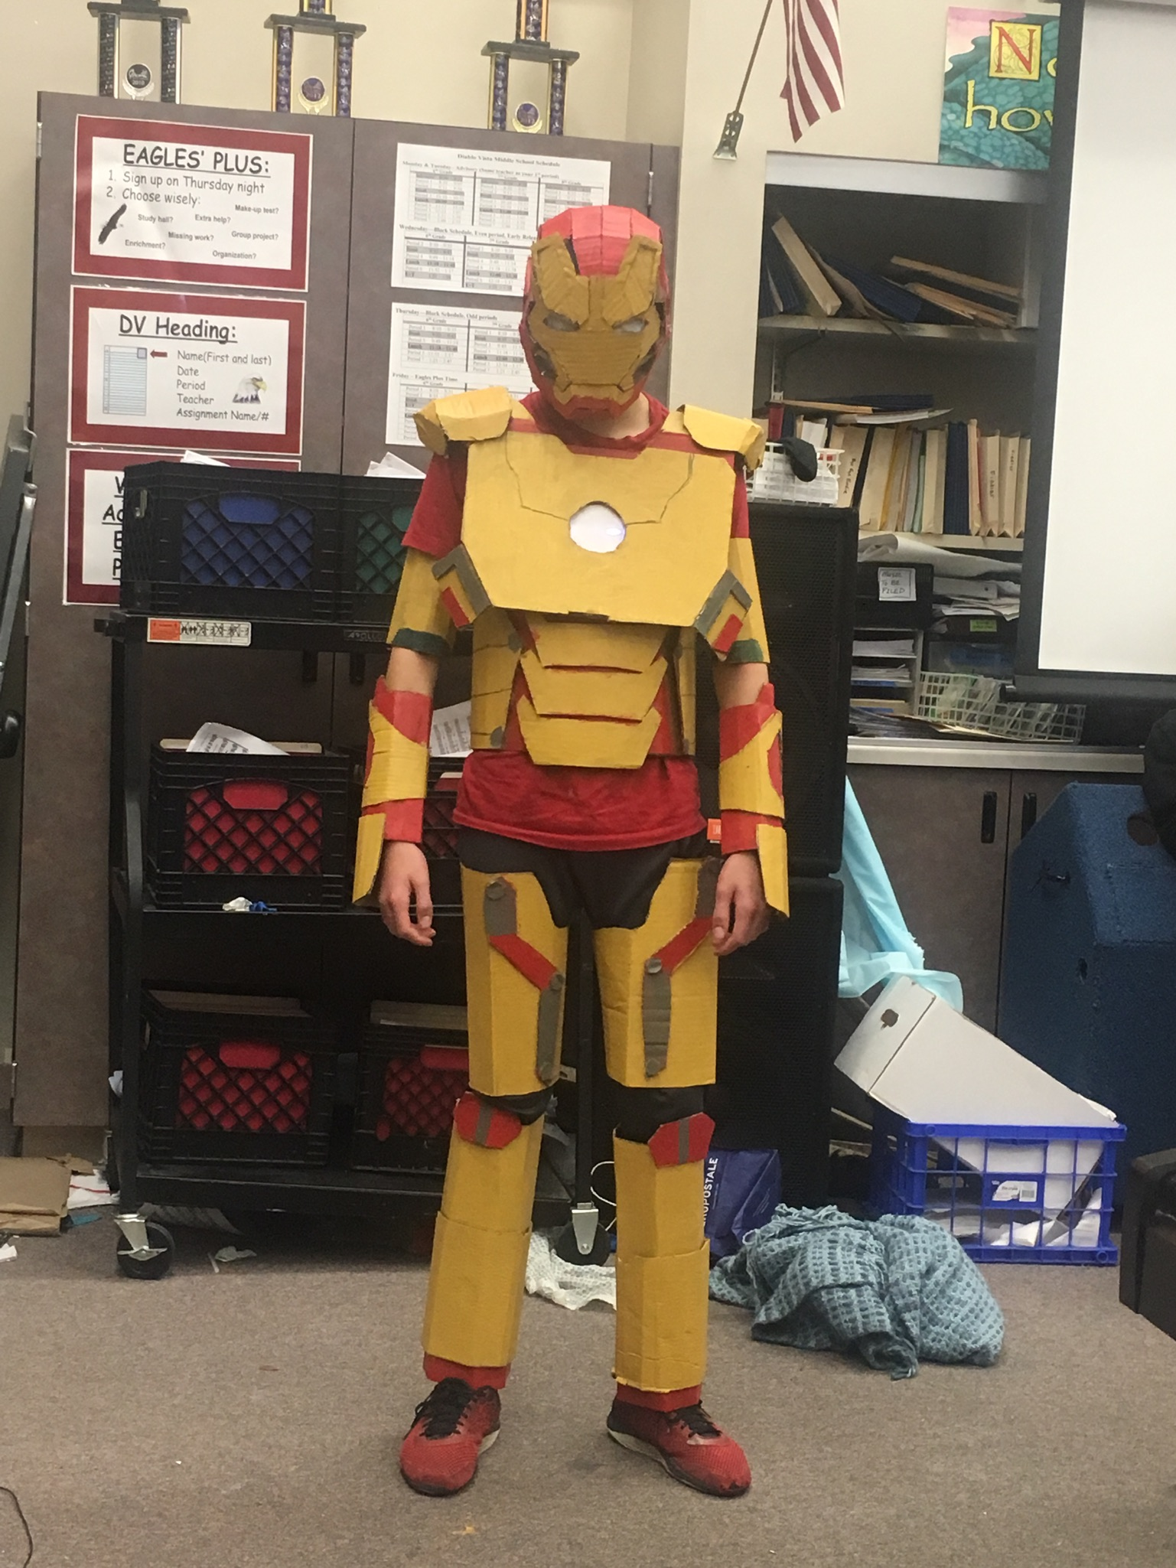
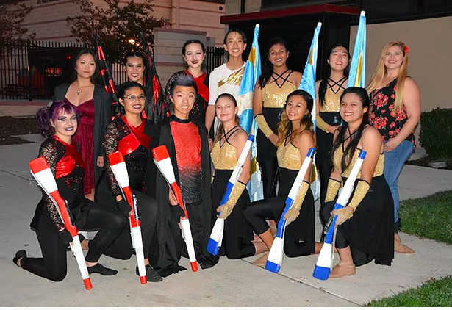
Secondary Arts Education
Drama
Jazz Band
Video Production
Marching Band
Stagecraft
Color Guard
Notes:
Arts education in our middle schools and high schools provide students with experiences in many types of artistic expression: from ceramics to orchestra..students building essential skills such as creativity, problem solving, perseverance, and collaboration.
Jazz Band photo is new

Slide 7
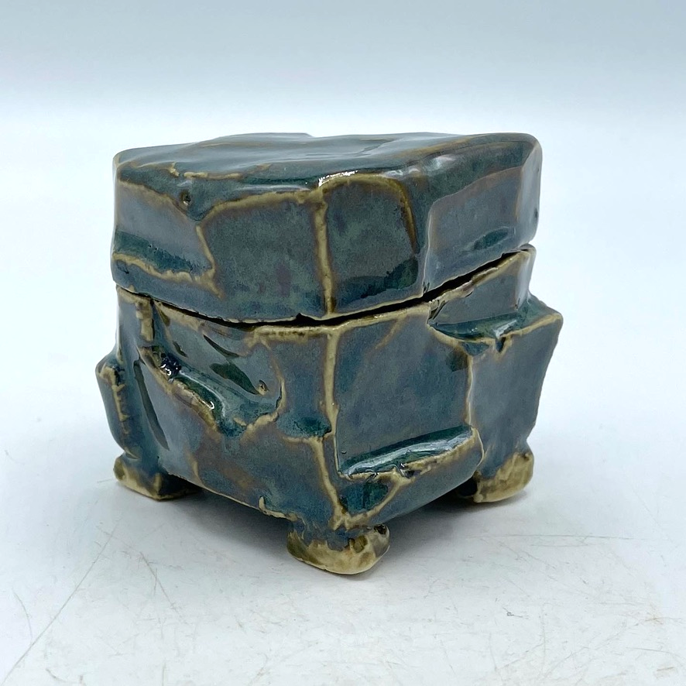
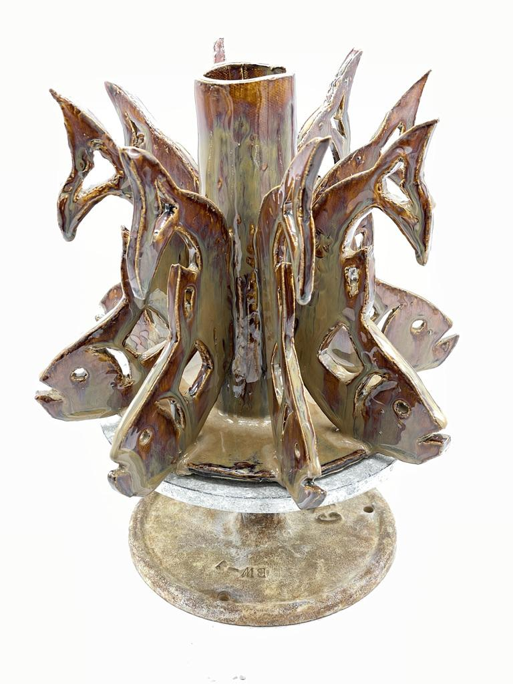
San Ramon Valley High School Ceramics
Andy Williams, Teacher
Advanced Ceramics students created vases using patterns, such as this fish. They rolled out many slabs of clay, traced the image on to the clay, and then cut it out. When they clay was firm, they could attach each piece to the center and base which were also made from slabs of clay. These pieces took a lot of planning, patience, and some cases, perseverance.
Notes:
Advanced Ceramics students created vases using patterns, such as this fish. They rolled out many slabs of clay, traced the image on to the clay, and then cut it out. When they clay was firm, they could attach each piece to the center and base which were also made from slabs of clay. These pieces took a lot of planning, patience, and some cases, perseverance. Completely new slide

Slide 8
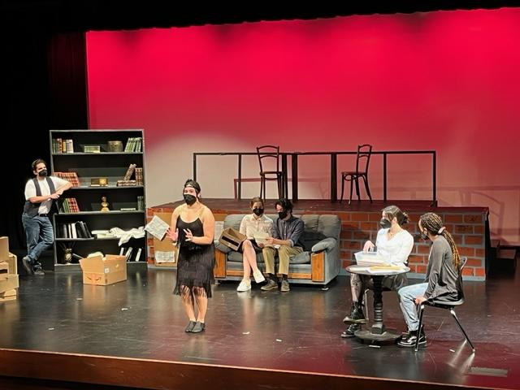
California High School’s winter show Dear Editor
Written by Shiphrah Moses, a Cal High Senior
Laura Woods, Teacher
The play is about a run down magazine and the woman trying to bring it back to life. As the interns read old letters of advice (think Dear Abby), the characters come to life from the 1920's, 50's and 80's. Everything for this show was student driven from the set design, set building to lights and costumes.
Notes:
Students in rehearsal for their upcoming Winter Show, Dear Editor, written by California High School Senior, Shiphrah Moses for the ROP play production class at California High School under the direction of Laura Woods. The play is about a run down magazine and the woman trying to bring it back to life. As the interns read old letters of advice (think Dear Abby), the characters come to life from the 1920's, 50's and 80's.
Everything for this show was student driven from the set design, set building to lights and costumes. Next Thursday and Friday at 7pm, we will run the show for our community
Completely new slide

Slide 9
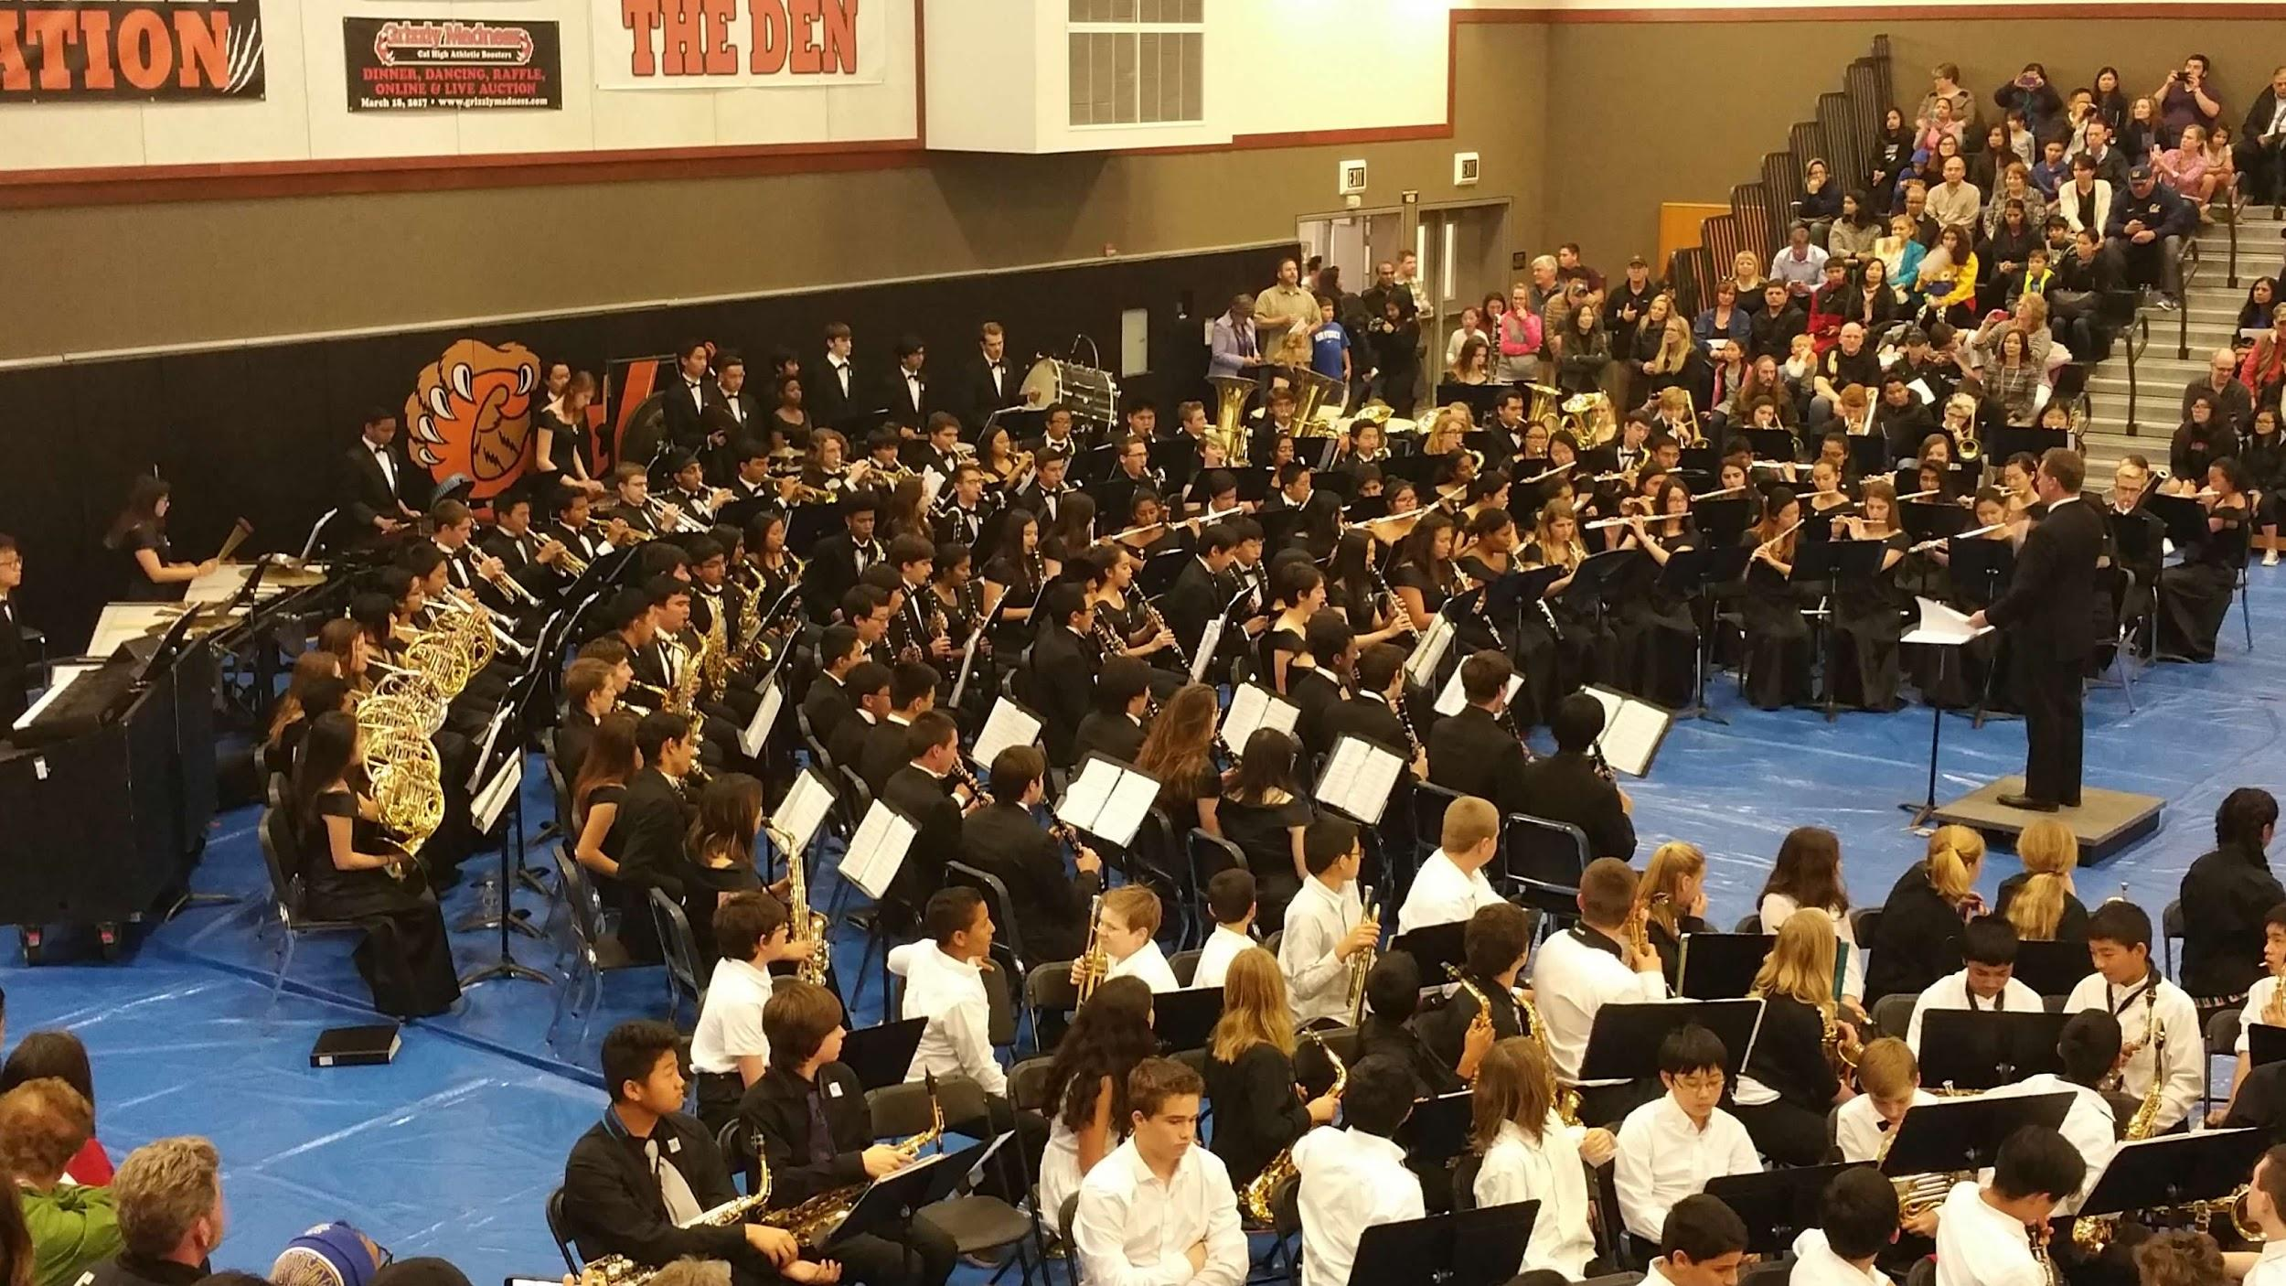
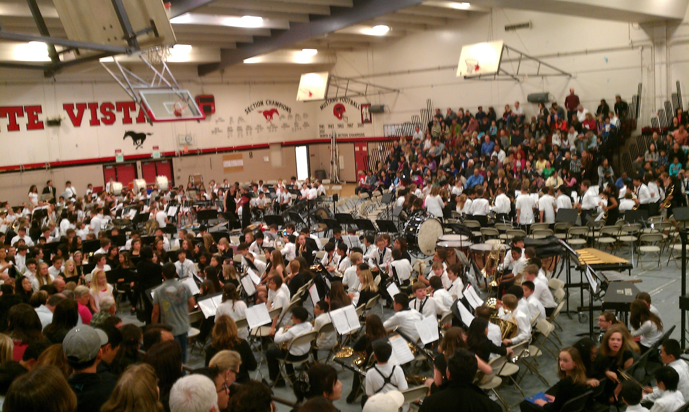
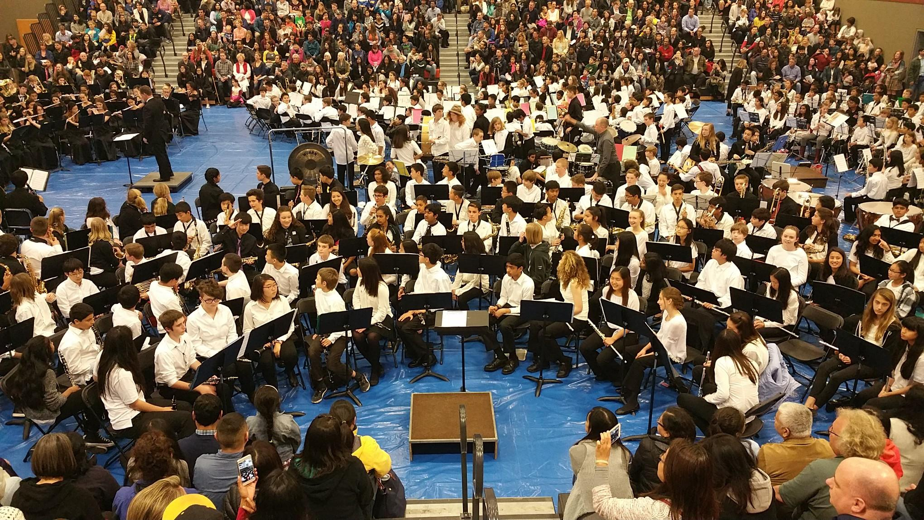
The spring brings a return to our community programs.
Feeder Area Band and Orchestra Festivals
Providing vertical articulation across the entire school district for students in grades 4-12. This program reaches nearly 5,000 students each year!
Notes:
This spring brings a return to our combined high school feeder band, orchestra and choir concerts. While the events will largely be held outdoors, we are excited to bring the community together for the return of the highlight of our programs where we are able to feature the results of prolonged participation in the arts.
Completely new slide

Slide 10
The Arts for
Social-Emotional Well-Being
45 minutes of art-making significantly reduces the amount of cortisol (stress hormone) in participants of all ages. (Kaimal, Ray & Harris, 2016)
Research shows that students who participate in the arts over extended periods of time show more sophisticated social and cooperative skills, reduced anxiety and shyness, and reduced aggressive behavior.
Children who participate in the arts are better able to control their emotions and express themselves in more productive ways.
Source: National Endowment for the Arts

Slide 11
Follow SRVUSD Arts
@SRVUSDMusic
@CalHighDrama
@SRVHS_SRVoices
@srvusd_music
@srvbandandorch
@mv_choir
@dvhsart
@calhighchoir
@mv_color_guard
@srvhschoir
@srvdramaclub
@srvhsart
@dv.choir
@srvtheatre
Notes:
Completely new slide

