Slide 1
Asian Pacific Heritage Month
May 2022

Slide 2
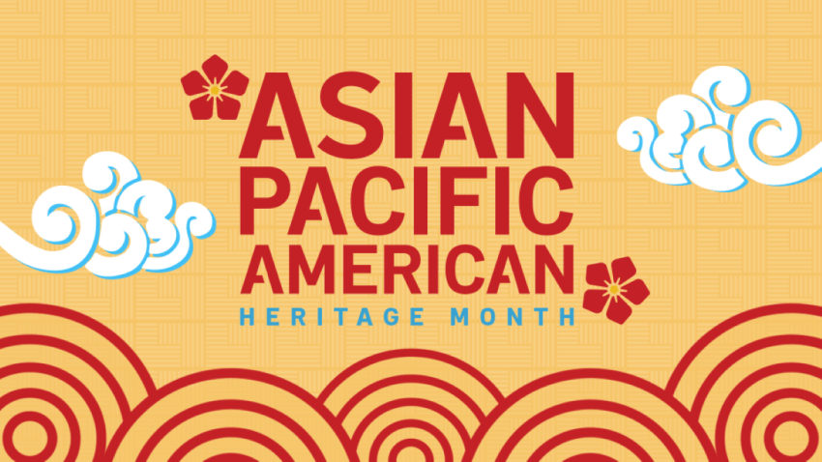
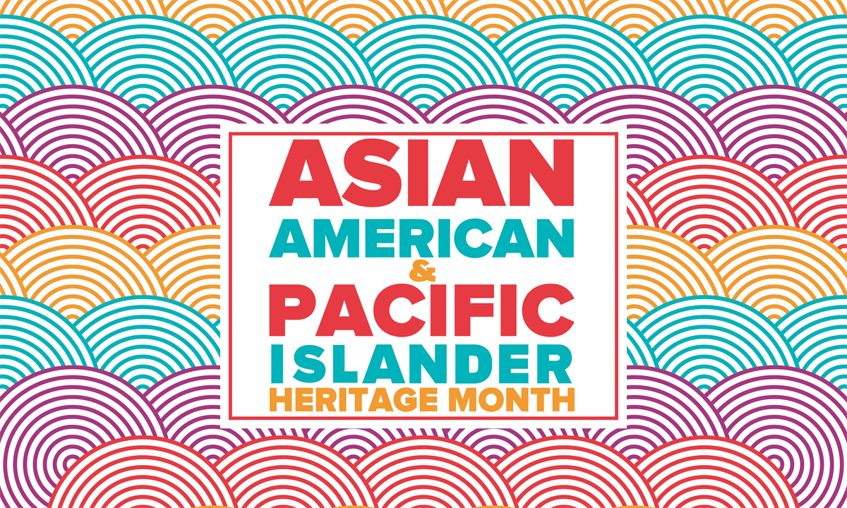
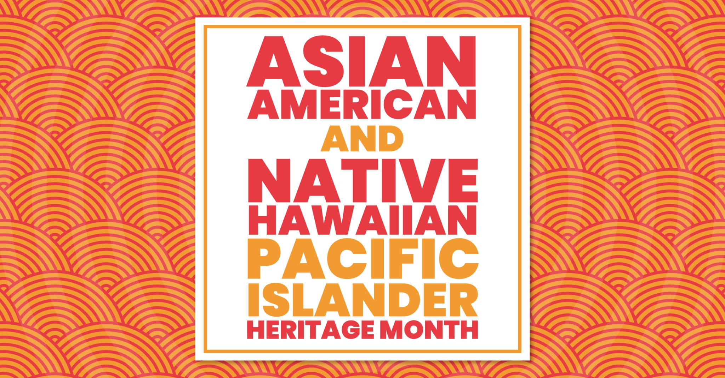
Notes:
May is Asian/Pacific American Heritage Month – a celebration of Asians and Pacific Islanders in the United States.
Asian and Pacific American Heritage month was the idea of former congressional staffer Jeanie Jew who first approached Rep. Frank Horton about the idea of designating a month to recognize Asian Pacific Americans, following the United States’ bicentennial celebration in 1976. In June 1977, Horton and Rep. Norman Y. Mineta, introduced a resolution in the U.S. House of Representatives to proclaim the first 10 days of May as Asian Pacific Heritage Week. A month later, a similar bill was introduced in the Senate by former U.S. Senators Daniel Inouye and Spark Matsunaga.
President Jimmy Carter signed a joint resolution for the celebration on Oct. 5, 1978. In 1990, George H.W. Bush signed a bill passed by Congress to extend Asian American Heritage Week to a month. On May 14, 1991, a public law was passed unanimously by congress and then signed by Bush, proclaiming May 1991 and May 1992 as Asian and Pacific American Heritage Month. By 1992, May was officially designated as Asian Pacific American Heritage Month.
The month of May was chosen because it commemorates the migration of the first immigrants from Japan to the United States on May 7, 1843 and to celebrate the completion of the transcontinental railroad by over 20,0000 Asian immigrants on May 10, 1869. However, the first Asian immigrants arrived in the U.S. in 1587 when Filipinos first began migrating to California. Immigrants continued to come from the Asian continent and the Pacific Islands through 1920 when the first Samoans were documented in Hawaii.

Slide 3
RESOLUTION NO. 24/21-22 IN SUPPORT OF MAY 2022 AS
ASIAN PACIFIC HERITAGE MONTH
WHEREAS the State of California is home to more than 600,000 students of Asian and Pacific Islander descent, transitional kindergarten through grade twelve;
WHEREAS these students reflect the great diversity of culture and heritage of the many countries of Asia and the Pacific Islands;
WHEREAS despite the hardships and barriers of the past, the people of Asia and the Pacific Islands who come to this country and their descendants have made substantial contributions to California’s economic growth and development and have woven clear, distinct threads into the state’s social fabric;
WHEREAS the California State Board of Education recognizes in its Policy Statement on Multicultural Education that each student needs an opportunity to understand the common humanity underlying all people; to develop pride in his or her own identity and heritage; and to understand, respect, and accept the identity and heritage of others;
WHEREAS the History-Social Science Framework for California Public Schools, Transitional Kindergarten Through Grade Twelve states that the history curriculum of community, state, region, nation, and world must reflect the experiences of men and women and of different racial, religious, and ethnic groups and must be integrated at every level; and
WHEREAS Asian Pacific Heritage Month is celebrated annually at the local, state, and national levels;
NOW, THEREFORE, BE IT RESOLVED that the San Ramon Valley Unified School District proclaims the month of May as Asian Pacific Heritage Month and encourages all schools to commemorate this occasion with appropriate instructional materials; and
BE IT FURTHER RESOLVED that this resolution be available to all schools within the District.
PASSED AND ADOPTED by the following called vote this 24th day of August, 2021.

Slide 4
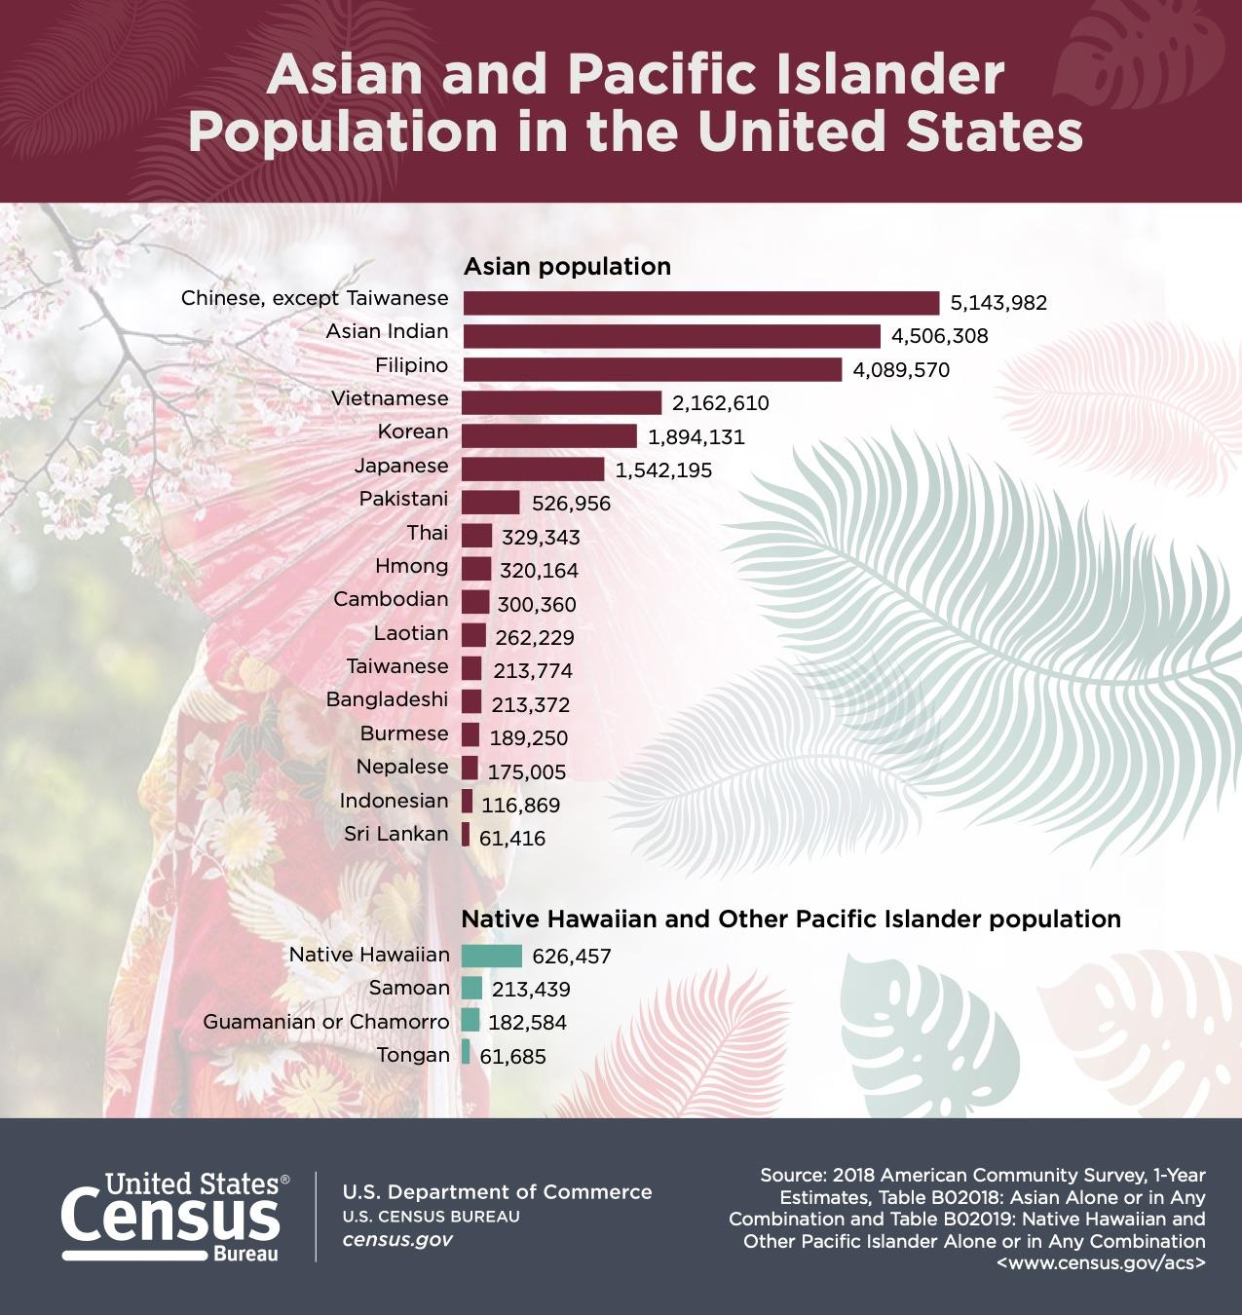
The following is a list of commonly used Asian American and Pacific Islander-related terms. While these terms may commonly be used, it is important to note there is a possibility some cultural identities can overlap in this larger classification of AAPI individuals.
AAPI: Asian American and Pacific Islander. This term generally includes all people of Asian, Asian American or Pacific Islander descent.
Asian: A person having origins in any of the original peoples of the Far East, Southeast Asia or the Indian subcontinent.
East Asian: A person of Chinese, Taiwanese, Japanese, Korean and Mongolian descent.
South Asian: A person of Indian, Bangladesh, Sri Lankan, Nepal and Pakistani backgrounds.
Southeast Asian: A person of Filipino, Cambodian, Vietnamese, Lao, Indonesian, Thai or Singaporean descent.
Central Asian: A person with origins in the original peoples of Kazakhstan, Kyrgyz Republic, Tajikistan, Turkmenistan and Uzbekistan.
Pacific Islander: A person with origins in the original peoples of Polynesia, Micronesia and Melanesia.
West Asian: A person with origins in the original peoples of Armenia, Azerbaijan, Bahrain, Cyprus, Georgia, Iraq, Israel, Jordan, Kuwait, Lebanon, Oman, Palestine, Qatar, Saudi Arabia, Syria, Turkey, United Arab Emirates and Yemen.

Slide 5
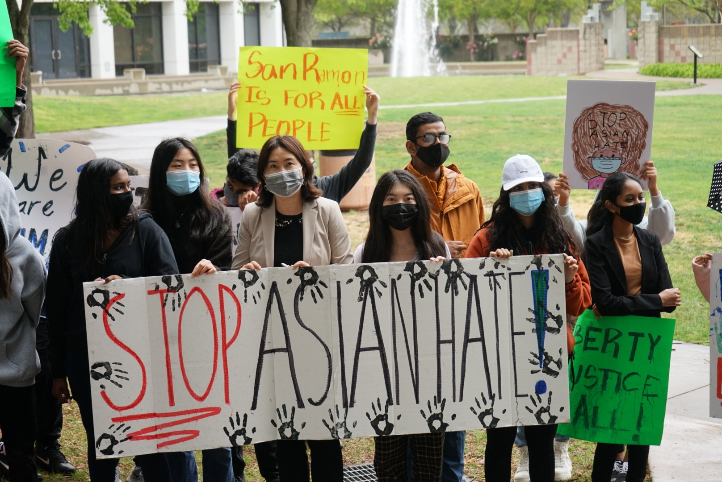
COMMUNICATION IN SUPPORT OF AAPI COMMUNITY (3/19/2021)
EXCERPT:
We, in the SRVUSD, stand together in solidarity with all people of Asian American Pacific Islander descent and condemn these acts of hatred. As an education community, we strive to create a culture of respect where all students and staff feel safe to learn and work. These acts of hatred and intolerance are in direct conflict with the values and beliefs that we teach and embrace. We are firmly committed to the work that we are doing around diversity, equity and inclusion, and we stand united in our commitment to combat racism, bigotry, bias and discrimination in all forms.

Slide 6




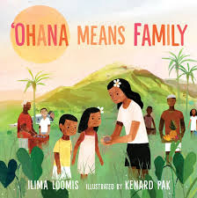


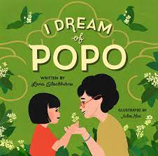

Slide 7
RESOURCES
Asian Pacific American Heritage Online Events
Asian Pacific American Heritage Month Lessons
Asian Pacific American Heritage Month - PBS
Asian Pacific American Heritage Month - All About the Holidays - Video
Teaching Asian and Pacific Islander Heritage | NEA - National Education Association
ADL - Asian American Pacific Islander (AAPI) Heritage Month Resources
Advancing Leaders Through Collaboration: AAPI Resource Center

Slide 8
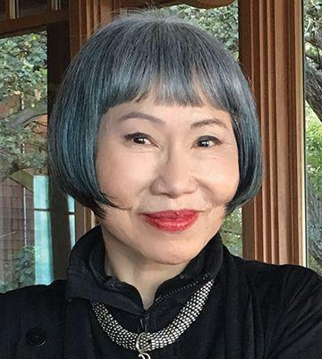
–AMY TAN, AUTHOR
“If you can’t change your fate, change your attitude.”

Slide 9
Thanks!
Do you have any questions?

