Slide 1
September
Attendance Awareness
We’re so glad you’re here!

Slide 2
Key research tells us
When students are engaged in school, success follows.
Click here for more on the research

Slide 3
Celebrating
our students’ return to school
In-person
& Virtual!

Slide 4
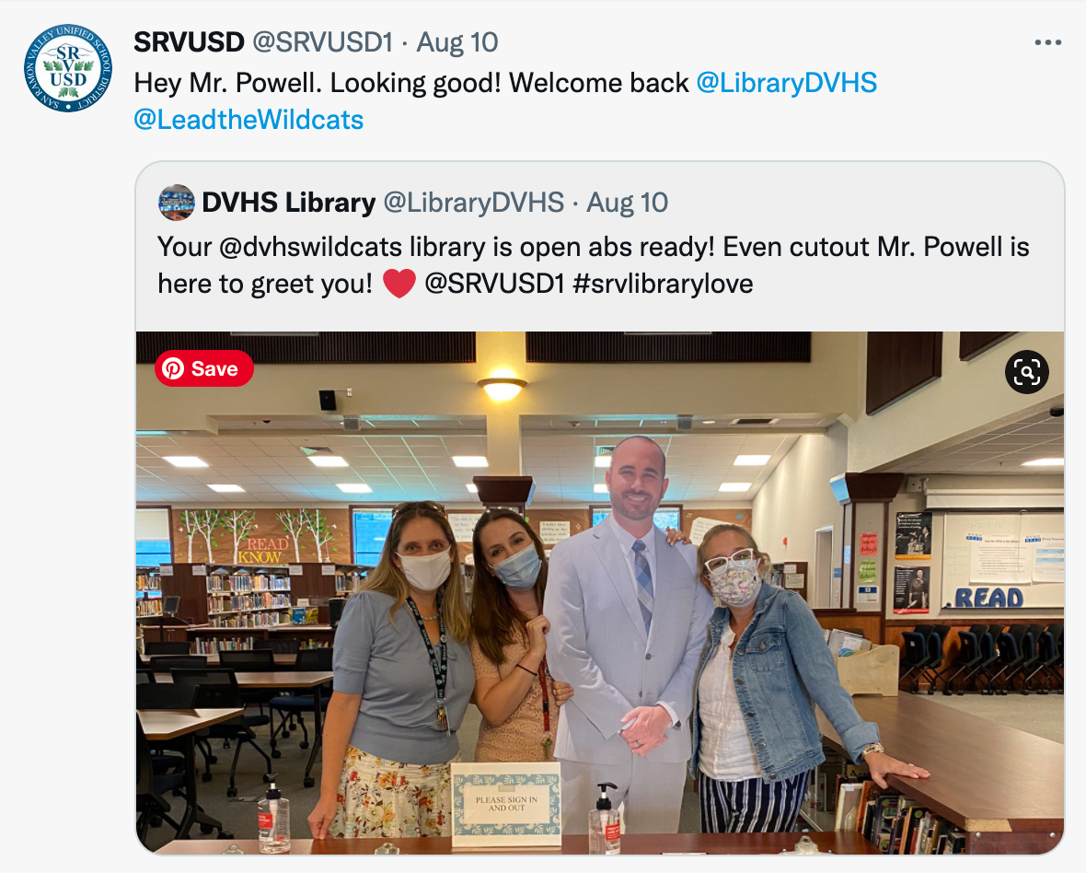
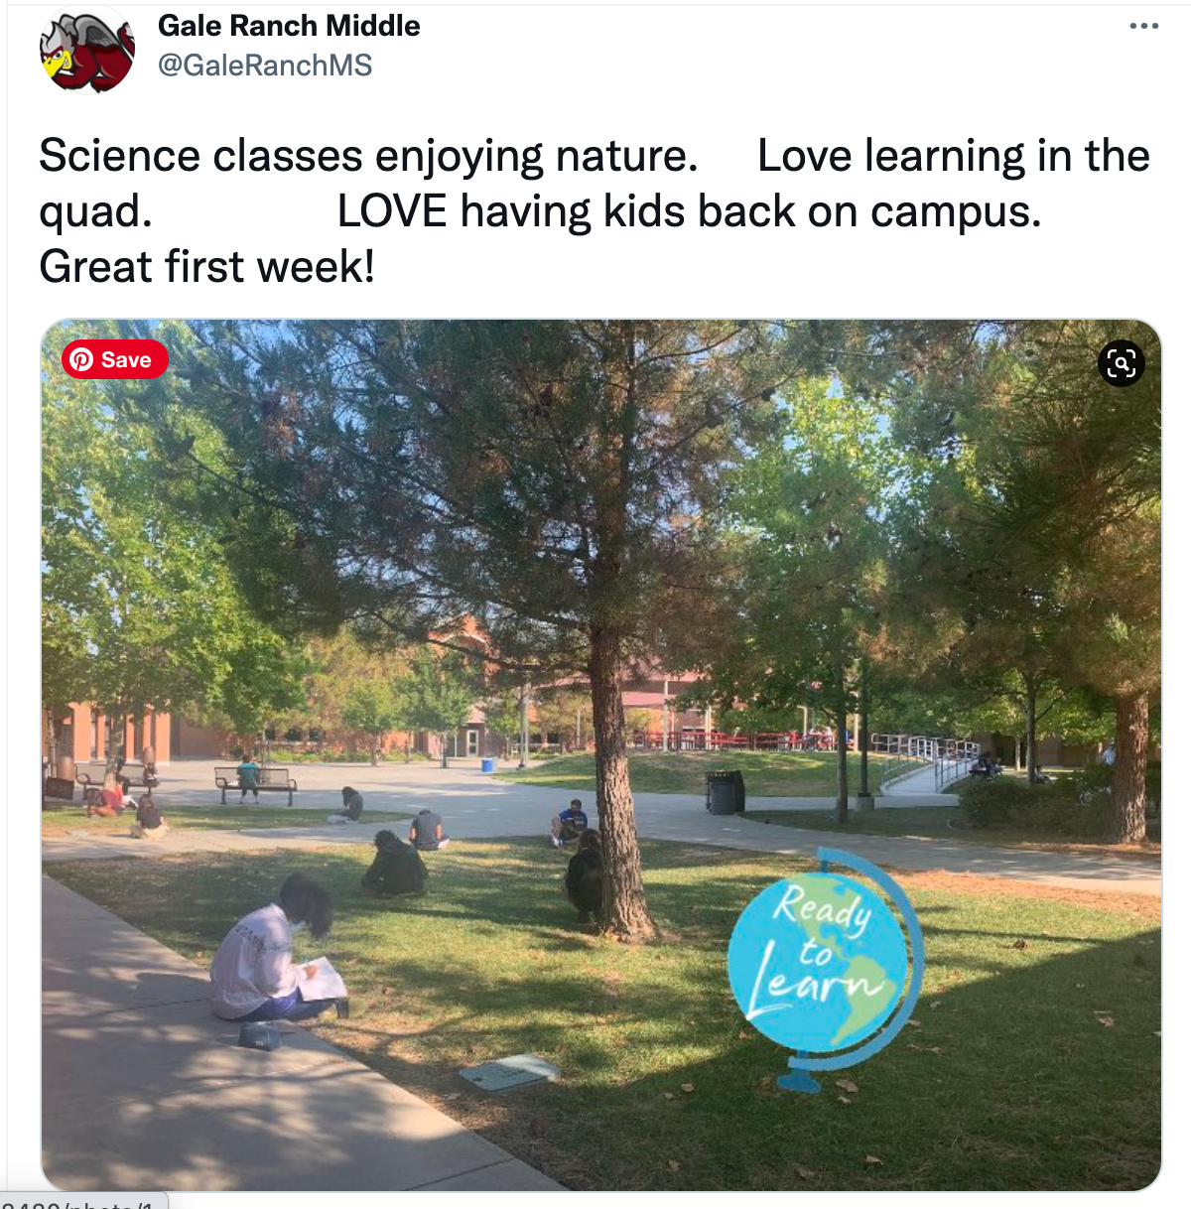
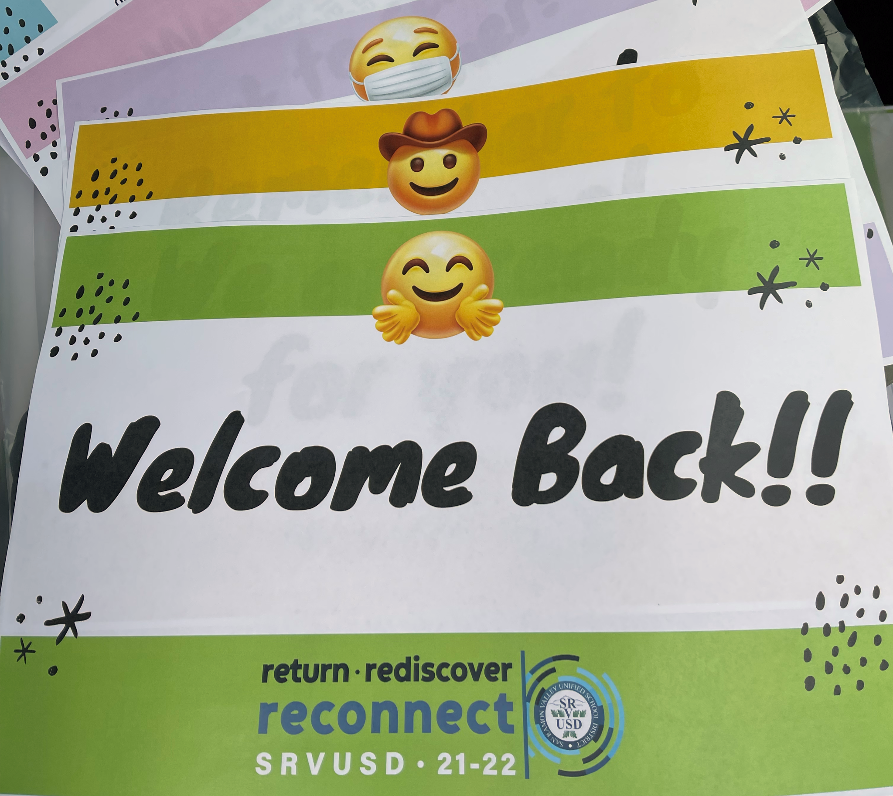
Celebrating
our students’ return to school
In-person
& Virtual!

Slide 5
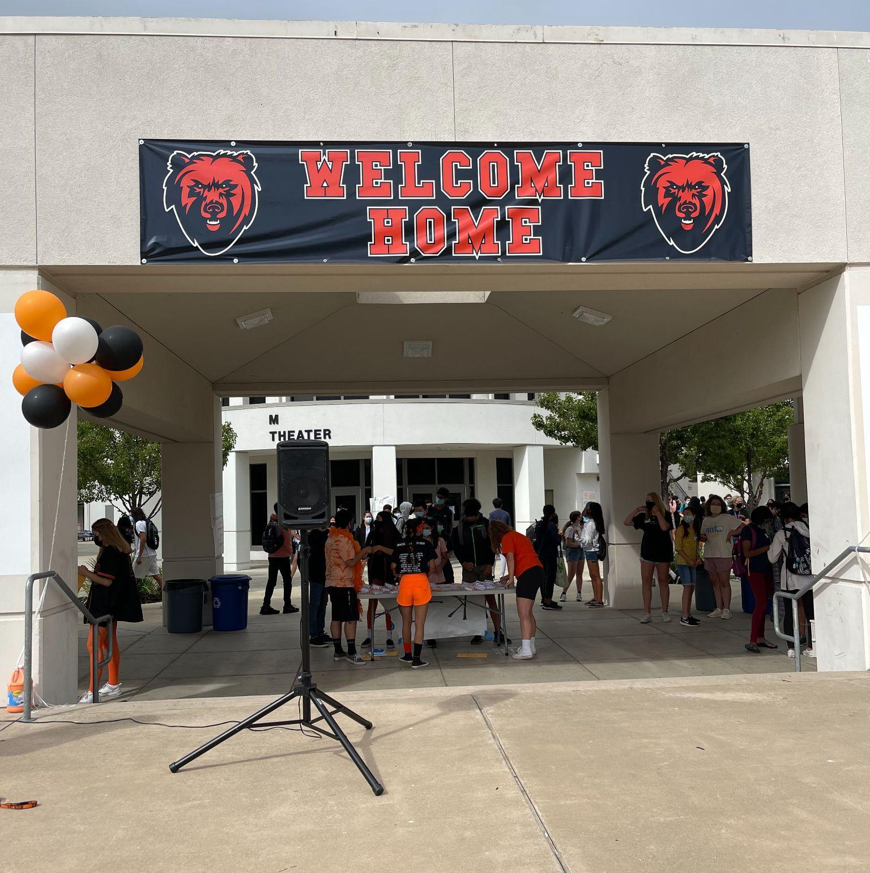
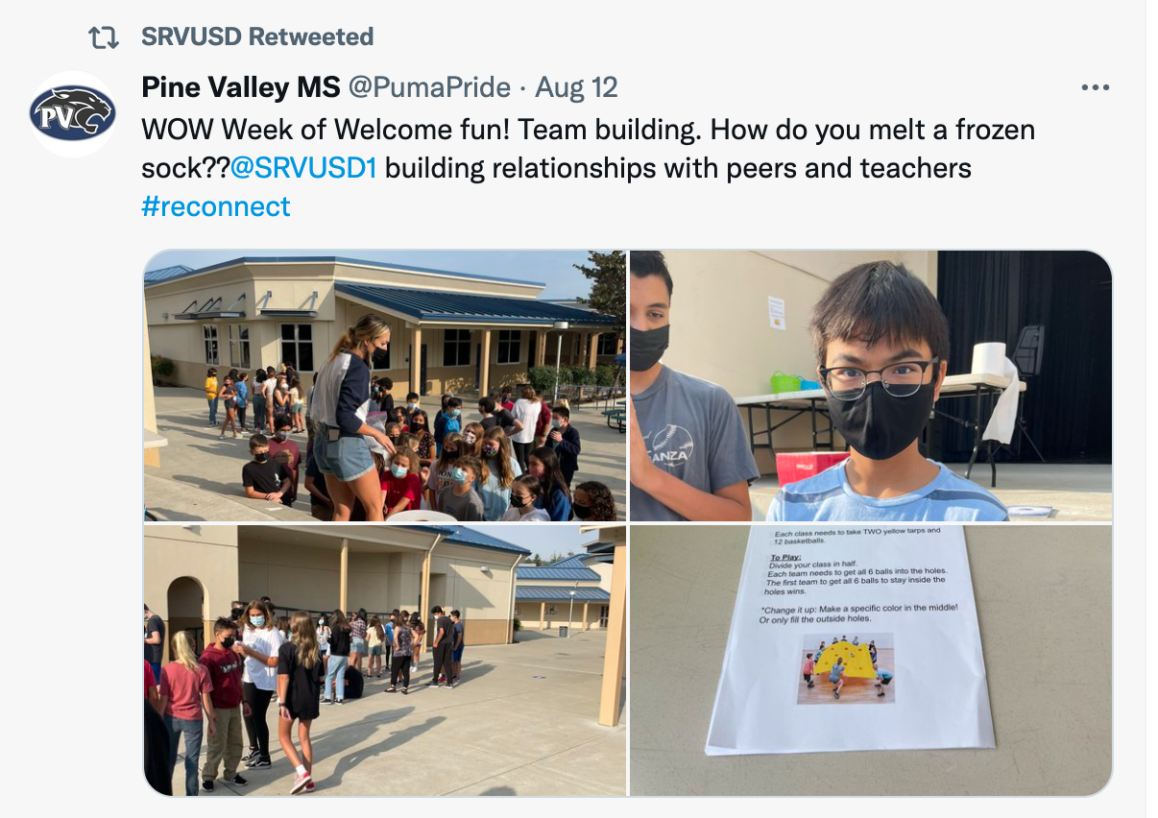
Celebrating
our students’ return to school
In-person
& Virtual!

Slide 6
Attendance FOCUS
Raise awareness of the importance of coming to school
Focus on the social-emotional well being of our students
Support students whether they are in-person, virtual, or need to stay home due to illness
Support students staying home when they are ill

