Slide 1
Autism Awareness Month
Light it up with kindness!

Slide 2
Autism Spectrum Disorder: Facts and Figures
Autism, or Autism Spectrum Disorder (ASD), refers to a broad range of conditions characteristized by challenges with social skills, repetitive behaviors, language and nonverbal communication.
The CDC reports that 1 out of 44 children are diagnosed with ASD, often manifesting within the first 3 years of life
Autism Awareness Month was conceived in 1970 in order to educate the community and celebrate opportunities associated with living, attending school, and working alongside people with ASD and their families.
Autism is the 3rd most prevalent eligibility category for special education in SRVUSD
Children, adolescents and adults with ASD each present with highly individualized patterns of needs and abilities.
Notes:
Although many students may meet diagnostic criteria as a student with ASD, that does not automatically signify that they qualify for Special Education services. Within the school setting, we are still obligated to follow IDEA guidelines when determining eligibility for special education.
the Autism Society held the first National Autism Awareness month in April of 1970.

Slide 3
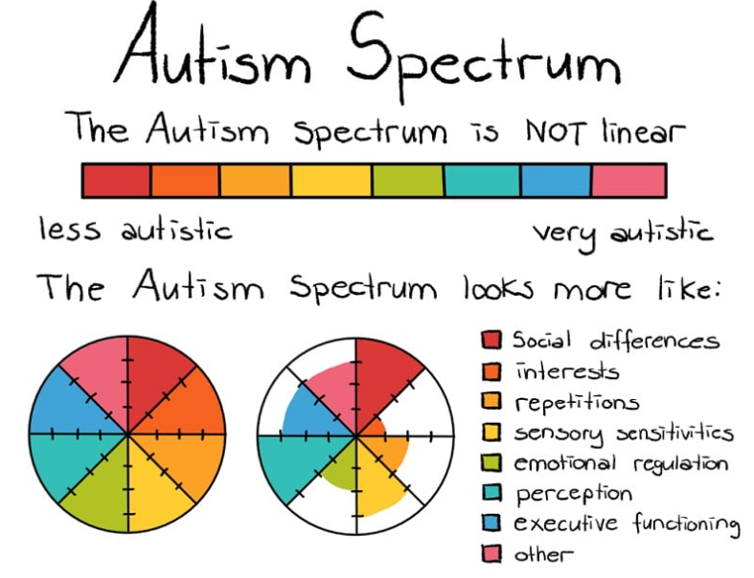

Slide 4
Supports within SRVUSD
Best Buddies
Peer to Peer Supports
Lunch Bunch
Special Olympics
Ability Awareness Activities
Instructional Technology/Assistive Technology
Rainbow Room
Zones of Regulation
Inclusive PE Opportunities
Mental Health Supports
Clubs/Organizations
Center for Early Intervention of Autism
Notes:
Peer to Peer: tutoring, Comrades, Pals program
Best Buddies: highlight PALS program
Rainbow Room: uses various curriculum to target and support social skill development, problem solving and perspective taking
Inclusive PE program (strategies and strategies for physical recreation): currently at XXX schools across the district. It includes general education and special education students
CEIA: Center for the Early Intervention of Autism
Mental Health Supports: SCIP counselors, Rainbow Room, Support Counselors, Social Workers

Slide 5
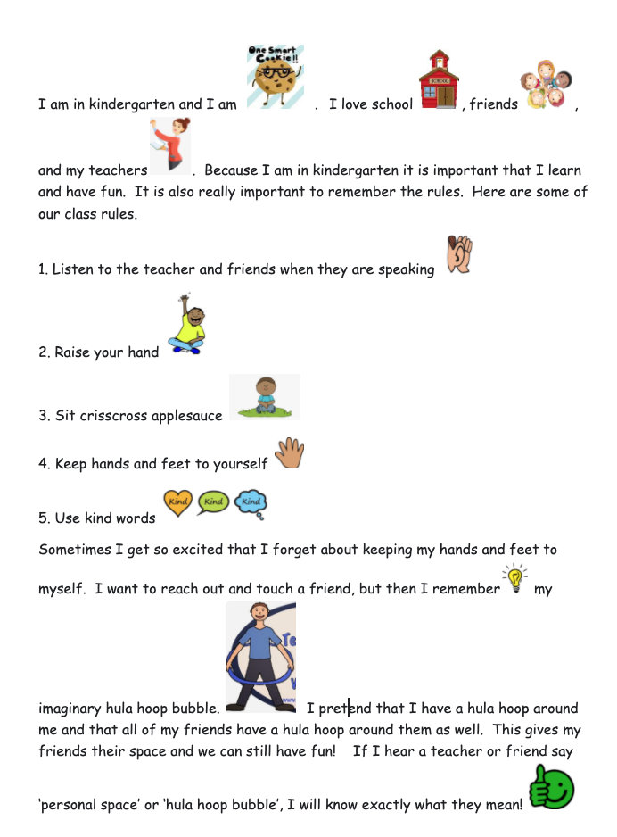
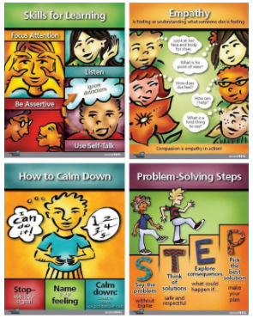
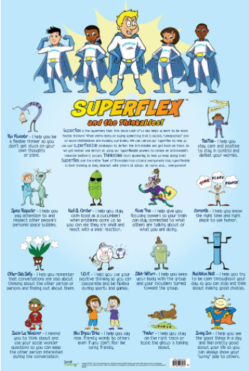
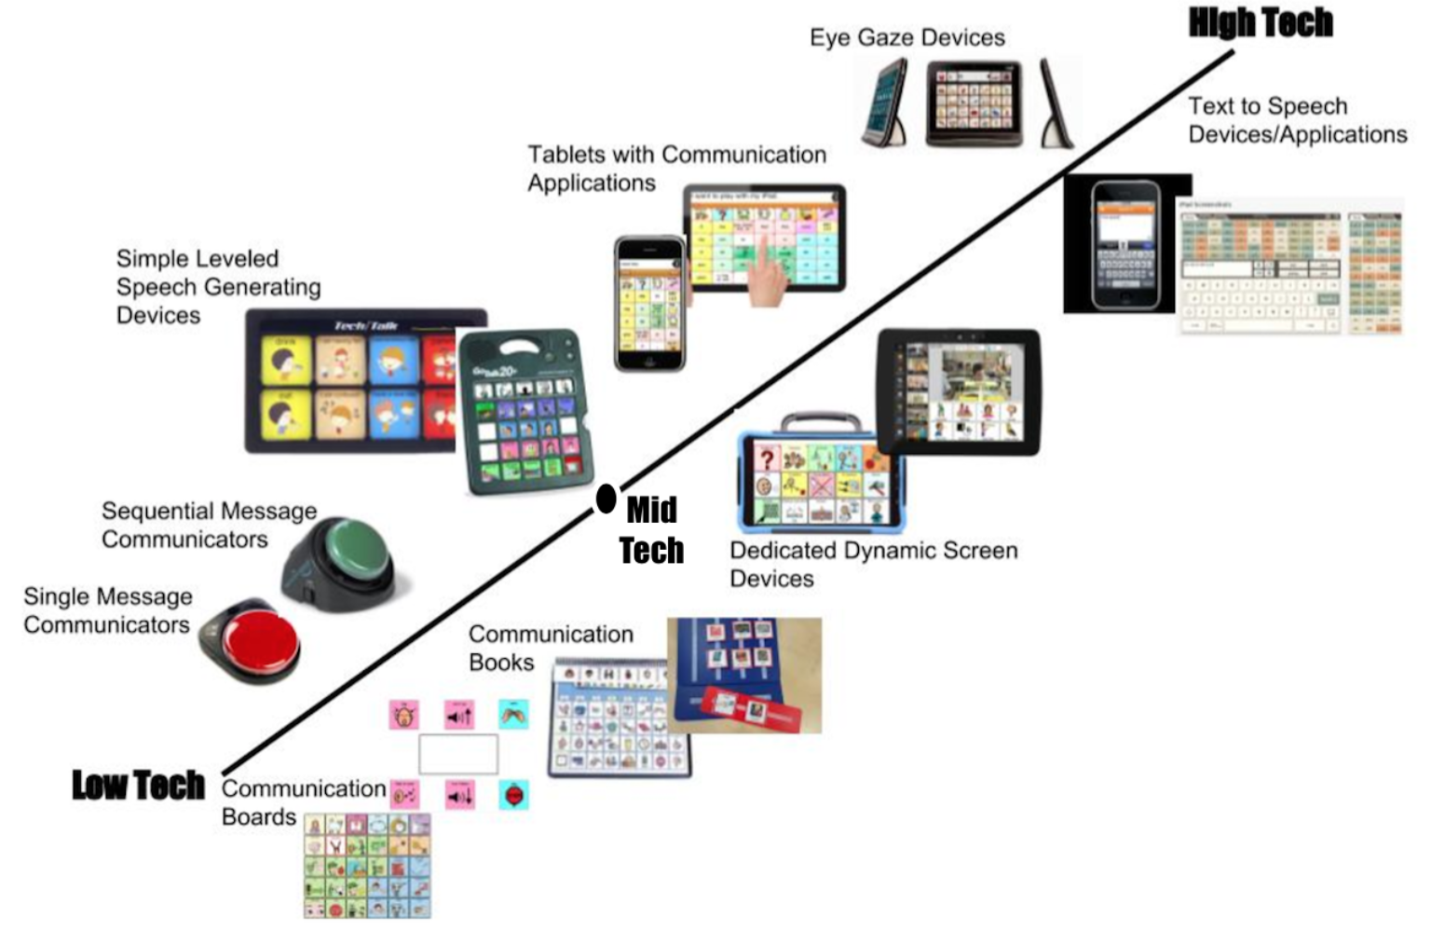
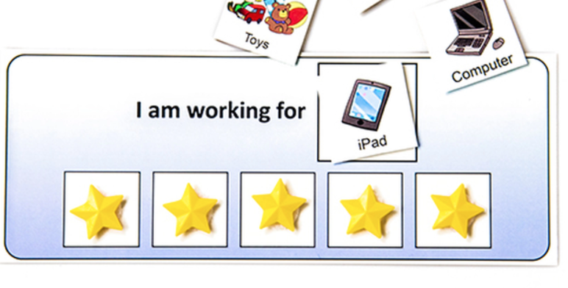
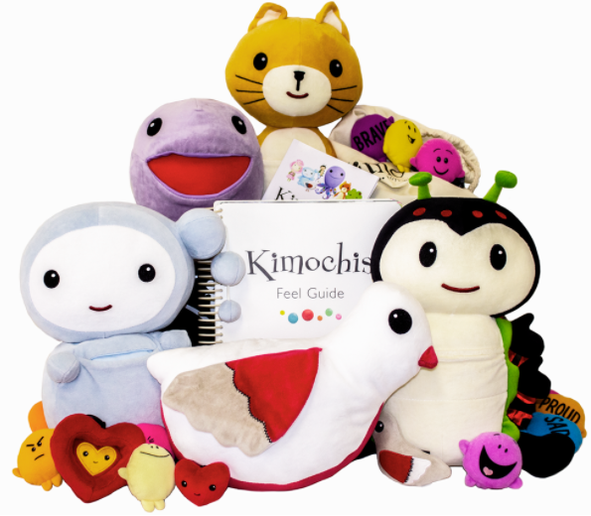
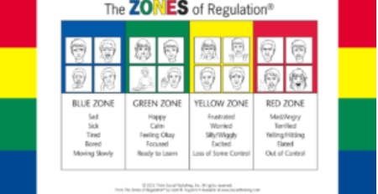
Strategies at Work

Slide 6
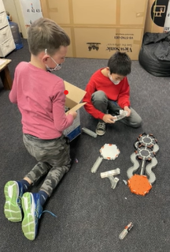
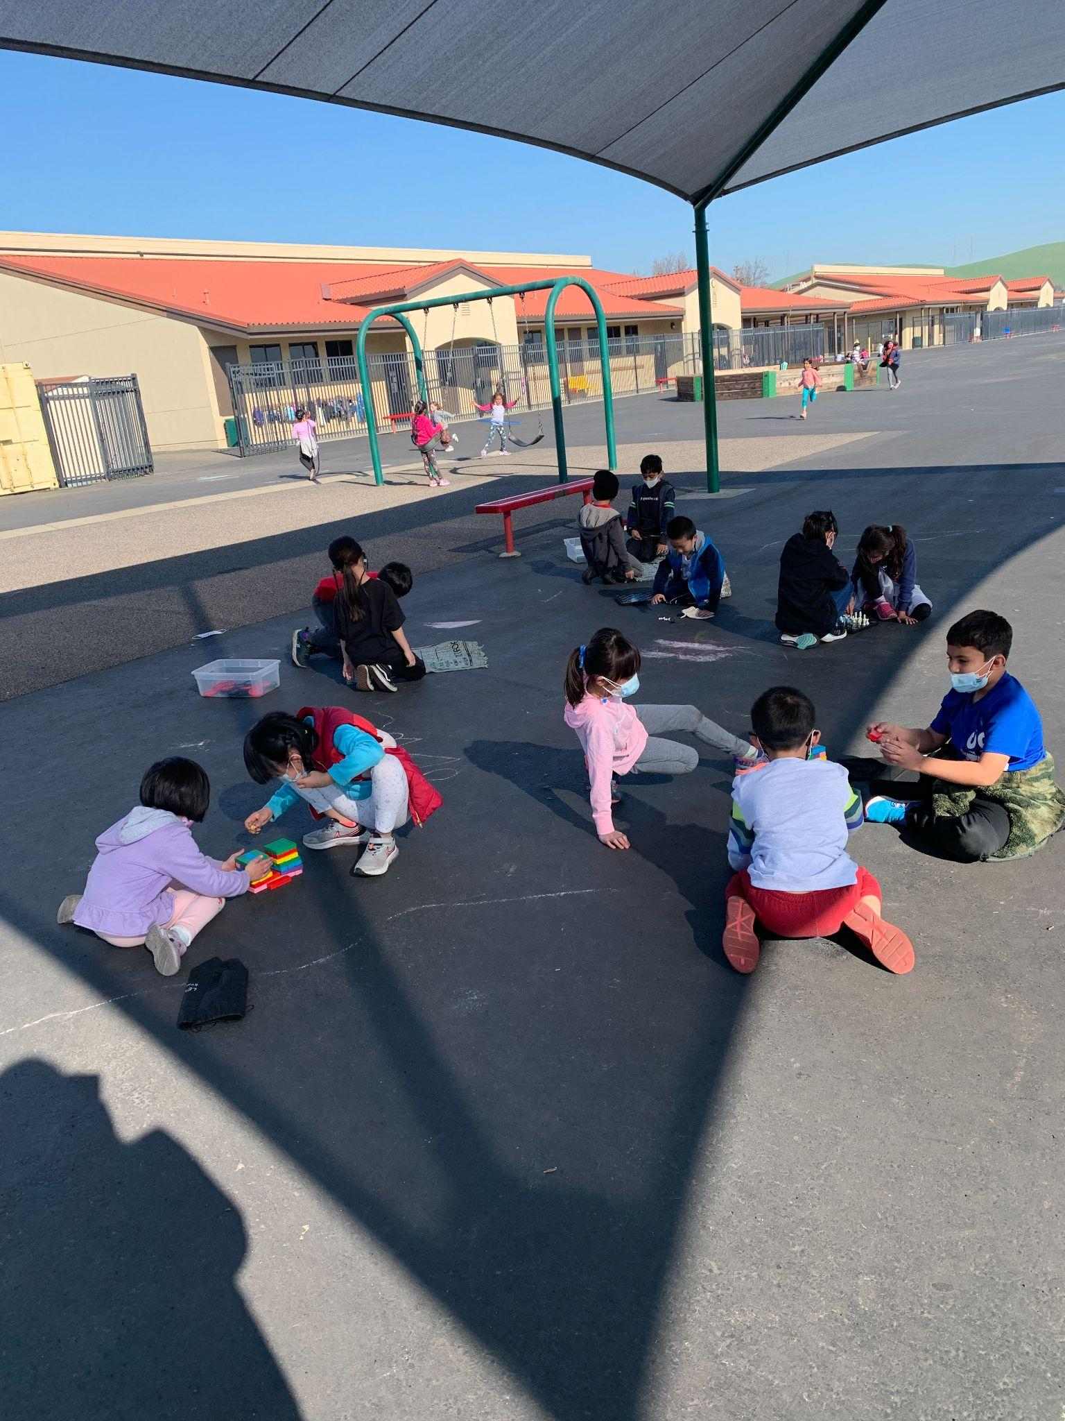
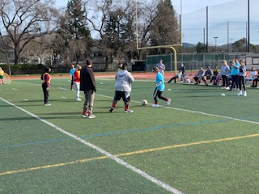
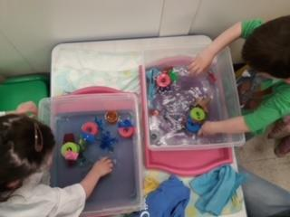
In Our Schools
Country Club
Coyote Creek
Students participate in an afterschool peer to peer play based program.
Chill Zone available for students who benefit from structured play activities during recess.
San Ramon High
Live Oak
Special Olympics soccer tournament included programs from across the county.
Preschool students enrolled in the CEIA program participate in sensory based play

Slide 7
—Temple Grandin
“The world needs all kinds of minds.”

