Slide 1
Comprehensive Support and Improvement Information Presentation
College and Career Readiness
for Alternative Education
June 7, 2022

Slide 2
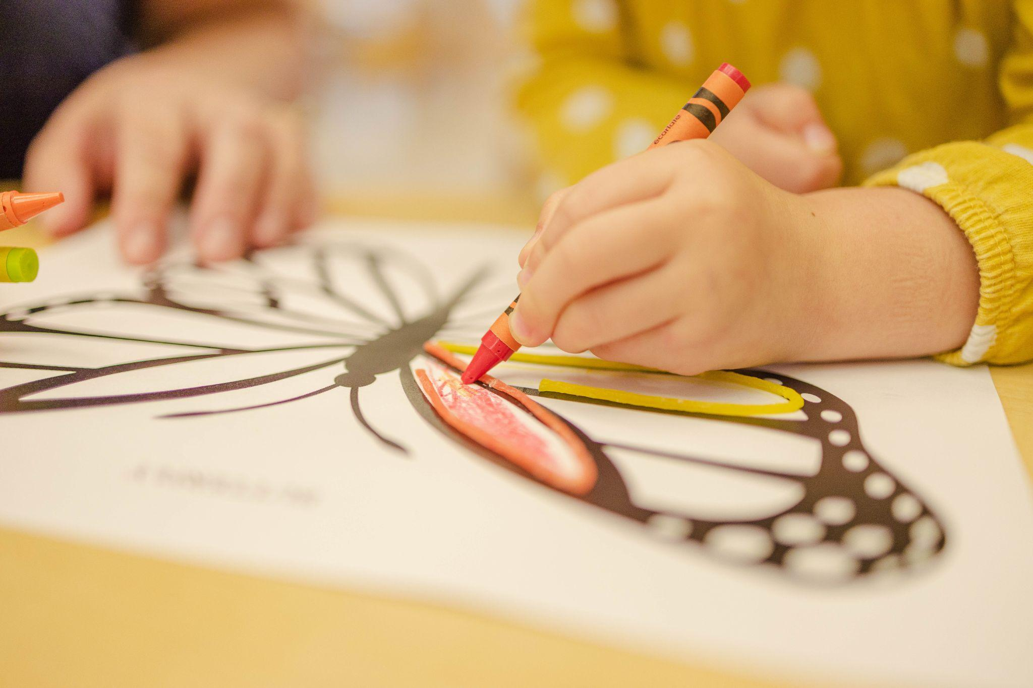
Proposed Spending Plan ($201,719)
Hire part-time social worker, psychologist ,and an instructional assistant to support academic and social emotional growth.
Professional development focused on restorative practices and evidence-based strategies on improving attendance.
Increase college and career readiness opportunities.
Expand Del Amigo Continuation High School.

Slide 3
Thank You!
Questions/Comments?

