Slide 1
Career & Technical Education (CTE)
San Ramon Valley Unified School District

Slide 2
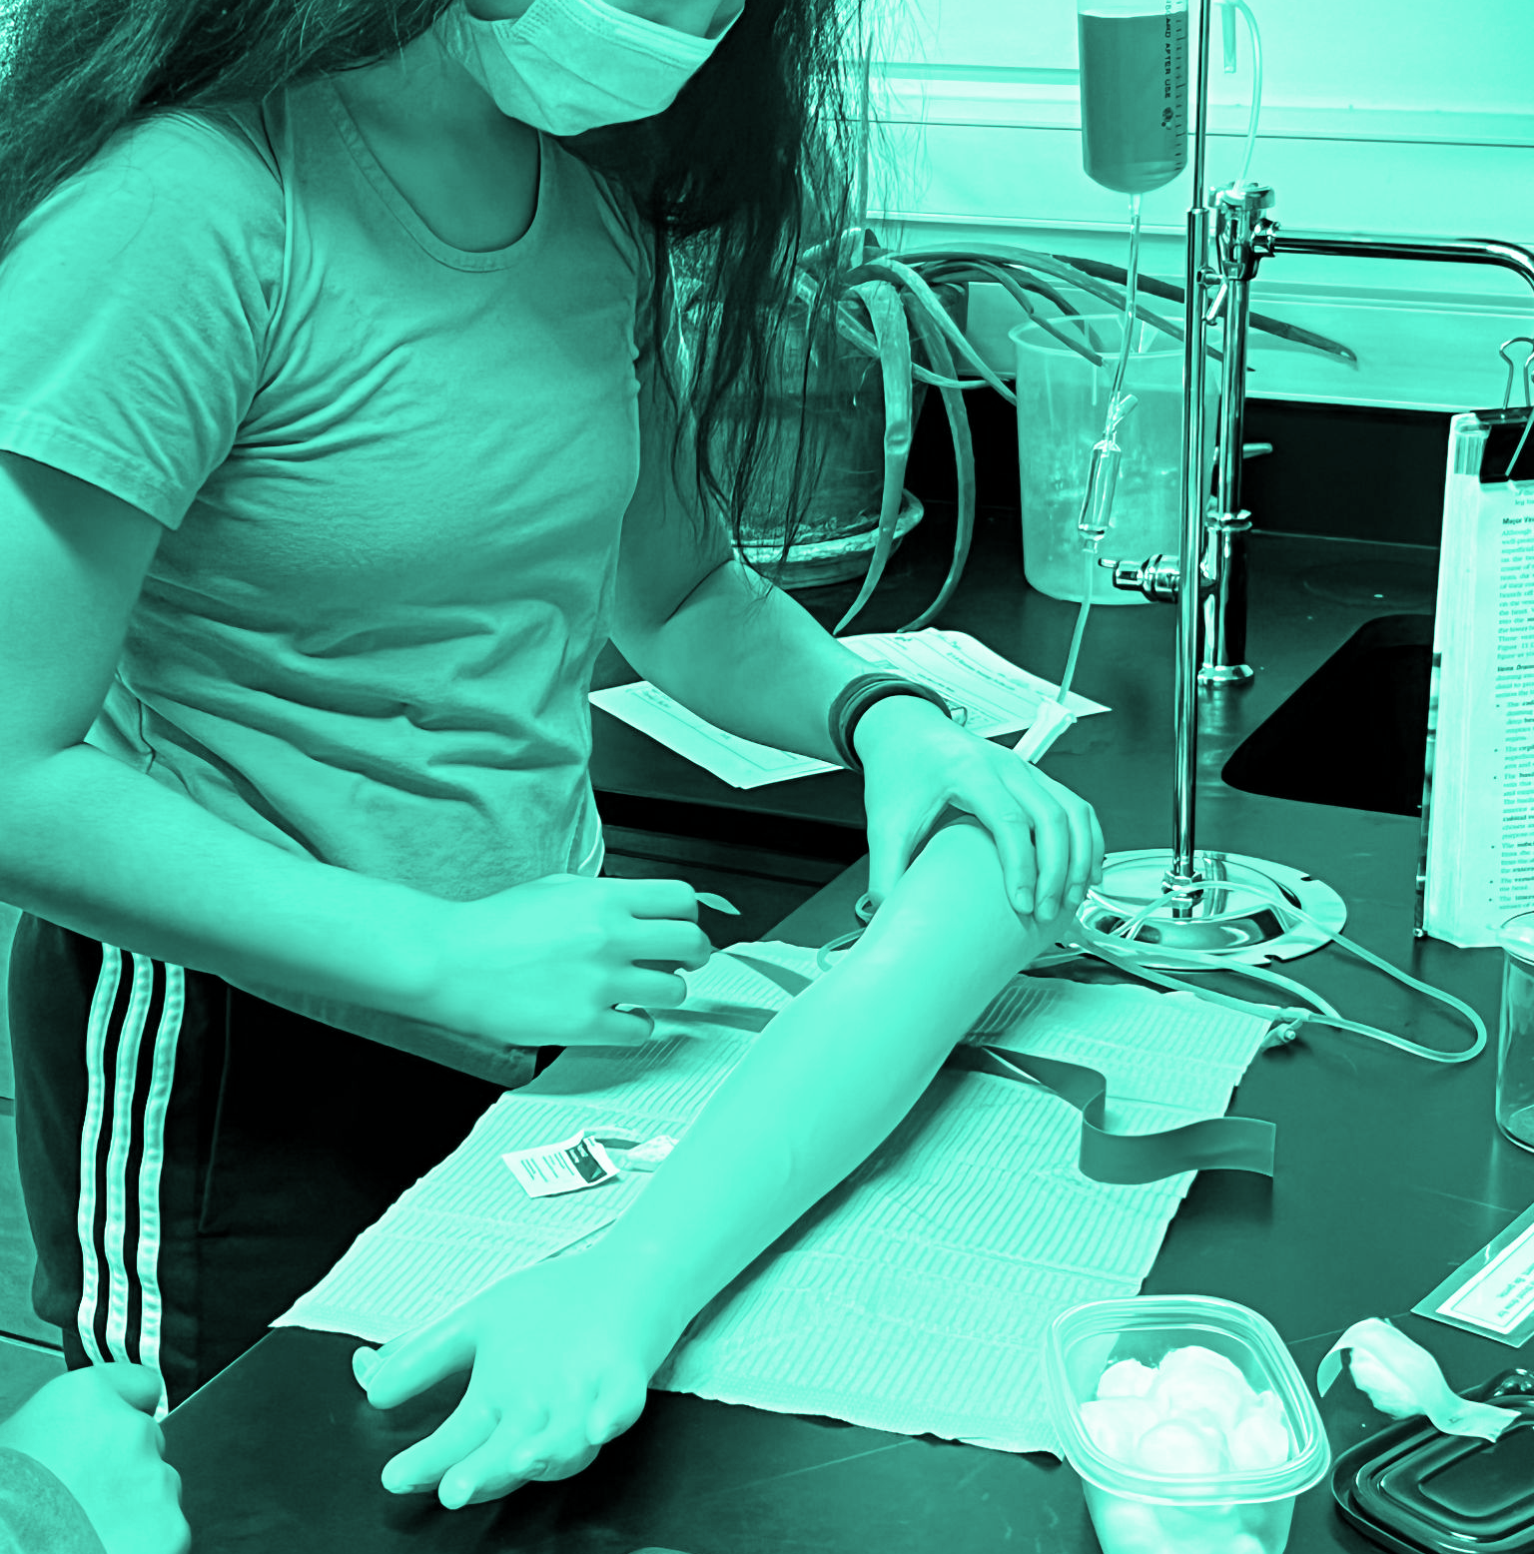
SRVUSD Strategic Direction
DEEP LEARNING
& INNOVATION
Goal Two: Develop and implement instructional models to engage students in learning at deep levels.
Strengthen and expand Career Technical Education (CTE) pathways to meet the needs of all students.
CHS: Principles of Biomedical Sciences

Slide 3
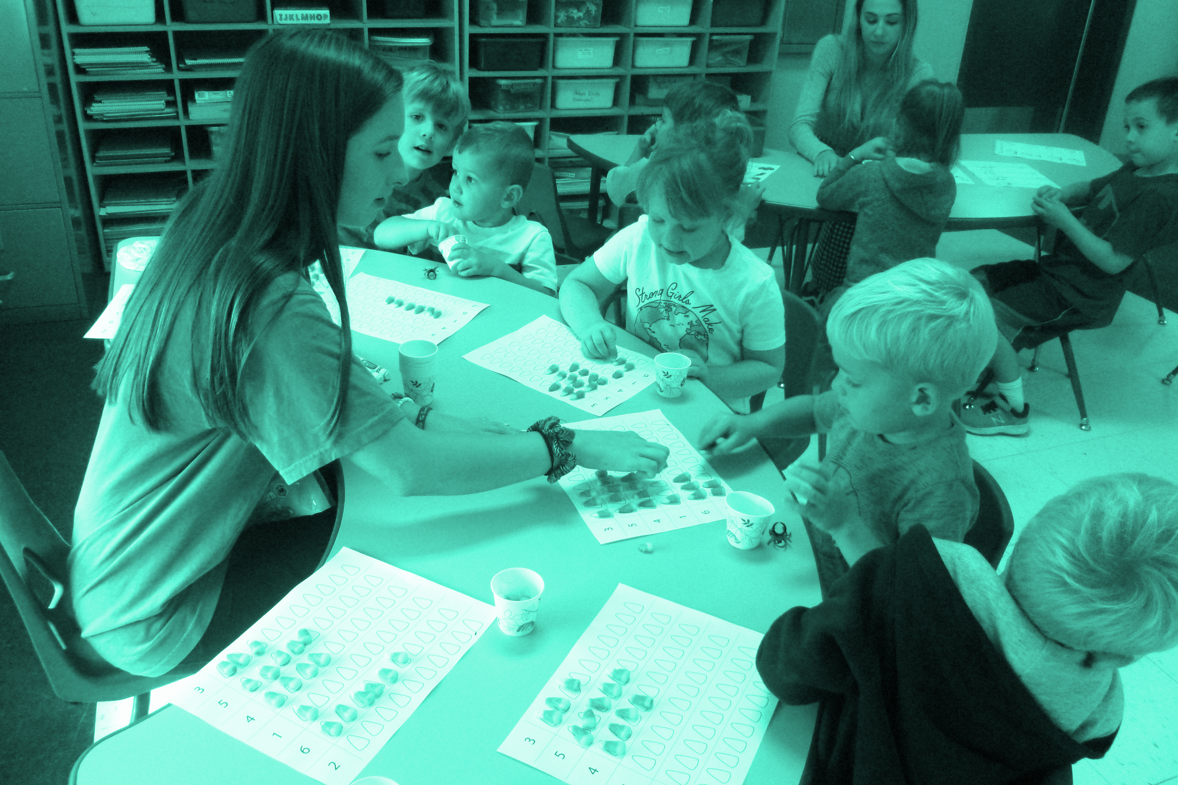
Rethinking CTE
Targeted instruction focusing on career oriented education
Exemplifies Deep Learning & Innovation in the classroom setting
Opens up post-secondary pathways which allow us to think about success differently
Enables community partnerships with outside organizations
MVHS: Early Childhood Development

Slide 4
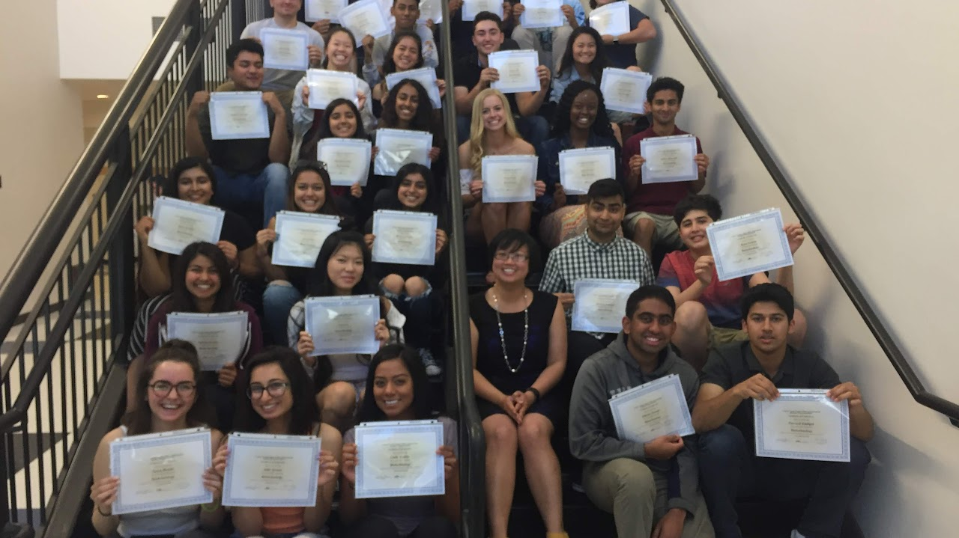
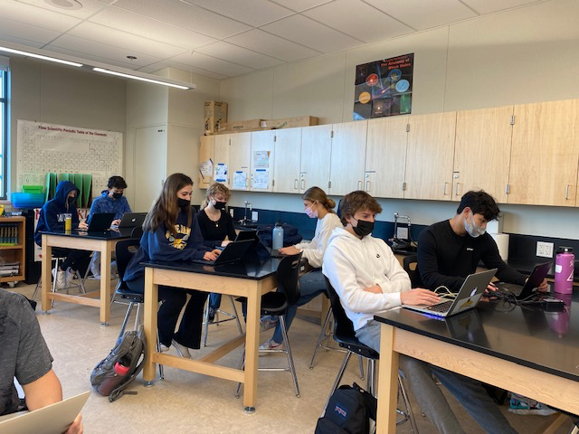
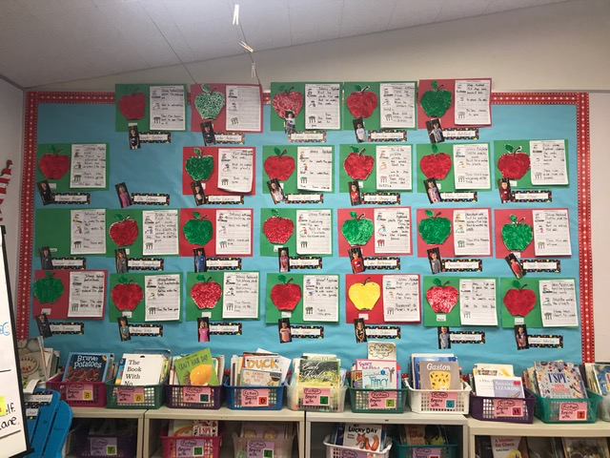
CTE in SRVUSD
PATHWAYS
VARIETY
ENROLLMENT
Auto Tech, Biotech & Biomedical, Computer Sciences, Culinary, Digital Media, Early Childhood Education, Engineering, Journalism, Sports Medicine
11 pathways represented throughout our High Schools
3,879 High School students in SRVUSD are enrolled in a CTE course this year
DVHS: BioTechnology
SRVHS: Careers in Teaching
SRVHS:

Slide 5
The Future of CTE in SRVUSD
Expanded Partnerships
Student Voice
& Choice
Strategic Direction
Articulation agreements and Increased Dual Enrollment opportunities with DVC and other CA Community Colleges
Expanding CTE Pathways to provide students with greater opportunities
A model for Deep Learning
& Innovation

Slide 6
Thank You!

