Slide 1
Child Nutrition Update
August 24, 2021

Slide 2
Agenda
Where We Were,
Where We Are Now,
Where We Are Headed

Slide 3
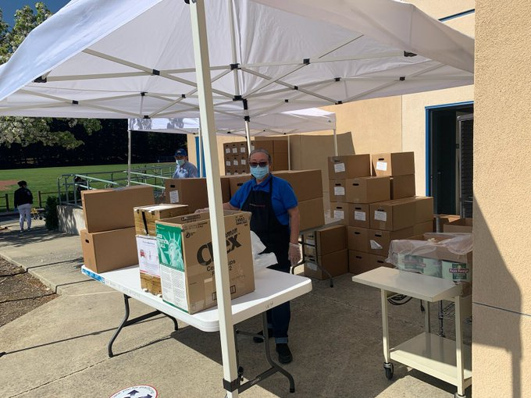
Where We Were
The cost per lunch was $4.25-$4.75 and the menu featured a large amount of a la carte snack items.
The 2019/20 school year started with a significant reduction in sugar, and a transition towards a focus on meals, rather than snacks.
Then the Covid-19 pandemic started - and over 1,750,000 meals were distributed.

Slide 4
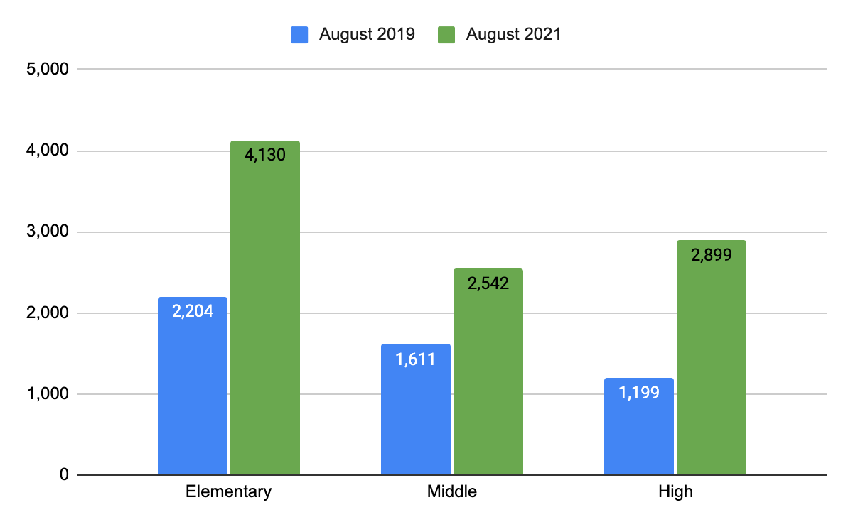
Where We Are Now - Twice The Students Participating

Slide 5
Where We Are Now - Operational Growing Pains
Short Staffing
Limited Availability of Food Items
Outgrown Central Production Kitchen
One 15 Minute Serving Period at High Schools
 | # of Students Per Minute Being Served | Average # of Lunches Served
Cal High | 16 | 710
Dougherty High | 13 | 1,400
Monte Vista High | 11 | 511
San Ramon High | 11 | 500

Slide 6
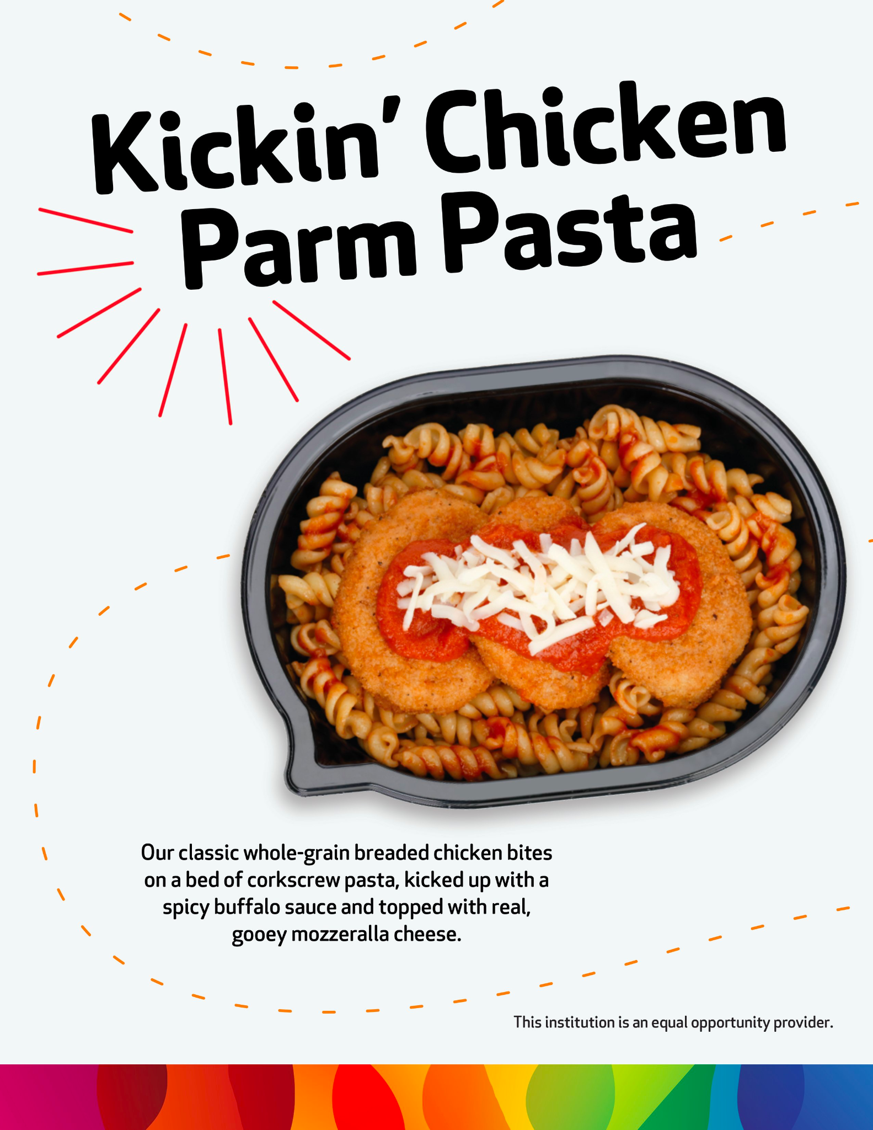
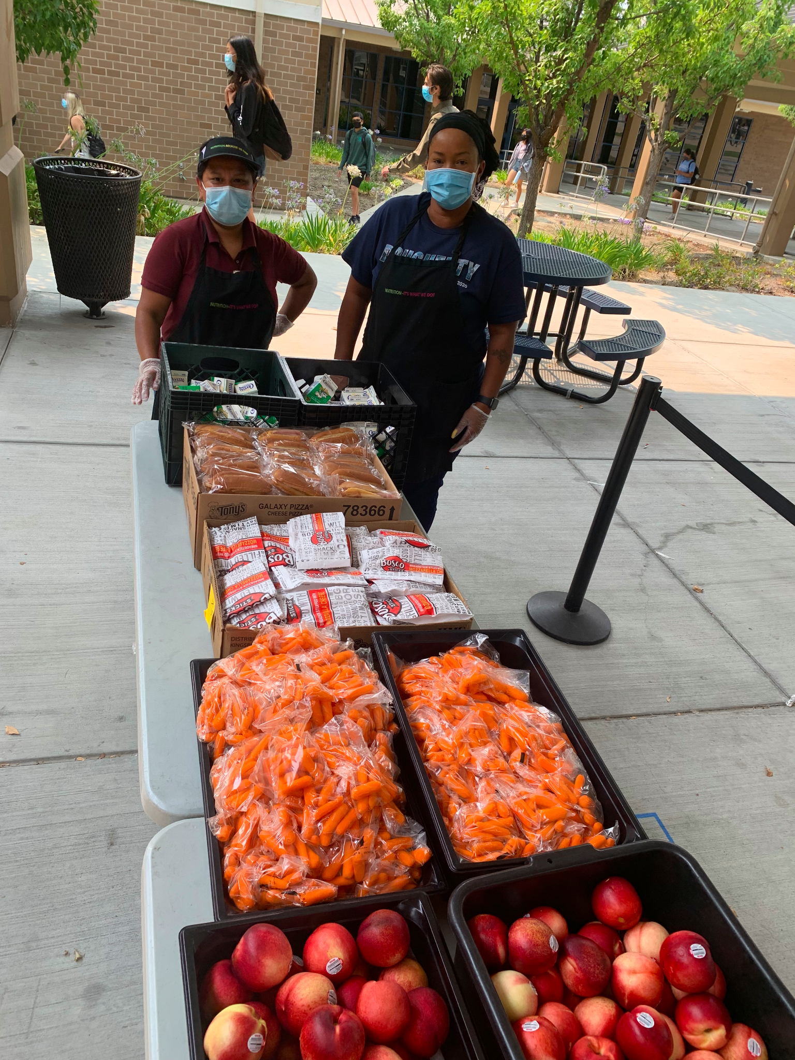
Where We Are Now - Changes Made

Slide 7
Where We Are Headed - More Than Food, Its Equity & Inclusion
We envision a program where students are connected, engaged, feel valued, and joyful about the school lunch experience. The program will be developmentally appropriate, not one size fits all.

Slide 8
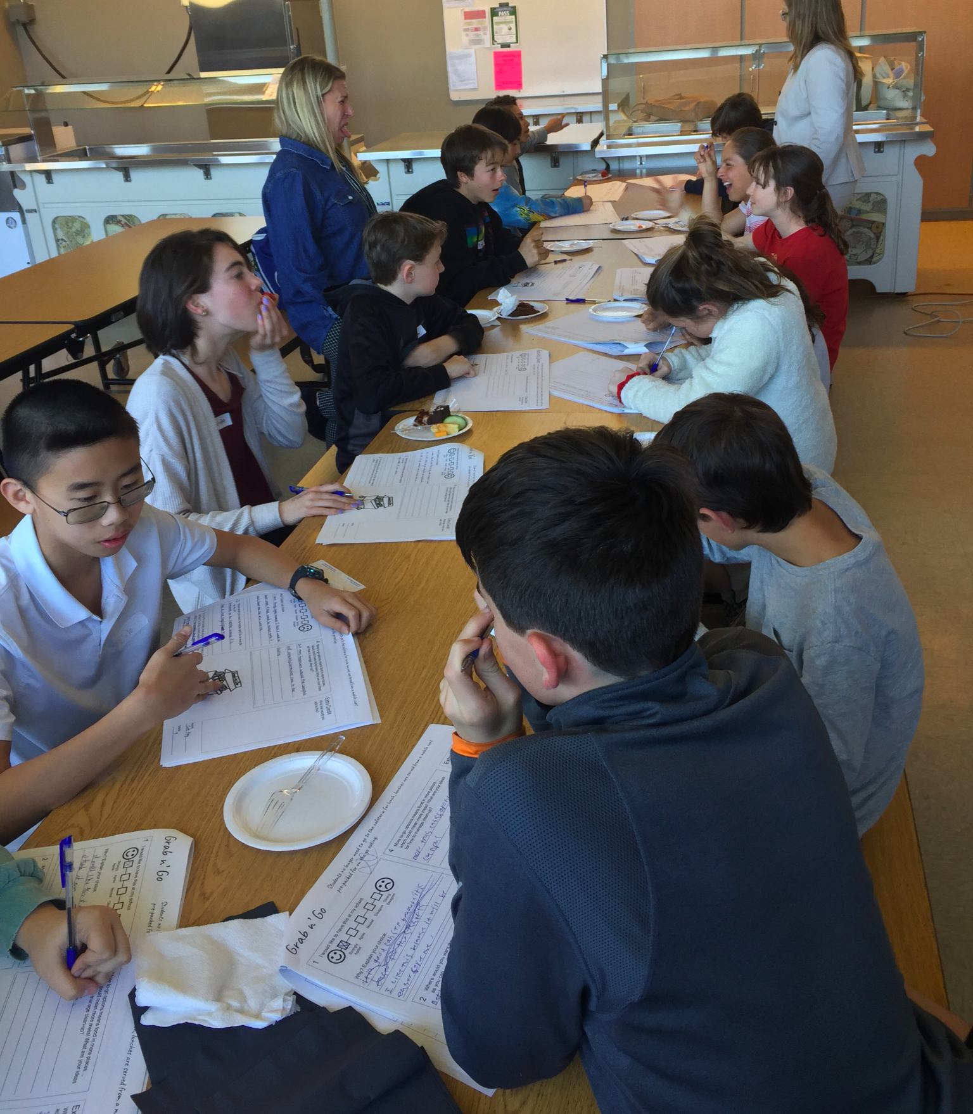
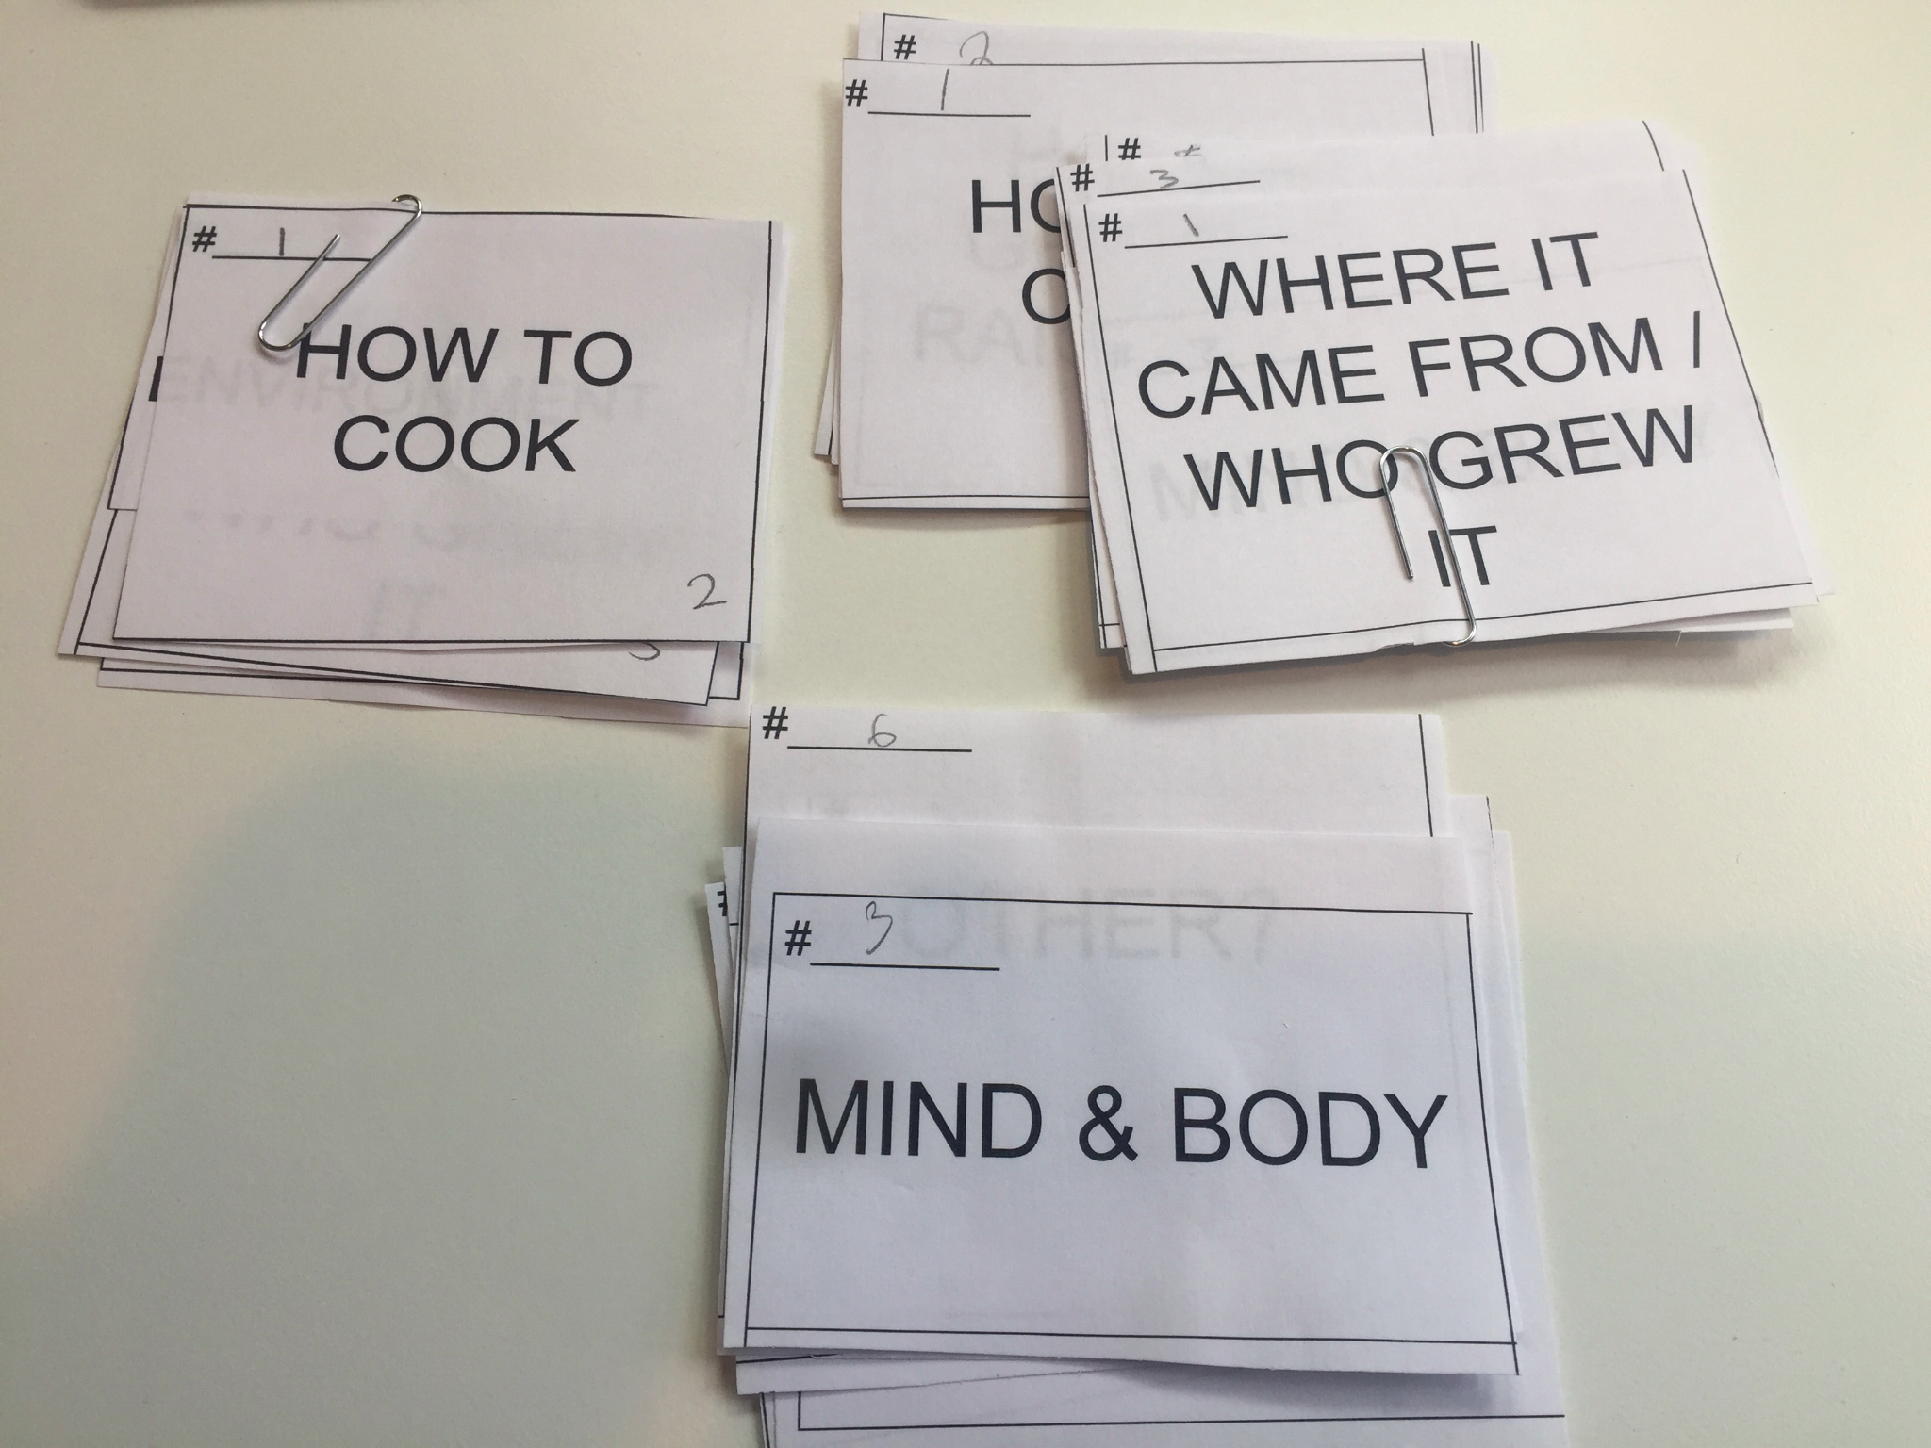
Where We Are Headed - Research & Engagement
To ensure we are truly designing a program that meets the specific needs of the SRVUSD community, we will need to research and engage with students, parents, and staff.

Slide 9
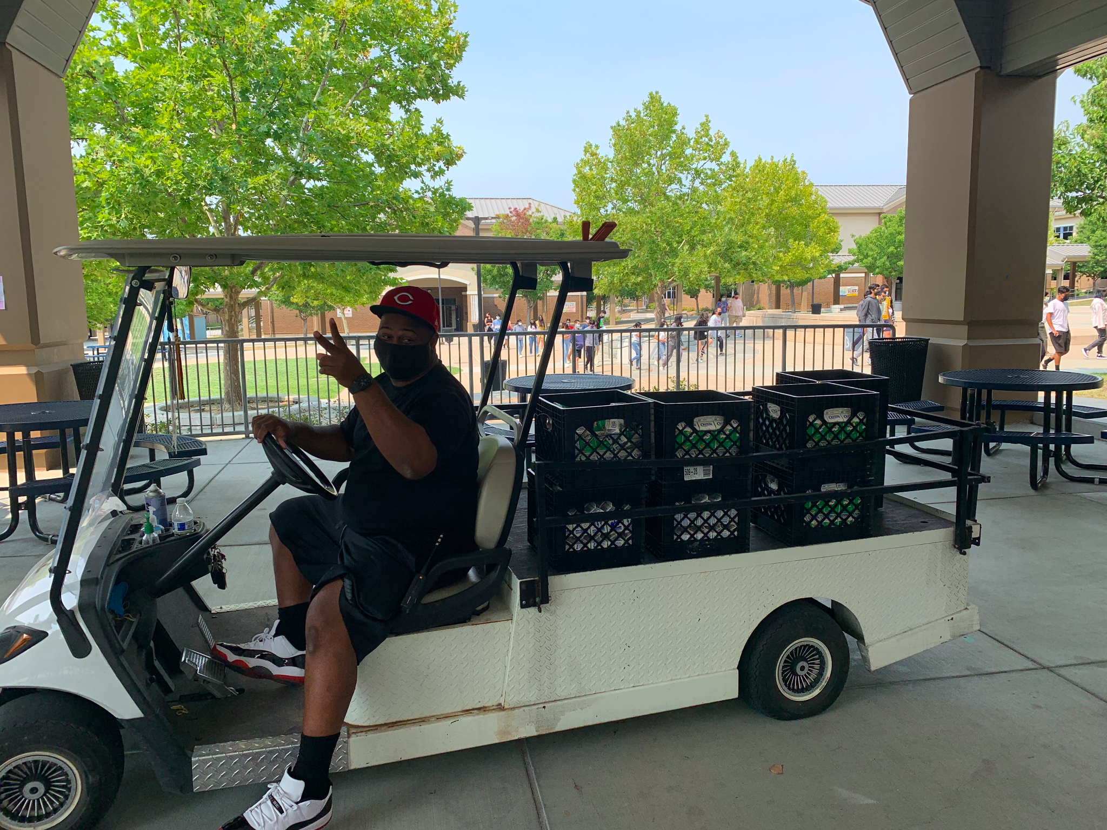
Questions

