Slide 1
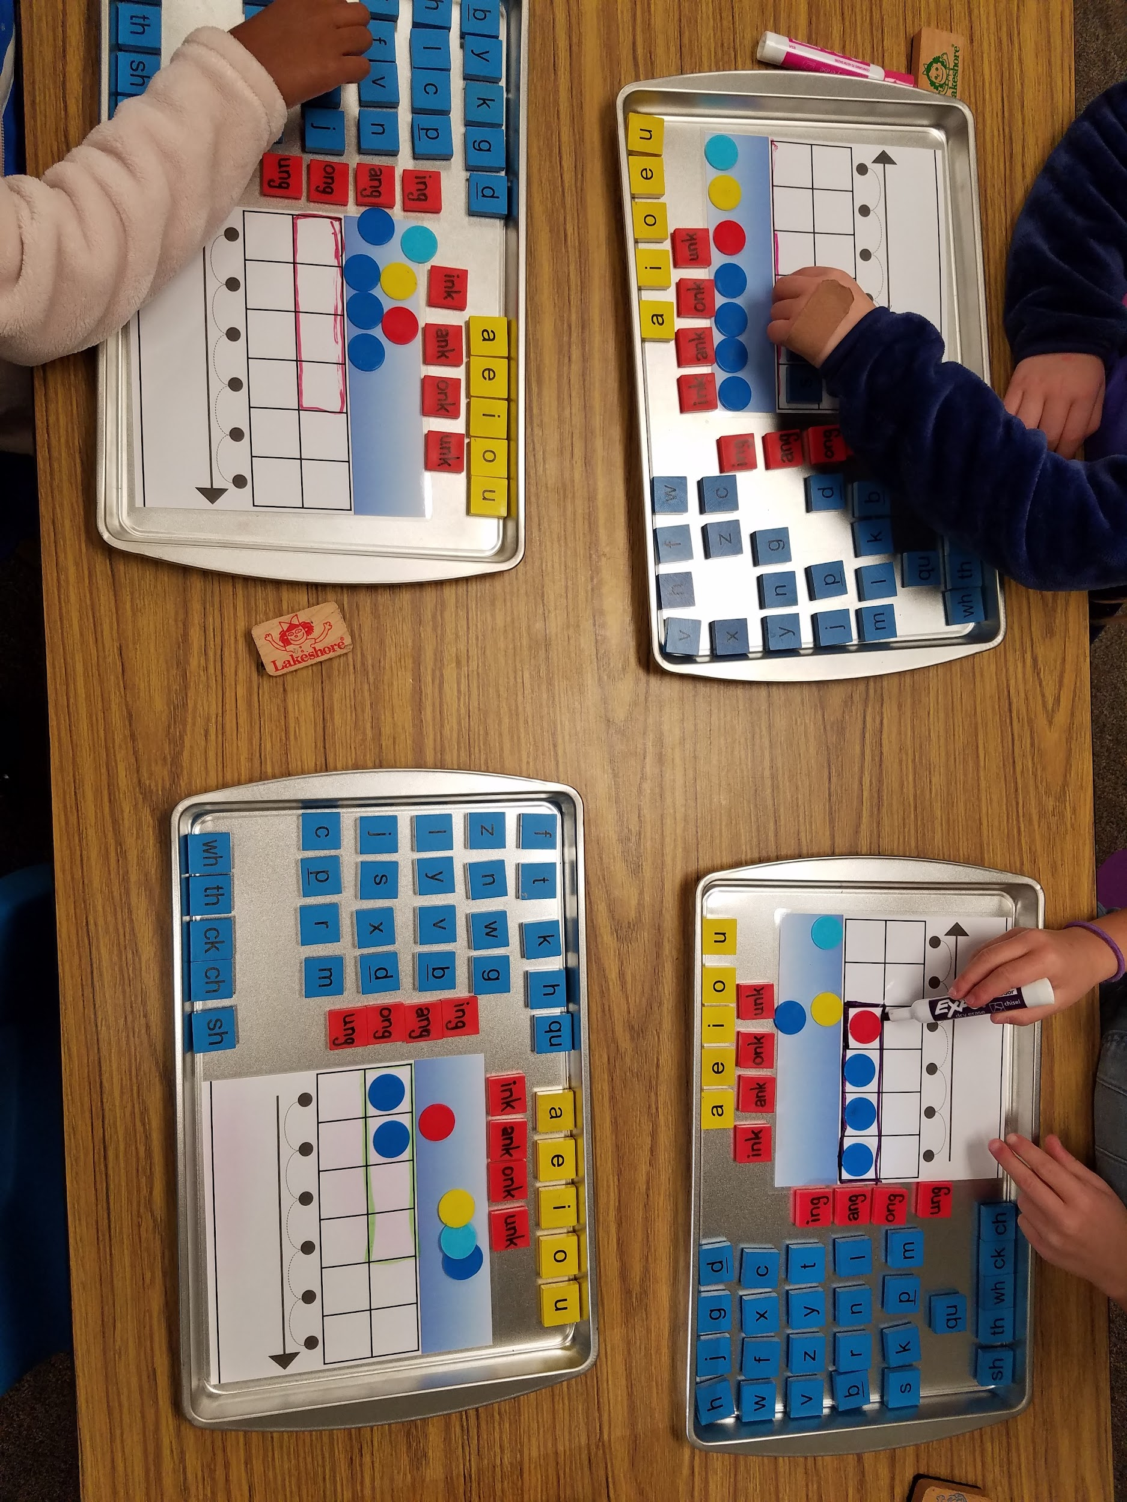
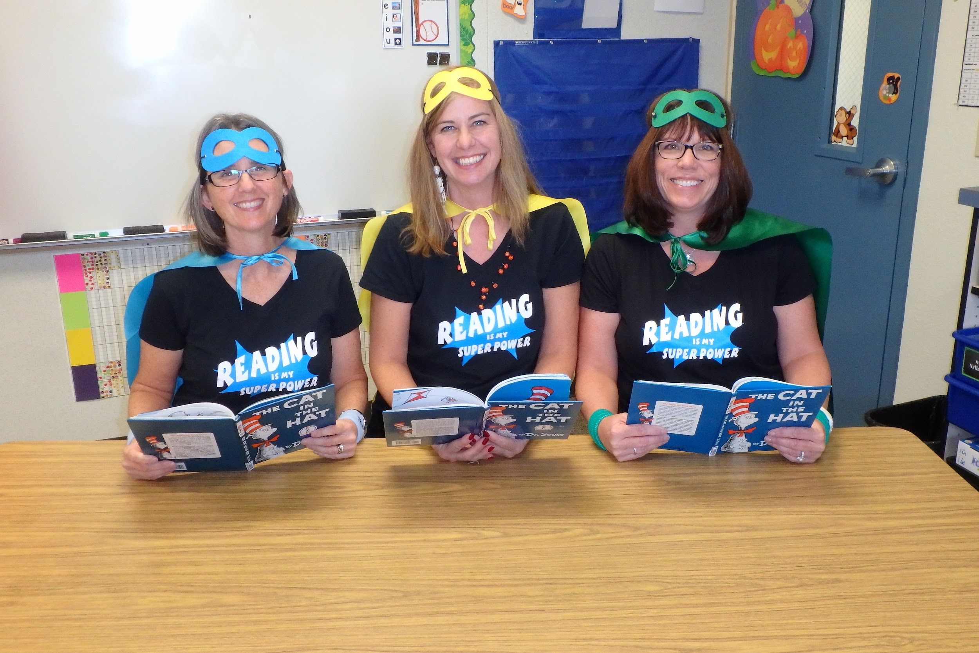
DYSLEXIA
San Ramon Valley Unified School District
October Resolution
Using Letter/Sound Trays
Teaching Reading is a SuperPower!

Slide 2
What is Dyslexia?
Research/Facts
Common Beliefs
Dyslexia is an auditory issue
It is genetic
It varies in intensity
It can impact speaking fluency (processing, storing, accessing)
Can have emotional consequences
Reversals of b/d p/q
Text moves on the page
Reading backwards
Eye or vision issues
Boys more than girls
Need to try harder
Notes:
Dyslexia is a specific learning disability that is neurobiological in origin. It is characterized by difficulties with accurate and/or fluent word recognition and by poor spelling and decoding abilities.These difficulties typically result from a deficit in the phonological component of language that is often unexpected in relation to other cognitive abilities and the provision of effective classroom instruction. Secondary consequences may include problems in reading comprehension and reduced reading experience that can impede growth of vocabulary and background knowledge.

Slide 3
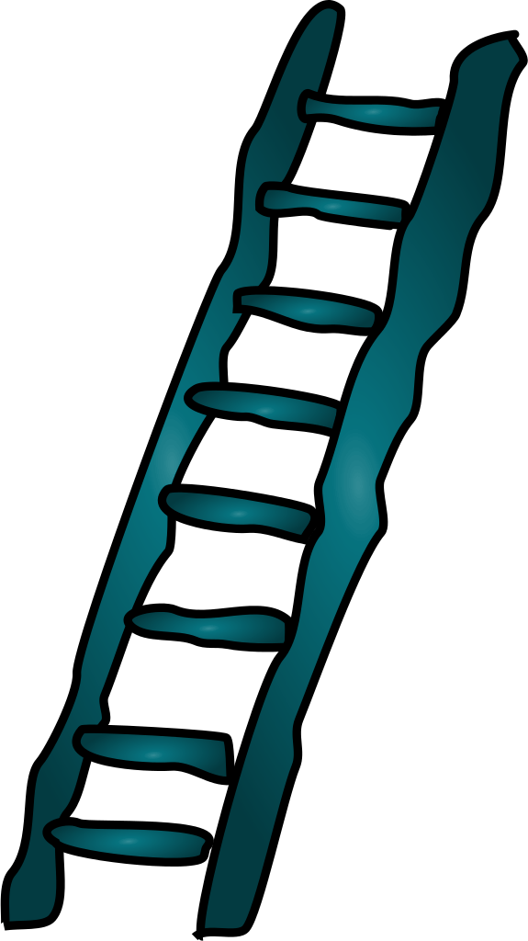
The Ladder of Reading
5%
Learning to read seems effortless
Are advantaged by a structured literacy approach
35%
Learning to read is relatively easy with broad instruction
40 to 50%
Learning to read proficiently requires explicit, systematic instruction.
A structured literacy approach is essential.
10 to 15 %
Dyslexia
Learning to read requires explicit/systematic instruction.
www.nancyyoung.ca
Notes:
According to the State Dyslexia Guidelines, the majority of people with dyslexia have a core deficit in the phonological processing component of language. The structured literacy approach provides students with explicit and systematic instruction that focuses on phonological awareness, phonological memory, and rapid naming skills.

Slide 4
THE MANY STRANDS THAT ARE WOVEN INTO SKILLED READING
Notes:
In order to understand dyslexia, it is important to understand how skilled reading develops. The Reading Rope consists of lower and upper strands. The word-recognition strands (phonological awareness, decoding, and sight recognition of familiar words) work together as the reader becomes accurate, fluent, and increasingly automatic with repetition and practice. Concurrently, the language-comprehension strands (background knowledge, vocabulary, language structures, verbal reasoning, and literacy knowledge) reinforce one another and then weave together with the word-recognition strands to produce a skilled reader.

Slide 5
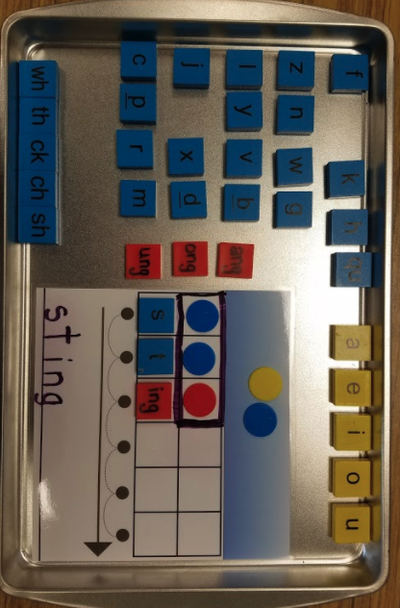
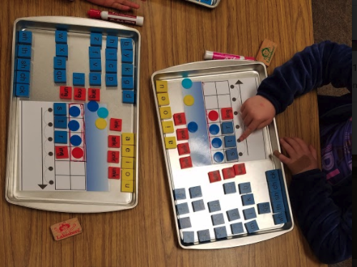
Reading and the Brain
The brain on the left is a child who is engaging in pre-reading activities. Looking at letters or performing a foundational task. The left hemisphere of this child’s brain is processing the information.
The brain on the right represents the brain of a child with Dyslexia. This child is performing the same foundational tasks but the brain is trying to process the information in the right hemisphere.
GREAT NEWS!
THE BRAIN CAN BE REWIRED THROUGH SYSTEMATIC AND EXPLICIT INSTRUCTION!

Slide 6
Structured Literacy Instruction
The Key to Developing Readers K-12
Phonology
Sound/Symbol Association
Syllable Instruction
Morphology
Syntax
Semantics
Systematic and Cumulative Instruction
Explicit Instruction
Diagnostic Teaching
Notes:
Structured Literacy prepares students to decode words in an explicit and systematic manner. This approach not only helps students with dyslexia, but there is substantial evidence that it is effective for all readers

Slide 7
Next Steps?
Structured Literacy Curriculum Pilot
District Literacy Study Team
Education!
Teaching the Why!
The Science of Reading P.L.
Ongoing Structured Literacy
Training
CORE Training and Professional Learning

