Slide 1
EQUITY
San Ramon Valley Unified School District
Tuesday, November 16, 2021

Slide 2
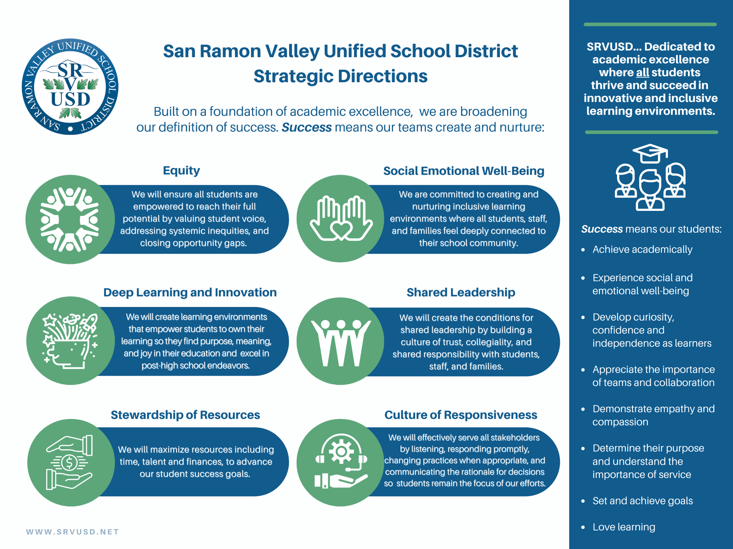

Slide 3
SRVUSD’S SIX STRATEGIC DIRECTIONS
Equity
Culture of Responsiveness
Social Emotional Well-Being
Stewardship of Resources
Deep Learning and Innovation
Shared Leadership

Slide 4
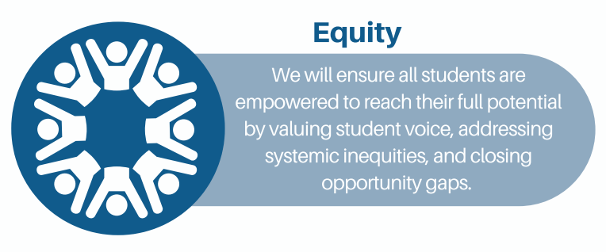

Slide 5
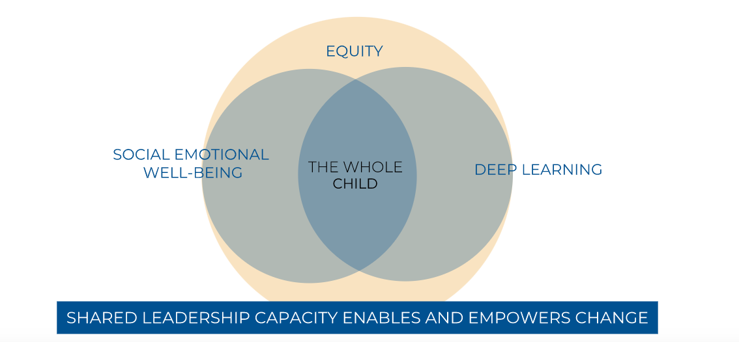
THE INTERSECTION

Slide 6
EQUITY STRATEGIC GOALS
3-5 YEARS
1
Create learning environments that are safe, equitable, and provide a sense of belonging for all students and staff.
3
Develop teaching and learning experiences that are responsive to and supportive of diverse cultures and identities.
2
Create culturally responsive and equity-informed policies, procedures, and practices that lead to equitable outcomes for students.
4
Recruit, hire, and retain a more diverse staff.
Notes:
We are in the process of reviewing policies, procedures and practices.

Slide 7
EQUITY BASELINE DATA
College and Career Readiness
Suspension data
CAASPP/Fastbridge and ESGI (Screener data)
Graduation rates
Staff demographic data
Notes:
We are exploring other qualitative ways to understand where we are and where we are going.

Slide 8
EQUITY DRIVERS
Every child needs the opportunities to succeed in education
The FAIR Education Act and the California Common Core State Standards demand that students see themselves in the curriculum and that the curriculum resources are reflective of the diversity of the community
Adopted resources
Supplemental resources
Empower every student to reach their full potential by valuing student voice
Foster awareness around culturally responsive learning environments
Promote inclusive practices for all students
Students will see themselves reflected in staff who educate and support them
Notes:
We create the conditions - the conditions are not always present.

Slide 9
KEY ACTIONS
Engage administrators in implicit bias professional development
Support the effective implementation of Gender Support Plan
Nurture inclusive learning environments
Build capacity in staff to lead restorative justice work
Diversify District staffing
Review District policies, procedures, and practices
Notes:
Overview of actions - get into more specific detail on the next slides.
Actions are clear - connect it back to strategic directions.
Connect implicit bias training to the work that we do.

Slide 10
IMPLICIT BIAS PROFESSIONAL DEVELOPMENT
All administrators will understand their own implicit bias in their position
Three cycles of professional development learning series for all administrators
Anti-Racist Facilitator Training
Courageous Conversations
District and site-based professional development
Trainings will inform our own implicit bias in the classroom and hiring practices
Notes:
Leadership training but supporting school sites to choose its goal - and implement strategies based on their context
Extended Cabinet - linking implicit bias training to practices - tie into site base goals

Slide 11
GENDER SUPPORT PLAN
Gender Support Plan training for administrators, social workers, counselors, psychologists, registrars, office managers, and site designees
Updating Student Name and/or Gender Change process
District Website

Slide 12
INCLUSIVE LEARNING ENVIRONMENTS
Increasing opportunities and access for all students
Gender inclusivity and support of Gay-Straight Alliance (GSA)/Prism Clubs
Student and staff affinity/focus groups
Analysis of health curriculum
Notes:
Special Education
Black
Socioeconomic status

Slide 13
RESTORATIVE JUSTICE
Responding to Discrimination and Hate Handbook training
Implementing restorative justice/practices in schools to reduce suspension rates, improve student behaviors, and repair harm
Deepen the work on restorative justice at our school sites
Student forums and seminars
Professional learning and partnerships
MEB Consulting
AASA Equity in Action Cohort
SEEDS
San Ramon Valley Diversity Coalition
Discovery Counseling Center
PFLAG
Notes:
Leaders,

Slide 14
DIVERSIFY DISTRICT STAFFING
Expand staff recruitment strategies and plans
Examine existing staff selection processes for bias
Revise and standardize staff selection processes to reduce/eliminate bias
Implement strategies to attract, recruit and select more diverse leaders
Notes:
KEITH

Slide 15
DISTRICT POLICIES, PROCEDURES, AND PRACTICES
Review Board Policies and Administrative Regulations
Examine current practices (i.e. math pathways)
Refine Responding to Discrimination and Hate Handbook and Gender Support Plan procedures
Notes:
KEITH

Slide 16
EXISTING WORK AND EQUITY
Informs
Implicit Bias
Gender Support Plan
Inclusive Learning Environments
Restorative Justice
Diversify District Staffing
District Policies, Procedures, Practices
Equity
Enhances

Slide 17
INTENDED OUTCOMES
2021-2022 SCHOOL YEAR
Increase self-awareness and understanding of bias
Embracing more systemic interventions
Improve learning outcomes for underrepresented students
Foster a sense of belonging and community for all students
Increase capacity at focus schools in restorative justice

Slide 18
INTENDED OUTCOMES CONTINUED
2021-2022 SCHOOL YEAR
Increase hiring of Black, Indigenous and People of Color (BIPOC) staff; Expand strategies to attract, recruit, develop & retain BIPOC leaders
Establish BIPOC staff and student forum opportunities
Decrease in suspensions
Increase in engagement per California Healthy Kids Survey
Decrease in discrimination and hate incidents

Slide 19
NEXT STEPS
Implement strategies outlined in this presentation
Continue to regularly monitor progress toward goals
Adjust strategies based on data
Continue to update the Board as we progress

