Slide 1

Hispanic Heritage Month
September 15 - October 15, 2021

Slide 2
“We need to help students and parents cherish and preserve the ethnic and cultural diversity that nourishes and strengthens this community - and this nation.”
-César Chávez

Slide 3
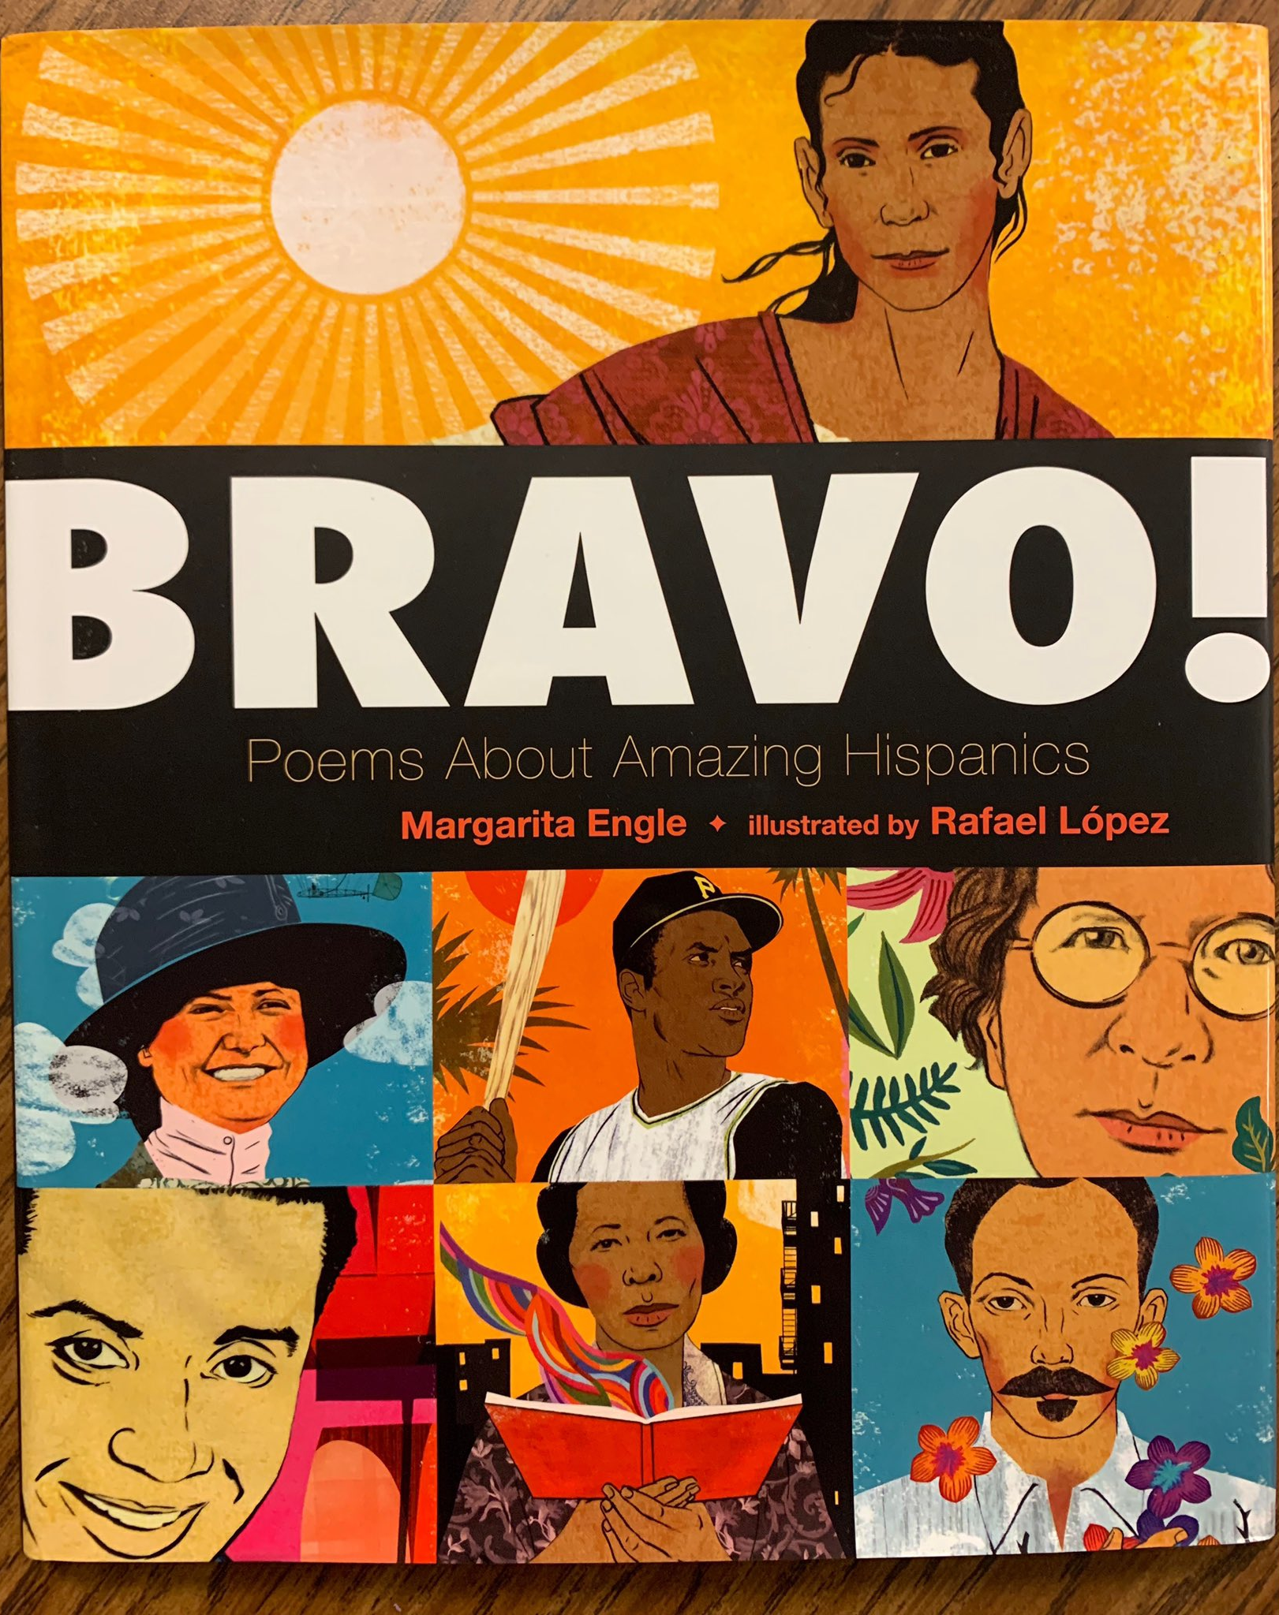
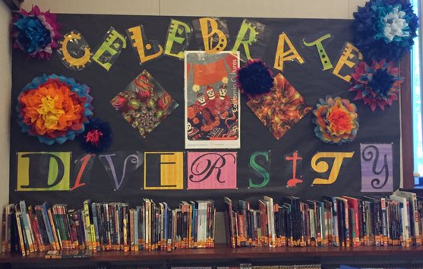
Hispanic Heritage Month celebrates the histories, cultures, and contributions of American citizens whose ancestors came from Spain, Mexico, the Caribbean, and Central and South America.
Notes:
Each year, Americans observe National Hispanic Heritage Month from September 15 to October 15. Hispanic Heritage Month celebrates the histories, cultures, and contributions of American citizens whose ancestors came from Spain, Mexico, the Caribbean, and Central and South America.
The Hispanic Heritage observance began in 1968 as Hispanic Heritage Week under President Lyndon Johnson and was expanded by President Ronald Reagan in 1988 to cover a 30-day period. It was enacted into law on August 17, 1988, on the approval of Public Law 100-402.

Slide 4
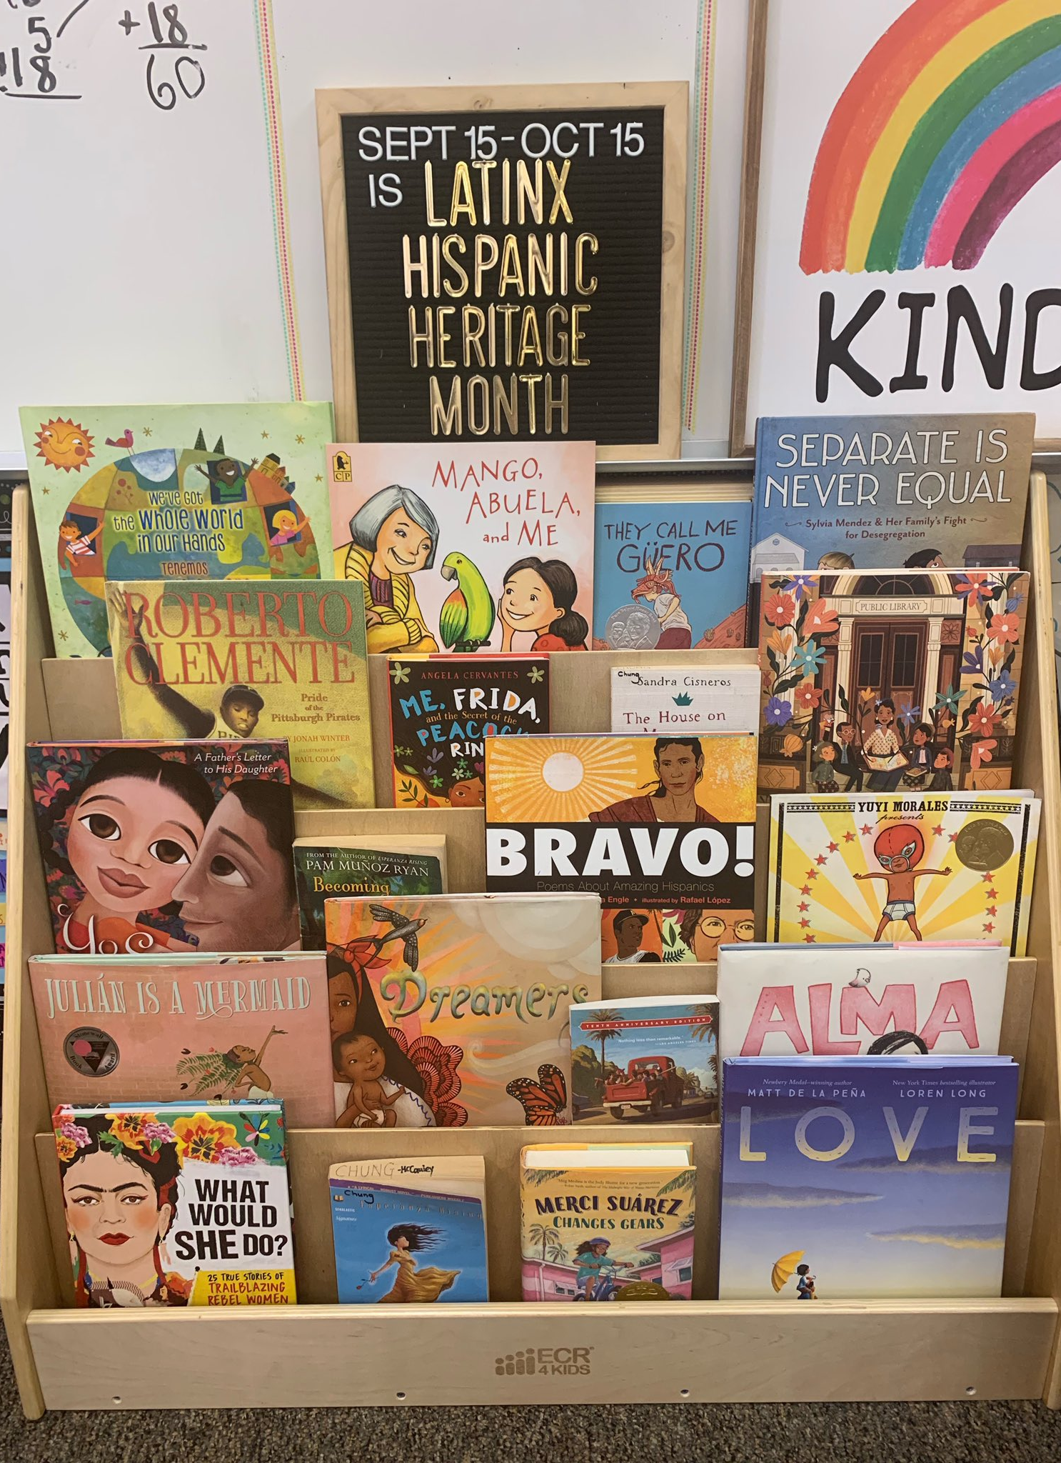
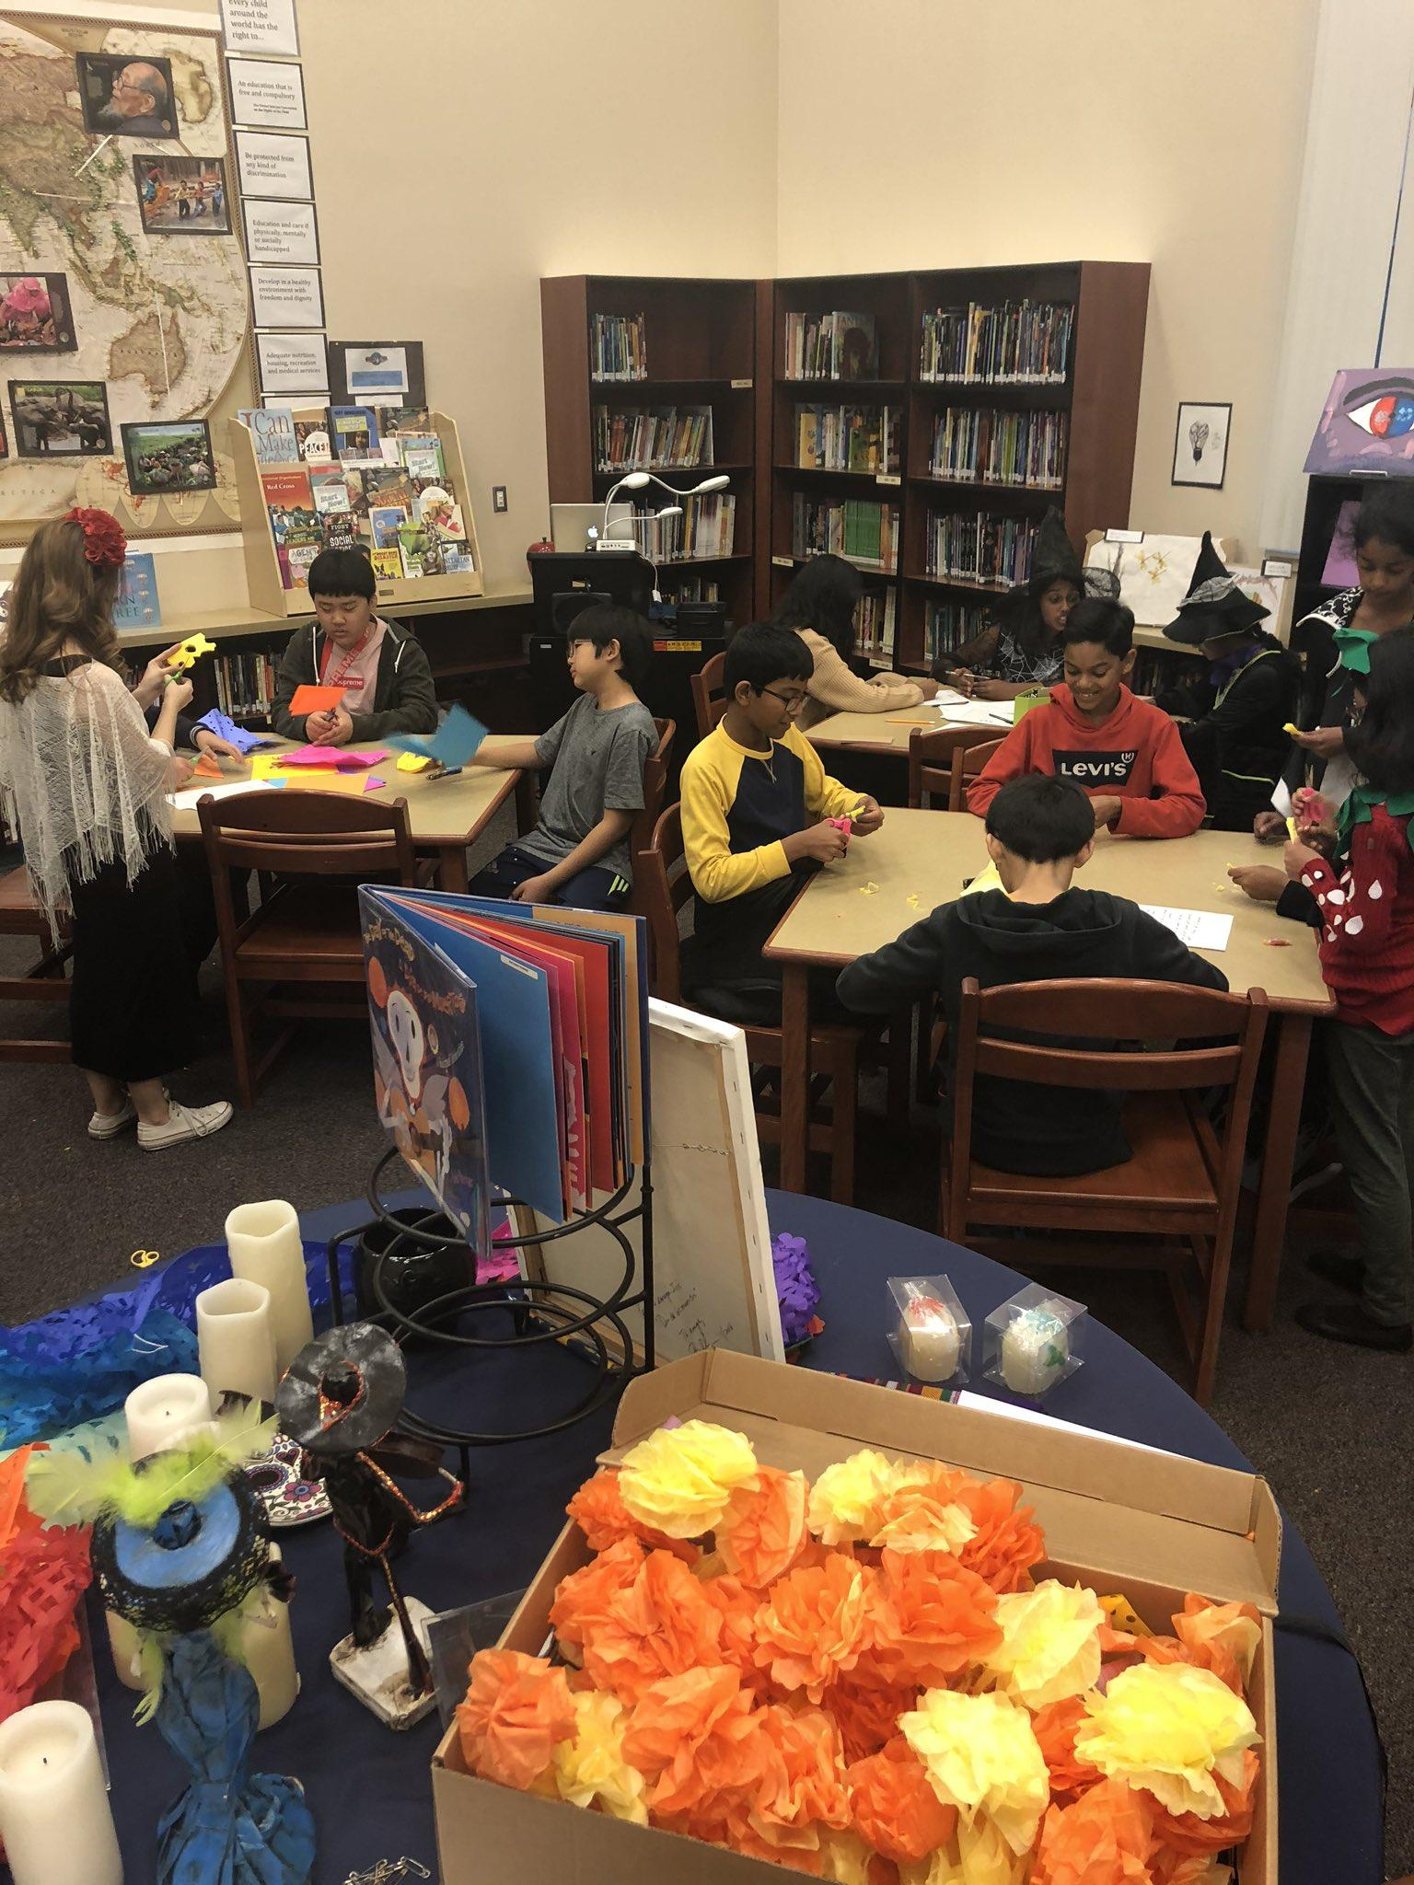
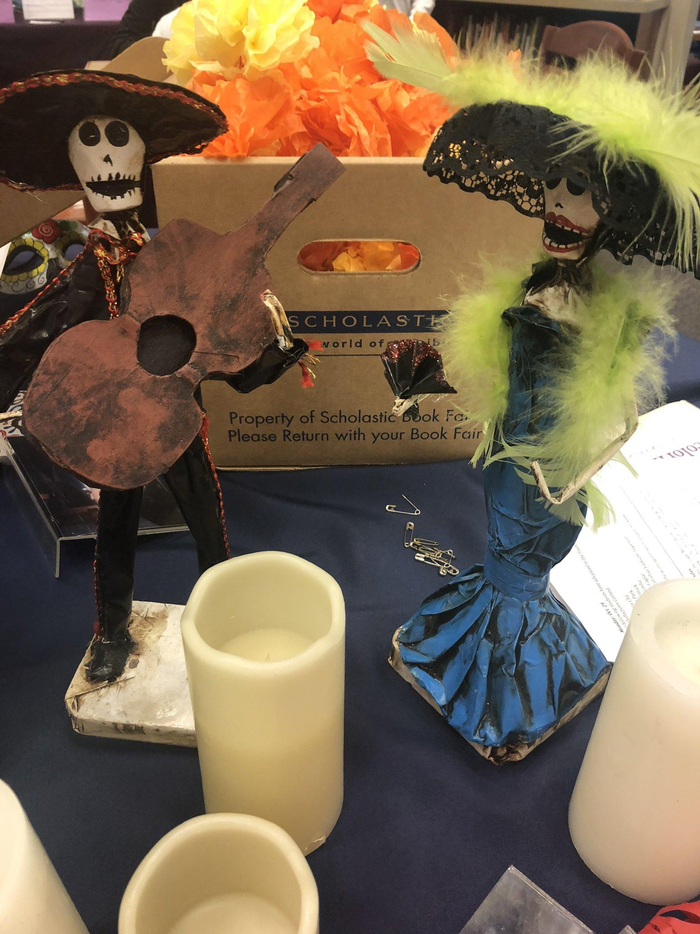
Notes:
School sites are encouraged to honor this month and make their school community aware of Hispanic Heritage Month by discussing in communications from the school
Our site librarians are encouraged to highlight books that teach students the rich heritage of Hispanic Americans and their contributions
Classroom staff are encouraged to engage in reviewing, selecting, and implementing a variety of the curricular activities
School sites partners with their parent organizations on unique ways to bring Hispanic Heritage Month to life for their students
There is researching and selecting Hispanic Heritage resources from various vantage points
Materials and links are provided to staff to access K-12 cross content curricular resources and special media presentations
Resources such as multi-media, book lists, discussion articles, art, writing, and online activities are utilized so all learning styles are taken into account for lesson planning and implementation

Slide 5
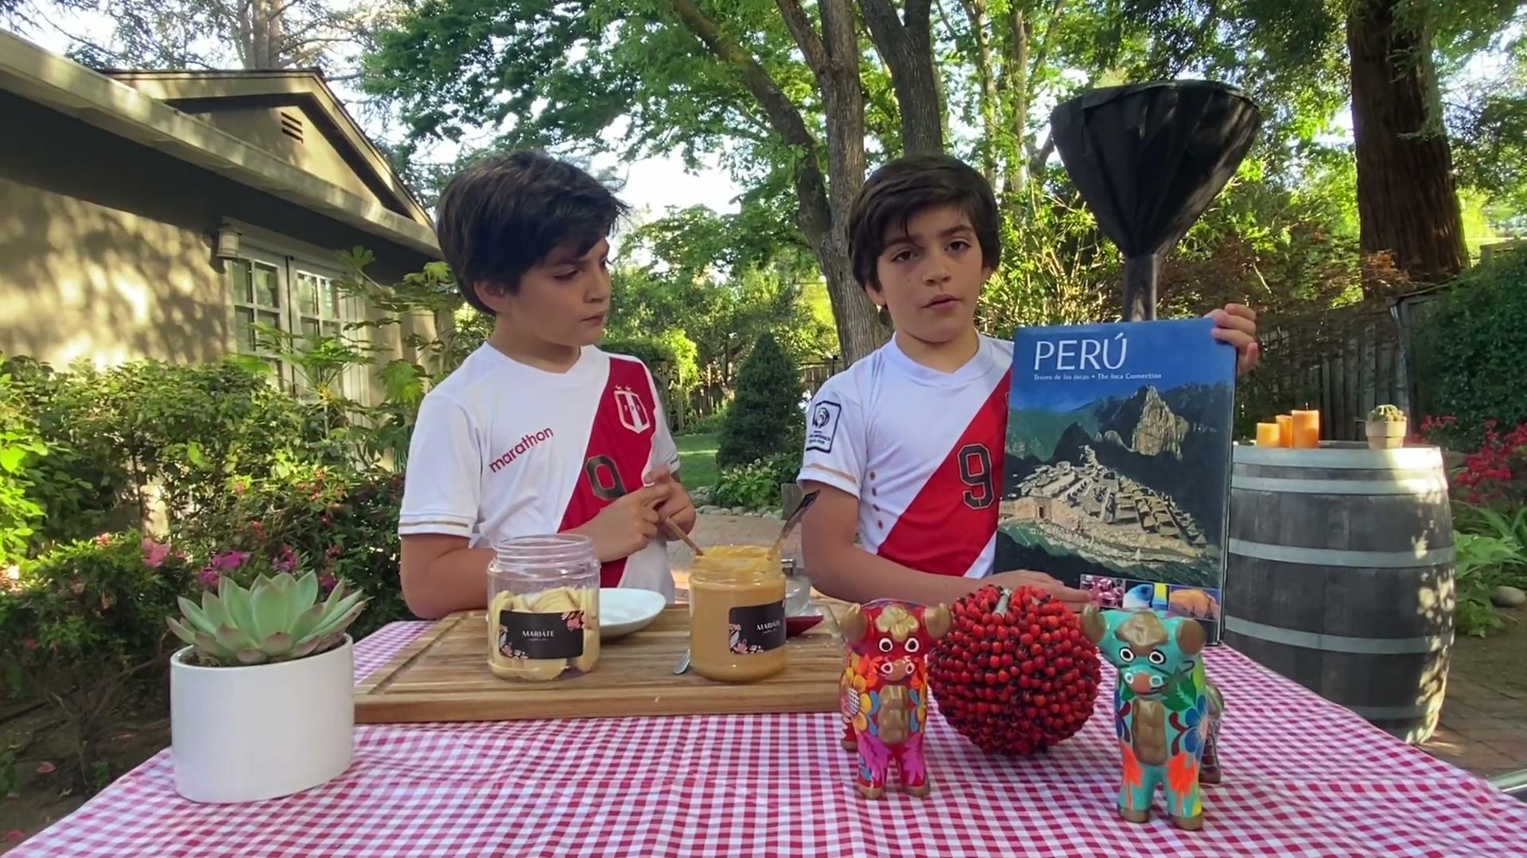
Learn about Peru from Gabriel and Sebastian
Alfajores (Peruvian Style Cookies)
Notes:
Gabriel and Sebastian, Rancho Romero (5th Graders)
Peru
Alfajores (Peruvian Style) - Cookies
Parent gave consent to show the video.

