Slide 1
Storyline Summary
Slides 2-6 | Establish the vision for our MTSS Framework and how it relates to our Strategic Directions, especially attending to our three instructional directions.
Slides 7-9 | Review our assessment journey: we have engaged in a screener as a part of our intervention framework and also as a replacement for CAASPP in the spring of 2021. Here is our reading, math, and ELPAC data that illustrates how our students performed in the 2020-21 school year.
Slides 10-12 | Distinguish the purpose of a screener from that of our mandated state tests and share our most recent screening results that indicate a need to support students with intervention in addition to our banded time for extra student support within the school day.
Slides 13-16 | Highlight the Before/After School Intervention program (BASI) and how it is serving our students’ needs and addressing learning loss using research-based instructional practices, tools, and progress monitoring.

Slide 2
Mid-Year LCAP Annual Update
February 22, 2022
Jon Campopiano | Sarah Acosta Landry
Executive Director, Secondary Education | Coordinator, Research, Evaluation, & Student Support
Notes:
Jon
Title Ideas:
Measuring Student Growth
Supporting All Students with a Multi-tiered System of Support

Slide 3
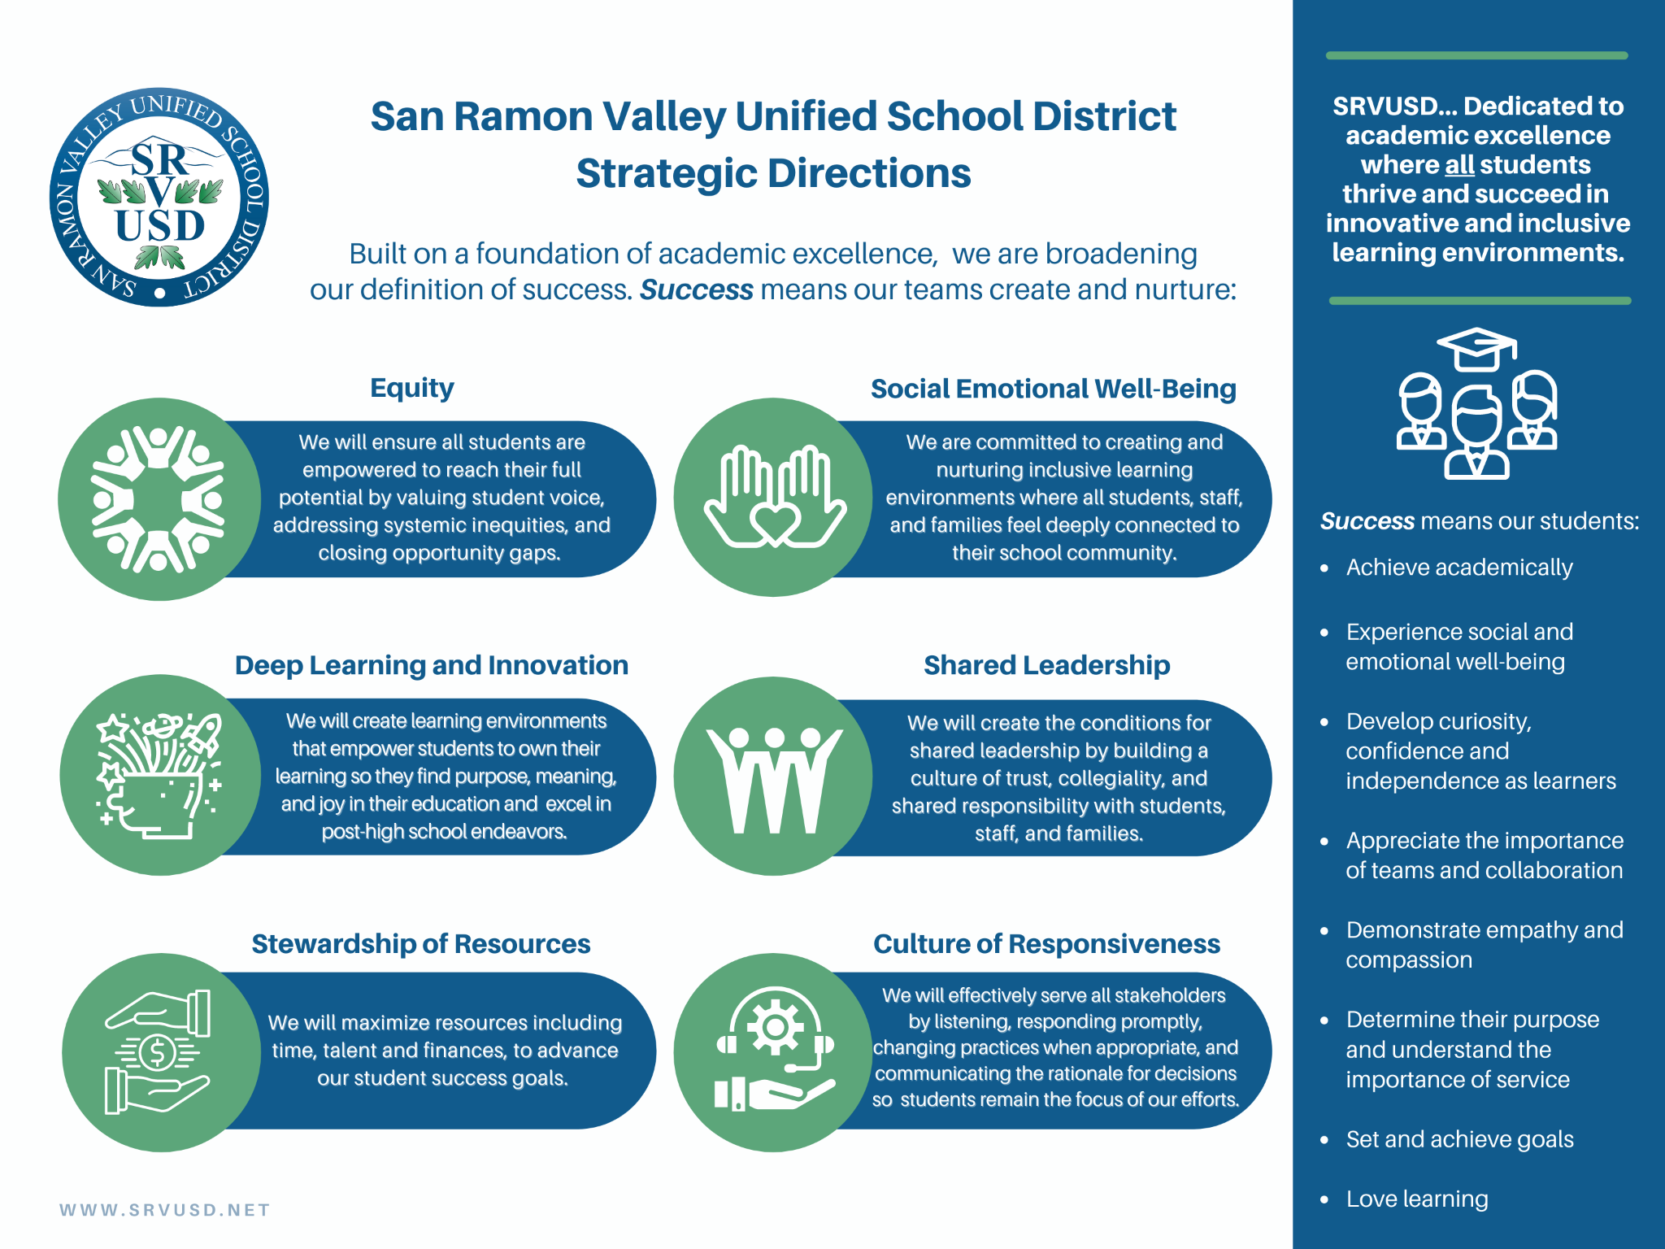
Notes:
Jon
We have received federal and state funding to help implement our SD’s; because we have a strategic strategy, we are able to quickly determine how our funds should be used to support…

Slide 4
Notes:
Jon

Slide 5
Background
Section 124(e) of Assembly Bill 130 requires LEAs to present an update on the annual update to the 2021–22 LCAP and budget overview for parents on or before February 28, 2022, at a regularly scheduled meeting of the governing board or body of the LEA.
Notes:
Jon

Slide 6
Impact to the Budget Overview for Parents
When SRVUSD approved the LCAP and Budget for 2021-22 on June 15, 2021, the state budget was not complete. The adopted state budget included additional funds for our district. The impact to our adopted Budget Overview for Parents is as follows:
Item | Projected Budget (Adopted in BOP) | Actual Amount per State Budget | Difference
Total LCFF Funds | $287,991,481 | $288,046,214 | $54,733
LCFF Supplemental & Concentration Grants | $5,099,625 | $5,139,258 | $39,633
All Other State Funds | $46,113,360 | $60,309,010 | $14,195,650
All Local Funds | $24,249,971 | $26,076,431 | $1,826,460
All Federal Funds | $6,849,930 | $21,898,664 | $15,048,734
Total Projected Revenue | $365,204,742 | $396,330,319 | $31,125,577
Total Budgeted General Fund Expenditures | $369,977,546 | $409,634,167 | $39,656,621
Notes:
Jon or Danny present- Danny completing

Slide 7
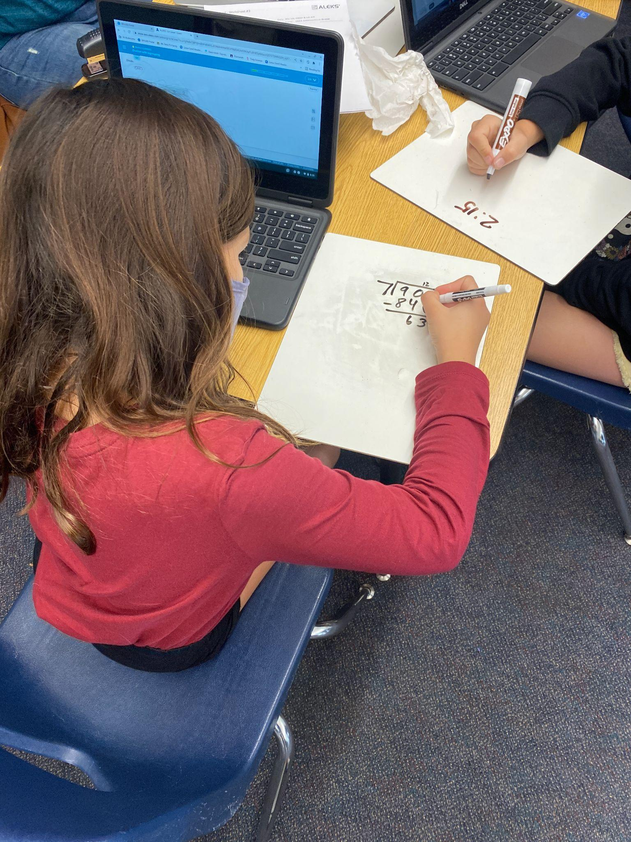
Before & After School Intervention Program
In a Multi-Tiered System of Support (MTSS)
Notes:
Jon transitioning to Sarah

Slide 8
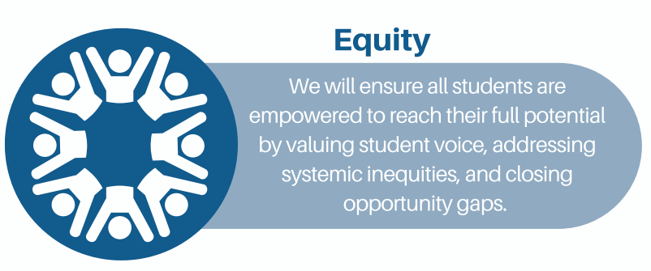
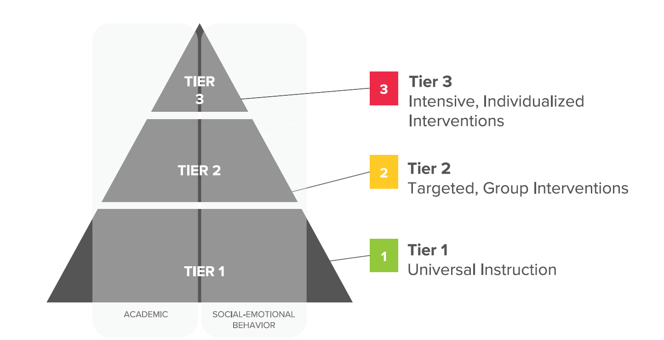
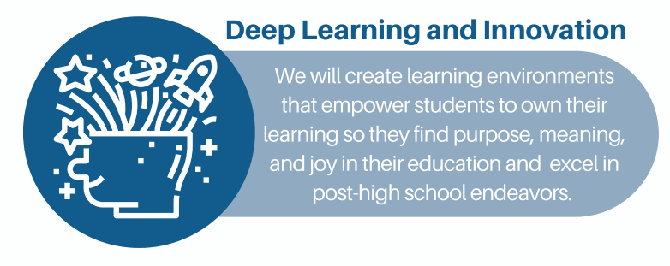
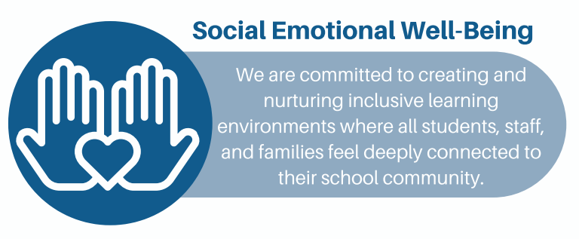
How does our MTSS connect to our Strategic Directions?
Before/After School Intervention Program (BASI)

Slide 9
Assessment Journey
2014
Spring
2020
Fall
2020
Spring
2021
Summer
2021
Fall
2021
Winter
2021
2022-23
CAASPP state testing paused
Begin of universal screener 3x/year in support of intervention
Screener administered in lieu of CAASPP based on CDE & Board Guidance
Student results reported to families in lieu of CAASPP data
Start of Year 2 of screener administration
Report on Spring 2021 data to board
Launch of Before/After School Intervention Program (BASI) in response to data
CAASPP: California Assessment of Student Performance
Notes:
Sarah- Here is SRVUSD assessment journey and the connection to the CDE spring testing 2021 guidance

Slide 10
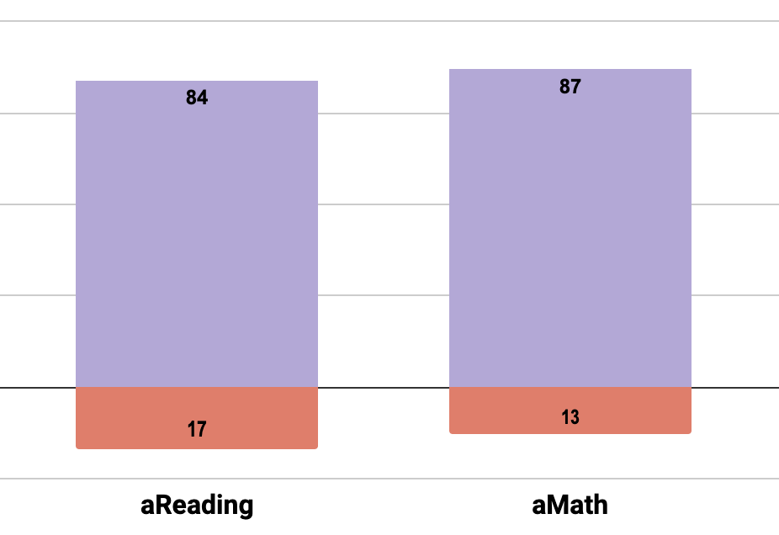
Spring 2021 Fastbridge Data
in lieu of 20-21 CAASPP per CDE guidance
Grades 2-11
Majority of students are on track
Must still work to address needs of those at-risk
On-Track
At-Risk
Notes:
Sarah - Similar to the board report in November 2019, where we reported the results of the 18-19 CAASPP, our Fastbridge data shows that most of our students are on track to master grade level standards AND we still have work to do.

Slide 11
Spring 2021 ELPAC Data
 | 18-19 | 20-21 | change
ELPAC RESULTS
# of Students Tested with Scores | 1,198 | 1,165
Level 4 - Well Developed | 36.14% | 44.60% | 8.46%
Level 3 - Moderately Developed | 40.15% | 33.73% | -6.42%
Level 2 - Somewhat Developed | 15.11% | 13.39% | -1.72%
Level 1 - Minimally Developed | 8.60% | 8.41% | -0.19%
All English learner (EL) students must take summative ELPAC in the spring
510 students scored level 4 and are eligible for RFEP (Reclassified Fluent English Proficient )
ELPAC: English Language Proficiency Assessments for California
Notes:
This data helps us inform the need to have liaisons as outlined in Jon’s summary of LCAP goal 1 Deep learning. We know we needed to do something more; and we asked for MTSS liaisons to add the extra support we need to support our EL students as well as all students who need more support.

Slide 12
Screener
State Testing
Fastbridge
CAASPP
ELPAC
formative
summative
3x/year
identifies students in need of extra support
1x/year
measures student performance at the end of the year
Notes:
Sarah -Distinguish difference between a screener and state testing; how one is formative and used to affect instructional practice and increase student achievement while the other is a summative measurement that grades how well we are doing at the end of the year.

Slide 13
Screening in an MTSS Framework
3
Intensive Intervention - 5% of students
Before/After School Intervention Program (BASI)
2
Targeted Intervention - 15% of students
1
Universal Instruction - 80% of students
Universal Screening = Foundation for ALL
Notes:
And here, we see how assessment data plays a role in an MTSS pyramid- Screening is a key element of an MTSS framework. It is used to identify students early who are in need of extra academic and SEWB intervention. We have both Academic Screeners + SEWB screeners – I’ll reference this pyramid when we look at our data later

Slide 14
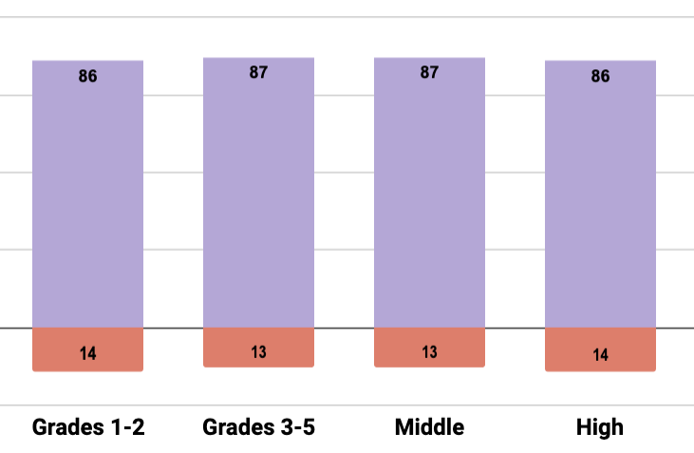
Winter Screener Data - Math
Surpassing MTSS benchmarks
Some students are still at-risk
On-Track
At-Risk
Notes:
Sarah - Data shows: Students are meeting benchmarks, doing well. And we also have a need for intervention based on learning loss - this data to be sure we are supporting ALL kids’ needs. This is the work of equity – meeting each student’s individual needs based on their current circumstances.

Slide 15
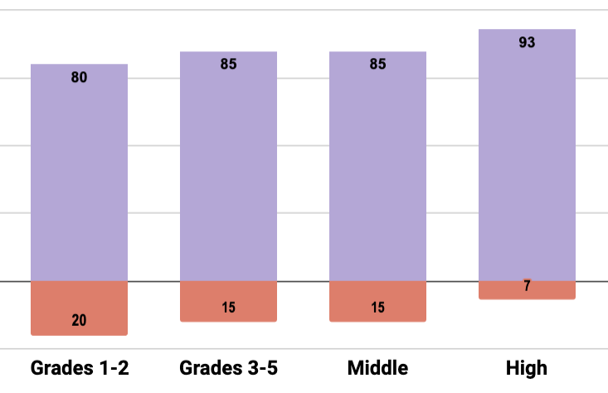
Winter Screener Data - Reading
Meeting or surpassing MTSS benchmarks
Reading skills were affected by learning environment during the pandemic
Students in lower grades experienced greater learning loss compared to their peers
On-Track
At-Risk
Notes:
Sarah- Greatest needs appear to be in reading skills overall and especially in early reading in younger grades.

Slide 16
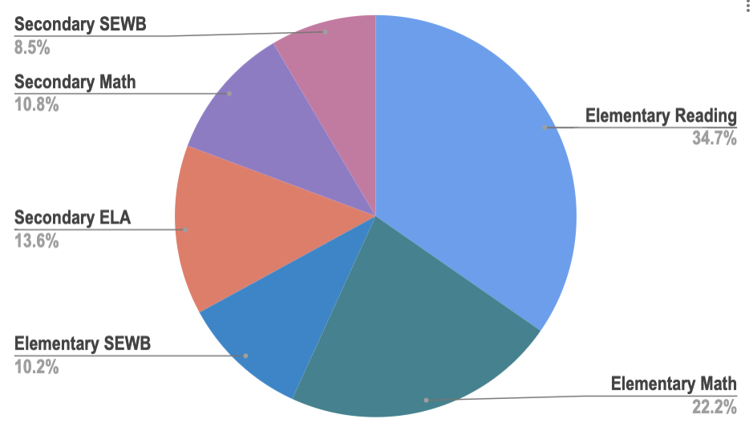
Before/After School Intervention
Program Details
176
8%
Before or After School Sessions
11%
35%
700+
14%
Students Being Served
10%
SEWB: Social-Emotional Well-Being
22%

Slide 17
Evidence-based Intervention Sessions
Before/After School Intervention Program Parameters
Focus on reading, math, SEWB (Social-Emotional Well-Being)
Intervention is targeted to student’s specific need
Small groups
High quality curriculum
Training for interventionist
Progress monitoring
Incentives
Notes:
Sarah - hard question: what

Slide 18
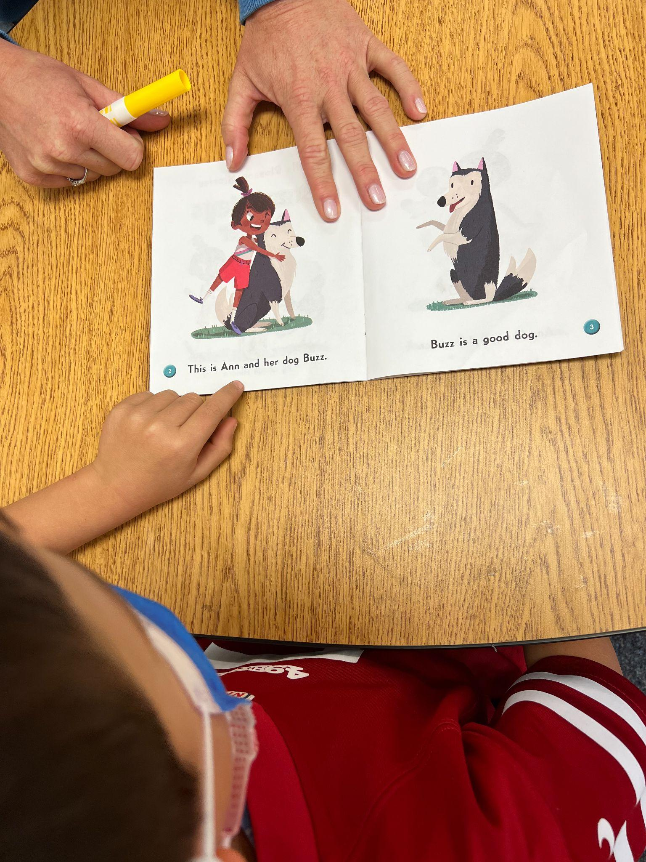
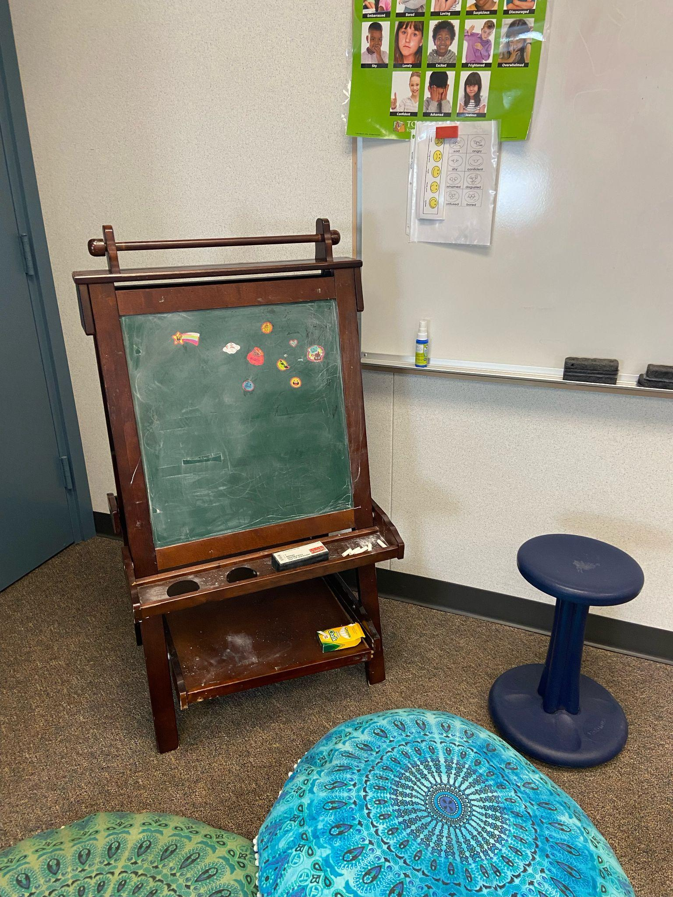
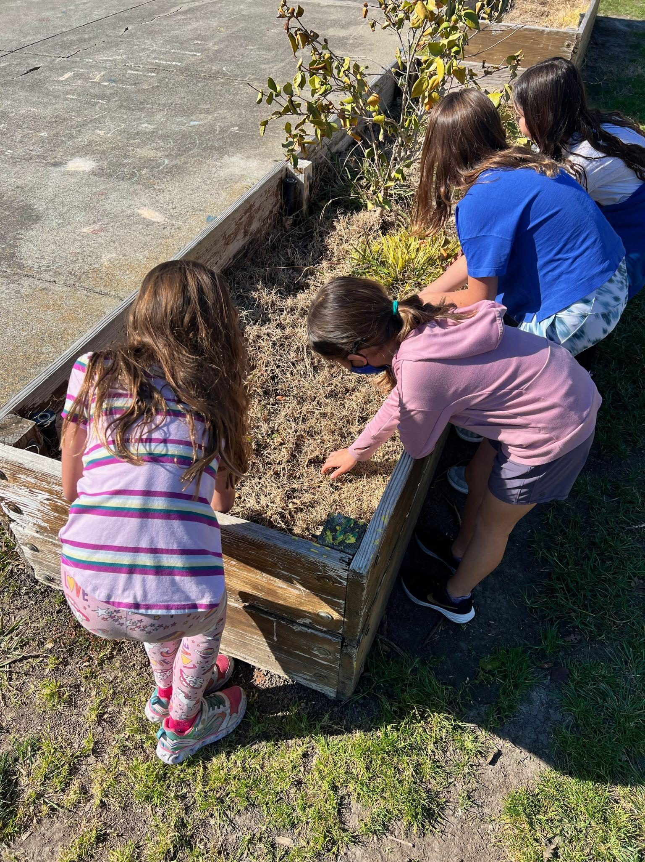
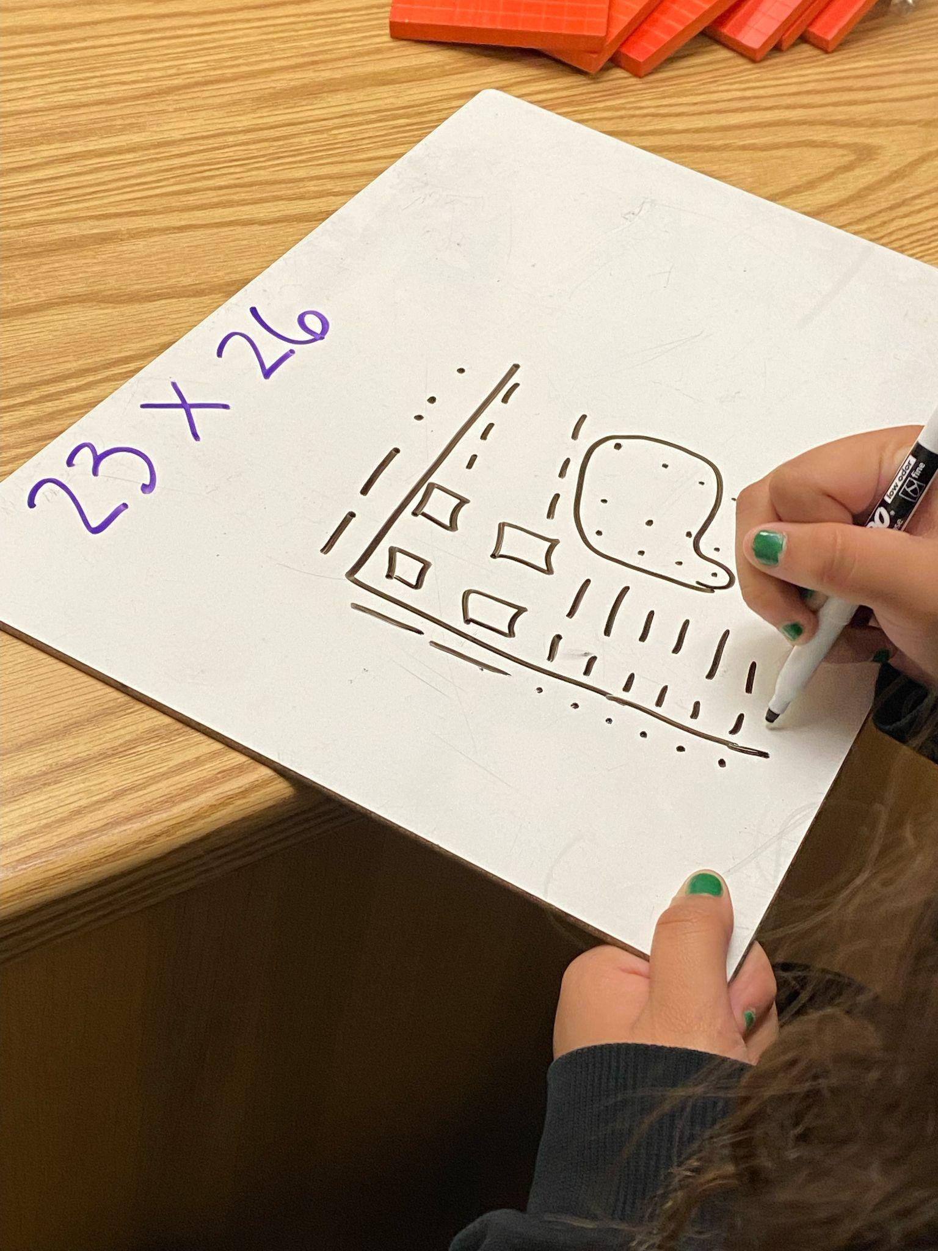
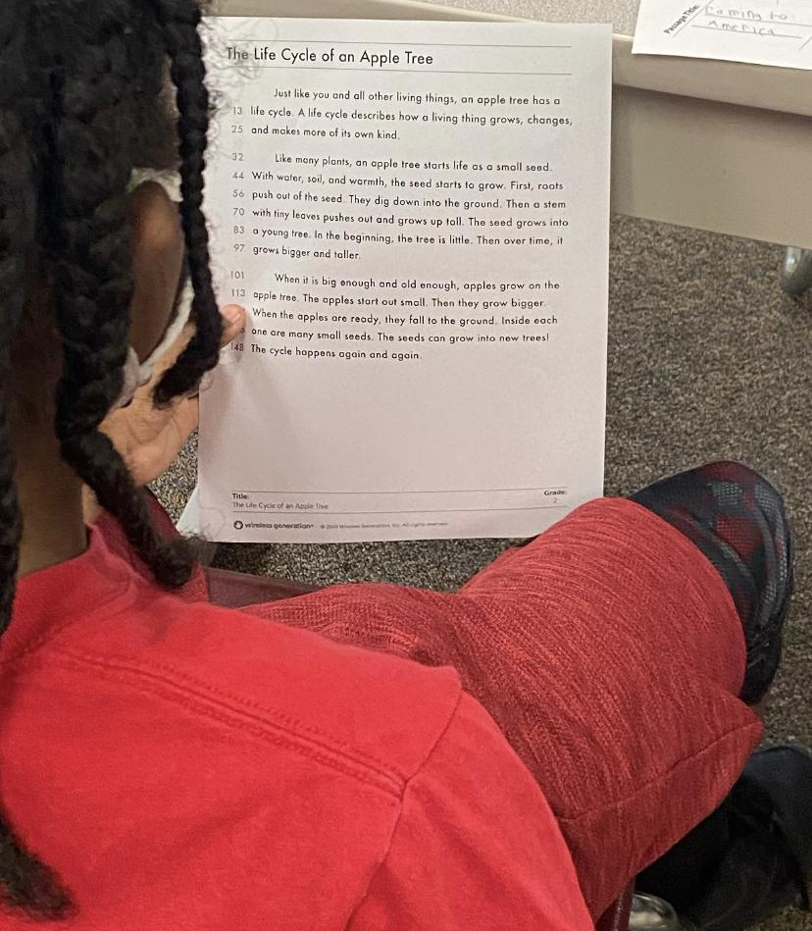
Academic Sessions
1-4 students
3x/week
up to 12 weeks
exit when proficient
SEWB Sessions
1-10 students
1-3x/week
up to 12 weeks
exit when proficient

Slide 19
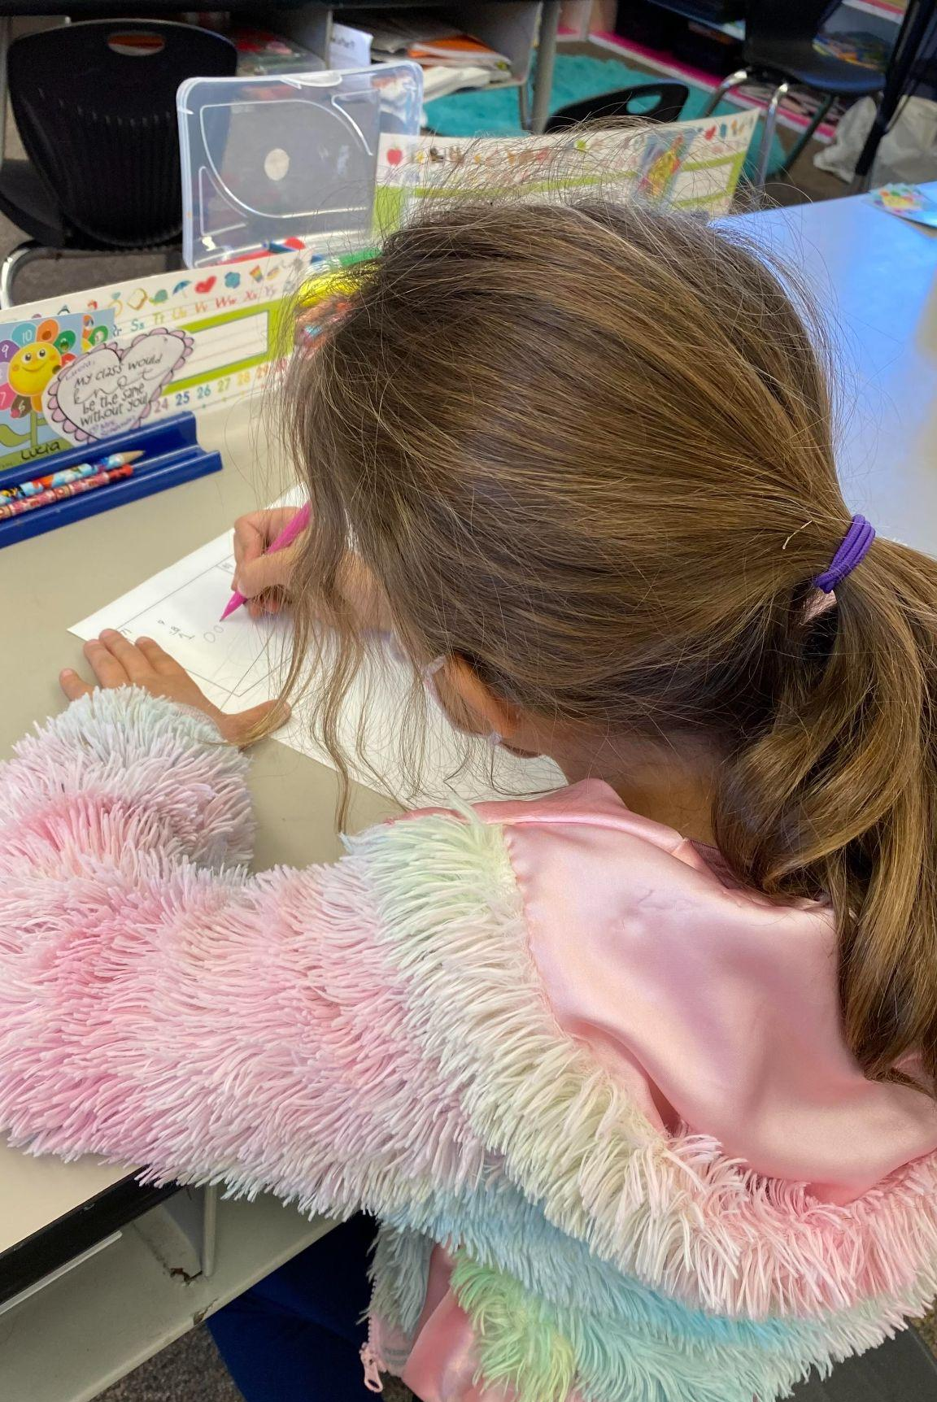
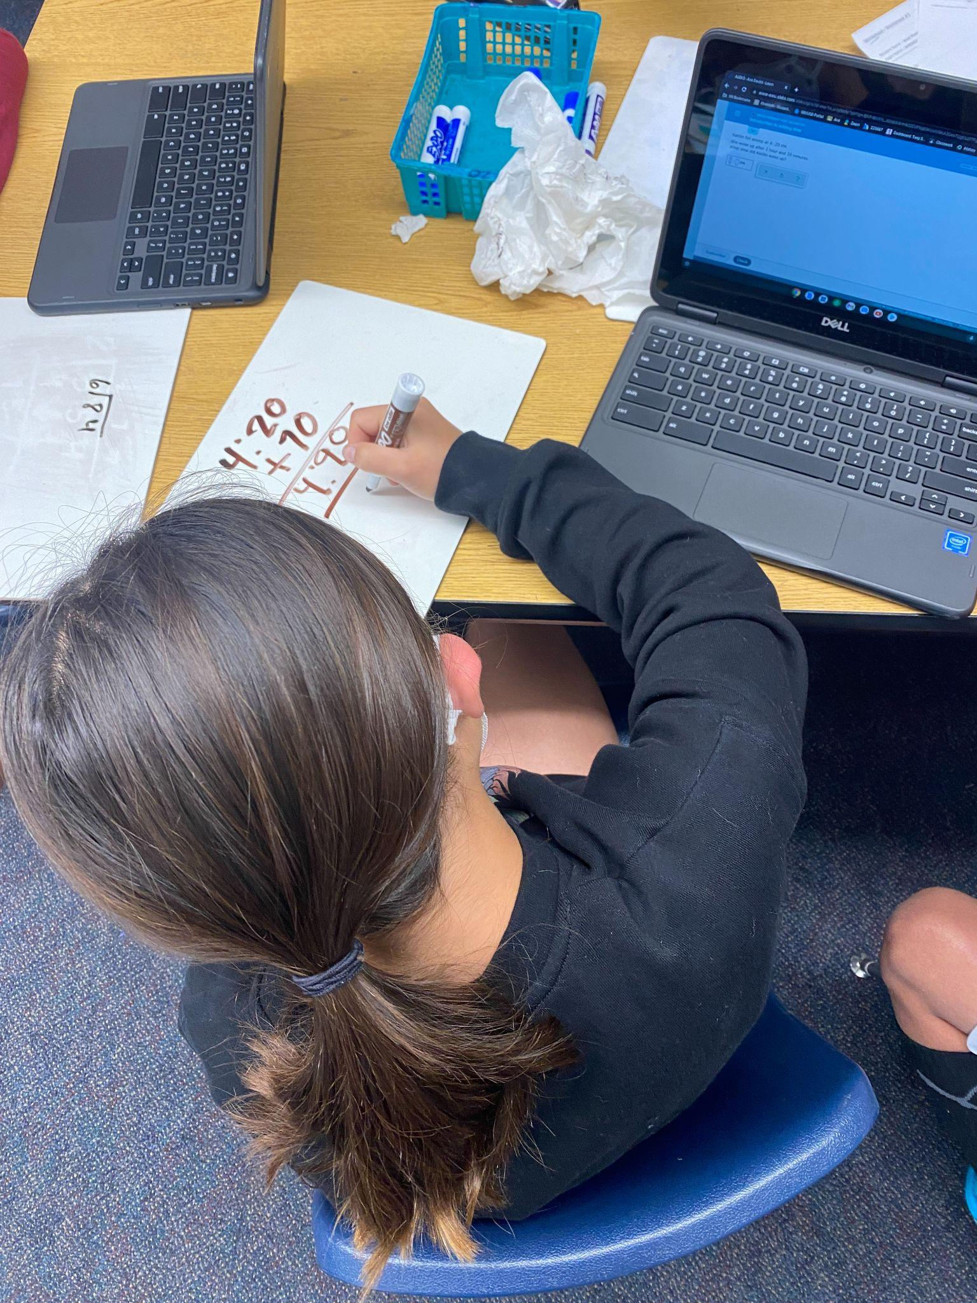
Thank you
Students learning in two of our before school intervention sessions
Credits: This presentation template was created with Slidesgo including icons by Flaticon, and infographics and images by Freepik.

