Slide 1
UNDERSTANDING THREE NEW STATE REQUIREMENTS:
TRANSITIONAL KINDERGARTEN EXPANSION
UNIVERSAL PRE KINDERGARTEN (UPK)
EXPANDED LEARNING OPPORTUNITIES PROGRAM (ELO-P)
May 17, 2022

Slide 2
UNDERSTANDING THE 3 NEW REQUIREMENTS
TK
The 2021 Budget Act created 3 new statutory requirements for UPK programs.
These new requirements intersect, but are distinct and separate.
Expansion
ELO-P
UPK
Plan

Slide 3
OVERVIEW: TK EXPANSION
TK
Purpose: Expand TK eligibility over a 3 year period with all 4 year old children becoming eligible for TK by 2025-26
Notes:
May not need these three slides

Slide 4
OVERVIEW: UPK
UPK
Purpose: District must create a plan that will offer all eligible children a full day of learning.

Slide 5
OVERVIEW: ELOP
E-LOP
Purpose: To provide enrichment opportunities for all unduplicated students in Transitional Kindergarten (TK) - 6th Grade.
Any student can enroll, and unduplicated students will be provided these additional hours of care at no cost.
Focus on the academic, social emotional, and physical needs and interests of our students.

Slide 6
Who is Right at School?
Our Mission:
To inspire a love of learning, support schools, and give parents peace of mind.

Slide 7
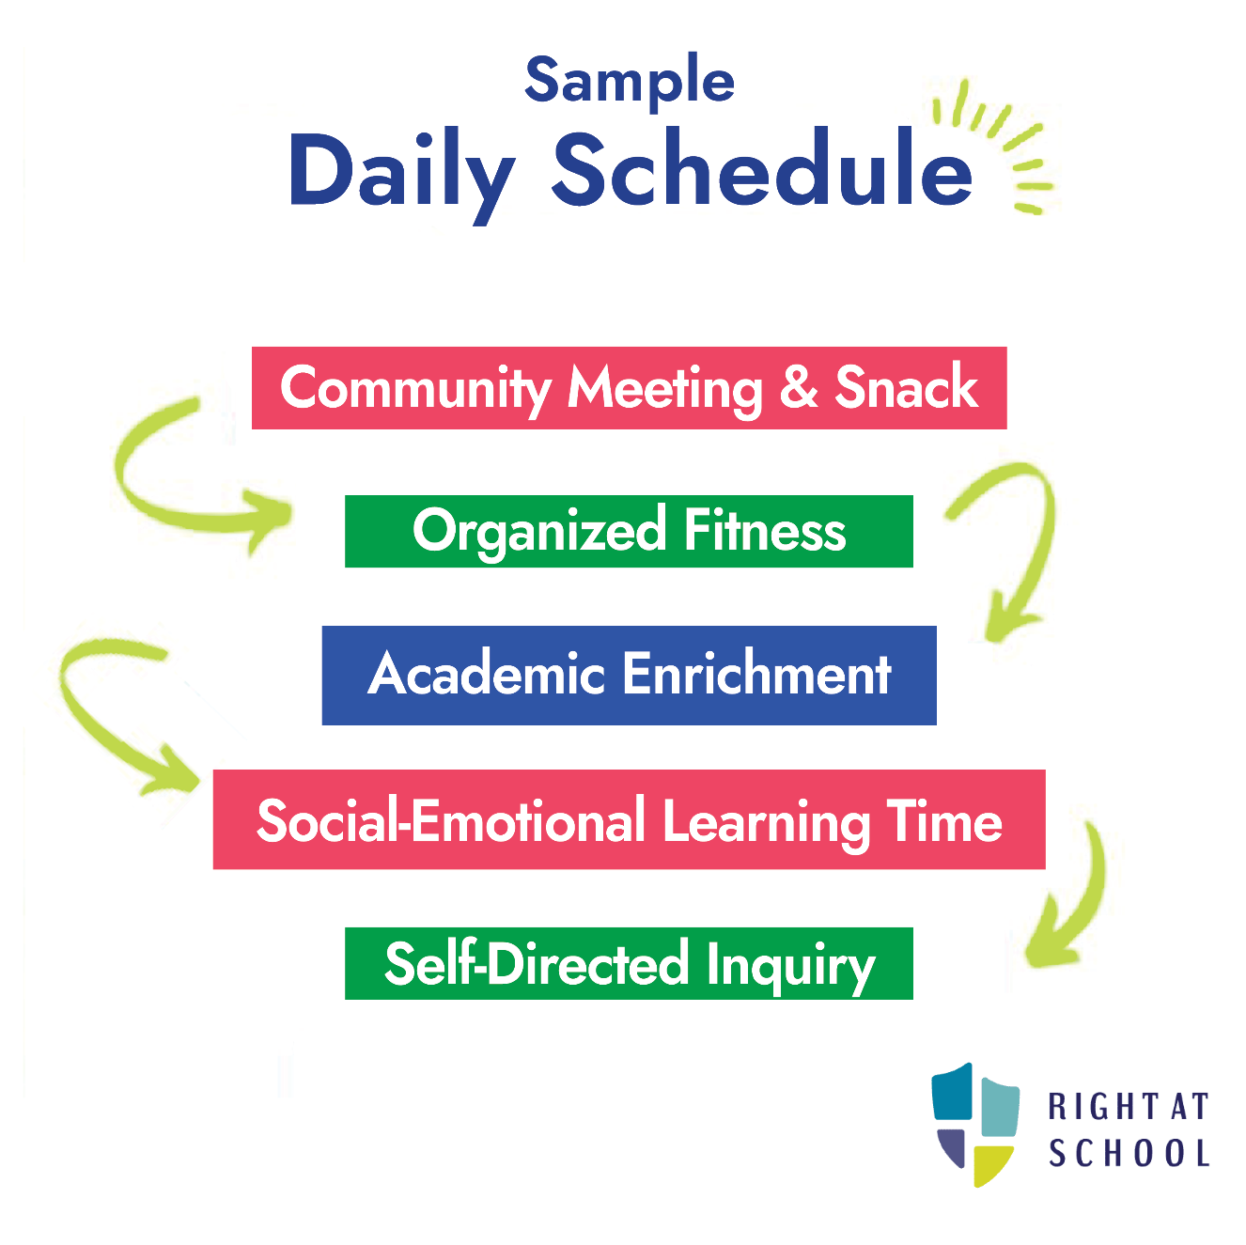

Slide 8
Transitional Kindergarten (TK)
and Kindergarten
Five locations: Greenbrook, Live Oak, Walt Disney, Quail Run and Montevideo
After school until 6:00 p.m.
Unduplicated TK/K students will be transported to the appropriate location
Depending on enrollment, may open at additional sites

Slide 9
Grades 1 - 6
All 22 Elementary School sites will have ELOP
After school until 6:00 p.m.
Programs for 6th grade students will also be offered at select Elementary sites, but locations have not yet been determined

Slide 10
Next Steps
Wednesday, May 18: Initial communication to community and registration opens
Targeted communications to families of unduplicated students; then will be opening up to incoming TK and to the wider community
Parent/Caregiver Information Sessions:
Thursday, May 19, 3:00 p.m.
Friday, May 20, 10:00 a.m.
Tuesday, May 24, 2:00 p.m.
Wednesday, May 25, 6:00 p.m.
Information will be posted on the SRVUSD webpage
Info Session recording will be made available

Slide 11
THANK YOU!
Questions/Comments?

