Slide 1





National Bullying Prevention Month
October, 2021

Slide 2


Start With Hello
Quail Run Elementary School, 2021
Start with a Smile
Staff welcome video to launch the week
Week of 9/24
National Call-to-Action week; however schools can choose any week during the month of September to celebrate
Say Hi to Friends
Activities such as Bingo and Art at Recess
https://www.sandyhookpromise.org/our-programs/start-with-hello/start-with-hello-week/

Slide 3

Stomp Out Bullying
World Bullying Prevention Month
Week of 10/04
Week of 10/18
Make friends with someone you don’t know at school
Challenge others to be kind
Week of Inclusion
Include others in school and after-school activities
Week of 10/25
Week of 10/11
STAND UP for Others Week
Be part of the solution - not the problem!
Start the Week with Conversations Amongst Your Peers
Share experiences and meet to discuss how to Change the Culture at school
https://www.stompoutbullying.org/world-bullying-prevention-month

Slide 4

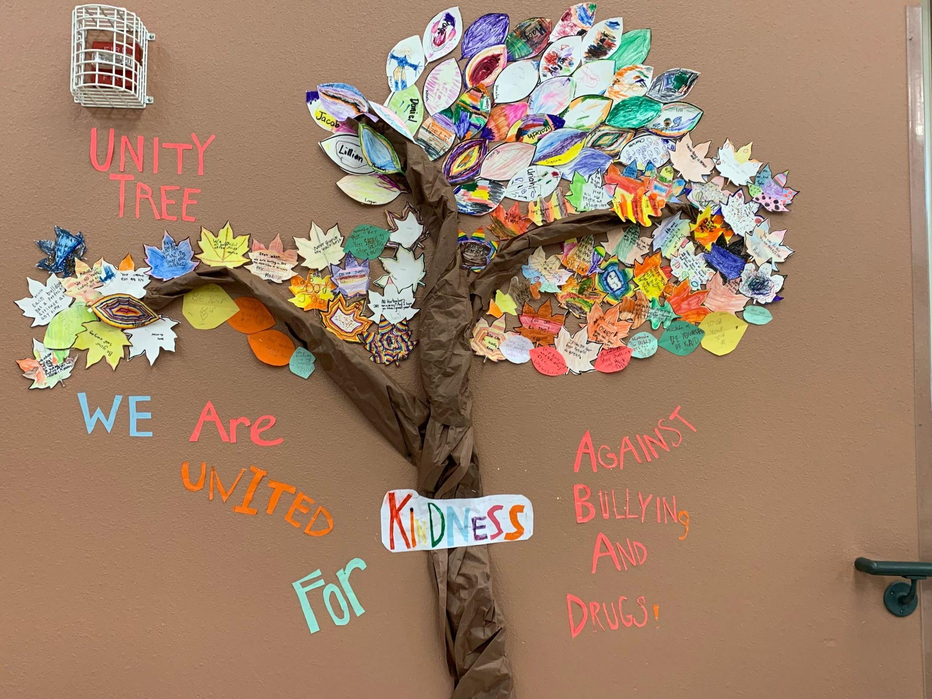

Unity Day:
October 20, 2021
Wear and share ORANGE to show unity for kindness, acceptance, and inclusion and to send a visible message that no child should ever experience bullying.
https://www.pacer.org/bullying/nbpm/unity-day.asp

Slide 5


