Slide 1
National School Counseling Week
Better Together
February 7 - February 11, 2022

Slide 2
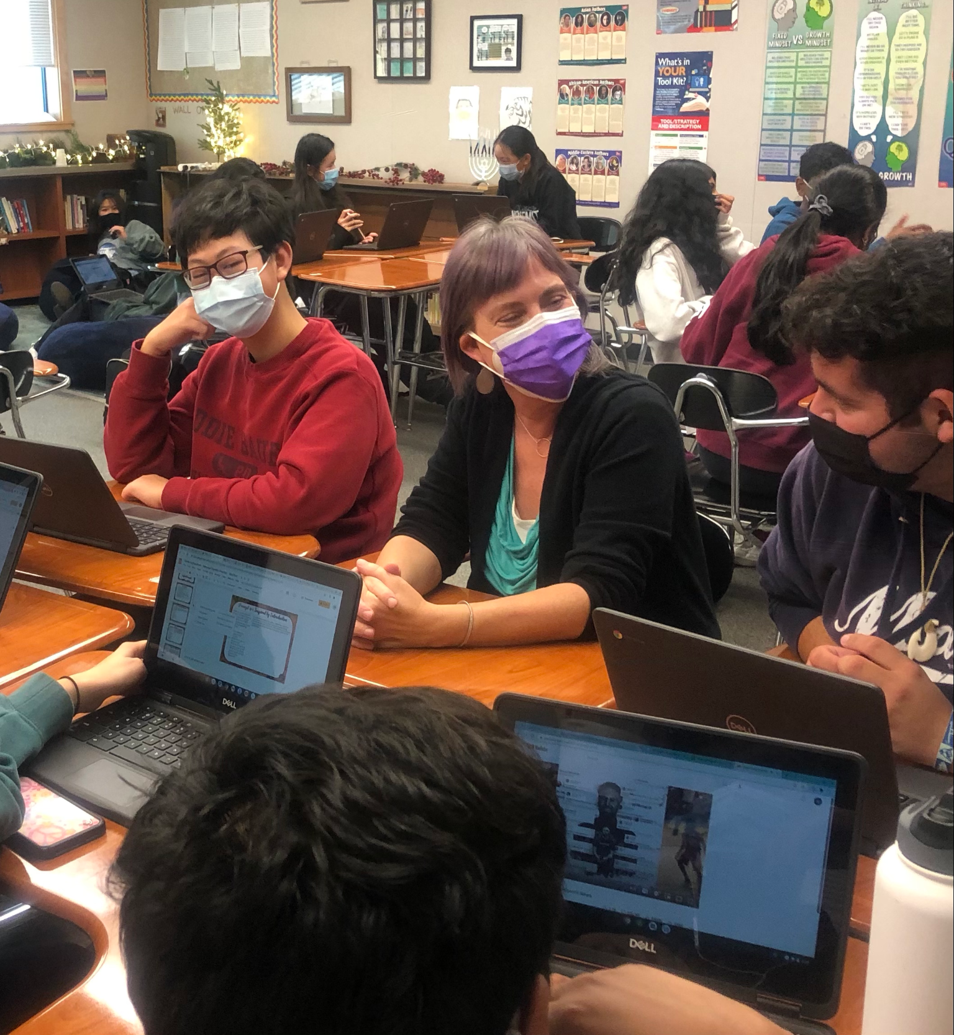
What is National
School Counseling Week?
Since the 1980s, the American School Counselor Association has promoted the work of school counselors in order to highlight their essential contribution within U.S. school systems and the tremendous impact they have in helping students achieve school success and plan for a career.
DVHS

Slide 3
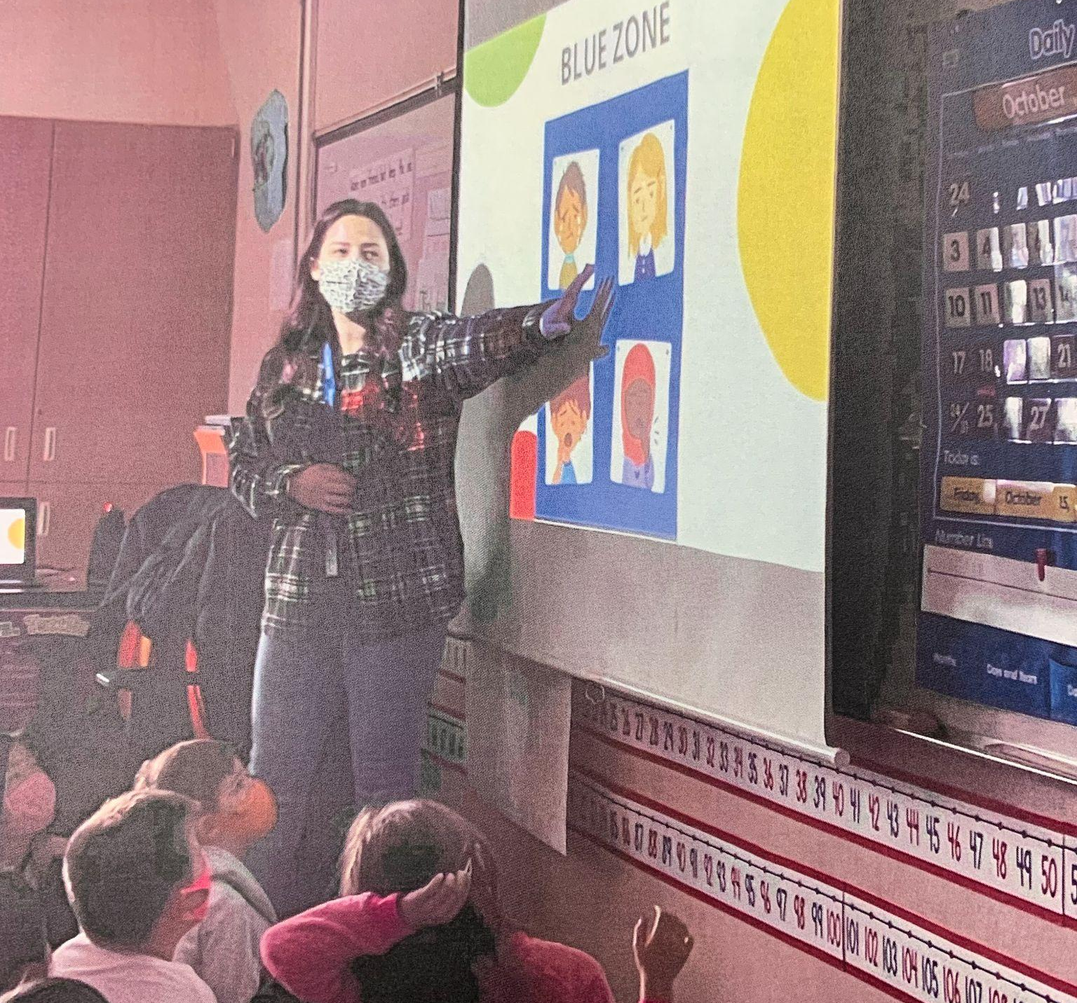
Eleven Elementary Counselors
Classroom SEL lessons
Small groups
1:1 counseling
Tassajara Hills Elementary

Slide 4
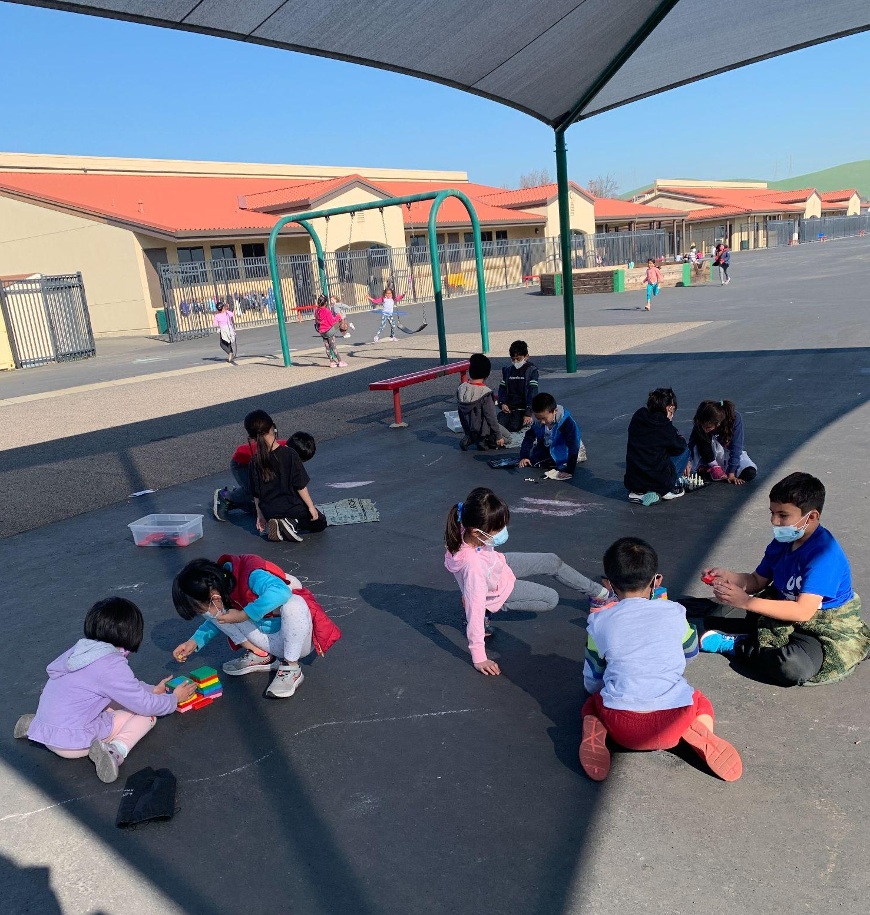
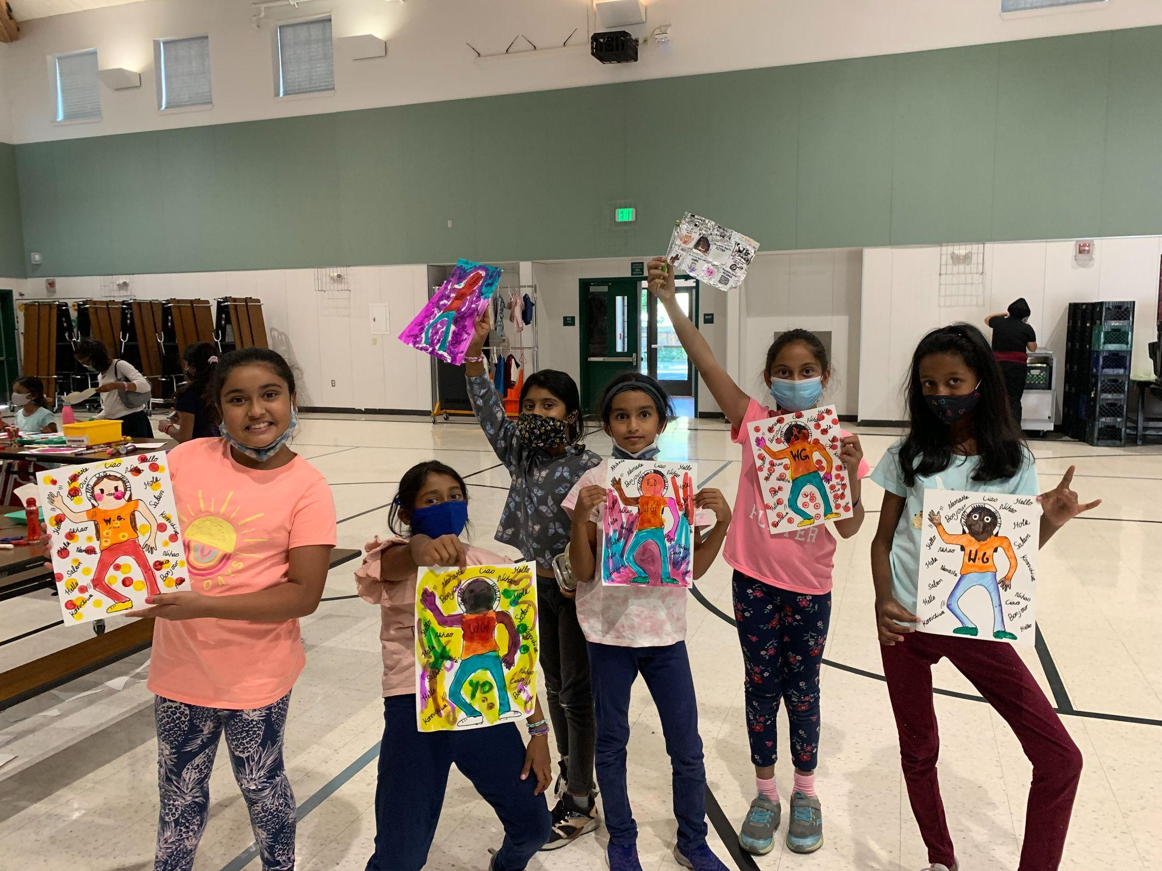
“Start With Hello”
“Chill Zone”
Quail Run Elementary
Students showing off their artwork to kick off the anti-bullying program.
Coyote Creek Elementary
A calm environment at recess where students can play checkers, Jenga, or just relax.

Slide 5
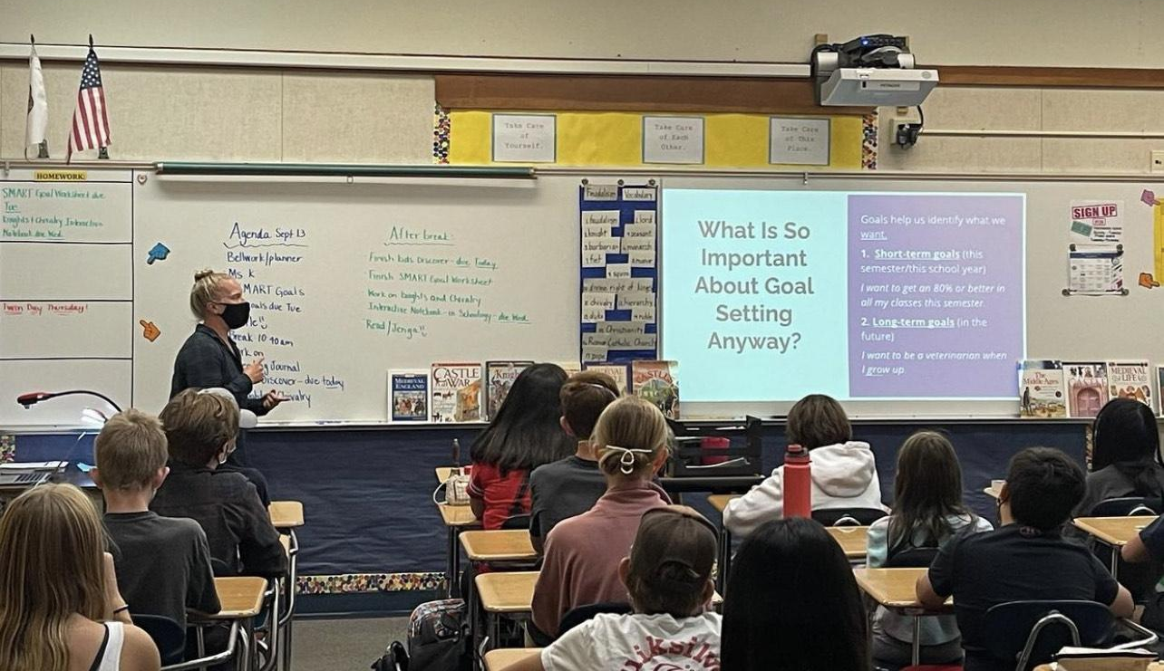
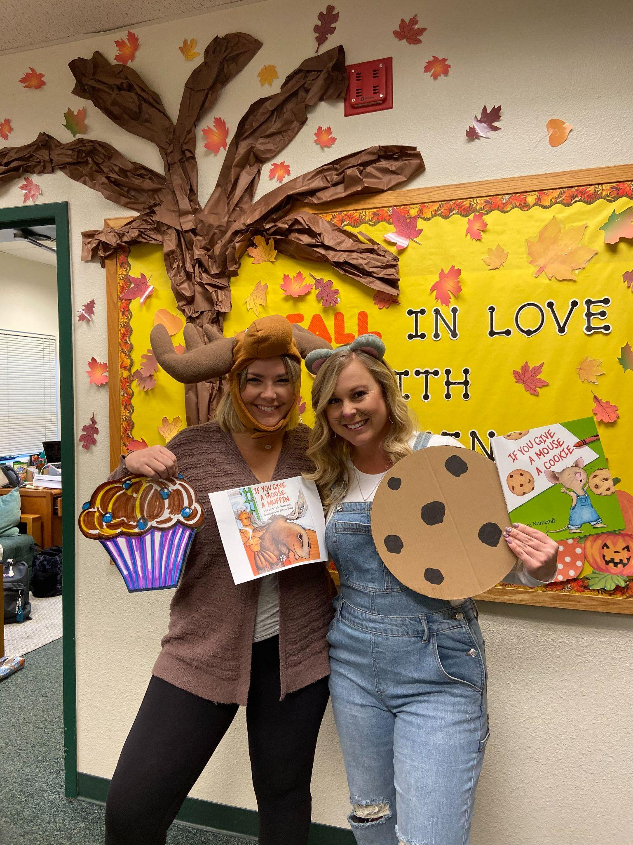
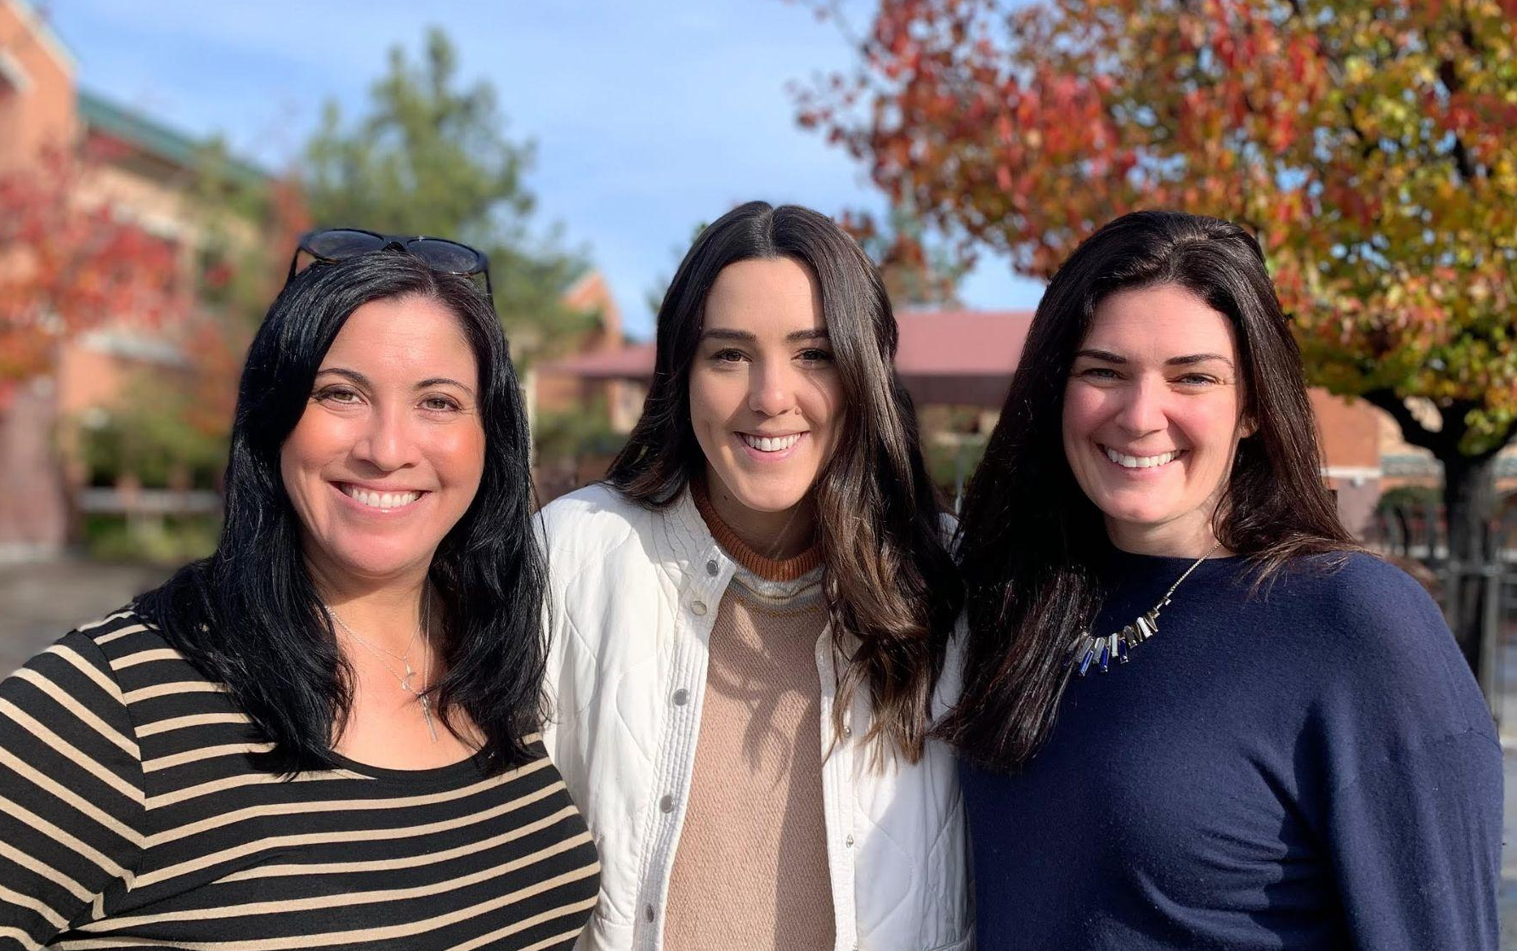
School Counselors Play Many Roles!
Los Cerros MS
7th grade SMART goal lesson
Charlotte Wood MS
Halloween spirit competition
Gale Ranch MS
Welcoming students back on the first day of school

