Slide 1
Native American Heritage Month
November 2021

Slide 2
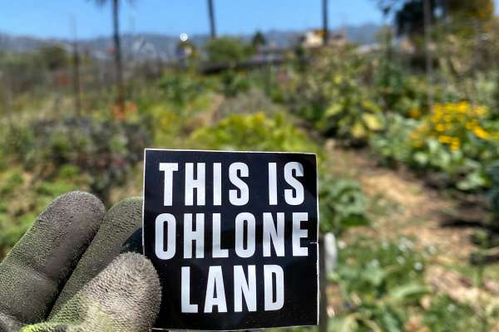
Land Acknowledgment
We acknowledge that SRVUSD sits on the traditional lands of the Chochenyo, Bay Miwok, and Ohlone people and pay respect to elders both past and present.
We recognize that every member of the SRVUSD community has, and continues to benefit from, the use and occupation of this land, since the institution’s founding in 1964. Consistent with our values of diversity, equity, and inclusion, we have a responsibility to acknowledge and make visible the district’s relationship to Native peoples. As members of the SRVUSD community, it is vitally important that we not only recognize the first of the land on which we stand, but also, we recognize that the Chochenyo, Bay Miwok, and Ohlone people are alive and flourishing members of the San Ramon Valley and broader Bay Area communities today.

Slide 3
History
In 1914, Reverend Red Fox James traveled 4,000 miles to Washington, D.C. to petition the president for a day to honor Native Americans.
In 1968, California Governor Ronald Reagan designated the fourth Friday in September as American Indian Day.
In 1990, President George H. W. Bush designated November as National American Indian Heritage Month.
It is now called National Native American Heritage Month.

Slide 4
Native American Heritage Month Resources
Celebrating Native American Heritage Month
Discover Native American artists
Read Native American authors
Listen to Native American music
Learn Native American history
Native American Leaders
Scott Momaday was the first person of Native American heritage to win the Pulitzer Prize for Fiction.
John Herrington was the first person of Native American heritage to fly in space.
Jim Thorpe was the first person of Native American heritage to win an Olympic gold medal for the United States.
Art and Literature
The writing of Joy Harjo
The music of R. Carlos Nakai
The artwork of Allan Houser
Native American Resources
https://nativeamericanheritagemonth.gov/
https://americanindian.si.edu/nk360/informational/rethinking-thanksgiving

Slide 5
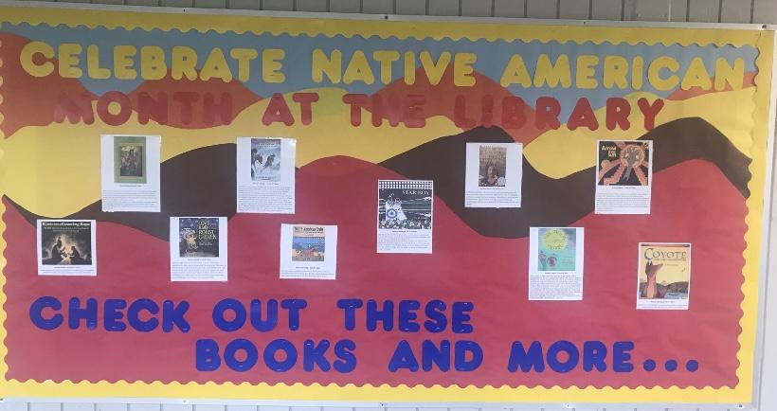
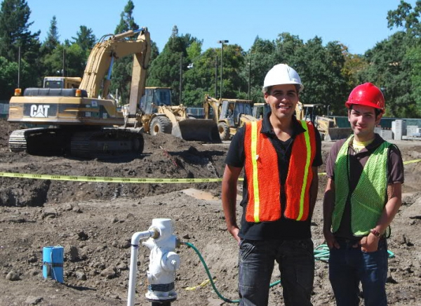
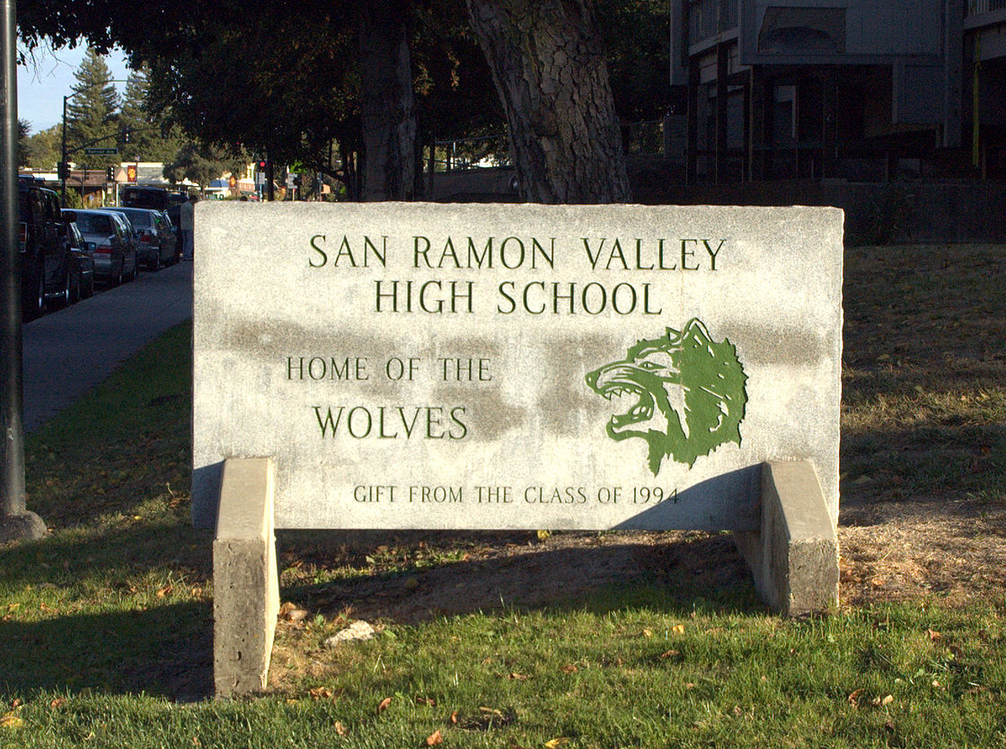
State to determine custody of American Indian remains found at Danville dig site
'Archeological dig' at high school uncovers remains of 27

Slide 6
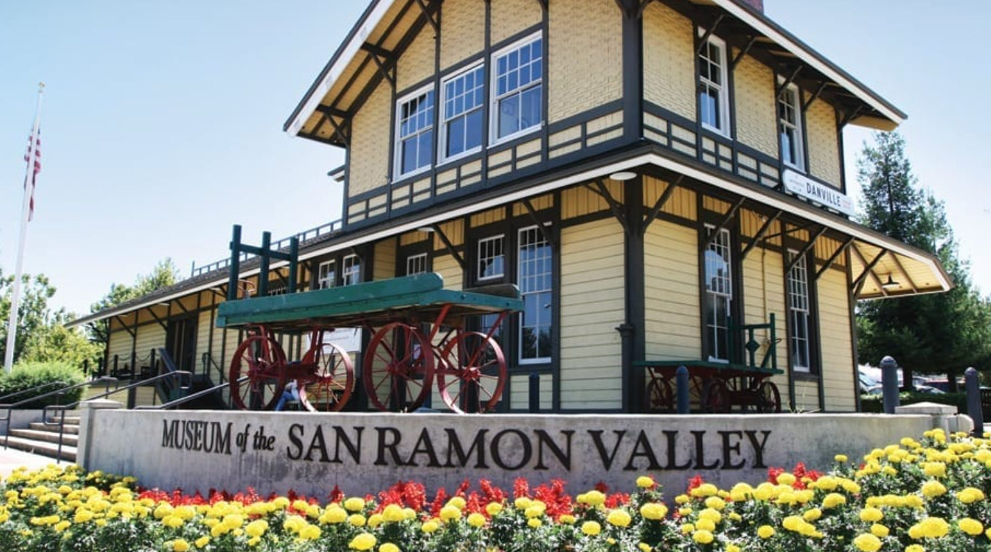
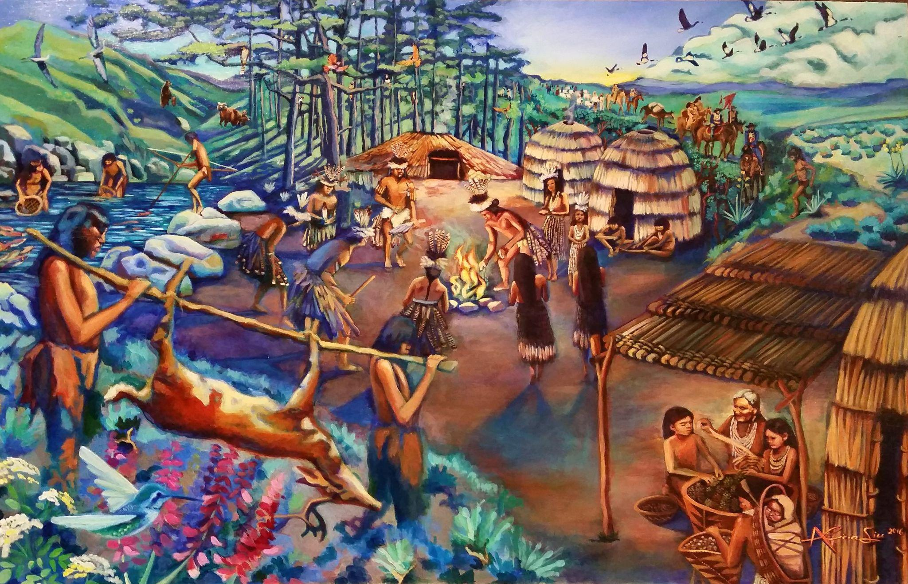
November is National
Native American Heritage Month!
First Peoples of California Exhibit

