Slide 1
California Prescription Drug Abuse Awareness Month
March 2022
San Ramon Valley Unified School District

Slide 2
Statistics
As the U.S. Department of Health and Human Services reports, America is entrenched in a prescription drug abuse epidemic.
Per one estimate, 48 million Americans (in the 12-and-older age group) have abused a prescription drug at least once in their lifetime. This figure translates to 20 percent, or one in every five people, in this age group. California, with a population of 38,332,521, is home to the greatest number of Americans compared to all other states.

Slide 3
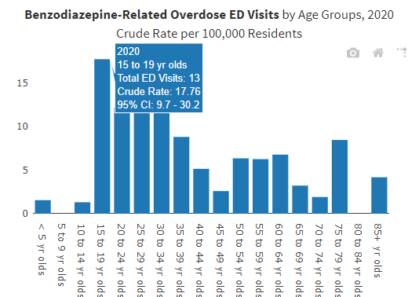
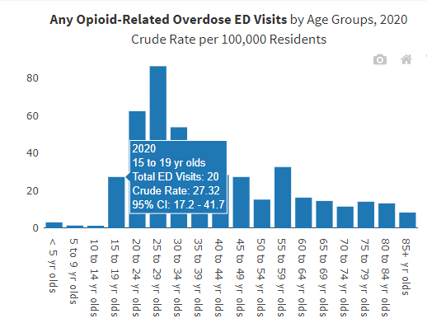
County Data - Emergency Overdose Visits 2020
Data from California Dept. of Public Health Overdose Surveillance Dashboard
Notes:
From CA Dept of Public Health, County-wide data for 2020
Box highlights data for 15-19 year olds (our HS students)
13 visits for Benzodiazepine OD
20 visits for Opioid OD
Highest bars on both charts are for people in their 20’s and 30’s - this is why we need to intervene with teens

Slide 4
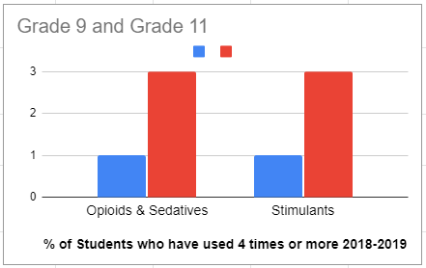
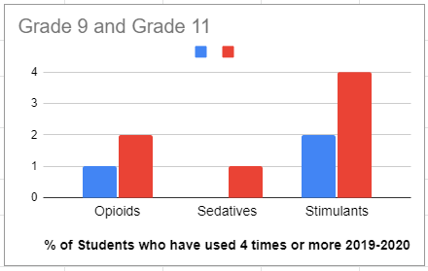
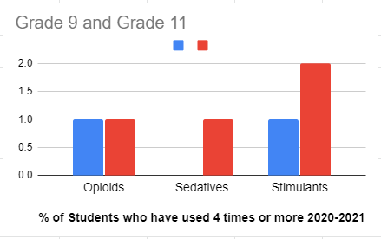
SRVUSD Healthy Kids Survey Data Trends
Repeated use (4 or more times) tends to increase from 9th to 11th grade
Repeated use of opioids has decreased since COVID began
Stimulants have been the preferred choice for older students in the last two years
Data from CA Healthy Kids Reports for SRVUSD Secondary Surveys: 2018-2019, 2019-2020, 2020-2021
Notes:
In 2018-2019, opioids and sedatives were grouped into a single category - starting in 2019-2020, these were separated into 2 categories
2018-2019 was the last full school year with all students attending in person - 2019-2020 and 2020-2021 were at least partially remote
School closures/remote learning may have impacted access to Rx medication and which Rx medications were more accessible/available
Data is self-reported by students who took the survey- may not be accurate and may not represent use patterns of students who did not take the survey
This data is for comprehensive high schools; non-traditional data looks different and middle school students are not asked detailed information about use

Slide 5
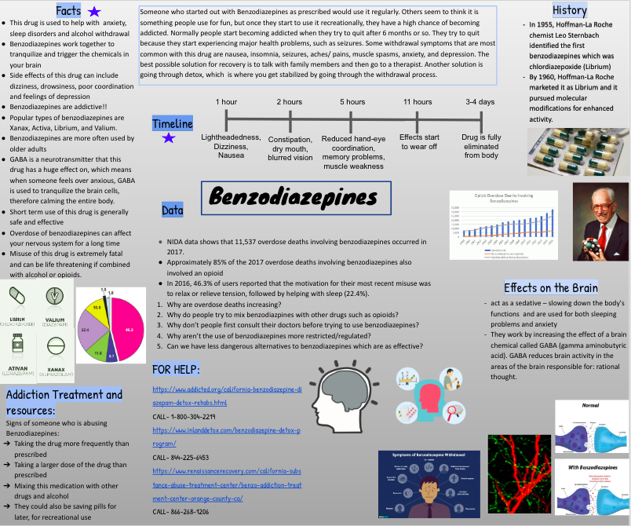
Health Education- Prevention
All 9th graders take Health in High Schools
Health curriculum teaches proper use and information about prescription medication and impacts it has on health.
Standard 1.5A Describe the use and abuse of prescription and nonprescription medicines and illegal substances

Slide 6
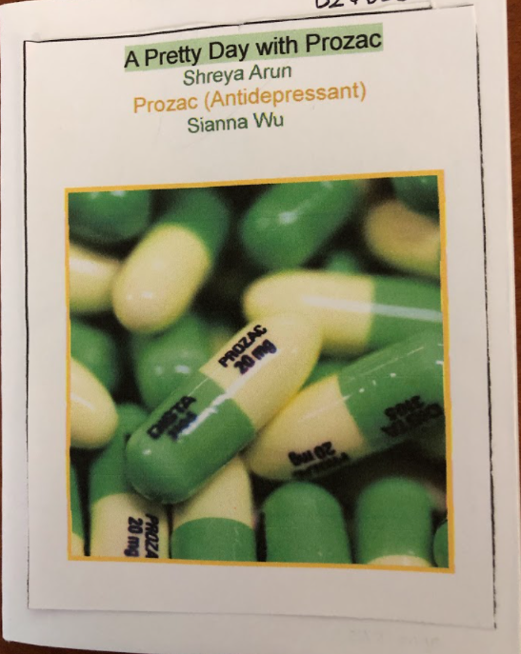
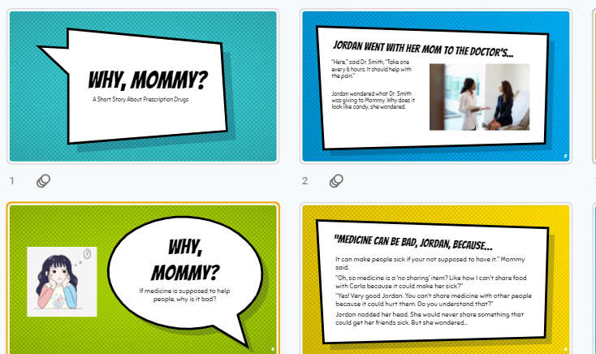
Health Education- Prevention
Health students creating drug awareness books
Standard 8.1A Participate in activities in the school and community that help other individuals make positive choices
Standard 8.2A Present a persuasive solution to the problem of alcohol, tobacco, and other drug use among youth

Slide 7
Role of School Support Staff:
School Counselors, School Psychologists, and School Social Workers
Tier 1:
Presentations to students and staff, and collaboration with County Offices and PTA for presentations to students and families
Tier 2:
Brief Intervention for Substance Use - district staff trained through Tobacco Use and Prevention Education (TUPE) Program of the County Office of Education
Collaboration with school site teams and outside providers to support students’ needs at school with a coordinated plan and refer families to resources in the community if needed
Tier 3:
Collaboration with outside providers, families, and school site teams to support needs of students returning to school from hospital or inpatient treatment programs through a coordinated plan

