Slide 1
Red Ribbon Week 2021
OCTOBER 23 - OCTOBER 31

Slide 2
National Family Partnership
ADVOCACY
AWARENESS
RESOURCES
Active in bringing concerns to policy makers at the local, state, and national level
Since 1985, has been sponsoring awareness of the harmful effects of drugs in America through the Red Ribbon Campaign
Provides a large variety of prevention literature for various Universal Campaigns it supports
Notes:
Red Ribbon Week is one of the programs supported by the Nat’l Family Partnership.
Universal Campaigns such as: Red Ribbon Campaign, Red Ribbon Certified Schools, Lock Your Meds , and Safe Homes / Safe Parties.

Slide 3
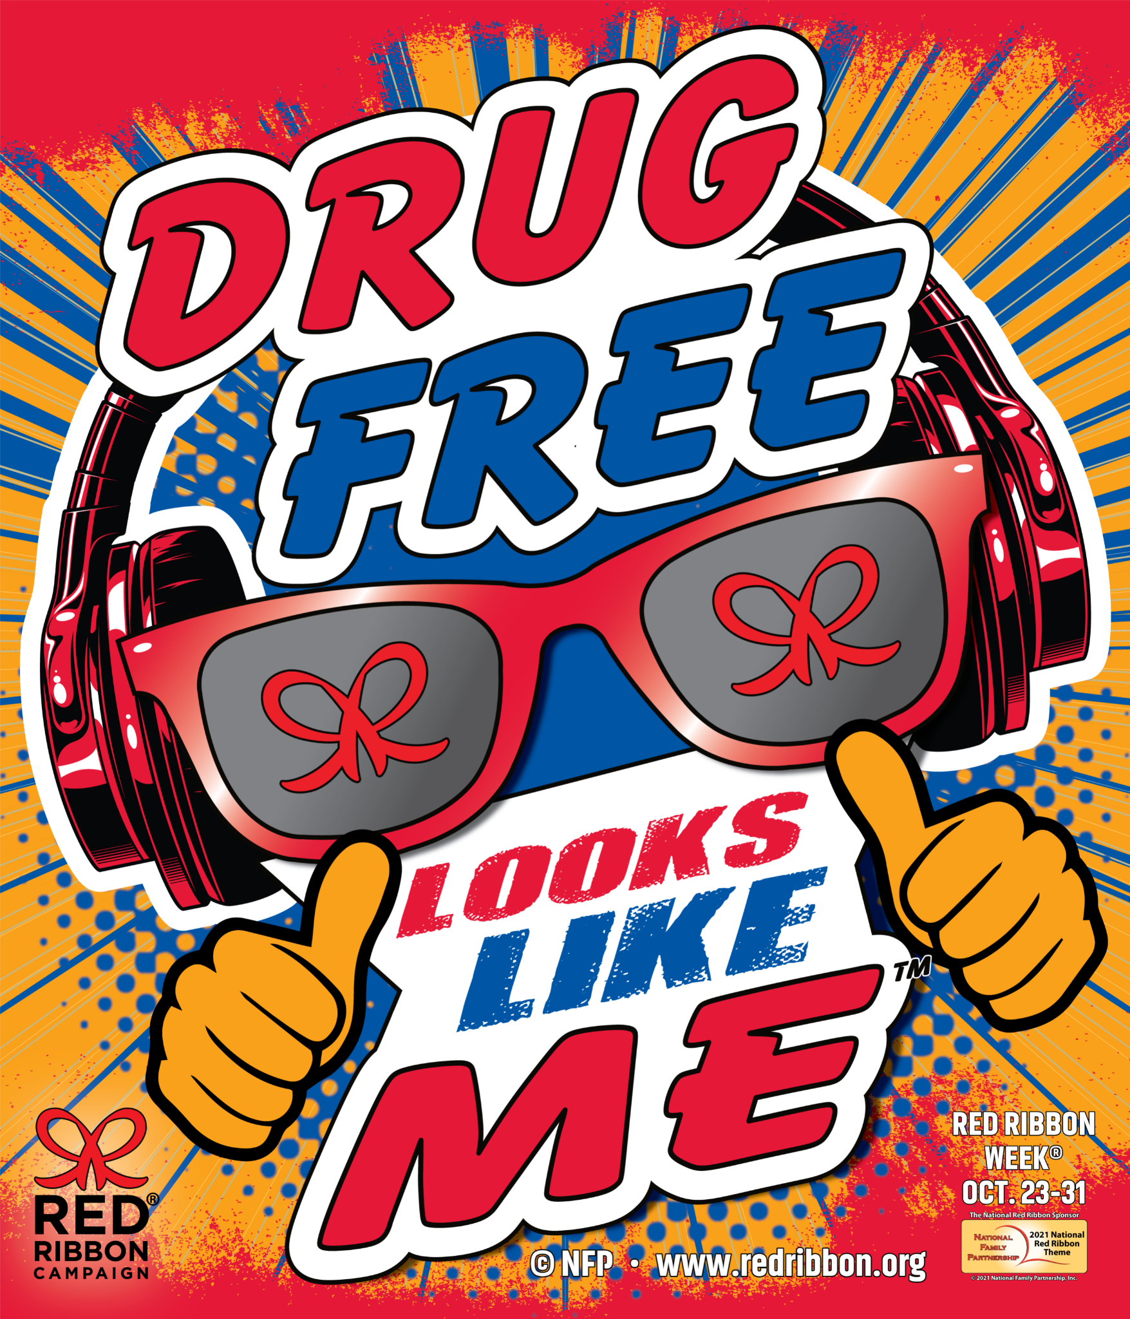
2021 Theme
Drug Free Looks Like Me!

Slide 4
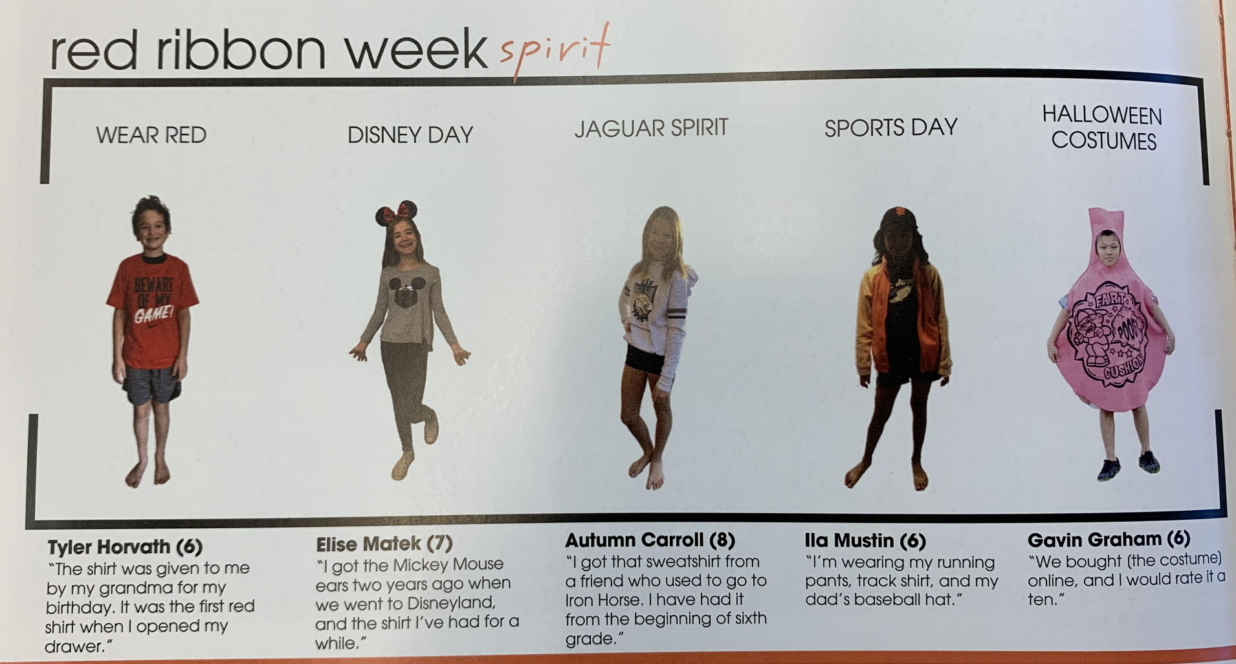
Iron Horse Middle School
Spirit Week
SRPD Officer to speak to 7th & 8th grade students

Slide 5
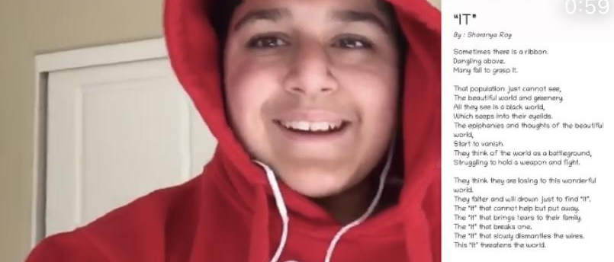
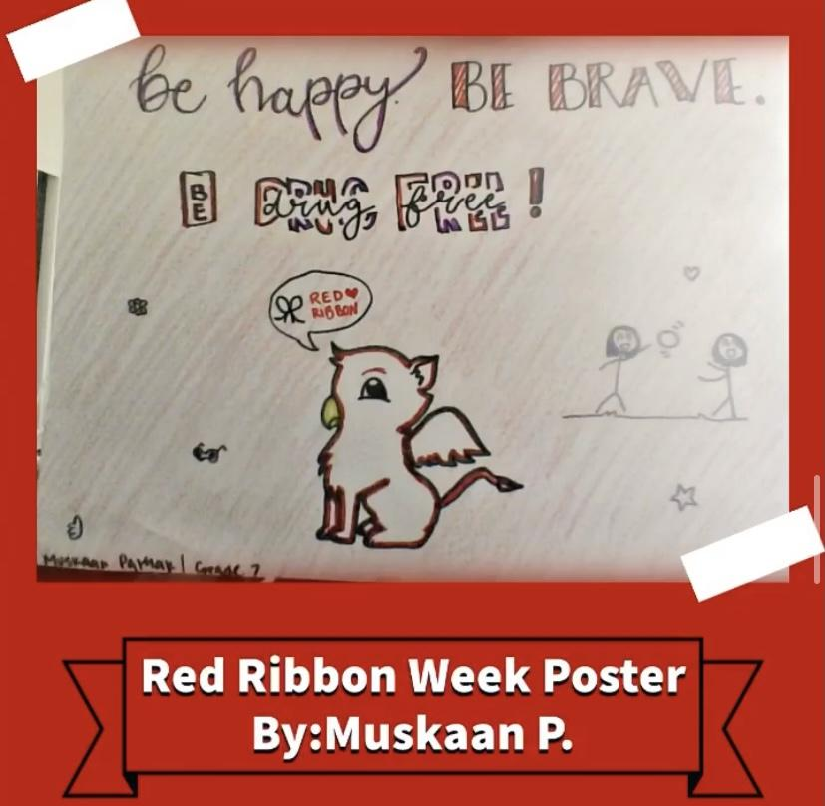
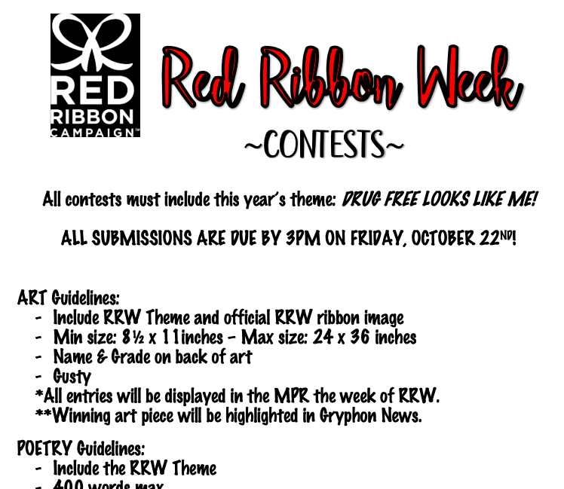
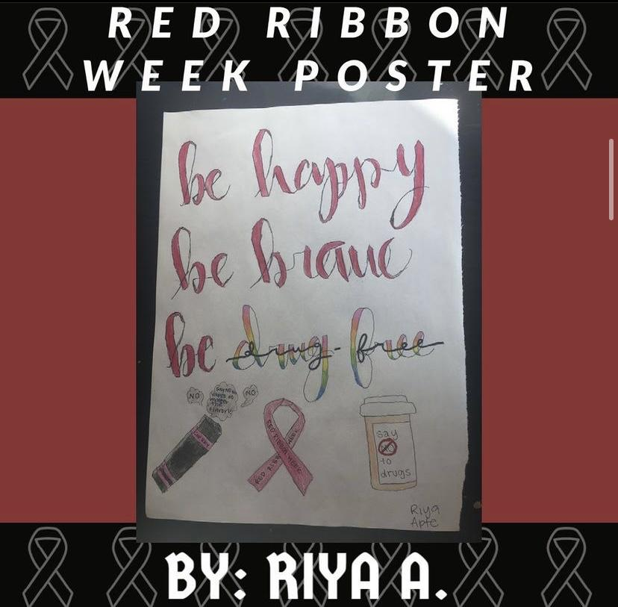
Gale Ranch Middle School
Contests!
LTA: Stomp Out Drugs!
Spirit Day: RED OUT
Informational Video on Gryphon News

