Slide 1
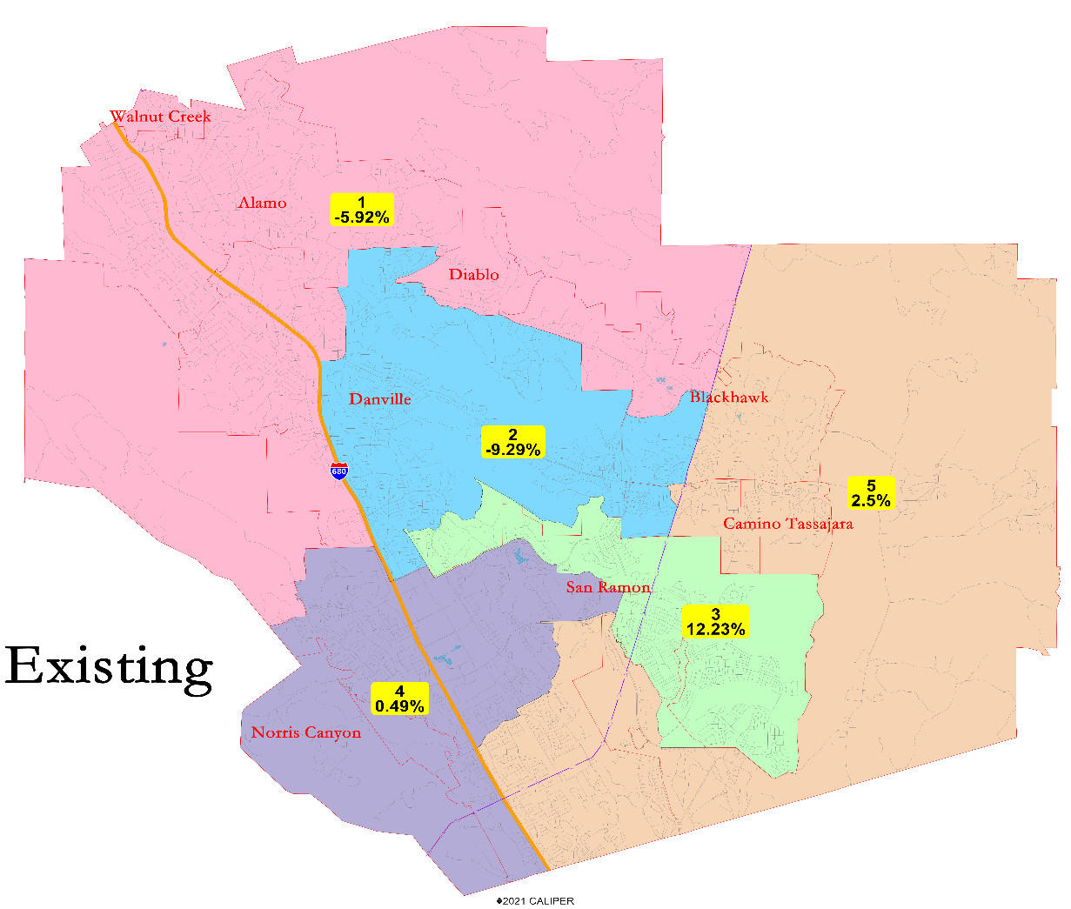
San Ramon Unified 2022 Redistricting
Douglas Johnson, President
National Demographics Corporation

Slide 2
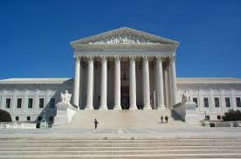
Redistricting Rules and Goals
Federal Laws
Traditional Redistricting Principles
Equal Population
Federal Voting Rights Act
No Racial Gerrymandering
Communities of interest
Compact
Contiguous
Visible (Natural & man-made) boundaries
Respect voters’ choices / continuity in office
Planned future growth
Minimize voters shifted to different election years
Preserving the core of existing election areas

Slide 3
Existing Trustee Areas
The difference between the smallest and largest must be less than 10%.
To balance, at a minimum Area 3 needs to give up population, while Area 2 needs to gain population.

Slide 4
Current Trustee Area Demographics

Slide 5
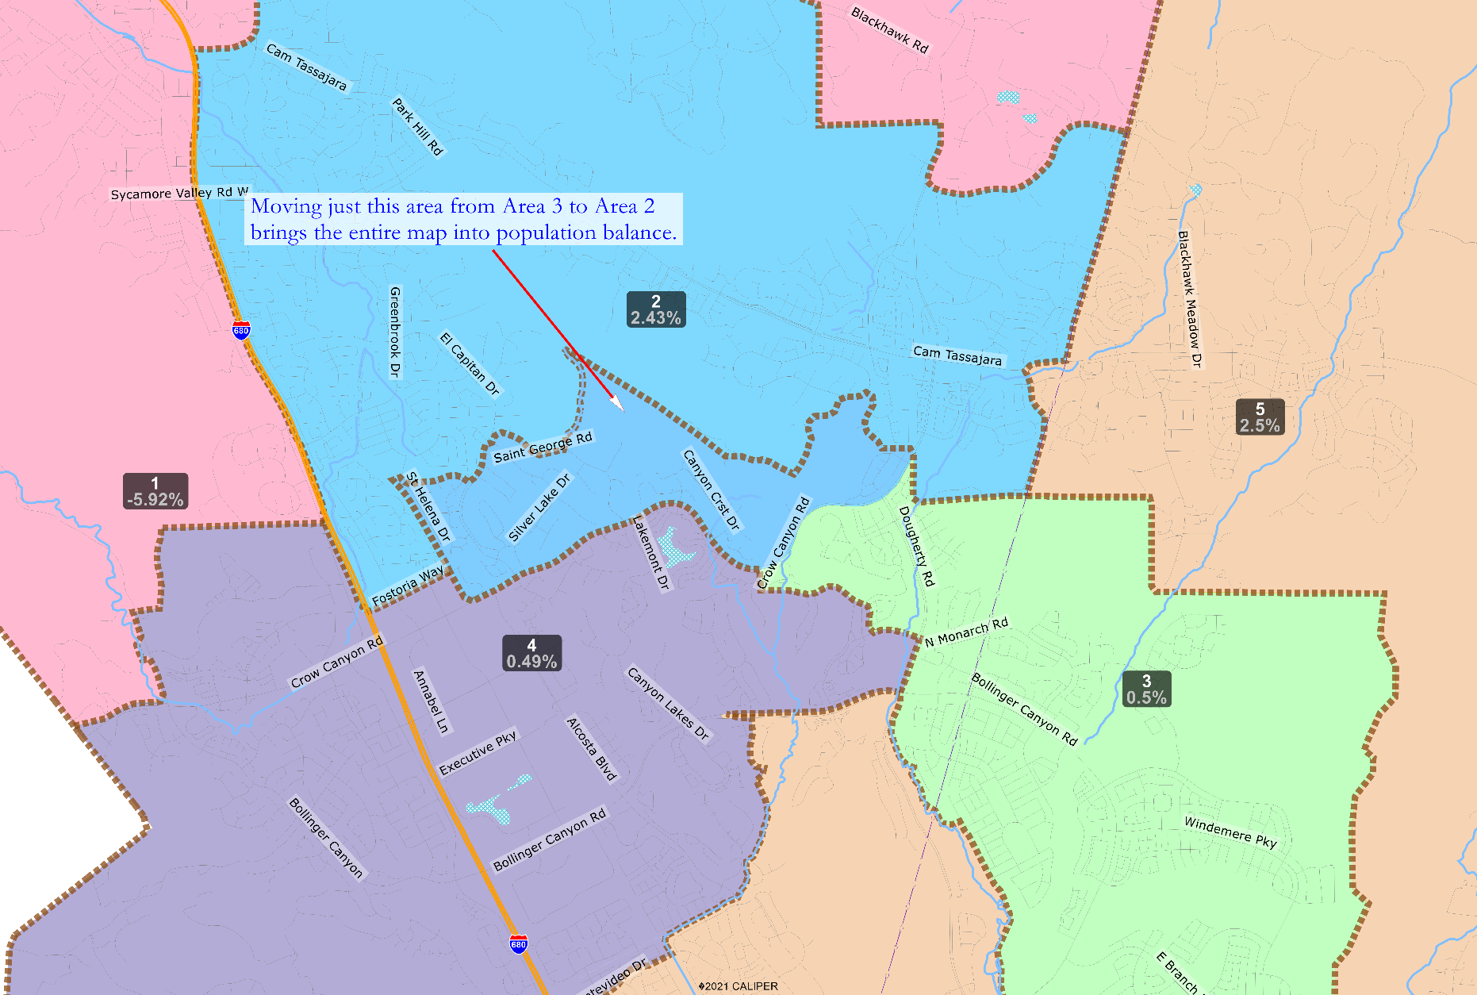
Minimal Change Option
The minimal changes necessary would leave Areas 1, 4 and 5 the same as currently configured, and would make the map significantly more compact.
The colors shown in this map would be the adjusted Trustee Areas.
Dougherty Valley now has enough population to be its own trustee area.

Slide 6
Min. Changes Map Demographics

Slide 7
Public Input & Discussion
Questions?
Public Input
Direction on Process and Mapping

