Slide 1
Special Education
San Ramon Valley Unified School District
Tuesday, February, 22, 2022

Slide 2
Our Strategic Directions
Built on a foundation of academic excellence, we are broadening our definition of success

Slide 3
We are dedicated to academic excellence where all students thrive and succeed
in innovative and inclusive learning environments.

Slide 4
Success means our students:
Achieve academically
Experience social and emotional well-being
Develop curiosity, confidence and independence as learners
Appreciate the importance of teams and collaboration
Demonstrate empathy and compassion
Determine their purpose and understand the importance of service
Set and achieve goals
Love learning

Slide 5
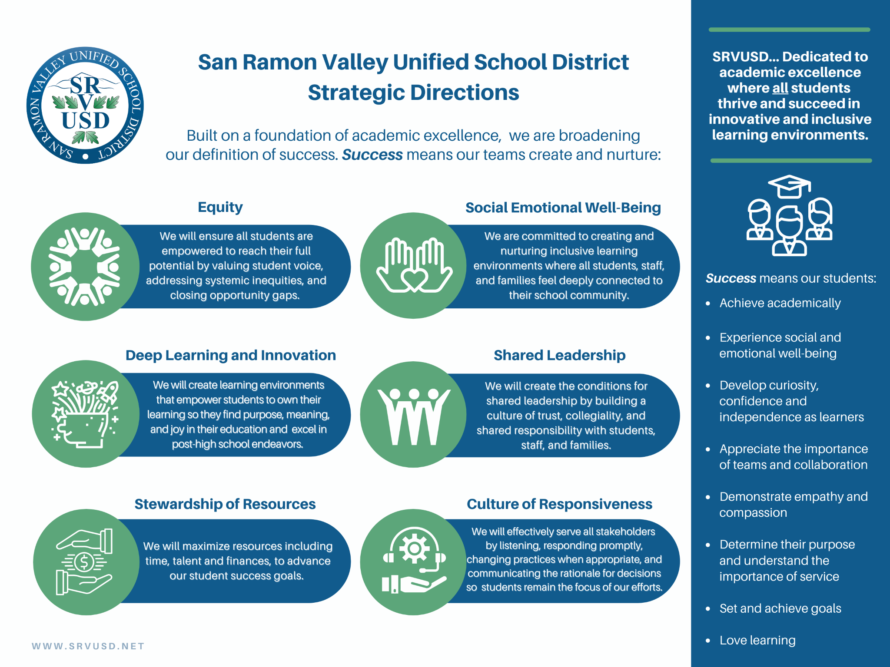

Slide 6
Special Education in SRVUSD
Special Education students in SRVUSD are first and foremost General Education students. The foundational tenets of IDEA charge us to provide each special education student with a free appropriate public education (FAPE) in the least restrictive environment (LRE). To do that we will:
Goal 1:
Goal 2:
Develop IEPs that are designed to meet each student’s unique needs and provide the necessary supports and services for them to access instruction and attain their goals.
Create and sustain programs where students have the opportunity to spend as much time as possible with their general education peers.

Slide 8
Special Education by Primary Disability
Total Students in Special Education | 3026
Specific Learning Disability (SLD) | 1032
Speech or Language Impairment (SLI) | 712
Autism (AUT) | 527
Other Health Impaired (OHI) | 453
Emotional Disturbance (ED) | 121
Intellectual Disability (ID) | 66
Orthopedic Impairment (OI) | 35
Multiple Disabilities (MD) | 29
Hard or Hearing (HH) | 26
Visual Impairment (VI) | 14
Deafness (DEAF)/Hearing Impairment (HI) | 7
Traumatic Brain Injury (TBI) | 3
Deaf-Blindness | 1
CALPADS Census Data Fall 16.1

Slide 9
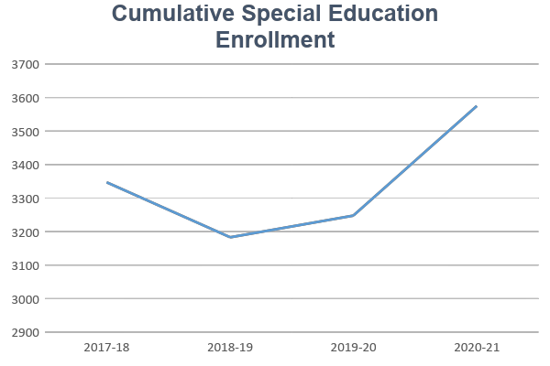

Slide 10
SRVUSD Special Education
Time in General Education
Special Education Programs

Slide 11
Special Education: CAASPP

Slide 12
SRVUSD Special Education

Slide 13
Significant Disproportionality
Over identification of African American students under the disability of Other Health Impaired (OHI)
Comprehensive Coordinated Early Intervening Services Plan (CCEIS)
Addressing implicit biases through increased staff development on equity
Developing a systematic consistent Multi-Tiered System of Support that addresses academic and behavioral concerns
Implementing a district-wide Student Study Team system in order to improve student engagement and achievement

Slide 14
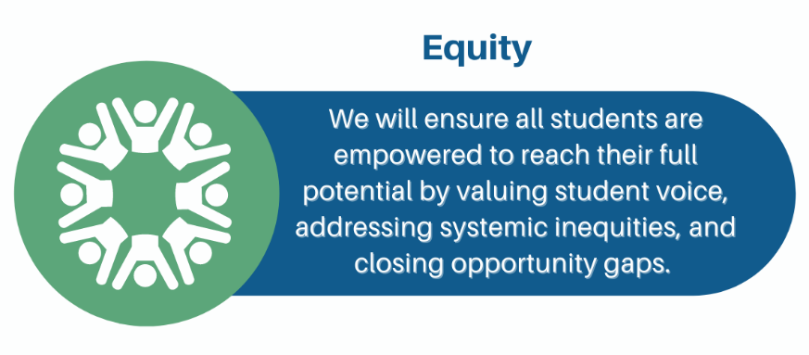
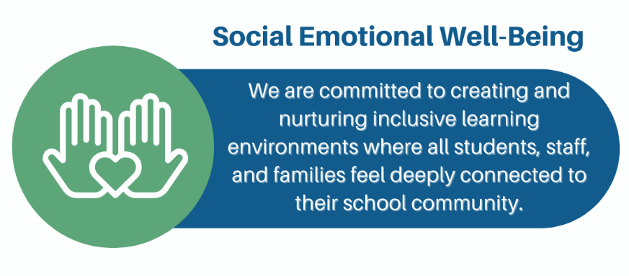

Slide 15
Equity
Create learning environments that are safe, equitable, and provide a sense of belonging for all students and staff
Intentionally design and deliver inclusive environments for students at every opportunity
Cultivate teaching and learning experiences that are responsive to and supportive of student’s unique needs
Develop IEPs that are strengths focused, starting with what the student can do not what they cannot do
Provide opportunities for special education students to participate in every aspect of campus life

Slide 16
Social Emotional Well Being
Individualized Education Programs that support the whole student
Create and nurture instructional environments that prioritize students’ social behavior and social emotional needs
Develop opportunities for students to practice social skills across the school day
Offer a continuum of mental health support for students addressing student IEP needs
Cultivate collaboration and coordination between school psychologists, social workers, support counselors and school counselors

Slide 17
Deep Learning
Students learn differently and we need to be responsive to these differences
Incorporating Student voice into what and how students are learning
Focusing on what students are bringing into the classroom
More authentic assessments that focus on what students should know
Essential standards are the back bone of IEP goal development
Universal Design for Learning is foundation
High expectations

Slide 18
Key Actions
Create inclusive learning environments for students through a universal design lens that promote access to general education curriculum and a sense of belonging for all students.
Fully considering all options when developing a student’s program
Defining a change of placement process that is thoughtful and based on multiple measures so that students are not moved to a more restrictive setting without careful consideration

Slide 19
Key Actions
Develop Individualized Education Programs that are
responsive to student needs and provide Educational Benefit.
Crafting IEPs to provide educational benefit and assume students can make progress and meet their potential
Providing students access to A-G courses with the necessary supports and accommodations in place as outlined in their IEP

Slide 20
Key Actions
Create responsive and clear procedures, and practices that support special education staff in facilitating the IEP process.
Support special education staff through targeted training and professional development
Develop a streamlined procedures guide that concisely outlines IEP process requirements

Slide 21
Measuring our Progress
IEP Implementation
Progress on goals
Percentage of time spent in general education
Increase in participation and performance on statewide assessment
Reduced Risk Ratio

Slide 22
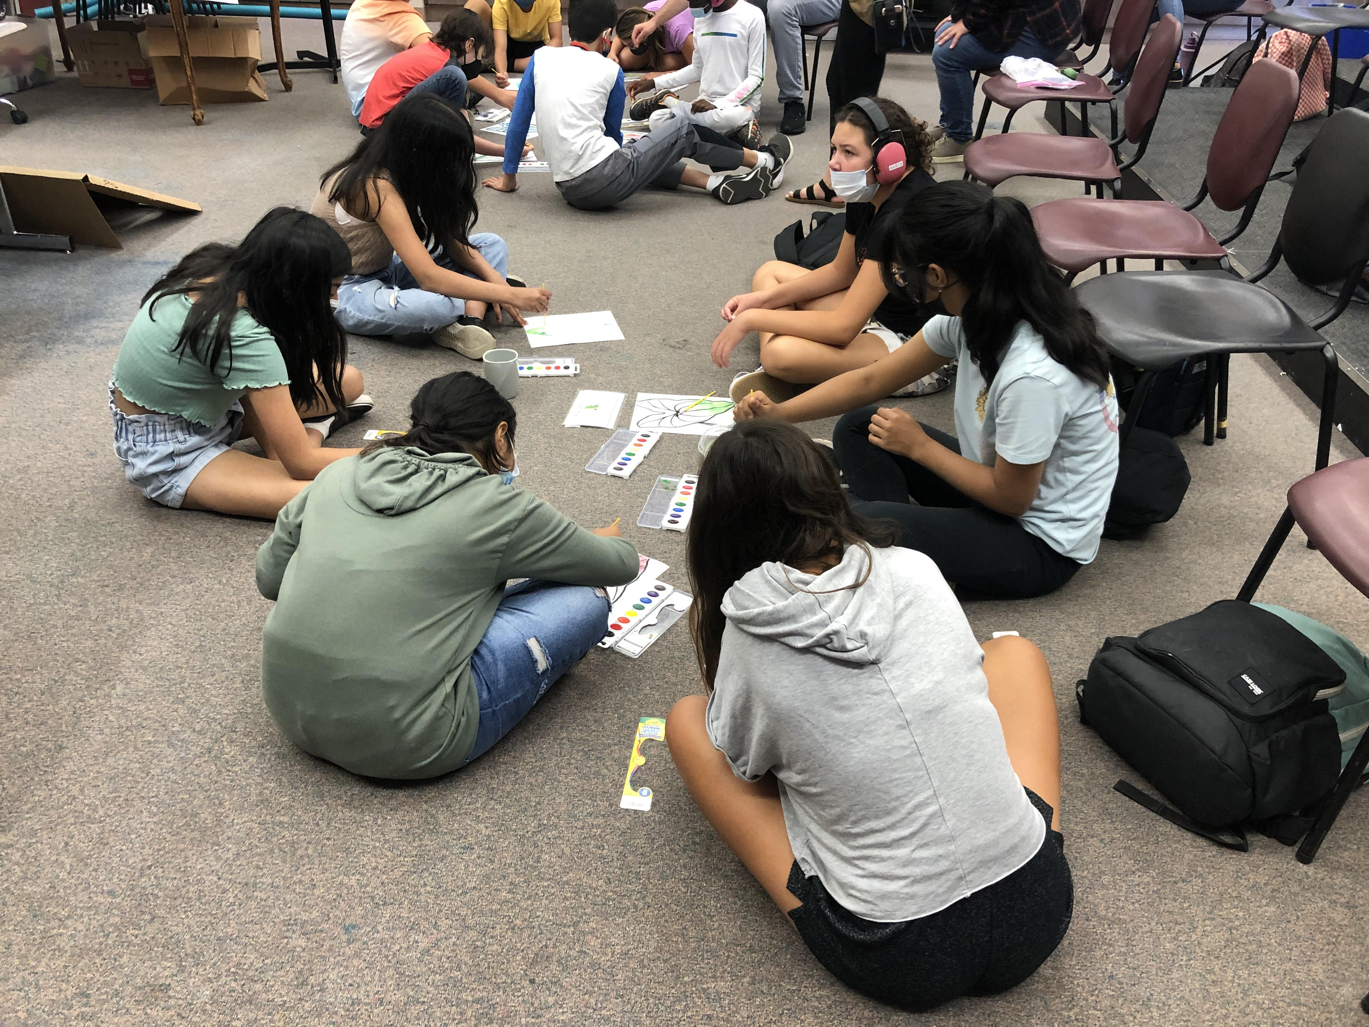
Inclusion is intentional planning for the success of all students.

