Slide 1
2021-22 Second Interim Report Summary San Ramon Valley Unified School District March 15, 2022

Slide 2
Second Interim Report
Purpose
Evaluate District’s Financial Position Second of two required interim reports Part of checks and balances
Process
Board of Education self-certifies the report as either: Positive Qualified Negative
Result
Board Adoption County Office of Ed. Certifies Report to Sacramento

Slide 3
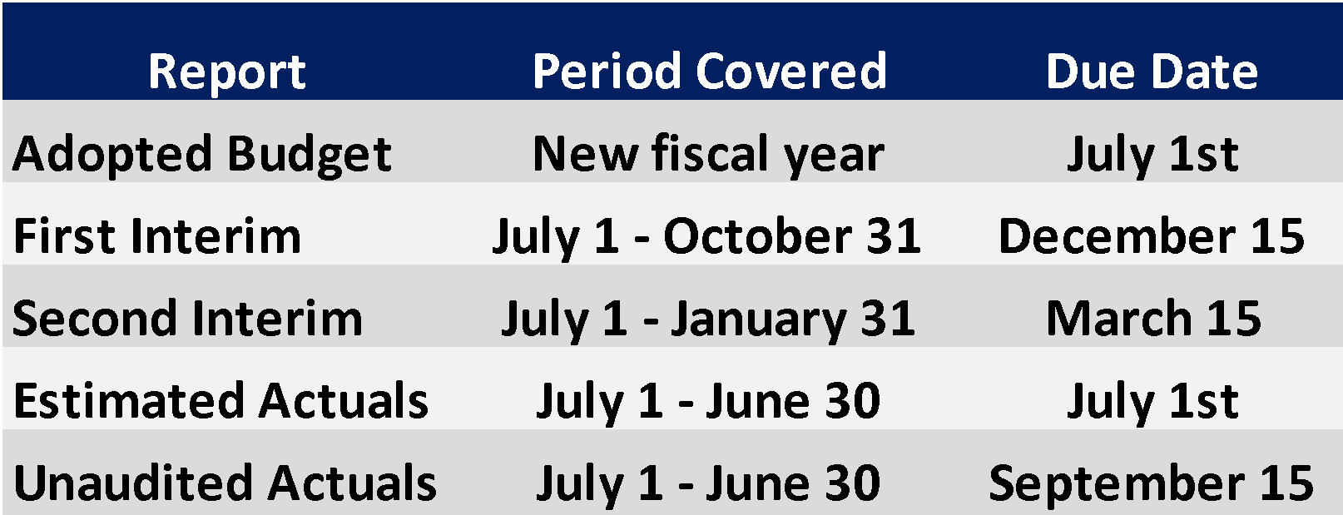
Public Education Budget Process
Financial reports in the SACS format must be adopted and submitted to the County Office of Education (COE) at least five times per year:

Slide 4
2021-22 Second Interim Multi-Year Projection (MYP)
 | 2021-22 | 2022-23 | 2023-24
Revenues | Budget | Projection | Projection
LCFF Sources | $288,314,452 | $296,530,554 | $298,927,391
Federal Revenue | $22,000,988 | $6,863,268 | $6,863,268
Other State Revenue | $68,737,755 | $52,976,822 | $53,106,596
Other Local Revenue | $28,006,001 | $29,370,374 | $29,383,472
Transfers In | $1,111,344 | $0 | $0
Total | $408,170,540 | $385,741,018 | $388,280,727
Expenditures
Certificated Salaries | $173,375,438 | $157,603,872 | $158,428,525
Classified Salaries | $55,840,612 | $53,727,361 | $54,244,095
Employee Benefits | $110,841,212 | $113,043,0663 | $115,568,3025
Books and Supplies | $37,201,225 | $13,558,267 | $12,791,441
Services | $43,621,654 | $38,307,333 | $38,695,683
Capital Outlay | $1,183,520 | $520,041 | $520,041
Other Outgo/Indirect Costs | $1,090,748 | $1,090,748 | $1,090,748
Transfers Out | $2,712,545 | $2,712,545 | $2,712,545
Total | $425,866,954 | $380,563,233 | $384,051,380
Net Increase (Decrease) in Fund Balance | ($17,696,414) | $5,177,785 | $4,229,347

Slide 5
Review of MYP Revenues & Expenditures
Revenues
Expenditures
Since 1st Interim Report: $7 million more in restricted dollars
New State program: ELOP
Educator Effectiveness Grant
Spec. Ed. AB 1602 calculation increase
ADA projections for revenue
New option: 3-year average of ADA
Existing choices: either prior year or current year ADA
District picks the larger number
Continued upward pressure from:
Health and welfare costs
Pension costs
Inflation increases
certificated staffing will adjust to ADA
assumes changes to staffing in 2023-24 as one time monies are exhausted

Slide 6
2021-22 Second Interim Multi-Year Projection (MYP)
 | 2021-22 | 2022-23 | 2023-24
General Fund 01 Balance | Budget | Projection | Projection
Net Beginning Fund Balance | $51,255,648 | $33,559,234 | $38,737,019
Ending Fund Balance | $33,559,234 | $38,737,019 | $42,966,366
Components of Ending Fund Balance
Non-spendable | $352,748 | $352,748 | $352,748
Legally Restricted | $11,476,481 | $10,944,162 | $11,541,207
Committed | $0 | $0 | $0
Assigned | $21,730,005 | $27,440,109 | $31,072,411
Undesignated/Unappropriated | $0 | $0 | $0
Total Ending Fund Balance | $33,559,234 | $38,737,019 | $42,966,366
Reserve for Economic Uncertainties (Fund 17)* | $12,776,009* | $11,416,897* | $11,521,541*
LCFF Shortfall for Declining Enrollment (Fund 17 Assigned) | $3,617,404 | $4,976,516 | $4,871,872
Reserve Percentage (Fund 17 Economic Uncertainty* + Fund 17 Assigned) | 3.85% | 4.31% | 4.27%
*Legally Required to maintain a reserve in the amount of 3% of annual expenditures

Slide 7
Review of MYP Ending Fund Balance
Required Reserves of 3% of expenditures
“Reserve for Economic Uncertainty” resides in Fund 17
Assigned categories in General Fund 01 includes funds for negotiated settlements
“Assigned” amounts are one-time dollars

Slide 8
Summary
State tax revenues continue to come in higher than predicted
State is aware of:
the ADA “funding cliff”
the declining population and school enrollment
We have work to do:
continue to match our expenditures to our revenues
continue to adjust our staffing to meet our actual declining enrollment
continue to provide the resources to support teaching and learning

Slide 9
Next Steps and Upcoming Milestones
Governor: Budget Proposal by mid January
Governor: Revised Budget released by mid May
March
June
January
May
District: Second Interim due on March 15th
District: Estimated Actuals for 2021-22 + Budget Adoption for 2022-23 on June 7th
Legislators: must pass a balanced budget by June 15th

Slide 10
Concluding Remarks

Slide 11
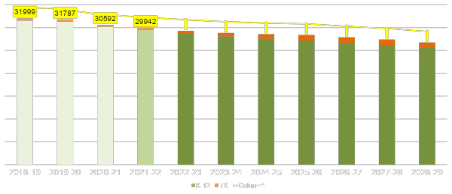
Resident Enrollment Projections through 2028-29

