Slide 1
LEADERSHIP DEVELOPMENT: STUDENT VOICE
APRIL 19, 2022

Slide 2
SRVUSD Strategic Directions
Built on a foundation of academic excellence, we are broadening our definition of success.

Slide 3
We are dedicated to academic excellence where all students thrive and succeed in innovative and inclusive environments.

Slide 4
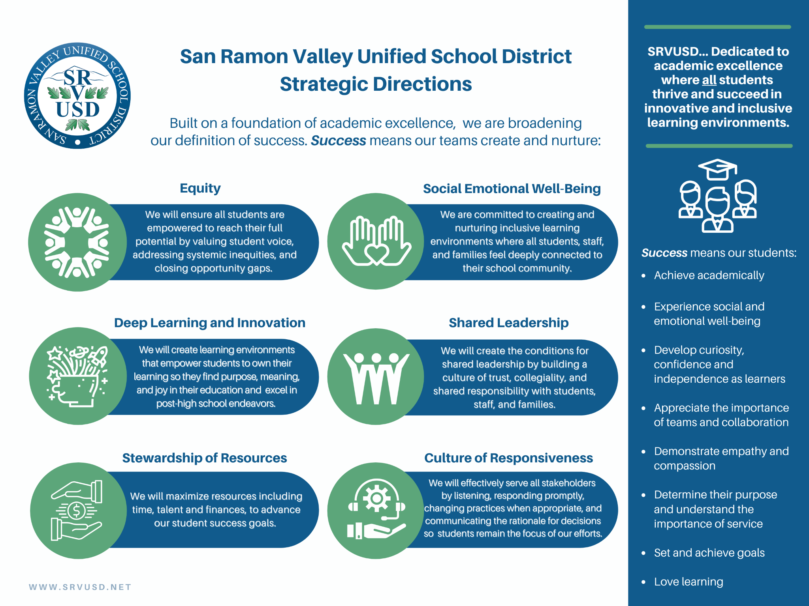

Slide 5
Successes and Next Steps
Through an intersection of the Strategic Directions of Culture of Responsiveness
and Shared Leadership,
we learn from student voice.

Slide 6
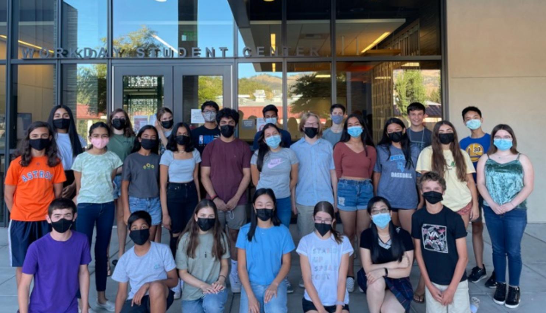
STUDENT SENATE
Notes:
Risha Jain

Slide 7
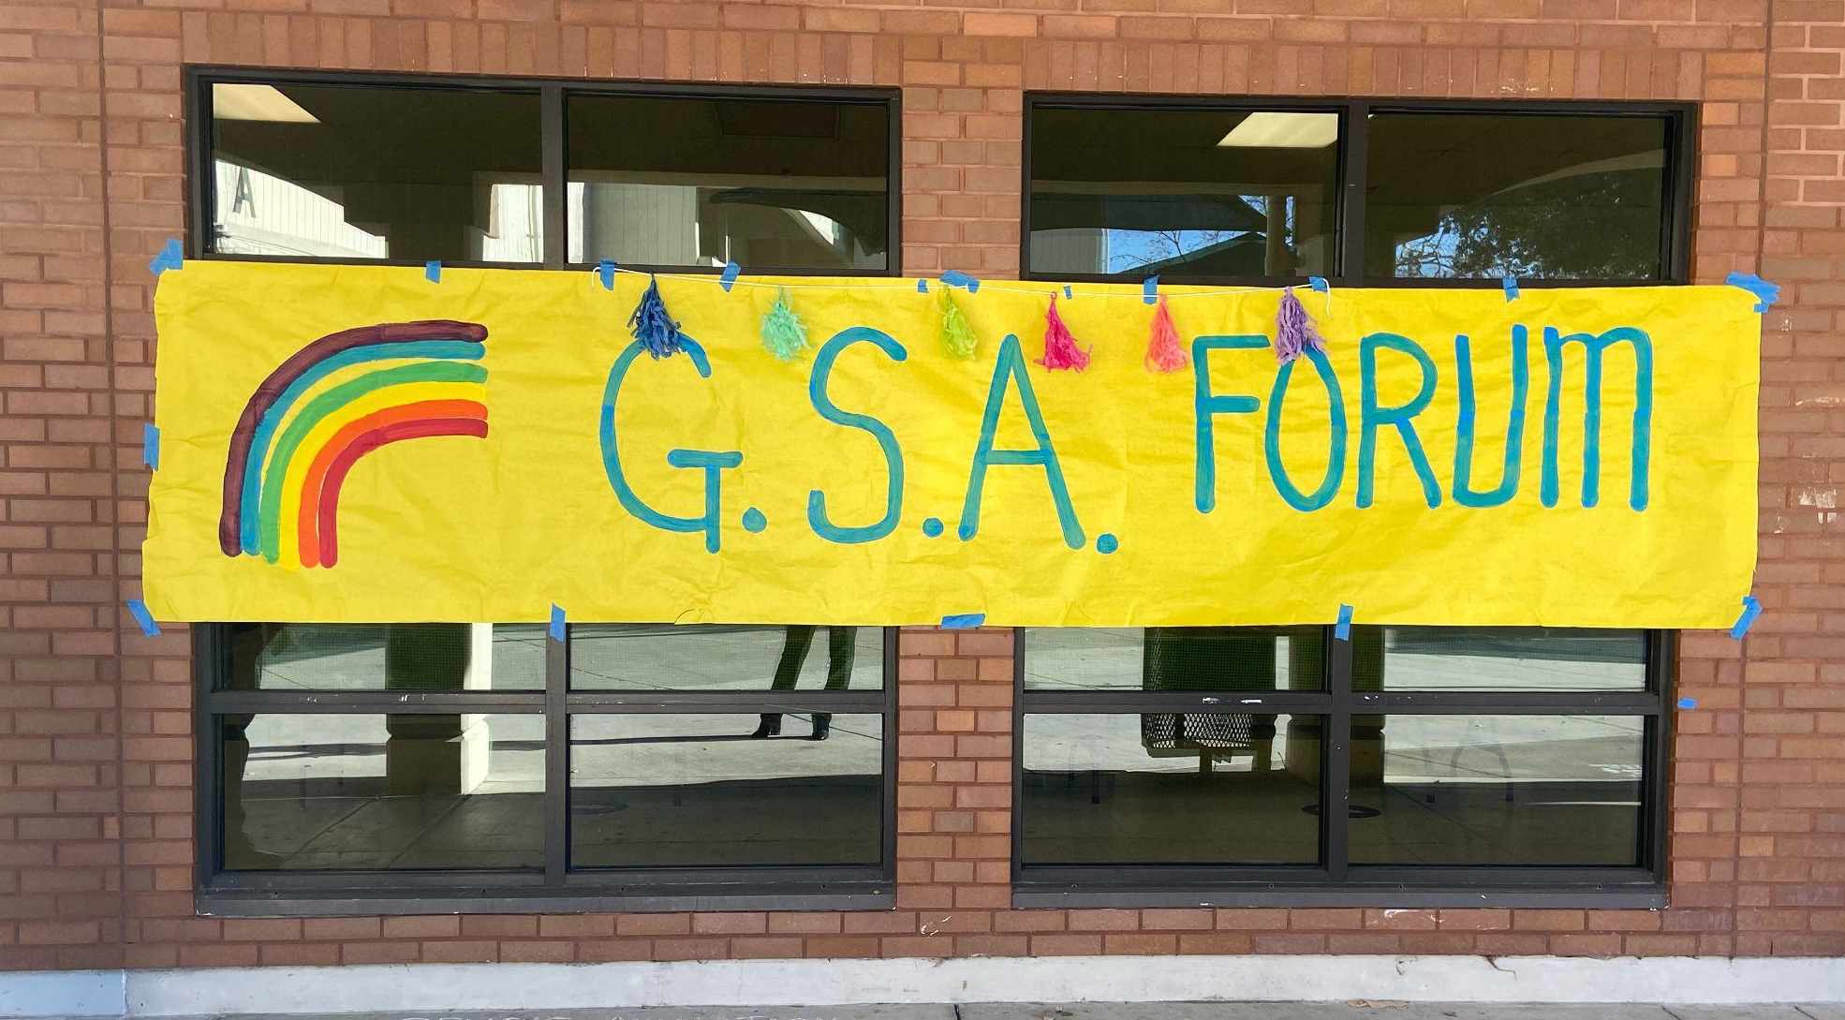
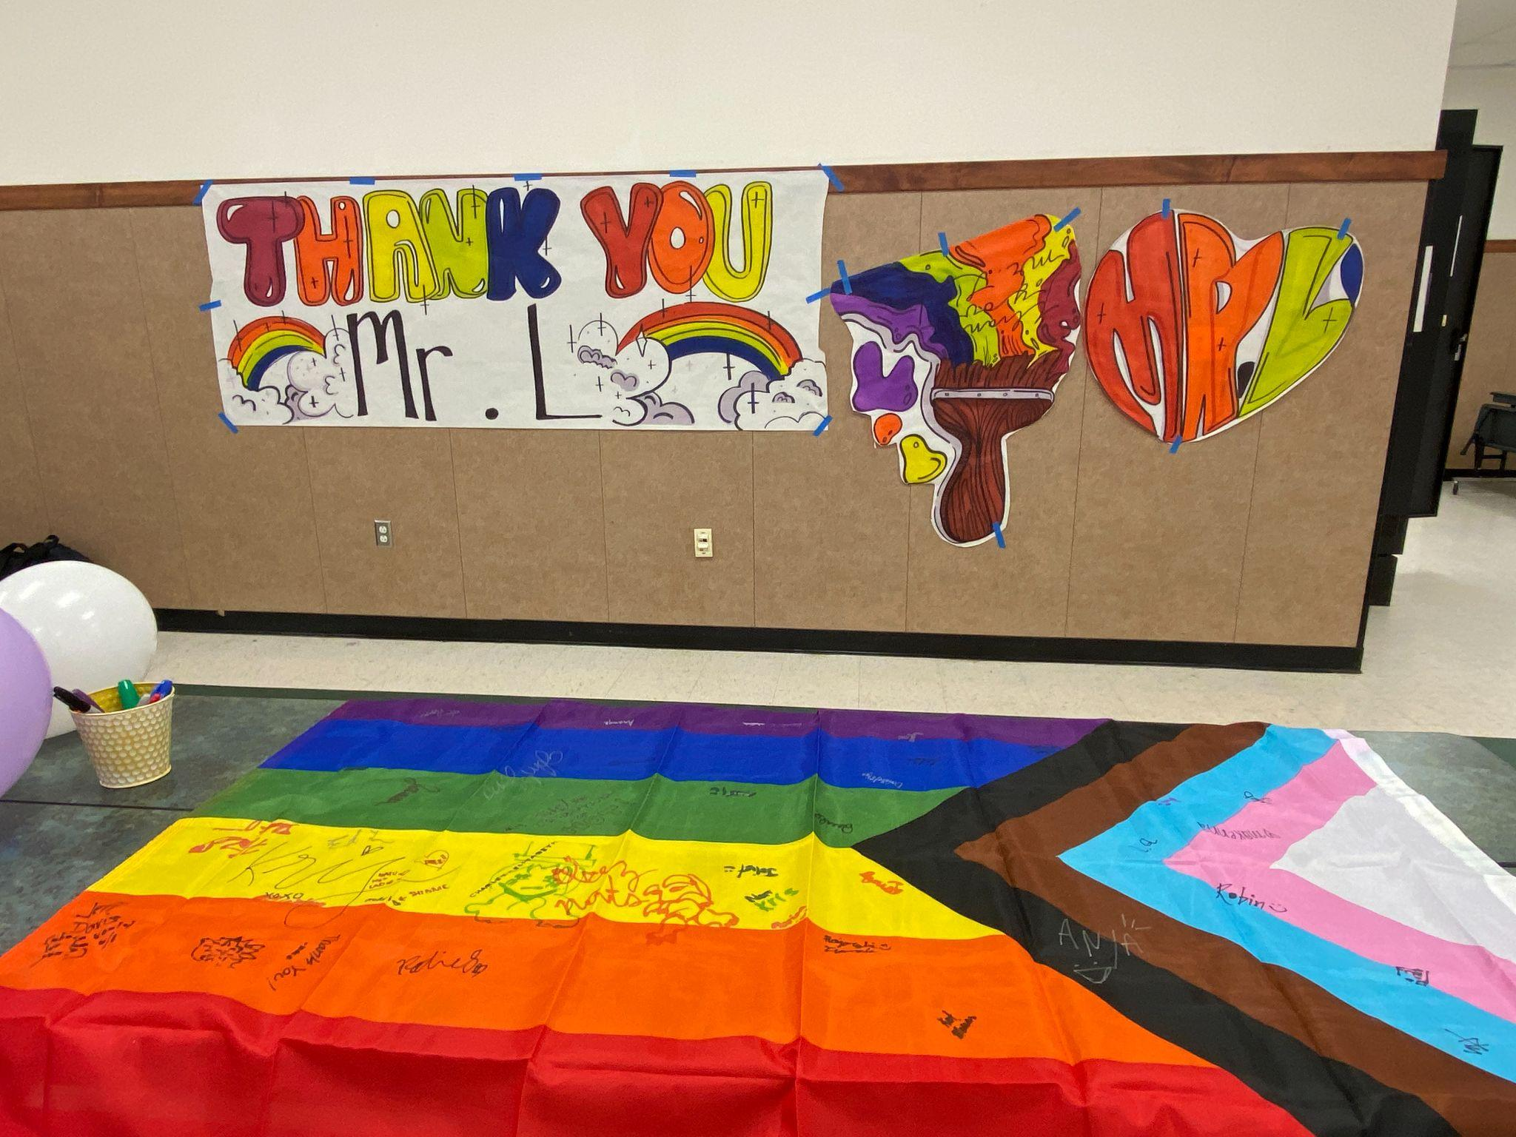
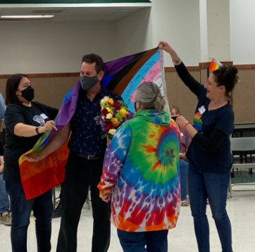
GSA
Notes:
Alex Reyes (DH)

Slide 8
BSU
Notes:
M'Kai-Demi (Julia) Sayyid (DH)

Slide 9
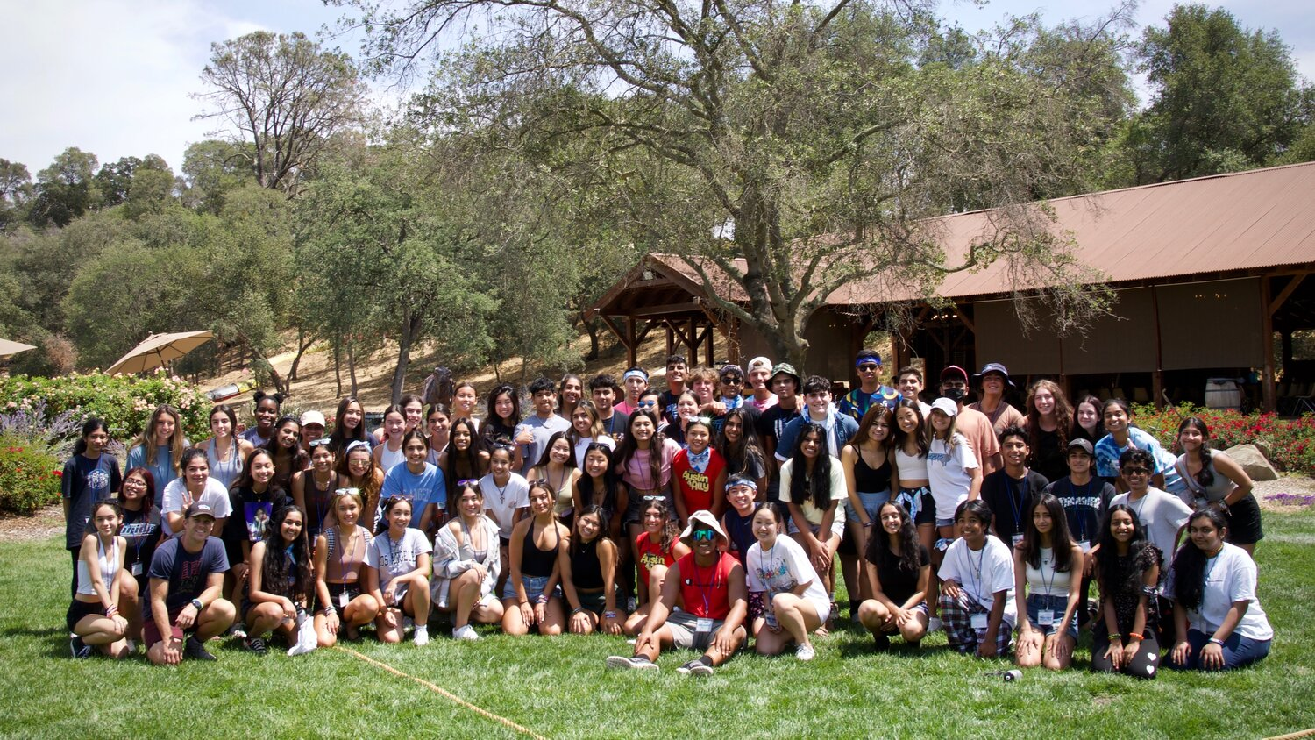
STUDENT LEADERSHIP
Notes:
Jacqueline Guerrero (SRV)

Slide 10
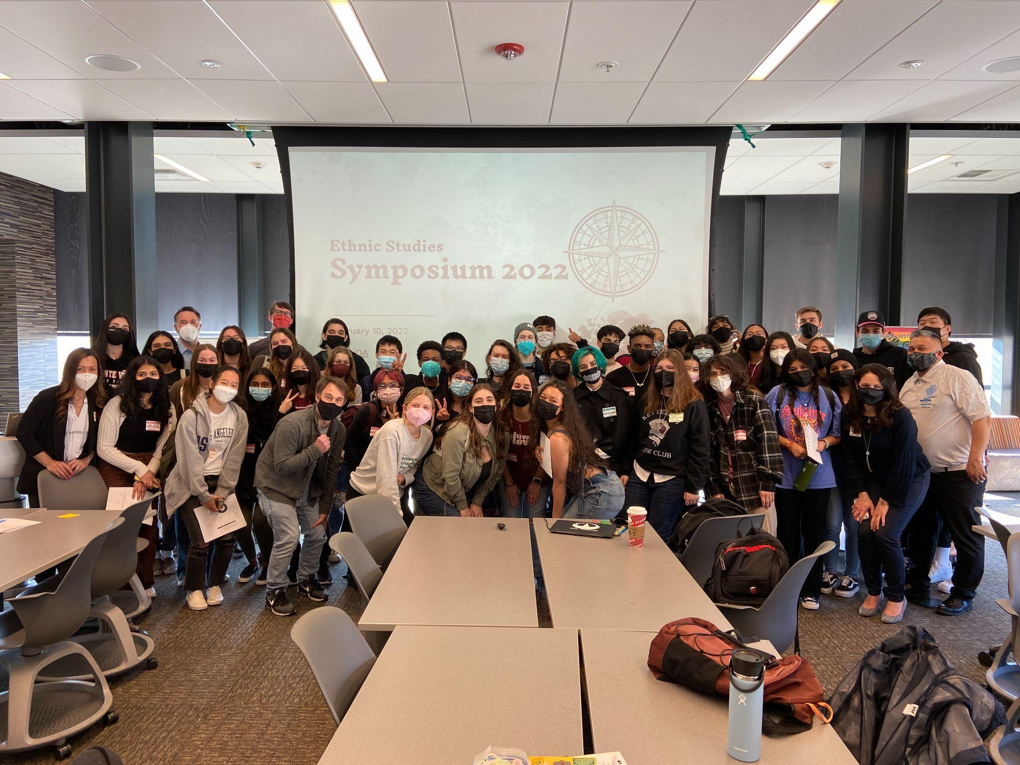
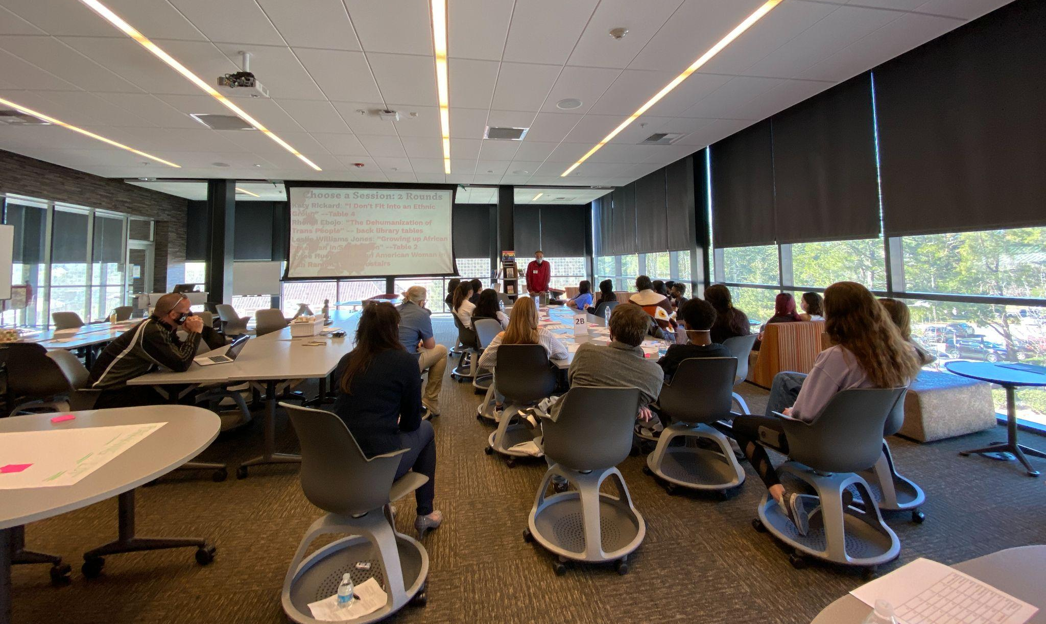
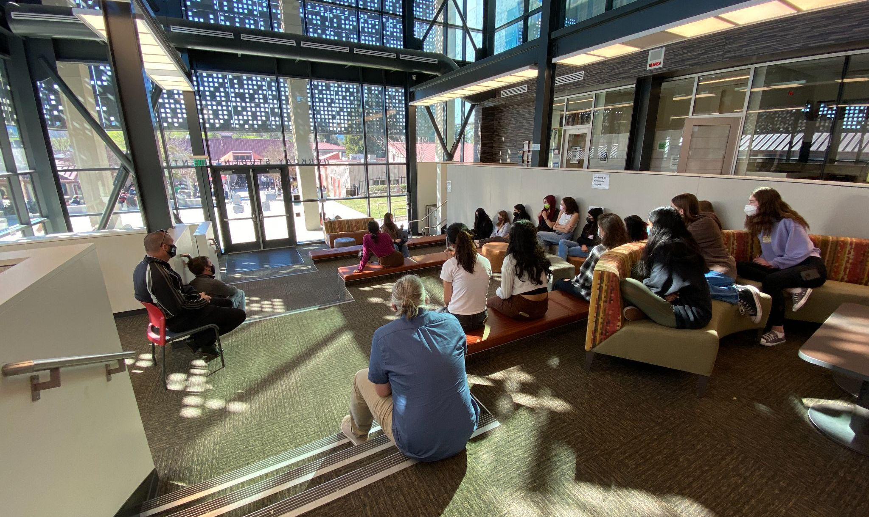
ETHNIC STUDIES
Notes:
Leslie Williams Jones (DH) and Sami Tripasuri (CH)

Slide 11
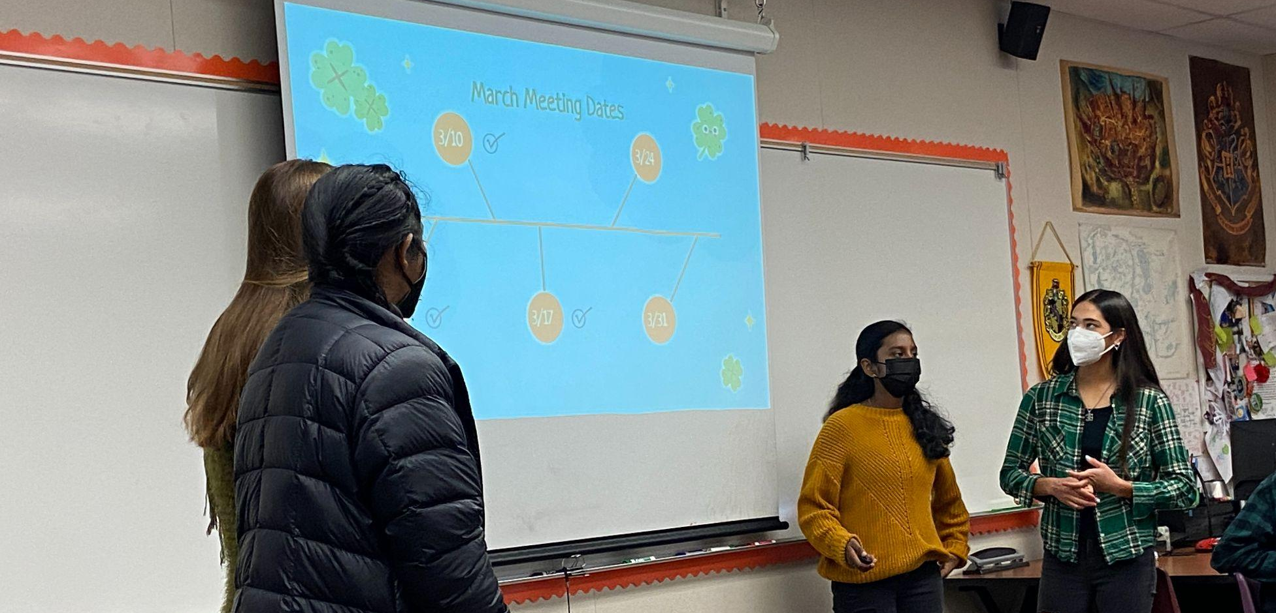
RESTORATIVE JUSTICE
CHS RESTORATIVE JUSTICE COALITION
Notes:
Hailey Godin (CH) and Yukta Chutturi (CH)

Slide 12
Call to Action
Elevate student voice in schools and the district
Board presentations
Community engagement
Participation in steering committees
Student-led Instagram

Slide 13
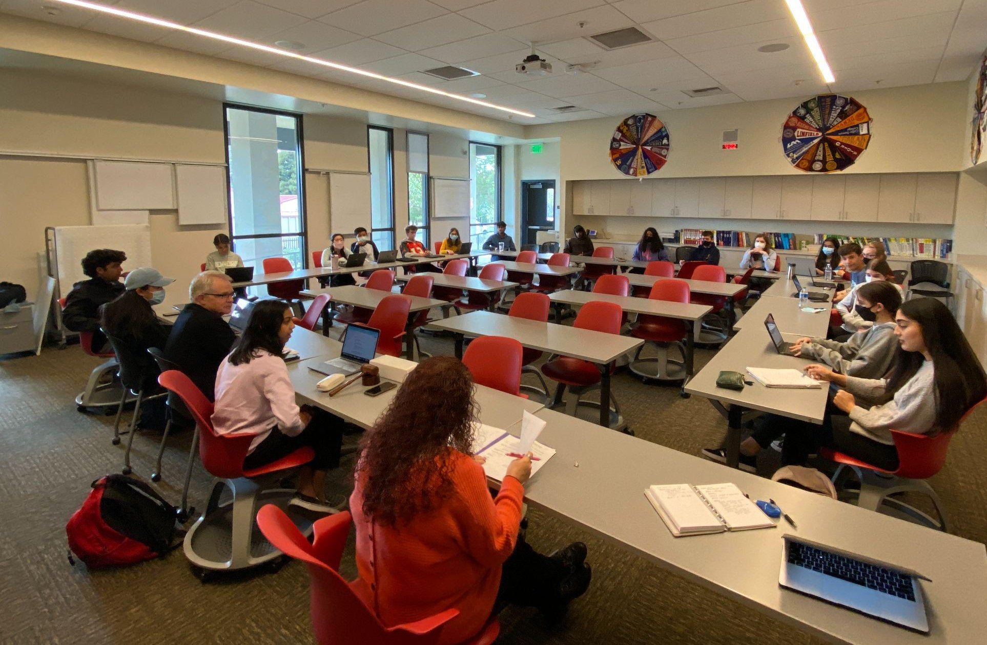
Call to Action
Engage in student-centered approach
Student Trustee
Student Senate
Student voice in decision making around SRVUSD Strategic Directions

Slide 14
SHARED LEADERSHIP
Understand, engage, and improve in the continuous improvement process
Create opportunities for students to share their voice and experience
Enhance trust across the district
Implement leadership development programs

Slide 15
“Education is the most powerful weapon which you can use to change the world.”
—Nelson Mandela

Slide 16
THANK YOU!
Questions/Comments?

Slide 17
ACTIONS

Slide 18
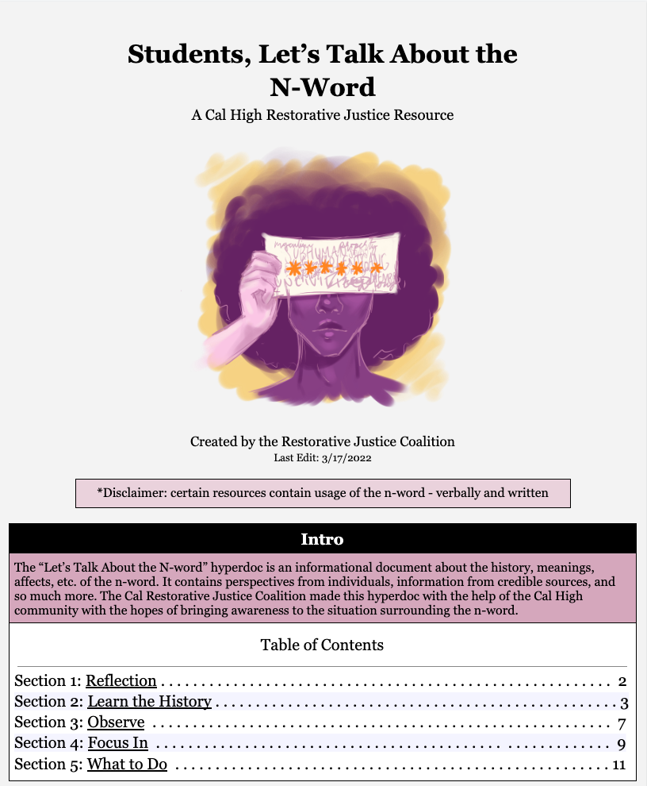
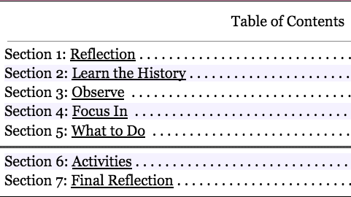

Slide 19
CULTURE OF RESPONSIVENESS
Effective, expedient and responsive service to all stakeholders
Enhance all processes and procedures by gaining insights and making necessary changes
Strengthen communication, enhance our website, and provide support to our staff

Slide 20
