Slide 1
Strategies for Supporting Students
SRVUSD Board Presentation
Educational Services November 16, 2021

Slide 2
Supporting Students’
Social Emotional Well-Being
Students learning & re-learning how to ‘do school’ and the importance of community
Difficulty with social interactions (pushing, waiting their turn)
Slower-to-develop communication skills (learning how to ask for help)
Poor self-regulation & self-control (higher frustration levels, demonstrating extreme behaviors, e.g. anger, running away)
Notes:
Dave speaks to what disruptive behavior looks like
we are concerned about our students’ SEWB and behavioral issues

Slide 3
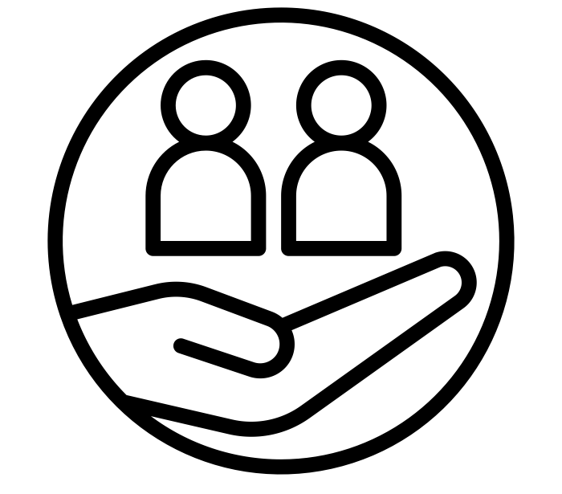
Systemic Supports
Elementary/Secondary Counselors
Social Emotional Well-Being Screeners
Student Support Team (SST) Process
Elementary Rainbow Rooms
High School Wellness Rooms
School Counseling & Intervention Program (SCIP) Counseling Interns
Social Emotional Supports and Interventions
Social Workers
SUBS - Speak Up and Be Safe (grades 2, 4, 6)
California Healthy Kids Survey
TUPE Programs for Vaping and Smoking

Slide 4
Site-Specific Responses
Social Emotional Teams
Supports Across Classrooms
Sanford Harmony (elementary)
Restorative Practices
Trauma-Informed Practices
Site-based Positive Progressive Behavior Support Plans
Access Period Support Groups (secondary)

Slide 5
Significant legislation that governs discipline issues
Managing privacy issues when supporting students and schools
Strategies to balance the needs of individual students who may be experiencing difficulties and the needs of the students in the class or on the campus
Further Reflections:

Slide 6
Thank You!

