Slide 1
Classified School Employee Week May 15-21, 2022

Slide 2
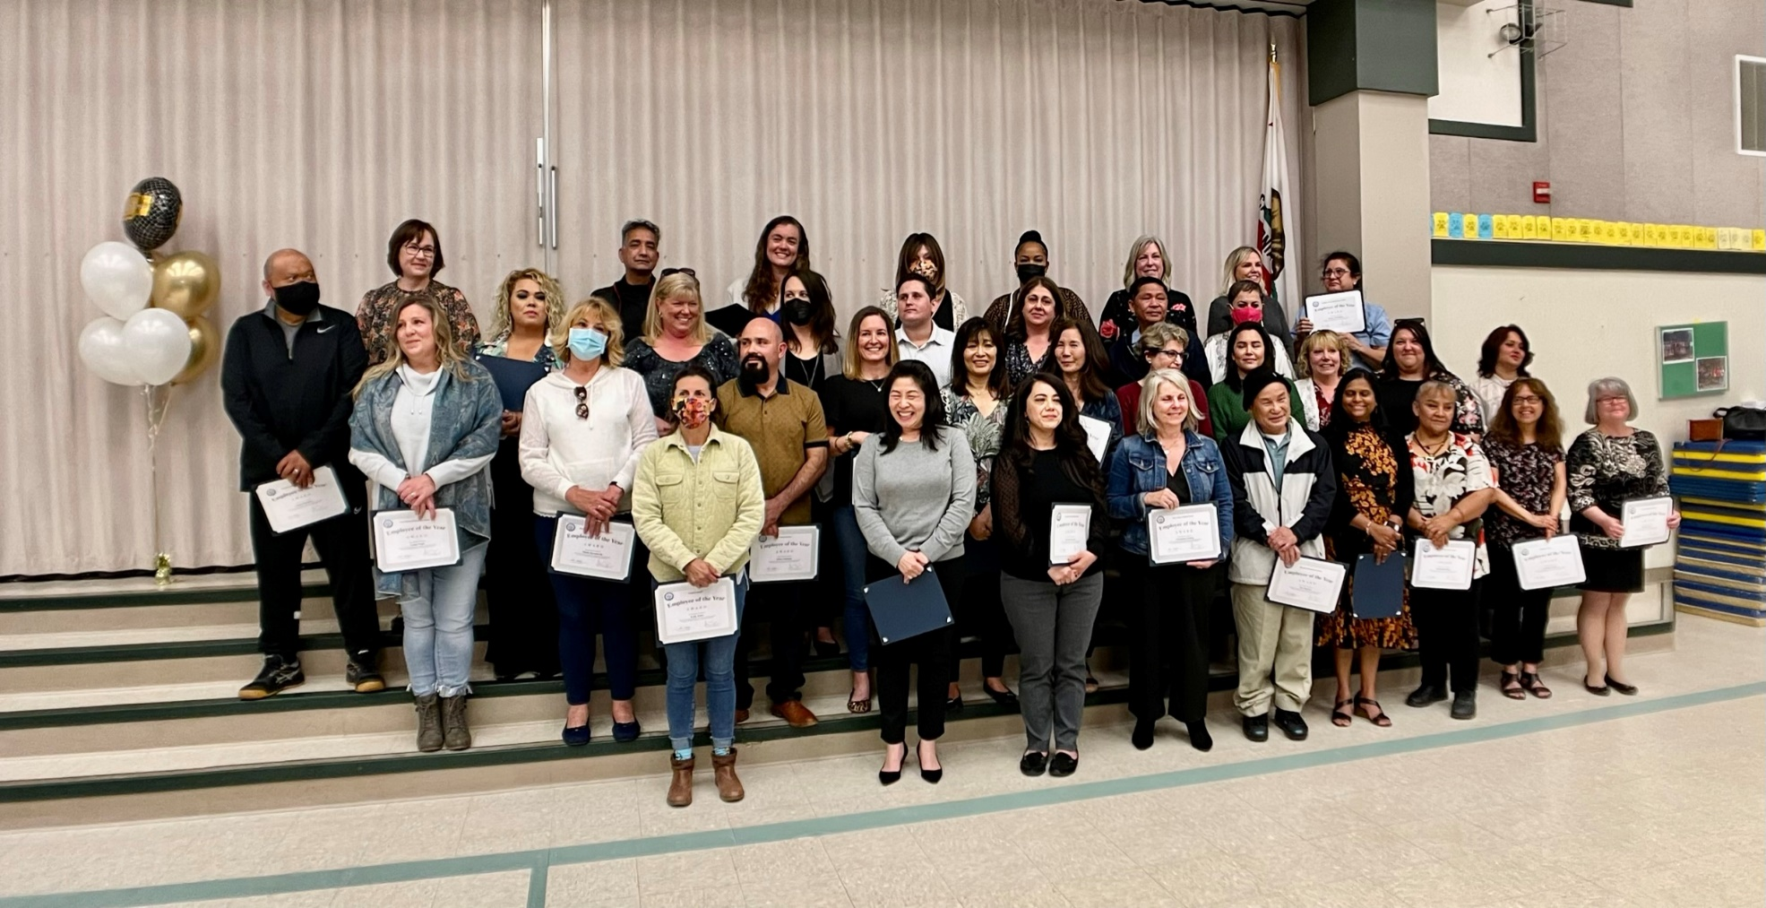
Celebrating a Tradition of Pride

Slide 3
Day of the Teacher May 11, 2022

Slide 4
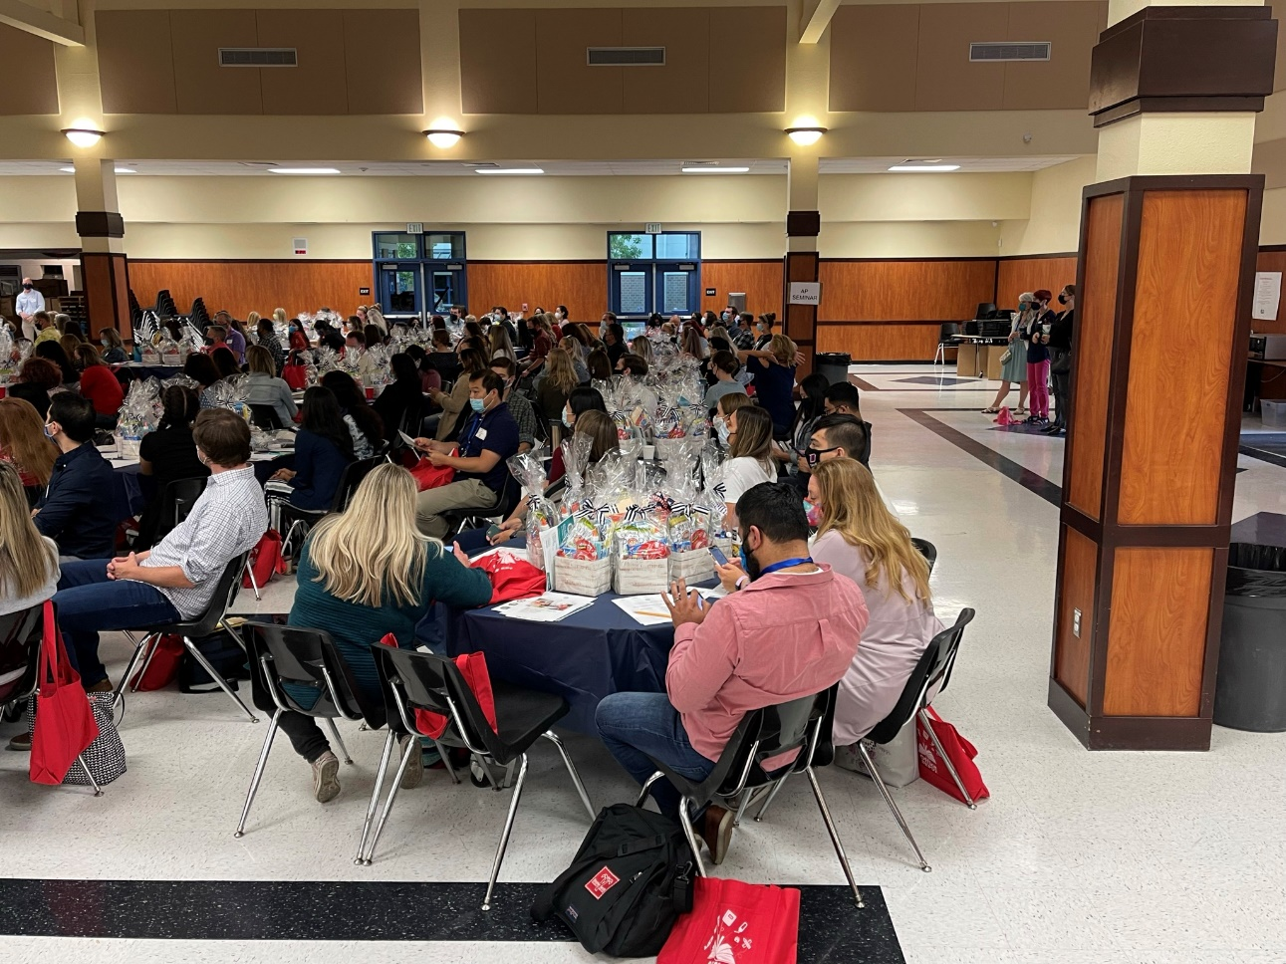
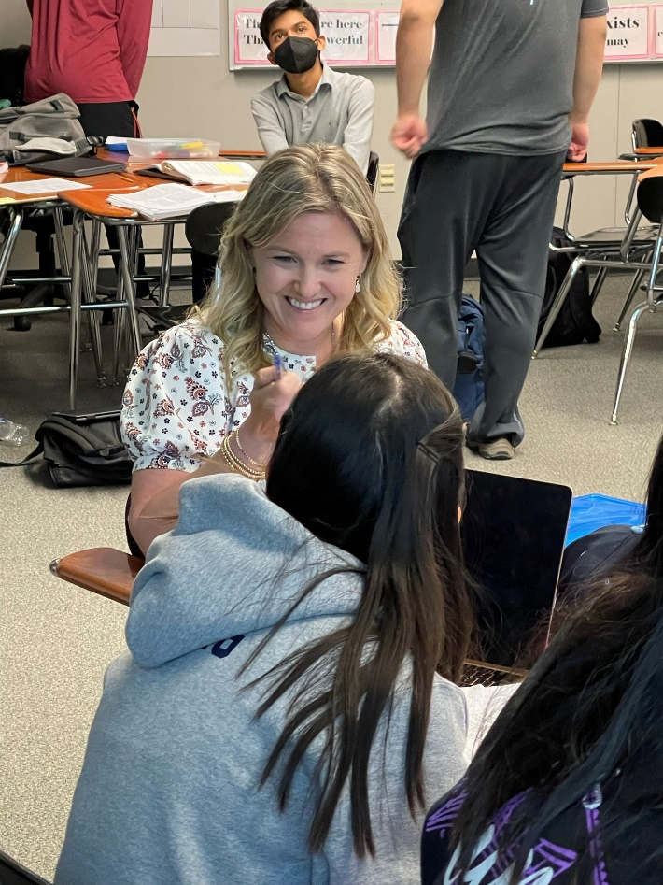
Leaders of Learning

