Slide 1
Universal Prekindergarten
Board Presentation
June 7, 2022

Slide 2
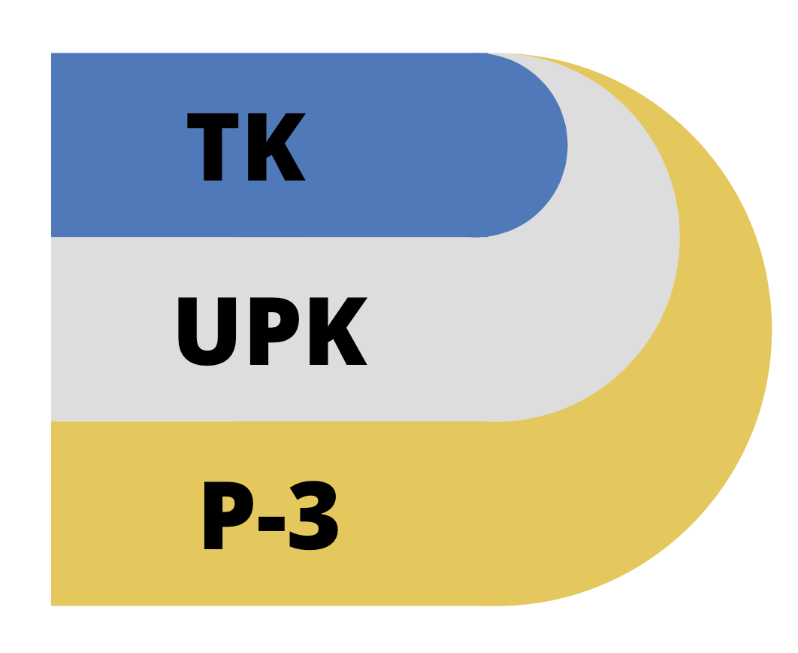
Preschool to Third Grade Framework (P-3)
TK is one component of UPK
UPK is mixed delivery system to provide every 4 year old access to quality learning before kindergarten
Alignment from preschool
to third grade (P-3)

Slide 3
Legislative Overview
Assembly Bill 130 (2021)
Expand access to classroom-based prekindergarten programs offered by school districts
Allow all 4 year olds the option of attending Transitional Kindergarten by 2025-26
Funding to support UPK planning and implementing
One-time funding to support workforce development

Slide 4
Key Components of UPK
Provide all 4-year olds access to prekindergarten
TK implementation phased in over 4 years (full implementation by 2025-26)
Classroom ratios are 1:12 in 2022-23

Slide 5
Key Components of UPK
4. TK teachers must have 24 units of ECE/CD (in addition to multiple subject credential) starting August 1, 2023 with some flexibility dependent upon work experience
5. Expanded Care/ELO-P as presented in the May 17 Board meeting

Slide 6
UPK Implementation Timeline
TK for 5th birthdays between 9/2 and 2/2
Board Reviews Draft Plan
TK for 5th birthdays between 9/2 and 4/2
TK for 5th birthdays before 9/1
SY 21-22
SY 22-23
SY 23-24
SY 24-25
SY 25-26
LEA submits required plan questions to CDE survey
24 units of ECE/CD requirement for TK teachers
TK for 5th birthdays between 9/2 and 6/2
Notes:
Include any other relevant milestones for implementation that your board will need to know

Slide 7
Transitional Kindergarten: Student Projections
2021-22 | Sept.2 - Dec. 2 | 322
2022-23 | Sept.2 - Feb. 2 | 474
2023-24 | Sept.2 - April 2 | 790
2024-25 | Sept.2 - June 2 | 1,010
2025-26 | 4 years by Sept. 1 | 1,222

Slide 8
Facilities Needs: Classrooms
2021-22 | Sept.2 - Dec. 2 | 19
2022-23 | Sept.2 - Feb. 2 | 28
2023-24 | Sept.2 - April 2 | 44
2024-25 | Sept.2 - June 2 | 51
2025-26 | 4 years by Sept. 1 | 61

Slide 9
Projected Workforce Needs: Teachers/Assistants
2021-22 | Sept.2 - Dec. 2 | 19/0
2022-23 | Sept.2 - Feb. 2 | 28/28
2023-24 | Sept.2 - April 2 | 44/44
2024-25 | Sept.2 - June 2 | 51/51
2025-26 | 4 years by Sept. 1 | 61/61

Slide 10
Community Input
PTA Council
SRVUSD Ed Fund
DELAC
LCAP
SRVEA and CSEA union partners
Community Advisory Council (CAC)
Deep Learning and Innovation Committee
SRVUSD Parent Liaison
TK/Kinder Meetings for incoming families
Parent Surveys from State Preschool

Slide 11
UPK Rollout
Continue current practice of 3.5 hour day
TK at each elementary site
Some sites with 2 classrooms
12:1 student to teacher ratio
Offer a full day of learning to all students the year before kindergarten (ELO-P)
Notes:
-Minimum of 36,000 annual minutes, 180 days
6 schools are: GB, GL, GV, TC, MO, VG, and possibly more

Slide 12
UPK as an LCAP Strategy
Embedded in LCAP
Aligned with SRVUSD Strategic Directions
Notes:
Children who attend high-quality, early education programs have better long-term outcomes, such as a higher likelihood of graduating high school, better health outcomes. Play based learning, language development.

Slide 13
Thank You!
Questions/Comments?

