Slide 1
Women’s History Month
March 2022
Presented by Jennifer Hunau

Slide 2
Women’s History Month Theme for 2022

Slide 3
History
1980, President Jimmy Carter pronounces Women's History Week​
​
1987, Legislation passed to create Women's History Month​
​
March was selected to coincide with International Women's Day on March 8th.​
celebrate women's achievements​
raise awareness about women's equality​
work for accelerated gender parity

Slide 4
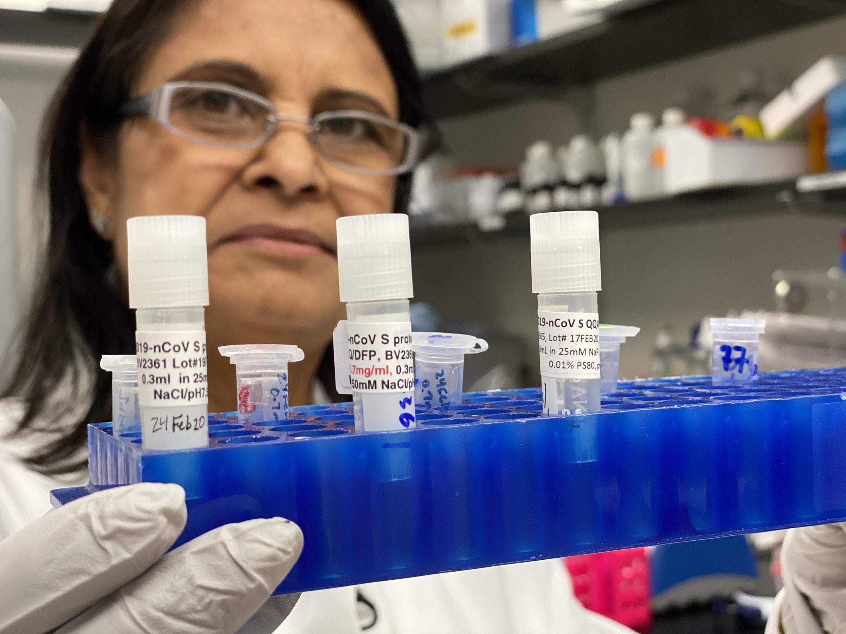
Women Providing Hope
Nita Patel, vaccine scientist
Dr. Kizzmekia Corbett, vaccine developer
Dr. Katrine Wallace, epidemiologist
Notes:
In the spirit of this year’s theme, we have some women who have been working to heal and provide hope in the midst of the ongoing pandemic. These women have worked to understand and develop vaccines, get them into human trials and get them approved. Dr. Kat has worked to provide accurate information to the public regarding the pandemic.

Slide 5
Library Books about Women
Notes:
On this slide we have just some of the many resources schools use to promote women and their contributions on their campuses. Our librarians promote books, curate and create lessons, and challenge students to engage in reading contests.

Slide 6
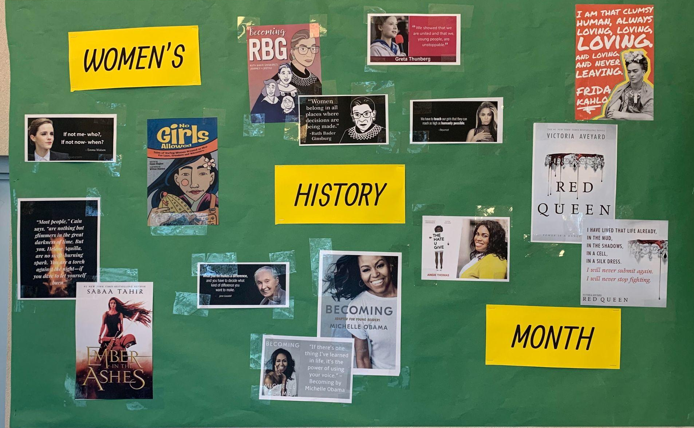
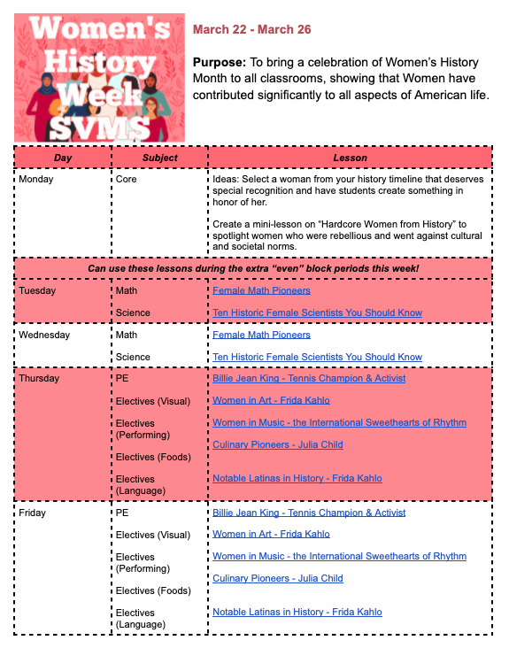
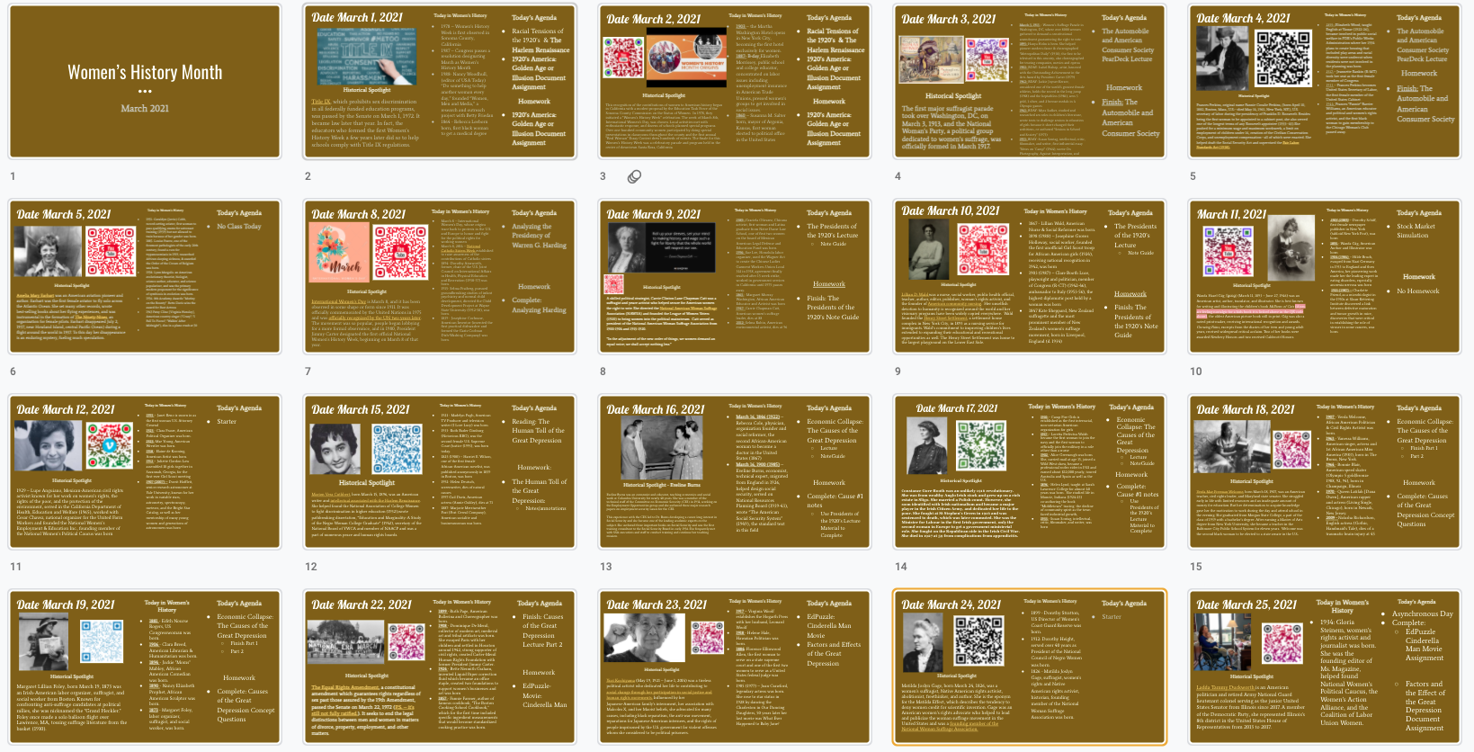
SRVUSD Celebrates Women
Notes:
In addition to the many books that students and teachers read, we also have bulletin boards, lesson plans, and shared slide decks. One of our middle school computer classes built a women’s history app to teach their peers about famous and influential women.

