Slide 1
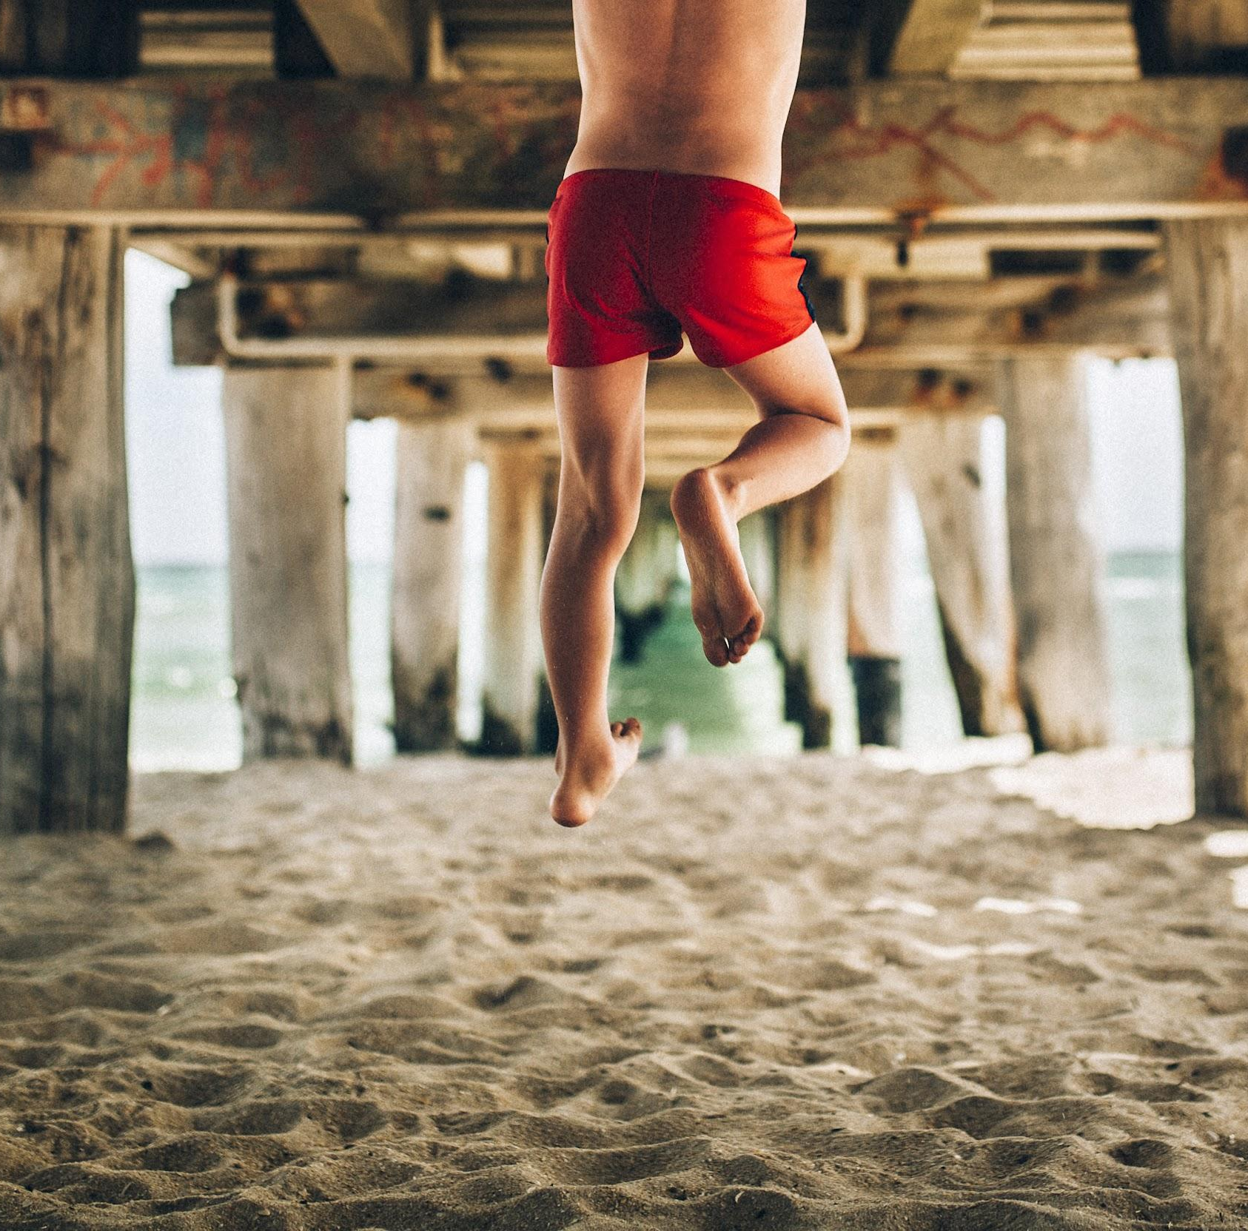
Words Matter!
2022
I know nothing in the world that has as much power as a word. Sometimes I write one, and I look back at it until it begins to shine.
-Emily Dickinson
The difference between the right word and the almost right word is the difference between lightning and the lightning bug.
Mark Twain

Slide 2
Words Matter Week celebrates the power of words and the impact they have on those around us.
WORDS MATTER WEEK
Celebrated across San Ramon Valley USD
schools February 7-11
Schools and their PTAs are
coordinating a wide range of events.

Slide 3
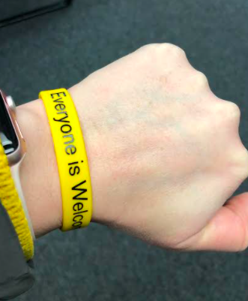
Words Matter
Together We Can…
-Bring attention to name calling, hate speech and verbal bullying of all kinds.
-Provide schools, students, and parents with tools and inspiration to launch ongoing dialogue about ways to eliminate these acts in our communities and our schools.
-Make sure that SRVUSD is a safe place for all students to learn.

Slide 4
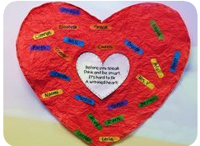
Words Matter
Together We Will END…
Harassment
Victimization
Bullying
Threatening words
Taunting Behavior
Anxiety & Depression
Race-related graffiti
“Before you speak,
Think and be smart.
It’s hard to fix
A wrinkled heart!”

Slide 5
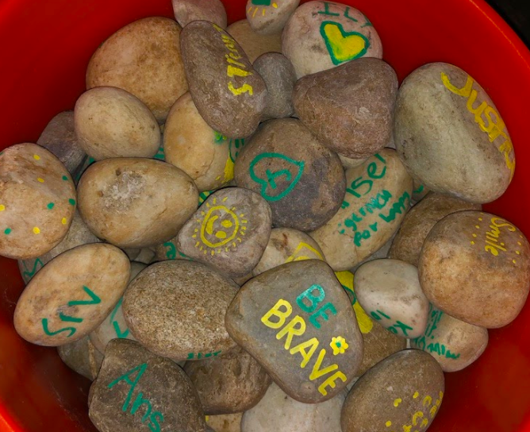
Words Matter
Together We Will PROVIDE…
Safe Learning Environments for all Students
Continued Expansion of the implementation of Culturally and Linguistically Responsive Strategies in all schools
A partnership with families to create spaces honoring diversity, equity, and inclusion for all students

Slide 6
Possible Activities to Support Words Their Way Week
Elementary, Middle, and High School
Kindness Challenge
Create a School Wide Kindness Video
Create a Kindness Rock Garden
Book of the Month
Watch Kid Congress-Words Matter and engage in a class discussion
Create a Mailbox of Encouragement
Act it Out
Gratitude Project
Postcard Exchange with buddy classrooms and create mentoring partnerships
Let’s Talk About How Awesome You Are
Chalk Talk: Post messages of kindness for your school community
Digital Citizenship: Making smart choices online
A Powerful Voice: Use Flip Grid with your students to share their ideas with others in SRVUSD
The Power of the Compliment Activity
Have students create a Wordle using words that lift others up and post them around your site

Slide 7
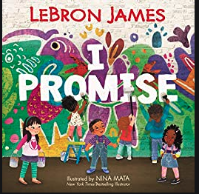
“I promise to use my voice and stand up for what’s right. And when things get tough, to keep up the fight.”

