Slide 1
Facilities Update and Capital Improvements
January 9, 2018
SRVUSD Board of Trustees Meeting

Slide 2
Purpose/Outcomes
Review and Discuss:
Classroom Changes through 2022-23 (relative to enrollment trends)
Current Project Updates – Measure D
San Ramon High
Stone Valley Middle
Modernizations
Capital Improvement Projects (CIP)
Facilities Funding (cash flow)
1

Slide 3
Total Enrollment - Through 2022-23
Average Projected Decline = 132 Students
2

Slide 4
Potential Opportunities in a Declining Enrollment Environment
Fewer Diversions
Open Enrollment
Elementary Magnet Opportunities
Interdistrict Transfers
Personalized Learning Ideas
Flexible Start Times (Middle and High Schools)
Off-Campus Credit Initiatives
Optimally Sized (Elementary, Middle and High Schools)
3

Slide 5
Elementary Schools Projected to Decline 10%+ Through 2022-23
4

Slide 6
Middle Schools Projected to Decline 10%+ Through 2022-23
5

Slide 7
High Schools Projected Enrollment
Peak
Current
2022-23
Current
2022-23
Current
2022-23
Current
2022-23
6

Slide 8
Projected Classroom Changes (2018-19 to 2022-23)
(MO)
(TC)
(IH)
(CH)
(DH)
(WR)
Montevideo = +4 (Classrooms)
+2 per year in 2021-22 & 2022-23
Twin Creeks = +10
+3 to 4 per year in 2020-21 & 2022-23
Iron Horse MS = +5
+4 in 2021-22 & +1 in 2022-23
California HS = +8
+3 in 2019-20 & +5 in 2020-21
Dougherty Valley HS = +6, -6
+3 in 2018-19 & 2019-20
-3 in 2021-22 & 2022-23
Windemere Ranch MS = -10
-3 or 4 per year in 2019-20 through 2021-22
7

Slide 9
Projected Classroom Changes
8

Slide 10
Measure D Project Updates and Current Projected Timelines
Stone Valley Middle School
Summer 2018 Occupancy
Fall 2018 Project Completion*
San Ramon Valley High School
Spring 2019 Occupancy
Winter 2020 Project Completion*
*Note: Completion includes interim housing removal, field renovation/restoration, landscaping, parking lot and entry/exit work, etc.
9

Slide 11
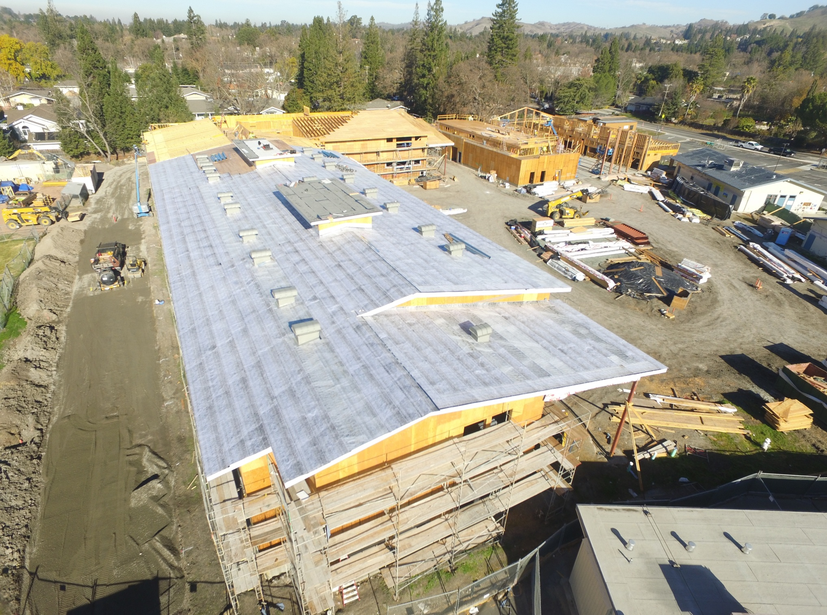
Stone Valley Middle (As of 12/28/2017)
10

Slide 12
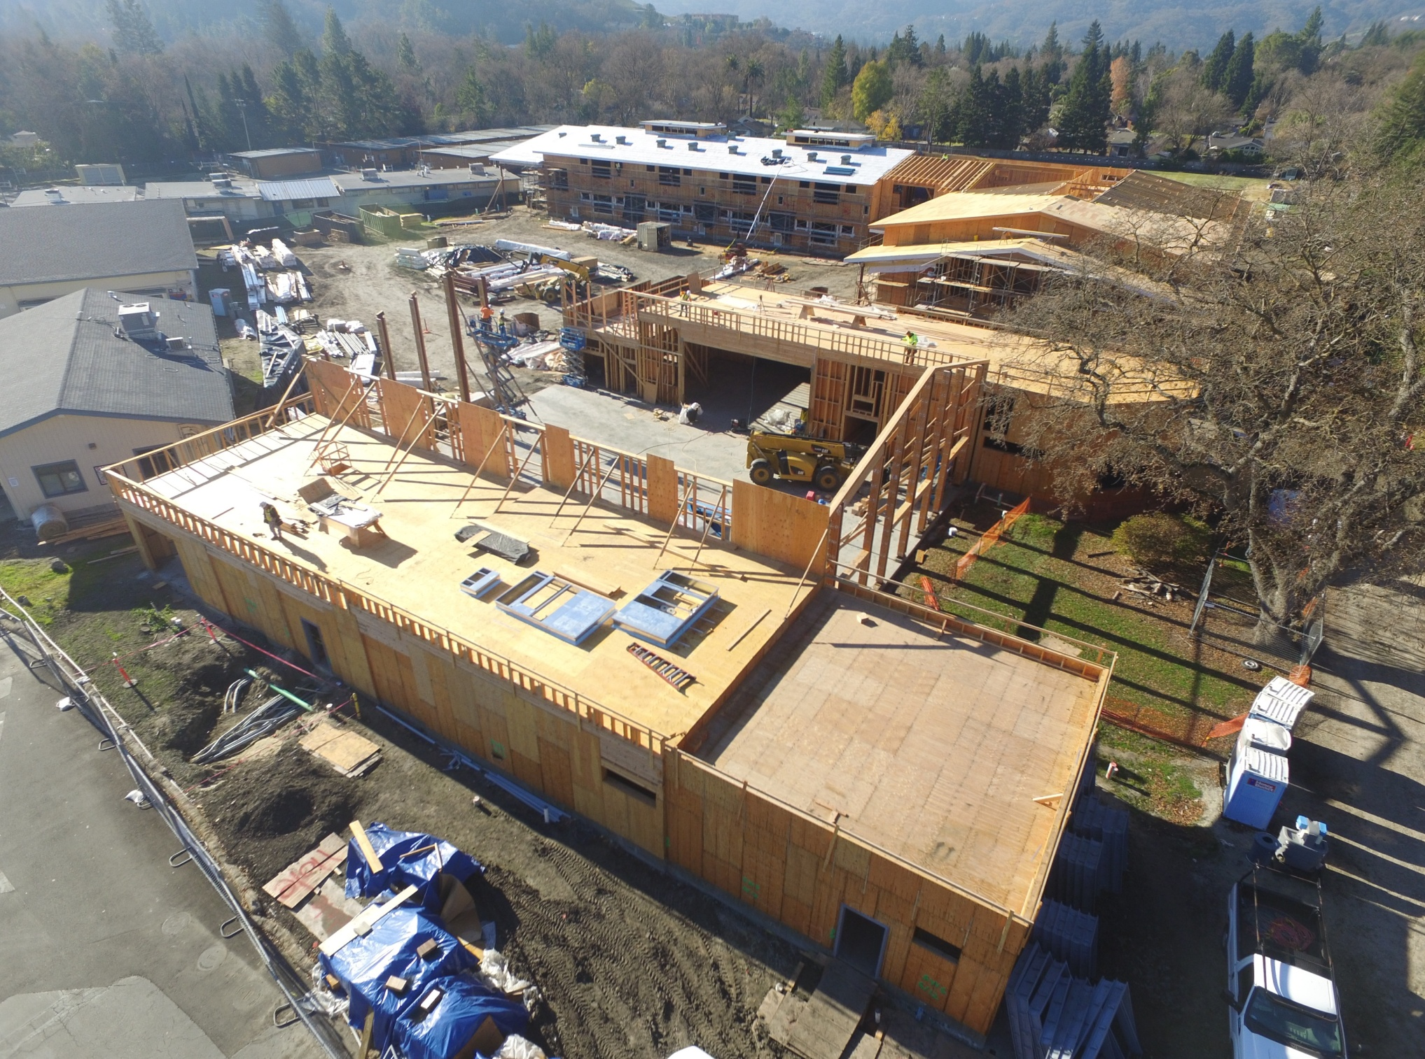
Stone Valley Middle (Cont.)
11

Slide 13
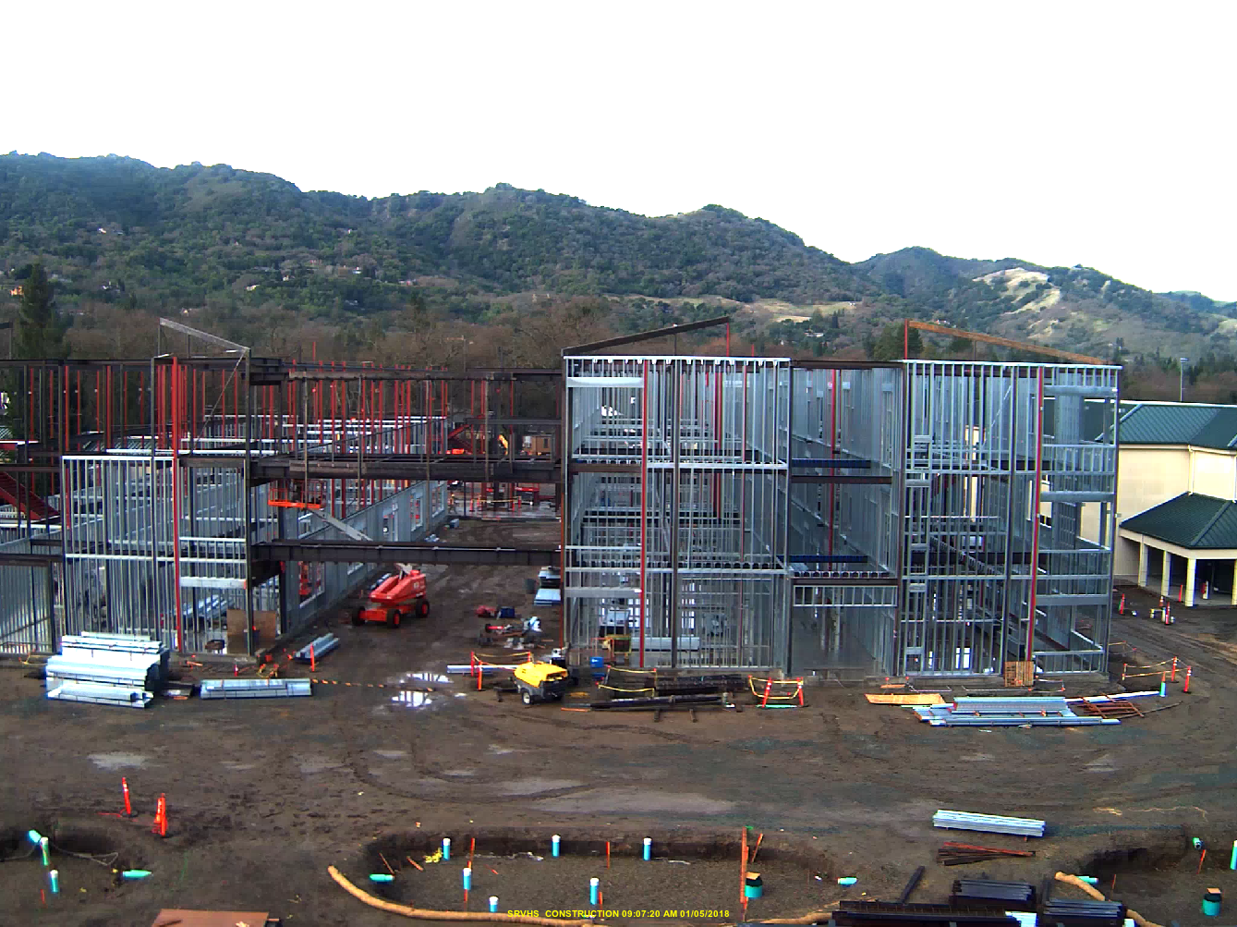
San Ramon High (As of 1/5/2018)
12

Slide 14
Measure D Modernization Projects
School | Project Status | Project Start
Golden View | under State Architect review | Summer 2018
Green Valley | under State Architect review | Summer 2018
Montevideo | under State Architect review | Summer 2018
Rancho Romero | under State Architect review | Summer 2018
Sycamore | under State Architect review | Summer 2018
Alamo | In Design | Summer 2019
Twin Creeks | In Design | Summer 2019
Charlotte Wood | In Design | Summer 2019
13
Note: Modernization projects are planned to be completed over two summers. The exception is to be Twin Creeks which has planned growth construction also.

Slide 15
Capital Improvement Program (CIP)
A Long-Term Planning Tool to help:
Identify District Facilities/Maintenance needs, establish priorities
Create timelines and planning milestones
SRVUSD CIP List could include items such as:
“Below the Line” projects from the Measure D Program
Replacement of the MVHS 300 Building
SVMS Phase IV replacement of the Administration Bldg.
Large Scope Long Term Maintenance projects
Renovation/Replacement of the MVHS pool
Renovation/Replacement of artificial turf fields and all weather tracks
Playground renovations and replacements
Future Needs
Classroom additions and or improvements due to enrollment fluctuations, i.e. Twin Creeks Elementary, CHS, IHMS, and Montevideo
Replacement of SRVHS Administration/Classroom Building
Safety renovations/remodels to multiple elementary Admin. Bldgs.
14

Slide 16
Measure D Cash Flow
Total Measure D Bonds = $260m
Series I: sold on 2/14/13 = $75m
Series II: sold on 8/1/15 = $125m
Series III: issuance in 2018 = $60m
Program Expenses to date =$153m
(as of 10/31/17)
Projected Program Expenses =$185m
(through summer 2018)
15

Slide 17
Series III Sale Projected Summer 2018
Past
Cautious Decisions throughout the sale of previous Measure D Series included:
100% Current Interest Bonds (“CIBS”) versus costly Capital Appreciation Bonds (“CABS”)
High Credit Ratings from both Standard & Poor’s and Moody’s
Cautious Assessed Valuation (“A/V”) Growth
Maturities resulting in Payback Ratios significantly less then comparable bond programs
Present
Series III Sale
Continued Cautious/Thoughtful Approach
Projected Assessed Valuation Growth
Protection of District Initiated $75.00 for $100,000 of A/V
Future
Finalizing the sale of Series III to maximize future flexibility
16

Slide 18
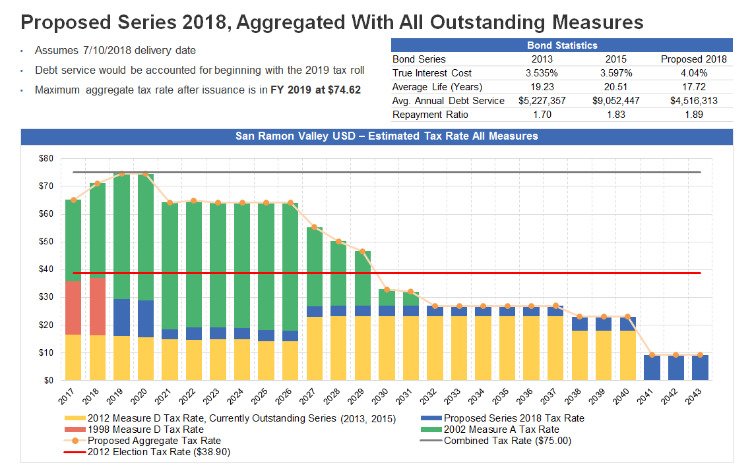
Total Outstanding Bond Repayments
17

Slide 19
State Funding: New Construction Backlog
Per OPSC*, $726m in bond authority will remain after the current backlog is cleared
18
*OPSC Workload Lists published 12.6.17 in the State Allocation Board Agenda

Slide 20
State Funding: Modernization Backlog
Per OPSC*, $1.58b in bond authority will remain after the current backlog is cleared
19
*OPSC Workload Lists published 12.6.17 in the State Allocation Board Agenda

Slide 21
Any Questions? Thank you!
20

